Slide 1
CSSE 375 Software Construction and Evolution: Configuration Management
“You don’t know what version the customer is running?”
-- Your instructors react.
Shawn and Steve

Slide 2
Kant these philosophy puns be automated?
No, they are Immanuel Kants.
→

Slide 3
Small programs don’t require much formal configuration management. Why do you suppose that software is so much harder to build as it gets older and bigger?
Think for 10 seconds…
Turn to a neighbor and discuss it for 30 seconds
Can we tawlk?
Q1
Notes:
Q1: Why do you suppose that software is so much harder to build as it gets older and bigger?

Slide 4
Problem: Three Dimensions of Change
Multiple people must work on software that is changing
More than one version of the software must be supported:
Released systems
Custom configured systems (different functionality)
System(s) under development
Software must run on different machines, operating systems…
Q2
→
Notes:
Q2: What are the three key dimensions of change addressed in Software Configuration Management?
Most of you have been exposed to Source [code] Configuration Management…
Software configuration management goes further to deal with the larger problems of software change…

Slide 5
Think about managing changes in your Junior Projects. Now think about how that would be different if your project was integrated with 25 other projects. What would you need to manage industrial strength projects?
Think for 25 seconds…
Turn to a neighbor and discuss it for a minute
Please identify 2 things you would need for large projects
→
Notes:
Most of you have been exposed to Source [code] Configuration Management…
Software configuration management goes further to deal with the larger problems of software change…

Slide 6
What is Software Configuration Management?
Definition: Set of management disciplines within the software engineering process to develop and maintain the integrity of a baseline.
Description: SCM encompasses the disciplines and techniques of initiating, evaluating and controlling change to software products during and after the software engineering process.
Standards (approved by ANSI)
IEEE 828: Software Configuration Management Plans
IEEE 1042: Guide to Software Configuration Management
Q3
→
Notes:
Q3:What is a basic definition of Software Configuration Management ?

Slide 7
SCM Basics
Identification – identifying software configuration items in a baseline
Control – controlling the release of a product and changes to it throughout its lifecycle
Status Accounting – recording and reporting of the status of components and changes
Auditing and Reviewing – Validating the completeness of a product and that SCM procedures are being followed
Q4
→
Notes:
Q4: What are the four Basic functions of Software Configuration Management?

Slide 8
SCM Definitions (1 of 2)
Software Configuration Item (SCI) – A collection of software elements treated as a unit for the purposes of SCM
Baseline – 1 or more SCIs that have been formally reviewed and agreed upon and serve as a basis for further development
Configuration – A collection of all the elements of a baseline and a description of how they fit together

Slide 9
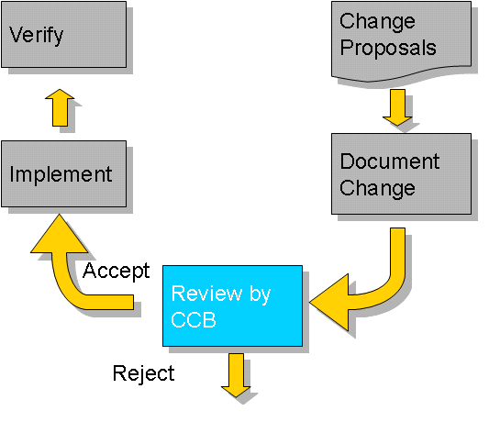
SCM Definitions (2 of 2)
Configuration Control Board – Group with the responsibility for reviewing and approving changes to baselines
Software [artifacts] – All of the code, specifications, plans, descriptions, processes, and documents associated with a software development effort
Version – A specific instance of a baseline or configuration item
Above - How a typical CCB operates.
→
Notes:
Image from http://vikasthange.blogspot.com/2012/10/software-configuration-management.html.

Slide 10
Example Configuration Items
Product concept specification
Software project plans
Software requirements specifications
Software design descriptions
Source code
Database descriptions
SCM procedures (controlling SCM change)
Software release processes
Software test documents
User documentation
Maintenance documentation

Slide 11
Example SW Configuration Item Tree
“The project” SCI
Models
Subsystems
Documents
Object Model
Dynamic Model
SRS
SADS
. . . .
Database
User Interface
. . . .
. . . .
Code
Data
Unit Test
. . . .
→

Slide 12
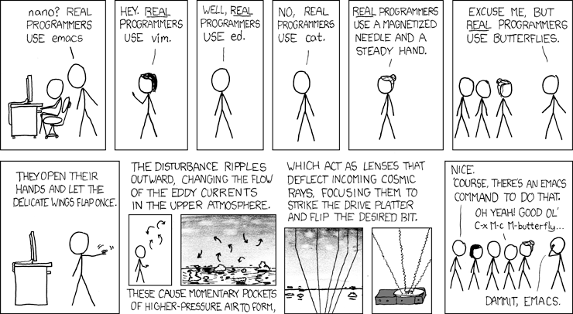
For SCM, bring back an oldy, but goodie…

Slide 13
SCM Activities
Configuration item identification
Modeling of the system as a set of evolving components
Promotion management
Creation of versions for other developers
Release management
Creation of versions for the clients and users
Change management
Handling, approval and tracking of change requests
Branch management
Management of concurrent development
Variant management
Management of versions intended to coexist
→

Slide 14
Key Tasks for Configuration Managers
Define Configuration Items
Define Promote /Release Policies
Define Activities And Responsibilities
Set Up Configuration Management System
Notes:
SCMP following the IEEE 828-1990 standard

Slide 15
Let’s say a change is made to the code to incorporate use of a packaged application that replaces the scheduler. How can you account for all the dependencies between the cognizant software artifacts?
Think for 15 seconds…
Turn to a neighbor and discuss it for 30 seconds
Can we tawlk?
Q5
Notes:
Q5: What is needed to account for all the dependencies between cognizant software artifacts when there are changes made to industry scale systems ?
Traceability between code, apps, design, and data.

Slide 16
More on Baselines
As systems are developed, a series of baselines is developed, usually after a review (reqts, design, or code reviews, system testing, client acceptance, ...)
Developmental baseline (SRS, SADS, Integration Test, ...)
Goal: Coordinate engineering activities.
Functional baseline (first prototype, alpha, beta releases)
Goal: Get first customer experiences with functional system.
Product baseline (product)
Goal: Coordinate sales and customer support.
Many naming schemes for baselines exist (1.0, 6.01a, ...)
A 3 digit scheme is quite common:
7.5.5
Release
(Customer)
Version
(Developer)
Revision
(Developer)
→

Slide 17
Baselines in SCM
Baseline A (developmental)
Baseline B (functional, first prototype)
Baseline C (functional, beta test)
Official Release
Time
How do we manage changes in the baselines?
Q6
→
Notes:
Q6: How do we manage changes in the baselines ?

Slide 18
Change Management
Change management handles change requests
General Change Process
Change is requested (this can be done by anyone including users and developers)
Change request is assessed against project goals
Change is accepted or rejected
If it is accepted, the change is assigned to a developer and implemented (otherwise, it’s returned to originators with rationale)
The implemented change is audited
→
Notes:
The complexity of the change management process varies with the project. Small projects can perform change requests informally and fast while complex projects require detailed change request forms and the official approval by one more managers.

Slide 19
Controlling Changes
Two types of controlling change:
Promotion: Internal development state of a software is changed.
Release: A changed software system is made visible outside the development organization.
Approaches for controlling change (Change Policy)
Informal (good for research type environments and promotions)
Formal (good for externally developed CIs and for releases)
Promote
Policy
Release
Policy
User
Software Engineer
Master
Directory
Software Repository
Promotion
Release
Q7
→
Notes:
Q7: What is the difference between promotion policy and release policy when controlling change in software ?

Slide 20
Standard SCM Directories
Programmer’s Directory
(IEEE Std: “Dynamic Library”)
Completely under control of one programmer
Master Directory
(IEEE Std: “Controlled Library”)
Central directory of all promotions
Software Repository
(IEEE Std: “Static Library”)
Externally released baselines
Promotion
Central source
code archive
Release
Foo’12
Foo’13
→

Slide 21
Change Policies
Change
Policies
When a promotion or a release is performed, one or more policies apply
Purpose of policies is to guarantee that each version, revision, or release conforms to commonly accepted criteria
Example change policies:
“No developer is allowed to promote source code which cannot be compiled without errors and warnings.”
“No baseline can be released without having been beta-tested by at least 500 external users.”

Slide 22
Version vs. Revision vs. Release
Version:
An initial release or re-release of a configuration item associated with a complete compilation or recompilation of the item. Different versions have different functionality.
Revision:
Change to a version that corrects only errors in the design/code, but does not affect the documented functionality.
Release:
The formal distribution of an approved version.
Question: Is Windows 8 a new
version or a new revision compared
to Windows 7?
Q8
→
Notes:
Q8: What is the difference between a version of software and a revision ?

Slide 23
Software Configuration Management Plan
Defines the types of artifacts to be managed and a naming scheme
Defines who takes responsibility for the CM procedures and creation of baselines
Defines policies for change control and version management
Describes tools to be used to assist the CM process and any limitations on their use
Defines the configuration management database used to record configuration information
→

Slide 24
Software Configuration Management Plan
1. Introduction (WHY?)
Describes purpose, scope of application, key terms and references
2. Management (WHO?)
Identifies the responsibilities and authorities for accomplishing the planned configuration management activities
3. Activities (WHAT?)
Identifies the activities to be performed in applying to the project.
4. Schedule (WHEN?)
Establishes the sequence and coordination of the SCM activities with project mile stones
5. Resources (HOW?)
Identifies tools and techniques required for the implementation of the SCMP
6. Maintenance
Identifies activities and responsibilities on how the SCMP will be kept current during the life-cycle of the project.
Notes:
(SCMP, IEEE 828-1990)

Slide 25
Types of Audits
In-process Audits
Verify consistency of the design as it evolves through development process
Functional Audits
Verify that functionality and performance are consistent with requirements defined in the SRS
Physical Audits
Verify that the as-built version of software and documentation are internally consistent and ready for delivery
Quality System Audits
Independent assessment of the compliance to the software QA plan

