Slide 1
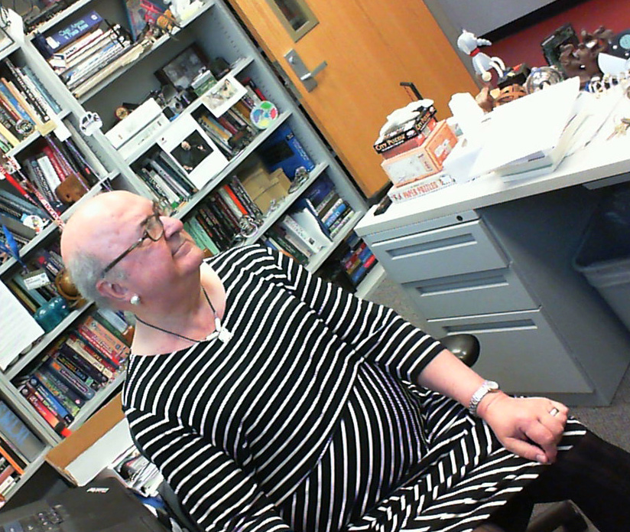
Software Construction and Evolution - CSSE 375 Reverse Engineering and Reengineering Approaches
Shawn & Steve
In long-term software developments, the “elephant in the room” that the system needs to be reengineered to make it easier to change, but nobody wants to do that because it’s so much work! At left – I’m looking for the elephant in the room when, in fact, there are about 3 to choose from – the one I’m wearing, the one dangling from the ceiling (if you look carefully), and probably myself.
Notes:
Remember Milestone 4…
Got a message about homework returns –Focused on Milestones as they build on one another and recently redos on MS3
HWs not so critical as they are not tied to things - Working on HW3 and hope to get it done this weekend (amongst my trip to VA)
Should have HW2 – if not, contact me.
Full Schedule is updated to the end of the term… Still a bit concerned about how much we want to cover

Slide 2
Let’s start with Software Construction

Slide 3
What is Software Construction?
From the Guide to the Software Engineering Body of Knowledge (SWEBOK), 2004 edition:
Software construction refers to the detailed creation of working, meaningful software through a combination of coding, verification, unit testing, integration testing, and debugging.
Q1
Notes:
Construction normally refers to the process of building
Making the “real thing” vs problem exploration, modeling, validating on either side of this.
For software construction: What are our construction “tools”? How do we ensure quality?
Q1: Please write in your own words your definition of software construction.

Slide 4
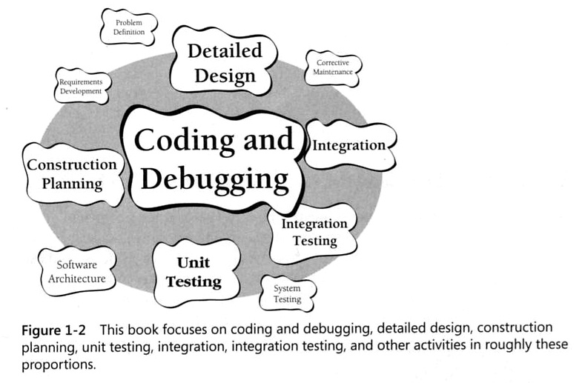
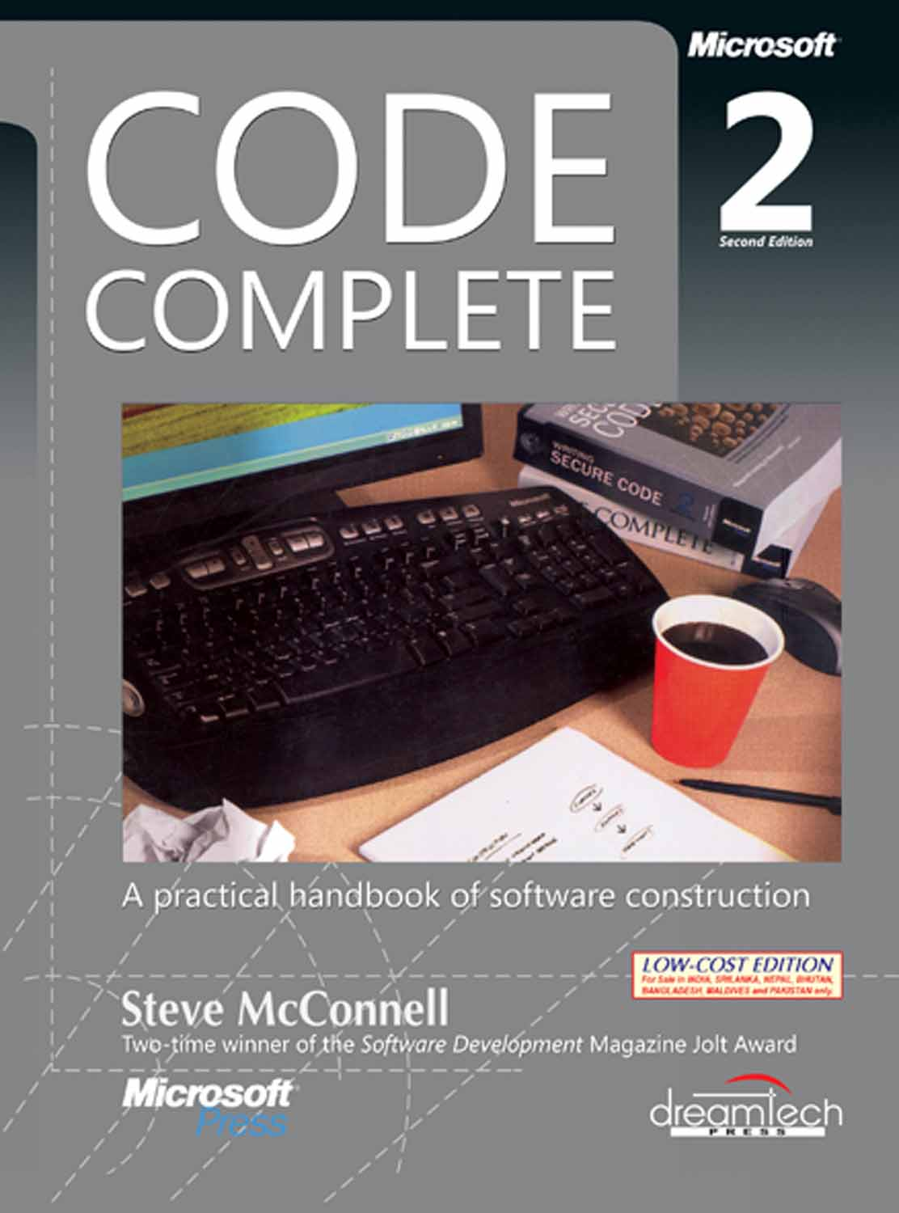
How Steve McConnell looks at Construction

Slide 5
Why is Software Construction Important?
It’s a large part and at the center of software development and maintenance
Focusing on construction can greatly improve an individual’s programming productivity
Source code is the only completely accurate description of the software
It’s the only activity that must be done!
That’s a hot topic in Agile development methods
Notes:
Question – What’s the opposite philosophy called? (Where coding is this little thing you do at the end, and it should work the first time!?)

Slide 6
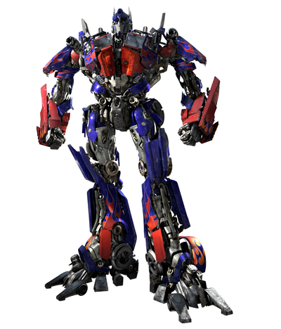
Software is Constructed… What’s Next?
It changes, it evolves, it grows, it ages…
Why can’t we just transform the thing to work on new platforms and do the new things?
Reconstruction AKA Reengineering
Q2
Notes:
Obsolescence -- Old technology (e.g., platforms), Aging business modes, Cost of continuous updates
Q2: What is another name for reconstructing or redeveloping a system?

Slide 7
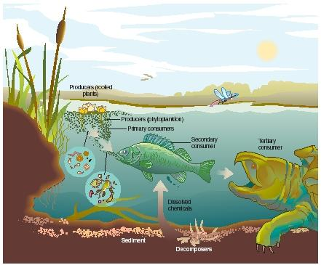
Reengineer Strategies and Drivers
Evolution vs. Revolution
With New Functionality or Without
Motivations/Drivers
Product/Environment Related
Maintenance Process Related
Commercially Related
Q3
Notes:
Q3: What is the strategy for reengineering a system when it is done incrementally? How is this different than maintenance?
Product/Environment Related - Old platform and need to migrate to a new one, Integrating multiple products and want a single environment…
Maintenance Process Related
Old product is no longer maintainable, but the product is valuable to the organization (high business value, low technical condition)
May want to redocument (or document for the first time) an existing system
Prelude to refactoring…
Commercially Related
Vendor went out of business and a vital component must now be reengineered…

Slide 8
Maintain or Reengineer?
P₁ = current annual maintenance cost for an application
P₂ = current annual operation cost for an application
P₃ = current annual business value of an application
P₄ = predicted annual maintenance cost after reengineering
P₅ = predicted annual operations cost after reengineering
P₆ = predicted annual business value after reengineering
P₇ = estimated reengineering costs
P₈ = estimated reengineering calendar time
P₉ = reengineering risk factor
(P₉ = 1.0 is nominal)
L = expected life of the system
Cost associated with continuing maintenance:
C_{maint} = [P₃ – (P₁ + P₂)] X L
Cost associated with reengineering:
C_{reeng} = [P₆ – (P₄ + P₅)] X (L – P₈) – (P₇ X P₉)
Overall benefit can be computed
cost benefit = C_{reeng} – C_{maint}
Q4
¹Sneed, H., “Planning the Reengineering of Legacy Systems”, IEEE Software, January 1995, pp. 24-25
Notes:
Go through the parts…
Q4: What are the four factors used to calculate Cost associated with continued maintenance?

Slide 9
Exercise: Reengineer, or Continue to Maintain System?
Need to understand the reengineering cost/benefit for the purchasing application (PA) in BuyNLarge Inc. The accountants calculated the current annual business value of PA (P3) to be $300K. The annual maintenance cost for PA (P1) is $22K and its annual operation cost (P2) is $50K.
It is estimated that the reengineering effort will take about 10 months (P8) and cost (P7) $65K. The projected annual business value of PA after reengineering (P6) is $360K. The projected annual maintenance cost after reengineering (P4) is $10K and annual operations cost after reengineering (P5) is $255K. The amortized expected life of the system will be 48 months after the reengineering effort (L).
The Reengineering project is projected to have a variance of 10% (risk factor slightly above nominal, thus P9 = 1.1) due to some changes in the user interface.
Cost associated with continuing maintenance:
C_{maint} = [P₃ – (P₁ + P₂)] X L
Cost associated with reengineering:
C_{reeng} = [P₆ – (P₄ + P₅)] X (L – P₈) – (P₇ X P₉)
Calculate the overall cost benefit = C_{reeng} – C_{maint}
Note: Times need to be converted to years!
Q5
Notes:
Q5: What is the cost benefit of doing the reengineering project for BuyNLarge’s Purchasing Application?

Slide 10
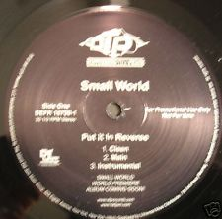
Reverse Engineering
“Software must have first been Engineered to be successfully Reverse Engineered.”
Shawn Bohner
Notes:
Image from http://www.ebay.com/sch/i.html?_kw=Put+Reverse.

Slide 11
Definitions of Software Reverse Engineering
Reverse engineering (RE) is the process of extracting the knowledge or models of man made things. Some assumption is made that it is engineered.
“[Software] Reverse Engineering is the process of analyzing an existing software system to identify the system's components and their inter-relationships, and to create representations of the system in another form at higher levels of abstraction.” -- Ira Baxter Semantic Designs, Inc.
Q6
Notes:
Difference between RE and research is that with RE the artifact being investigated is man made
Goal of RE is to identify missing abstractions, ideas, and engineering philosophy from the original product
Q6: Please write in your own words your definition of software reverse engineering.

Slide 12
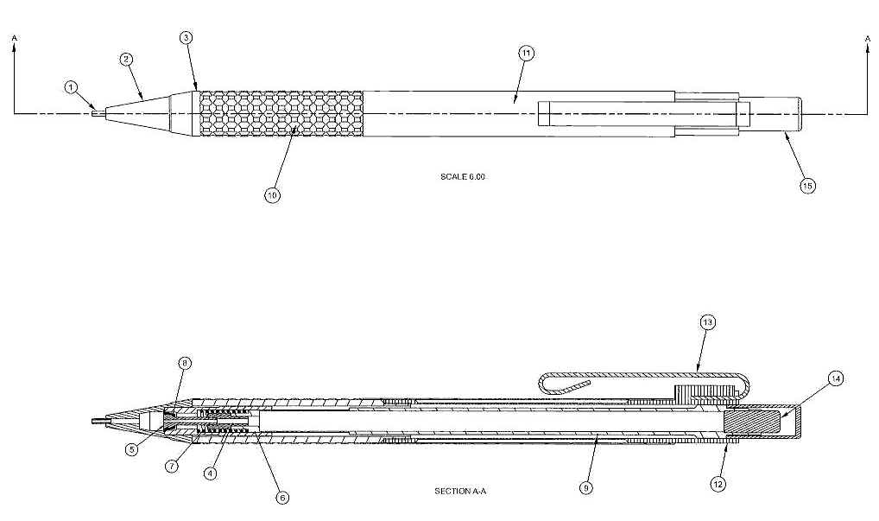
Reverse Engineering a Mechanical Pencil
Q7
Notes:
Q7: Where do you start when reverse engineering a tangible product like a mechanical pencil?

Slide 13
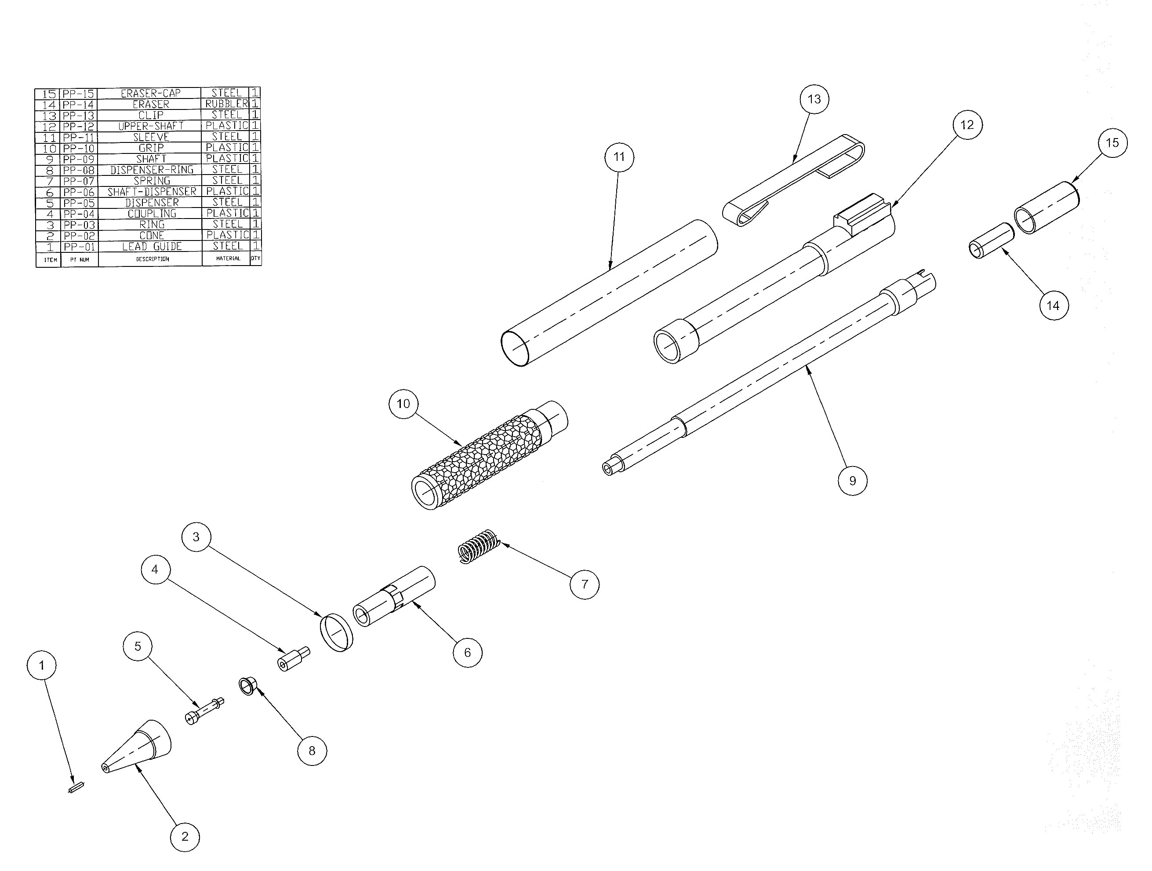
What are the Relevant Pencil Parts?
Notes:
The grip, the lead extender mechanism (very complex parts), the clip, the shaft, the cone, etc.

Slide 14
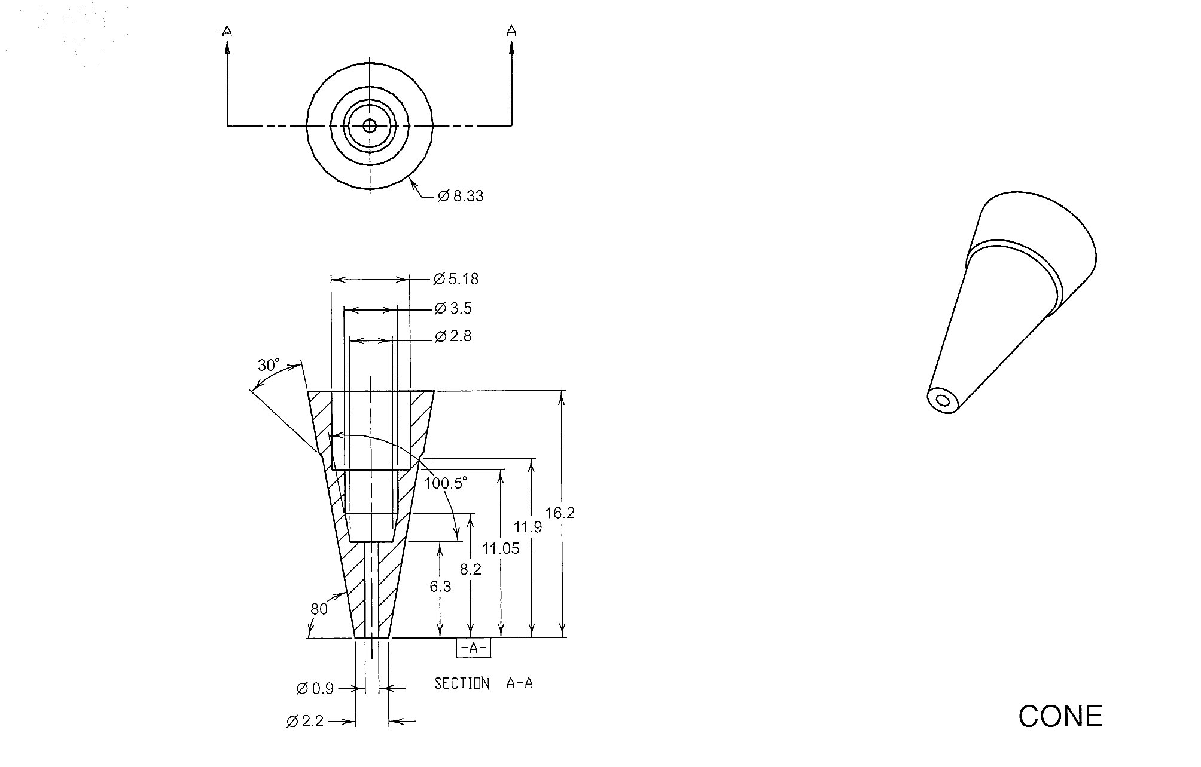
Evaluate the Pencil Parts: Cone
Metal to prevent wear
Tapered to: 1) provide writing control subject to preference, 2) maximize writing space or options
Notes:
Let’s take a simple part … the cone.
Etc. …

Slide 15
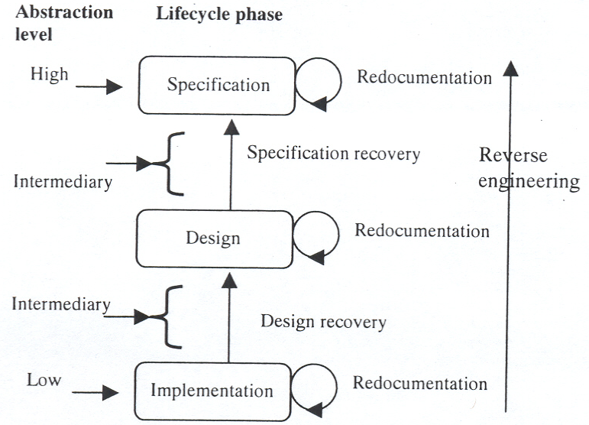
Levels of Abstraction

Slide 16
Software Reengineering Techniques
Reverse Engineering / Redocumentation /Design Recovery
Restructuring /Refactoring
Conversion
Migration
Software Salvaging
Requirements
Architecture
Reverse Engineer
Forward Engineer
Physical Design
Implementation
This is the famous “Reengineering U”
Q8
Notes:
Q8: How does the previous construction impact the potential for reengineering a system?

Slide 17
Software Reengineering Techniques
Redocumentation
Reverse Engineering
Restructuring
Conversion

Slide 18
Software Salvaging and Migration
Software Salvaging
(for reuse)
Software Migration
Q9
Notes:
Q9: How is software salvaging different from Software Migration?

Slide 19
Software Salvaging for Reuse (Archeology?)
Reverse Engineer
Software Artifacts
Identify and Prepare
Reusable Parts
Integrate Reusable and New
Parts to Construct System
Asset
Management
System
Asset
Management
System
Acquisition Management
System
Acquisition
Management
System
Converged/
Reengineered
Systems
Existing
Systems
Captured
Artifacts
Reusable
Components
Q10
Notes:
Q10: What is the process by which software is salvaged for reuse?

