Slide 1
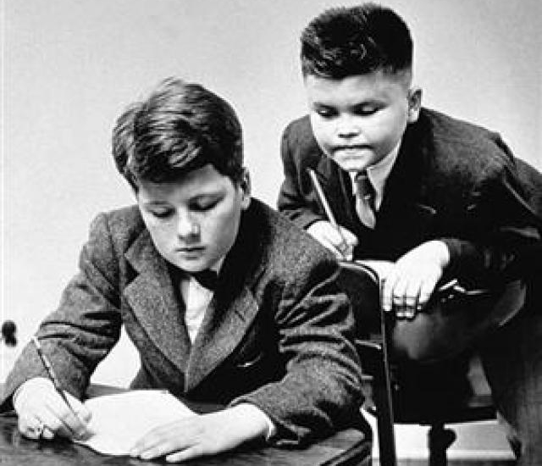
Software Construction and Evolution - CSSE 375 Reverse Engineering Tools and Techniques
Shawn & Steve
Left – Reengineering from the competition can be seen as theft!
Notes:
Image from http://allthingsd.com/20120725/apple-google-warned-samsung-against-copying-us/.

Slide 2
Using: SW Reengineering Techniques
Reverse Engineering / Redocumentation /Design Recovery
Restructuring /Refactoring
Conversion
Migration
Software Salvaging
Requirements
Architecture
Reverse Engineer
Forward Engineer
Physical Design
Implementation
Recall the Famous “U”

Slide 3
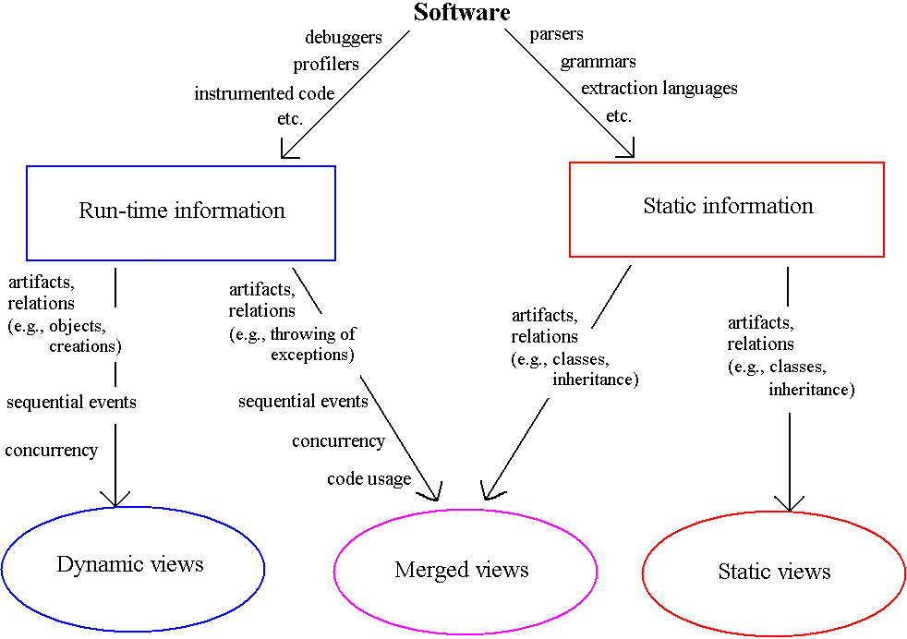
Extracting Info from Software
Q11
Notes:
Q11: Visualizing software artifacts and elements are critical to Program Understanding. What are examples of helpful dynamic views?

Slide 4
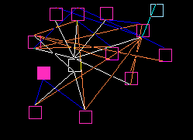
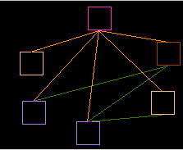
Visualizing Static Models
Examine static structure, architecture
Relationships between software artifacts
Visualization:
Class diagrams
Hierarchical graphs
Program Dependence Graphs (PDG)
Q12
Notes:
Q12: What are some static model visualizations that help with understanding a software code base?

Slide 5
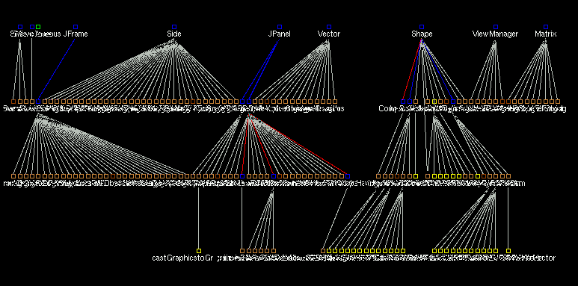
Reverse Engineering Tool: Rigi View 1
These tools use “Rigi standard format” to store relationships about a system. Like, “call main printf” to record that “main” has a dependency on the printf function.
Notes:
All nodes except classes, methods, constructors and typecasts have been filtered out and a layout algorithm applied.

Slide 6
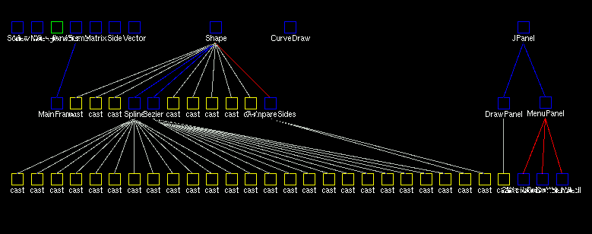
Rigi View 2: Show By Class
Notes:
methods collapsed into their classes
All the casts inside a class are attached to that class…

Slide 7
Rigi View 2: Show By Class (2)
Notes:
…but a class node can be opened to show the members inside with their cast nodes attached

Slide 8
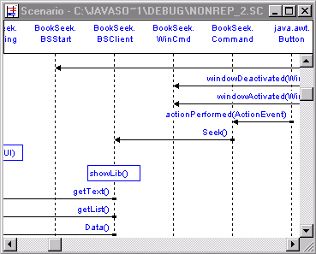
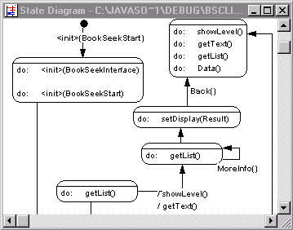
Visualizing Dynamic Models
Examine run-time behavior of software
Debugger, profiler, source code instrumentation
Visualization:
Scenarios (sequence diagrams, activity diagrams)
State diagrams
Animations
Q13
Notes:
Q13: What are some dynamic model visualizations that help with understanding a software code base?

Slide 9
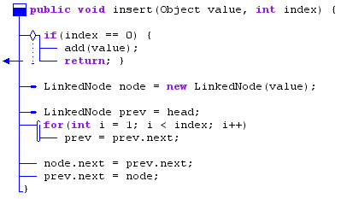
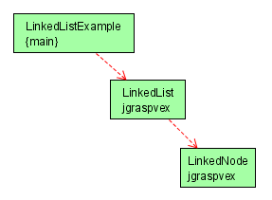
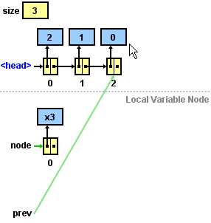
jGRASP http://www.jgrasp.org/
Control Structure Diagram
UML Class Diagram
Data Structure Diagram
Notes:
Visualizations are often built into the software environment – jGRASP is an IDE the exemplifies this.
jGRASP continues to be an active project – see http://www.jgrasp.org/.

Slide 10
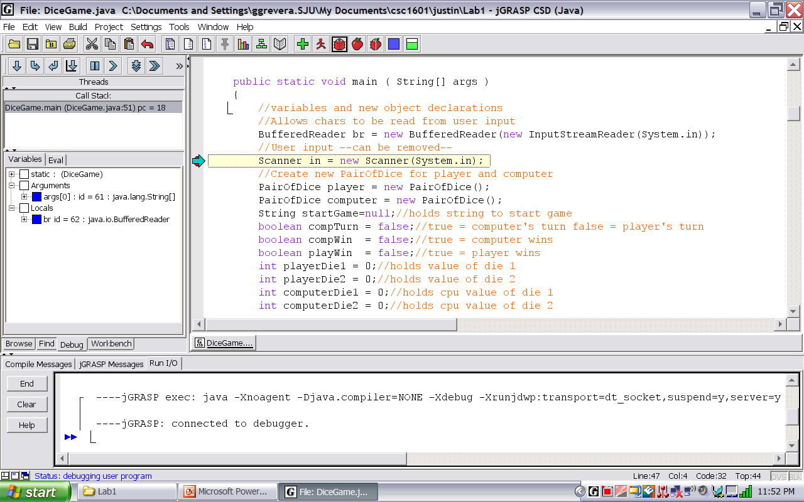
jGRASP Environment

Slide 11
Reverse Engineering: Alias “Reversing”
“If you think Reverse Engineering Design from Java is hard, abstracting up from binary is near impossible!”
Shawn
“However, don’t count on the fact that hackers can’t do it!”
Steve

Slide 12
Software “Reversing”
Reversing is dissecting a program and examining its internals
Common applications of Reversing in the software industry to recover the source code of a program because:
Source code/documentation was lost
Need to find how the program does particular operations
Need to improve the performance of a program
Need to fix a “bug”
Need to identify a security vulnerability / malware
Q14
Notes:
Q14: What to you is the most important application of Reversing?

Slide 13
Model of Reversing
Hard, but doable if the conditions are good.
Really hard, and traction is mostly when small segments or simple situations are attempted.
Q15
Notes:
You really need to have good patterns at the lower levels to identify and extract.
Q15: Where do you get the best traction for reversing?

Slide 14
Hex Editors
Hex editors read executing programs from RAM
Display their contents in hexadecimal code
Enable the editing of the running hexadecimal code
Hex Editors | RAM Editor | Data Recovery Tools | RAM Disassembler
WinHex | x | x
Tsearch | x |  | x

Slide 15
Hex Editors: WinHex

Slide 16
Decompilers
Decompile a binary programs into readable source code
Replace all binary code that could not be decompiled with assembly code
Executable
Decompiler
Source Code
Q16
Notes:
Q16: True or False: The results from the decompiler are readily readable for use in other programs.

Slide 17
Decompilers: REC

Slide 18
Disassemblers/Debuggers: OllyDbg

Slide 19
Legal Issues: Interoperability
Exposed software interfaces allows development of interoperable software that runs on the platform
Legal case: Sega vs. Accolade
Ruled in favor of Accolade as they did not violate code copyright of Sega
Notes:
Exposed software interfaces allows development of interoperable software that runs on the platform
Advantage: increases sales penetration on platform
Disadvantage: if the competition offers a product on the same platform
Legal case: Sega vs. Accolade -- Ruled in favor of Accolade as they did not violate code copyright of Sega
Competition benefited market customers
Court essentially authorized reversing for the purpose of interoperability

Slide 20
Legal Issues: Competition
Opponents of software reversing claim that it stifles innovation
Illegal
Quite provable: directly stealing code
Hard to prove: decompiling programs and recompiling them to generate a different, but functionally equivalent binary
Legal
Reversing small parts of a product to gather information, not code
Then develop code independently
Funny how scale and independence plays such a role…
Q17
Notes:
Q17: What is legal from the perspective of competition for doing Reversing?

Slide 21
Legal Issues: Copyright Law
Copyright violation: directly copy protected code sequences from the competitor’s product into you own product
Some have claimed that intermediate copies during RE decompilation violates copyright
If the final product does not contain anything that was directly copied from the original product, copying is considered fair use
Notes:
Some have claimed that intermediate copies during RE decompilation violates copyright
These claims have not held in court because intermediate copies are created when a program is installed from a CD onto a hard disk

