Slide 1


Software Construction and Evolution - CSSE 375
Open Source Software
Shawn & Steve

Slide 2
Pervasive Computing Evolution
Penetration
What do you think the impact of this is on Open Source Software?
Open Global
Services
Internet
Computing
Programmable Data Center
Networked Personal
Computing
Information
Utility/Appliances
Distributed
Computing
Open Systems of
Clients and Servers
Batch Computing
and Timesharing
Micros
Minis
Mainframes
1960
1970
1980
1990
2000
2010
Source: Joel Birnbaum, 1982
Notes:
TRUST IS IMPORTANT FOR PATH WE ARE ON IN INFORMATION TECHNOLOGY
Joel Birnbaum began talking about what he called pervasive computing twenty years ago... this chart has become a roadmap for HP technology. It has evolved only slightly over the years, but the fundamental vision remains the same... that the value of technology will some day be driven by its ability to achieve total collaboration through openness and ubiquity.

Slide 3
Open Source Evolution
First Wave – Operating System
  Linux
Second Wave – Infrastructure
  Web Servers, Database, Application Servers…
Third Wave – Applications
  ERP, Business Intelligence, Project Management…
Fourth Wave – Management
  IT Management, Compliance, Application Deployment/Life Cycle Management
Notes:
The first wave was started with Linux, which caught the attention of enterprises with the second wave when
Web servers, databases, and App Servers came to the market, all based on open source. This in turn
Fuelled the demand for open source Operating Systems,
The third wave of open source started with open source ERP, CRM, BI, and Project Management applications
Coming to the market.
Now at the fourth wave where CIOs are looking at Open Source applications for IT Management, Application
Deployment, Life Cycle Management, and so on.
Pointgain focuses on this segment targeting the discerning CXO and CIO seeking adaptability, flexibility, extensibility
and ROI.
Today, the open source software model and accompanying products are increasingly showing up on the radar of
mainstream enterprises. Earlier adopters have proved the merits of open source and now the mainstream is comfortable
making the leap themselves.

Slide 4
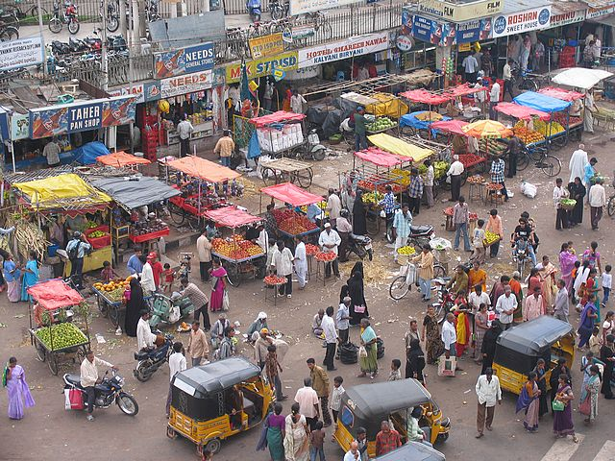
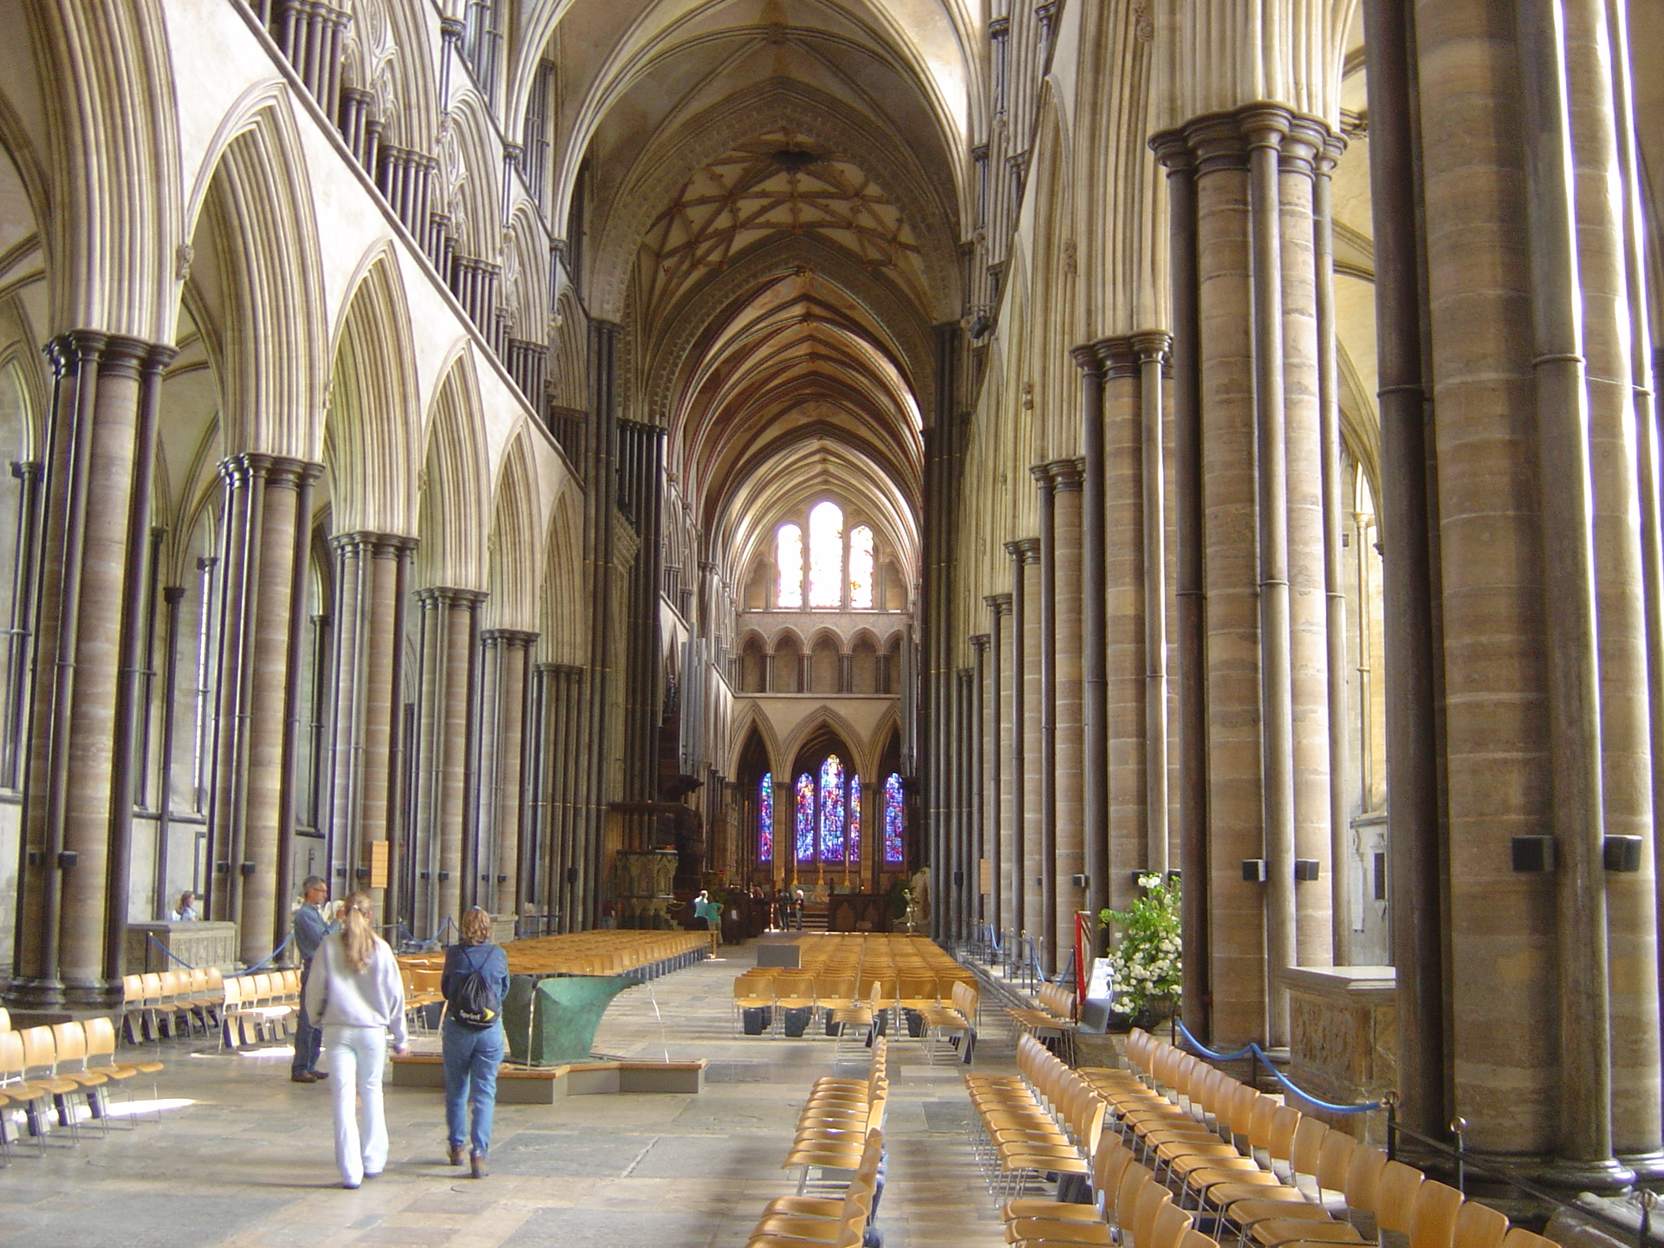
What’s the difference between these 2?
Notes:
Bazaar in Hyderabad, India image is from http://sporum.wikia.com/wiki/File:India_Hyderabad_bazaar_market_fruit.jpg.
Cathedral in Salisbury, England image is from http://tourists360.com/salisbury-cathedral-church/.

Slide 5
Mindset: Cathedral vs. Bazaar (Eric Raymond)
Cathedral - Closed Source (e.g., MS WinXP)
  Developed in a controlled, coordinated way
  Relatively small, tightly-knit group
  Secrecy maintained through NDAs
  Bugs reported to this group (access to source)
Bazaar - Open Source (e.g., Linux)
  Developed by many volunteers
  Coordinated through the Internet
  Quality maintained by releasing very often
  Bugs reported to authors getting fast feedback from many users
Q1
Notes:
Q1: As more information is freely available, the marketplace for software changes. What is meant by Eric Raymond’s Bazaar for open source?

Slide 6
Open Source Perspectives
Open source is more than “free software”
Free redistribution
Source code is available
  Enables modification and inspection
Derived works
  Free/encouraged to modify (and redistribute)
Q2
Notes:
Q2a: True or False: Freeware and shareware are examples of Open Source Software.
Q2b: Please list two examples of Open Source Software.
Not Freeware or Shareware (no source code); Not Public Domain; Not for non-commercial use only, or Community Codes

Slide 7
Open Source Perspectives (continued)
Integrity of Authorship
  Retain authorship of modifications
No discrimination against persons, groups or use (including commercial use)
Notes:
Who do you suppose the discrimination would be directed at?

Slide 8
Ownership - Copyright & Licensing
Ownership stays with the author(s)
  unless they relinquish their claims to it or transfer the copyright to another party
Over 30 Open Source Licenses recognized by the Open Source Initiative
(http://www.opensource.org/licenses)
Q3
Notes:
Focusing in on ownership…
Q3: In general, ___________________ owns the Open Source software.

Slide 9
Defining Open Source
Open Source Initiative (OSI) in 1998
Developed the Open Source Definition
Free Redistribution
Source Code
Derived Works
Integrity of the Author's Source Code
No Discrimination Against Persons or Groups
No Discrimination Against Fields of Endeavor
Distribution of License
License Must Not Be Specific to a Product
License Must Not Restrict Other Software
License Must Be Technology-Neutral
Q4
Notes:
Success of Linux inspired creation of the Open Source Initiative (OSI) in 1998
Led by Eric S. Raymond and endorsed by Linus Torvalds
Q4: The Open Source Initiative (OSI) has ten elements to its definition. Please list the ones that do not have to do with the licensing of software directly (i.e., not in the title).

Slide 10
Multiple Versions & Natural Selection
Natural selection process favors end-user
Over time new versions become
  dominant & widely used,
  die off due to lack of support/usage, or
  get folded back into the original
Ability to fork off different versions ensures surviving version will have features majority of end-users want
Q5
Notes:
Q5: The Ecosystem for Open Source Software is analogous to natural selection. In that the evolving of multiple versions the process favors who?

Slide 11
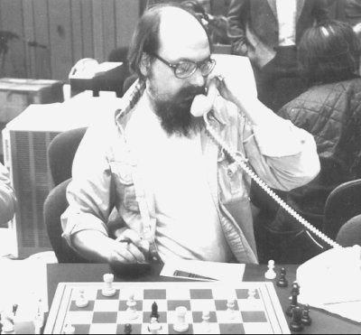
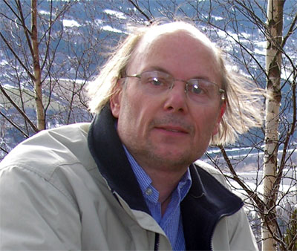
Pre/Emerging Open Source
Unix developed at AT&T in 1971
Monopoly restrictions on AT&T
Given free to universities w/source
Bjarne Stroustrup founder of C++
Unix co-founder Ken Thompson
Monopoly restrictions lifted 1983
UNIX/C now became hot properties
  Source code no longer available
Stroustrup’s C++ - mid 1980’s
  “open library” of classes
Unix-like systems began to appear
  Most prominent: Linux (1991)
Notes:
Ken Thompson image from http://en.chessbase.com/post/a-history-of-cheating-in-che-2-.

Slide 12
Then Open Source took off!
1984 -The GNU Project, Richard Stallman, and the Free Software Foundation
1987 - Cygnus, the first commercial company devoted to provide commercial support for GNU software and open source software in general, is founded.
1991 - Linus Torvalds releases first Unix-like kernel; combines it with GNU software to form first release of Linux operating system
1992 - "Linux commercialization wave" started. The first commercial distribution, called Yggdrasil was created by Adam Richter:
1994 - Redhat is founded to distribute and support Linux commercially
1995 - A community of developers start work on the Apache Web Server
Q6
Notes:
Q6: When was the term “Open Source Software” coined and who coined it?
In a 1998 strategy, "open source software" was selected by Todd Anderson, Larry Augustin, Jon Hall, Sam Ockman, Christine Peterson, and Eric S. Raymond.[4]
Richard Stallman had not been invited. The session was arranged in reaction to Netscape's January 1998 announcement of a source code release for Navigator (as Mozilla). Those at the meeting described "open source" as a "replacement label" for free software and Open Source Initiative was soon-after founded by Eric Raymond and Bruce Perens to promote the term as part of "a marketing program for free software".

Slide 13
Then Open Source kept taking off!
1997 - “The Cathedral and the Bazaar” is published by Eric Raymond
1998 – Term "Open Source" is coined by group at 1998 strategy session (conference) in California
2001 - Linux 2.4, a highly scaleable version released
2001 - HP Open Source's printer drivers
2001 - IBM "invests" $1billion in Linux
2002 - Significant commercial adoption commences in financial services, government, retail, and manufacturing industries
2003 – Novell acquires SuSE Linux, enterprise Linux strategy
… and so on…
Q6
Notes:
Q6: When was the term “Open Source” software coined and was it really coined by Richard Stallman?
In a 1998 strategy, "open source software" was selected by Todd Anderson, Larry Augustin, Jon Hall, Sam Ockman, Christine Peterson, and Eric S. Raymond.[4]
Richard Stallman had not been invited. The session was arranged in reaction to Netscape's January 1998 announcement of a source code release for Navigator (as Mozilla). Those at the meeting described "open source" as a "replacement label" for free software and Open Source Initiative was soon-after founded by Eric Raymond and Bruce Perens to promote the term as part of "a marketing program for free software".

Slide 14
Example Site: SourceForge
Hosts more than 100,000 projects
Services Provided:
  Open Source Software (OSS) and Community
  Web Tools for Community and Project Management
  File Release System
  Donation System
  Compile Farm
  CVS Service
  Subversion Service
  Communication Tools
  Publicity
  Project Web Service

Slide 15
Government Open Code Collaborative (GOCC)
www.gocc.gov
A voluntary collaboration between public sector entities and non-profit academic institutions
Created for the purpose of encouraging the sharing, at no cost, of computer code developed for and by government entities where the redistribution of this code is allowed

Slide 16
Exercise: What Open Source Means to You
As a student, what Open Source Resources do you use to develop projects here at Rose?
Two years from now, when you are working in the real world, how do you thing this perspective will change?
Working for a Business
Working as a Consultant
Owning a Business
Q7
Notes:
Q7: What will Open Source Software mean to you in two years?

Slide 17
Cool concept, but what’s in it for me?
Exemplars - systems like the one you may have in mind to construct
Reuse - anything from wholesale reuse to design salvaging
Opportunity to contribute to the body of evolving software
Opportunity to interact with some of the best software engineering professionals in the business - Learn!
Okay, but what does the have to do with Construction and Evolution?
  Next slides - stay tuned!

