Slide 1
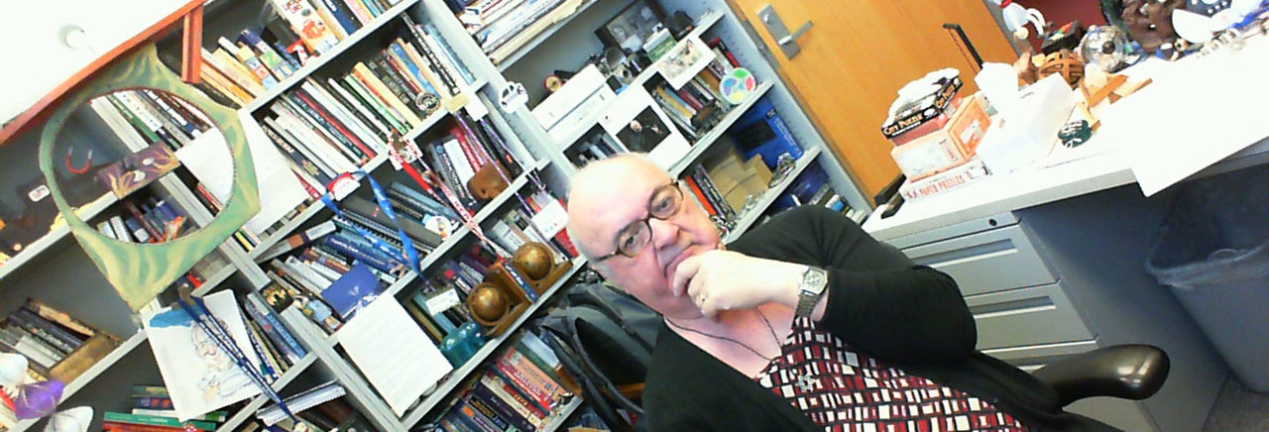
Software Construction and Evolution - CSSE 375 Program Understanding
Shawn and Steve
Notes:
Above – The pose to strike when trying to understand software. We have surely concocted the most complex brain teasers of all time.
The middle lanyard in the background is from CSEE&T, the conference in Austria I attended over spring break.
The odd hanging shape, mostly green, is a double pendulum my younger daughter invented in a grade school art class.

Slide 2
Common Maintenance Situation
Taylor D. Programmer is given the task to make a change to some software that someone else has written
It consists of about 50KLOC, 2000 modules/components, etc. (not a big system!)
Where does Taylor start?
What is Taylor looking for?

Slide 3
Program Understanding: Basic Manual Approach
Read about the program
Read the source code
Run the program
Return to steps 1 or 2 as necessary (Wash-Rinse-Repeat…)
Q1
Notes:
Q1: What are the steps in the basic manual process for Understanding a Program?

Slide 4
Perhaps some strategy can help….
Top-down (Decomposition)
Bottom-up (Composition)
“Chunking”
Opportunistic
Combination of top-down and bottom-up
How can you avoid it becoming “ad hoc”?
Q2
Notes:
Q2: What are three general strategies for systematically understanding a program?

Slide 5
Program Understanding
Also known as Program Comprehension and Software Visualization
Definition: The process of acquiring knowledge about a computer program
A discipline of understanding computer source code
view(soulPredicates,<byCategory,byHierarchy>). viewComment(soulPredicates,
['This intentional view contains ALL classes that implement SOUL predicates (i.e., Prolog-like predicates that may use Smalltalk code due to language symbiosis).']). default(soulPredicates,byCategory).
intention(soulPredicates,byCategory,?class) if category(?category), name(?category,?name), startsWith(?name,['Soul-Logic']), classInCategory(?class,?category). include(soulPredicates,byCategory,[Soul.TestClassifications]).
intention(soulPredicates,byHierarchy,?class) if …
Q3
Notes:
Useful for reuse, maintenance, reverse engineering and the like in the context of Software Engineering
Q3: What are two other names for program understanding as a technology area? Why didn’t they also call it “Program Listening” or “Program Smelling”?

Slide 6
Program Understanding Factors
Expertise
Representation Form
Implementation Issues
Documentation
Organization and Presentation
Notes:
Expertise – domain knowledge, skill with language/environment, system knowledge…
Representation Form – Structure, Semantics, Language Form/Type (Declarative, Symbolic, Procedural, Functional)
Implementation issues - Naming conventions, Comments, Decomposition Mechanism
Documentation – relation to source code, hypertext links
Organization and Presentation – of the software artifacts, formal/informal

Slide 7
Parts of a Whole Comprehension
Studies on people’s perception indicate that there is a natural tendency to look for ways which can bring the parts into a meaningful whole (Gestalt) : The Aha Moment!
This feeling comes when all the parts can be linked to form a holistic picture.
Meaning lies in the connection.
Notes:
Humans need both “informal” and “formal” knowledge for program understanding
As a human begins to understand a program he/she finds and recognizes informal concepts and starts assigning them to structures in the program
Automatically “discovering (find + recognize) these informal concepts and assigning them to their implementation instances (structures of code) is the concept assignment problem”

Slide 8
Concept Assignment Problem
Program understanding →
put in context of
Program knowledge
(structure, syntax,
plans etc.)
Human oriented
world concept
knowledge
Assign concepts
to parts of code
Find concepts
(recognize)
Concept
Assignment
Problem
Q4
Notes:
Humans understand in terms of application domains e.g. “reserves an airline seat” ≠ “if(seat = request(flight)) && available(seat) then researve(seat, customer)”
Humans understand because of “rich context of world knowledge”
Machines lack contextual world knowledge
Q4: What does the Concept Assignment problem map? Why would OO programs help with this?

Slide 9
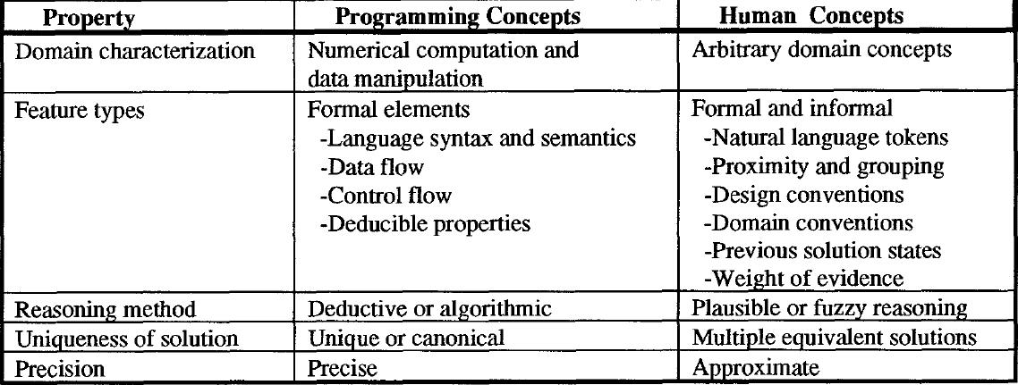
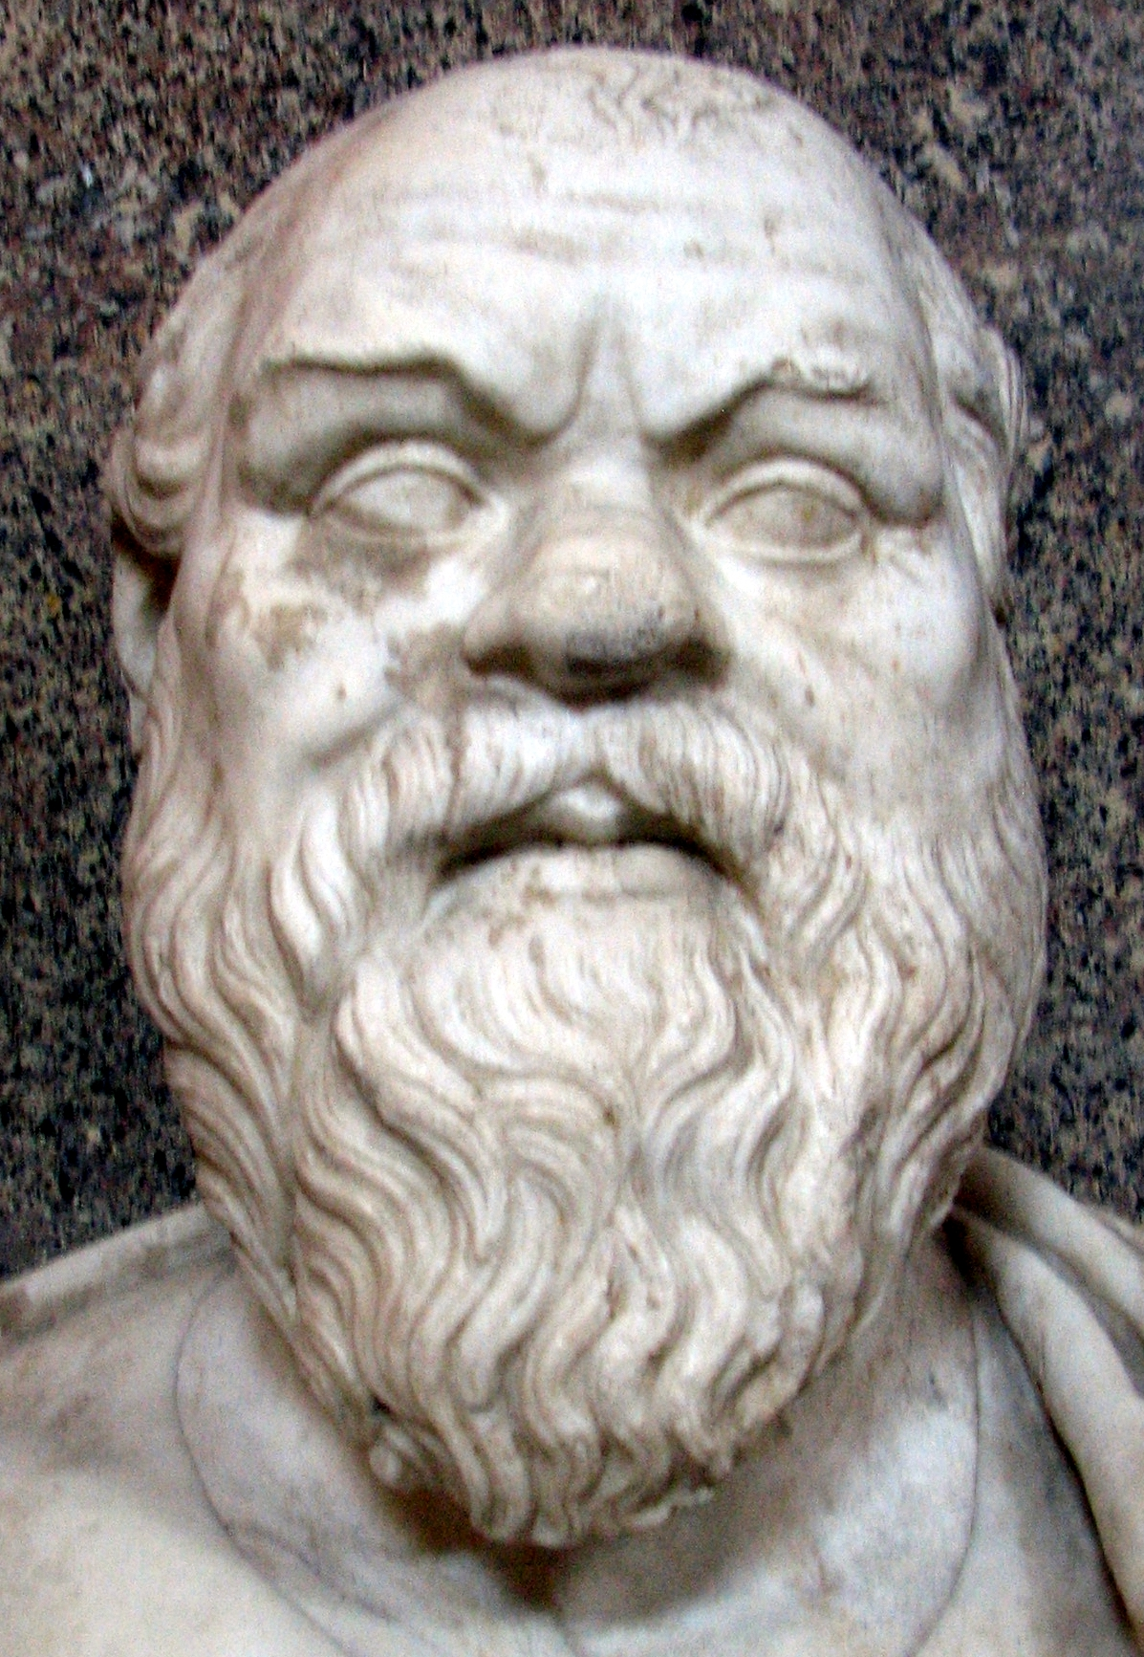
Program and Human Concept Types
Typical open-ended human problem: “What would Socrates say about that?” We don’t expect a single answer.
Q5
Notes:
Q5: What is the difference between programming concepts and human concept with respect to uniqueness of solution? How do you explain that?
Image of Socrates from http://en.wikipedia.org/wiki/Socrates.

Slide 10
Program Slicing
int main() {
int sum = 0;
int i = 1;
while (i < 11) {
sum = sum + i;
i = i + 1;
}
printf(“%d\n”,sum);
printf(“%d\n”,i);
}
Program slicing is the computation of the set of a program’s statements, the program slice, that may affect the values at some point of interest, referred to as a slicing criterion.
Q6
Notes:
Q6: In your own words, what is program slicing?

Slide 11
Program Slicing – Backward Slice
int main() {
int sum = 0;
int i = 1;
while (i < 11) {
sum = sum + i;
i = i + 1;
}
printf(“%d\n”,sum);
printf(“%d\n”,i);
}
Backward slice with respect to “printf(“%d\n”,i)”

Slide 12
Program Slicing – Forward Slice
int main() {
int sum = 0;
int i = 1;
while (i < 11) {
sum = sum + i;
i = i + 1;
}
printf(“%d\n”,sum);
printf(“%d\n”,i);
}
Forward slice with respect to “sum = 0”
Q7
Source: Tom Reps
Notes:
Q7: True / False: A forward slice in program slicing is simply the reverse of a backward slice.

Slide 13
Exercise: What does this do? What Slice is the Character Count?
void line_char_count(FILE *f) {
int lines = 0;
int chars;
BOOL eof_flag = FALSE;
int n;
extern void scan_line(FILE *f, BOOL *bptr, int *iptr);
scan_line(f, &eof_flag, &n);
chars = n;
while(eof_flag == FALSE){
lines = lines + 1;
scan_line(f, &eof_flag, &n);
chars = chars + n;
}
printf(“lines = %d\n”, lines);
printf(“chars = %d\n”, chars);
}
Notes:
Think/Pair/Share – take 38 seconds to think, 2 minutes with a partner, then report
Line-Character-Count Program

Slide 14
Character-Count Program
void char_count(FILE *f) {
int lines = 0;
int chars;
BOOL eof_flag = FALSE;
int n;
extern void scan_line(FILE *f, BOOL *bptr, int *iptr);
scan_line(f, &eof_flag, &n);
chars = n;
while(eof_flag == FALSE){
lines = lines + 1;
scan_line(f, &eof_flag, &n);
chars = chars + n;
}
printf(“lines = %d\n”, lines);
printf(“chars = %d\n”, chars);
}

Slide 15
Control Flow Graph
int main() {
int sum = 0;
int i = 1;
while (i < 11) {
sum = sum + i;
i = i + 1;
}
printf(“%d\n”,sum);
printf(“%d\n”,i);
}
Enter
F
sum = 0
i = 1
while(i < 11)
printf(sum)
printf(i)
T
sum = sum + i
i = i + i
Source: Tom Reps

Slide 16
Flow Dependence Graph
int main() {
int sum = 0;
int i = 1;
while (i < 11) {
sum = sum + i;
i = i + 1;
}
printf(“%d\n”,sum);
printf(“%d\n”,i);
}
Flow dependence
p
q
Value of variable
assigned at p may be
used at q.
Enter
sum = 0
i = 1
while(i < 11)
printf(sum)
printf(i)
sum = sum + i
i = i + i
Source: Tom Reps

Slide 17
Control Dependence Graph
int main() {
int sum = 0;
int i = 1;
while (i < 11) {
sum = sum + i;
i = i + 1;
}
printf(“%d\n”,sum);
printf(“%d\n”,i);
}
Control dependence
p
q
q is reached from p
if condition p is
true (T), not otherwise.
T
p
q
Similar for false (F).
F
Enter
T
T
T
T
T
T
sum = 0
i = 1
while(i < 11)
printf(sum)
printf(i)
T
T
sum = sum + i
i = i + i
Source: Tom Reps

Slide 18
Program Dependence Graph (PDG)
int main() {
int sum = 0;
int i = 1;
while (i < 11) {
sum = sum + i;
i = i + 1;
}
printf(“%d\n”,sum);
printf(“%d\n”,i);
}
Control dependence
Flow dependence
Enter
T
T
T
T
T
T
sum = 0
i = 1
while(i < 11)
printf(sum)
printf(i)
T
T
sum = sum + i
i = i + i
Q8
Source: Tom Reps
Notes:
Q8: What kind of dependencies are depicted in a Program Dependence Graph (PDG)? Why would you want to show both at once?

Slide 19
What Are Slices Useful For?
Understanding Programs
Restructuring Programs
Program Specialization and Reuse
Program Differencing
Testing
Notes:
Understanding Programs
Restructuring Programs - Isolation of separate “computational threads”
Program Specialization and Reuse - Slices = specialized programs, Only reuse needed slices
Program Differencing - Compare slices to identify changes (Impact analysis)
Testing
What new test cases would improve coverage?
What regression tests must be rerun after a change?

Slide 20
Program Comprehension Tools
A tool that aids in program understanding through the capture, analysis, and presentation of different perspectives (views) of the software
Basic Process is:
Extract information by parsing the source code
Store and handle the information extracted
Visualize all the retrieved information
Notes:
These tools possess the complications of compilers (completeness, consistency, invariance…)

Slide 21
Interesting Software Views
Machine (ex. Byte Code, Assembly Code)
Program (ex. C code, Java code)
Define/Use Graphs
Data Flow
Control Flow
Call Graph
Function Graph
Module Graph
Architecture components…
Q9
Notes:
Q9: What software views listed above are you familiar with?
Define/Use Graphs - Functions and data used in runtime

Slide 22
Why do it?
Figure out a single component you’re going to have to fix.
Add a new feature – somewhere!
Recall Feathers said this part of making changes was still hard – finding where to make a change.
Maybe automatically spot problems?
Show dependencies as you’re making changes.
Explore a whole system.
Get ready to rewrite a system.
Q10
Notes:
Q10: Why would visualizing an existing system with a tool be a logical step in getting ready to rewrite it?

Slide 23
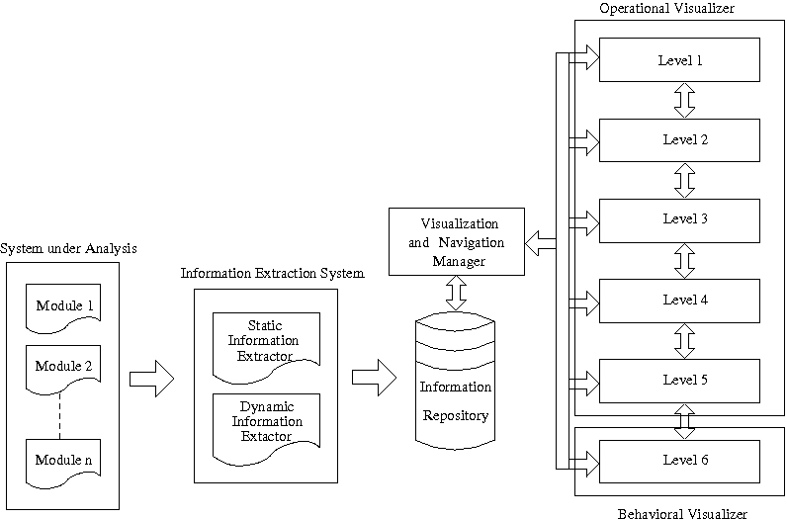
Anatomy of Software Visualization Tool

Slide 24
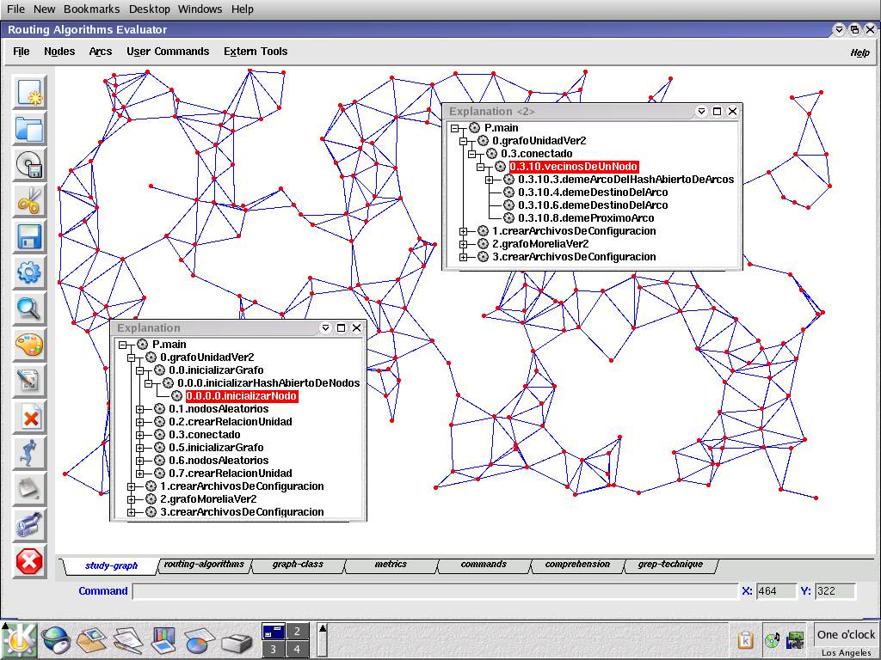
Example:EAR (Un Evaluador de Algoritmos de Ruteo)

Slide 25
Example: ComVis Tool

Slide 26
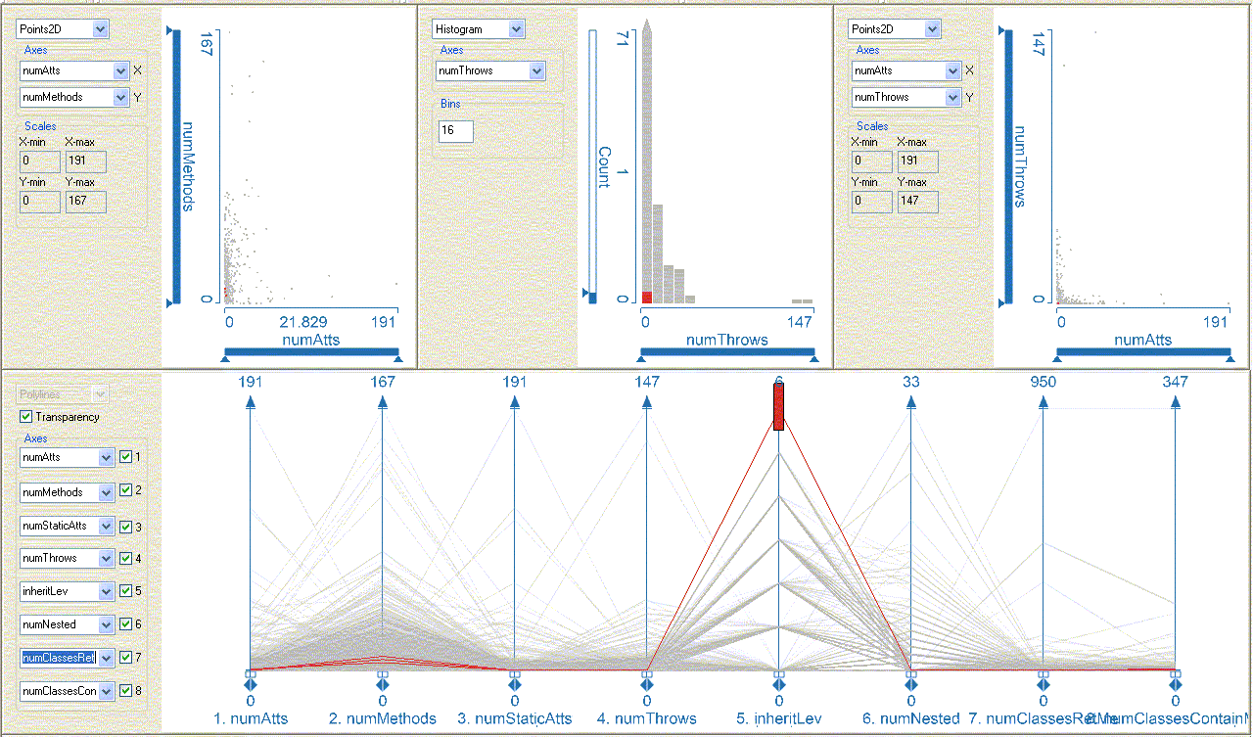
Static View: Aspects of Classes
Compare # of Methods vs. # of Attribures
# of Throws
# of Attributes
Brush Classes that have highest Inheritance Level
Note that they have low # of Attributes, etc.
Notes:
Linked Multi-views, composite brushing.

Slide 27
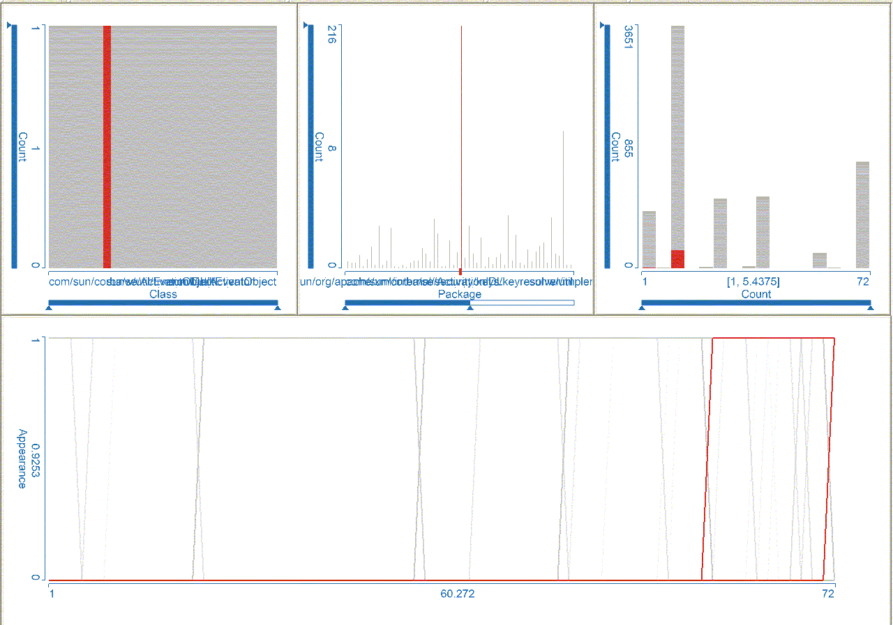
Dynamic View: Time series
Select
package with highest # of classes
Note # of classes WRT total in
version
Indicates how the selected classes show up across all 72 versions
Notes:
Overall view of the Java SDK source code history.
Lower view provides a family of 8537 curves, each representing a class over a sequence of 72 versions (from version 1.1.2_012 to 1.6.0).
An individual curve has values 0 or 1 -- present (1) or absent (0) in a given version of the code (time values from1 to 72).
While a simultaneous presentation of 8537 curves in a curve view is not necessarily useful, the ability to brush (select) to provide focus and content makes this view very useful.
TOP right view - histogram of the individual packages with the highest number of classes in the largest versions…72 versions and 3651 classes in largest version

