Slide 1
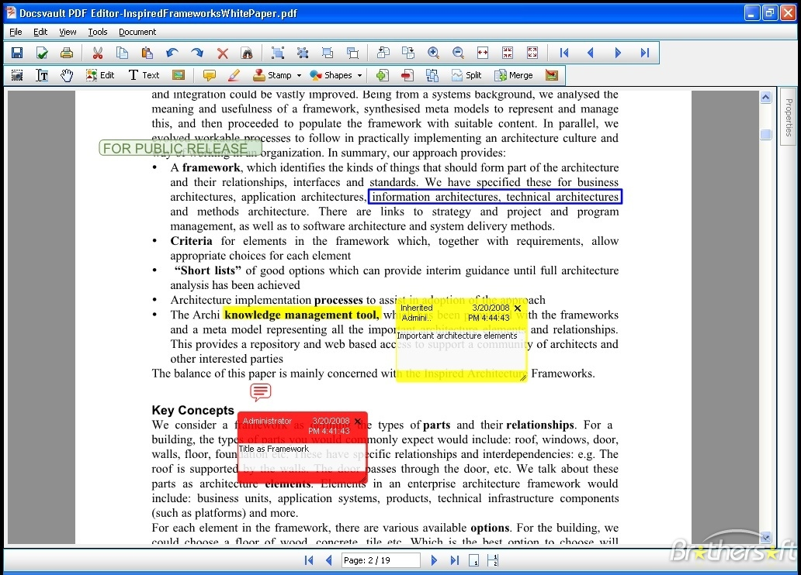

Software Construction and Evolution - CSSE 375
Software Documentation 2
Shawn & Steve
Left – Ideally, online documents would let you comment and highlight, just like paper documents.
Notes:
Image from http://www.brothersoft.com/docsvault-sb---multi-user-document-mgmt.-67227.html

Slide 2
Recall: User Documentation
Constituent Document | Function
Installation Manual / Guide | System installation and set up, configuration and customization to hardware and other software systems
Beginner’s Guide / Tutorial | Simple explanations of how to get started using the system
Reference Guide | Provides in-depth description of each system facility and how it can be used
Maintenance Manual / Guide | Outlines the software change processes Refers to req’ts & design specifications Refers to test data and results Summary of new features for releases
Quick Reference Card | Serves as a lookup for key capabilities
System Administration Guide | Provides information on services such as networking, security, and upgrading

Slide 3
Example User Documents Online
User Documentation Plan –
http://www.projectconnections.com/templates/detail/user-documentation-plan.html
Google –
http://deployment.googleapps.com/Home/user-resources/documentation-templates
Project Connections templates –
http://www.projectconnections.com/templates/

Slide 4

Maintaining
Documentation

Slide 5

Documentation Updates
Updating Source Code
  Understandable code, Commenting…
Updating Development Documents
  SRS’s, SDS’s, Test Cases…
Updating User Documents
  User’s Guide, Installation and Maintenance Guides, Getting Started instructions…
The larger the product, the more critical the need for traceability
Q1
Notes:
I think you have a handle on updating SRS, SDS, and perhaps even User Docs.
Q1: When software changes, there can be a lot of places that need changes to be made. What do you need for large software systems to aid in finding the places where changes need to be made?

Slide 6
What does this code do?
for (int i = 1; i < num; ++i) {
meetsCriteria[i] = true;
}
for (int i = 2; i < num / 2; ++i) {
int j = i + i;
while (j <= num) {
meetsCriteria[j] = false; j += i;
}
}
for (int i = 0; i < num; ++i) {
if (meetsCriteria[i])
Console.WriteLine(i + " meets criteria");
}
Q2
Notes:
Q2: What does the code on this slide do?

Slide 7
More effective (self-documenting) Code
for (int primeCandidate = 1; primeCandidate < num;
++primeCandidate) {
isPrime[primeCandidate] = true;
}
for (int factor = 2; factor < num / 2; ++factor) {
int factorableNumber = factor + factor;
while (factorableNumber <= num) {
isPrime[factorableNumber] = false;
factorableNumber += factor;
}
}
for (int primeCandidate = 0; primeCandidate < num;
++primeCandidate) {
if (isPrime[primeCandidate])
Console.WriteLine(primeCandidate + " is prime.");
}

Slide 8
Consider Commenting that Documents (1 of 2)
Repeat of the code
  Gives reader more to read without adding value
Marker in the code
  E.g., To-do, TBD, ********NOT DONE
Summary of the code
  Especially helpful in maintenance
Q3
Notes:
Remember the commenting bad smell in refactoring … not all comments are bad smells!
Marker in code is okay for things that need to be done, but not as acceptable in deliverable code…
Summary of code is useful for maintenance as many dependencies may not be explicit or even apparent. Helps avoid the hydra effect…
Q3: Why should the code not be repeated in the comments even in a concise form?

Slide 9
Consider Commenting that Documents (2 of 2)
Explanation of the code
  If the code is so complicated that it needs to be explained – rewrite it!
Description of code’s intent
  E.g.,
  // ClearHiddenChars() used to remove all codes
  // in file to condition it for HTML editor.
Information that can’t be expressed in code
  E.g.,
  // This attribute is accessed by foobar() later…
Q4
Notes:
The first one is the comment bad smell from Fowler’s book
To indicate intend is something that is hard to show in the code itself… hence adds value to the code.
Q4: If the code is so complicated that it needs to be explained in the comments, what should be done?

Slide 10
Some Tips for Commenting Efficiently
Use styles that don’t break down or discourage modification
Integrate commenting into your development style
  Make this apart of your coding standards!
IBM study suggests: 1 comment for every 10 lines of code
  What do you think?
Notes:
Don’t use code documentation to burden the understanding and modification process – it should aid development and maintenance
Llke programming, there is a style to commenting – find one that works for your organization and be consistent.
What is the right amount of commenting?

Slide 11

Focus of Comments
Don’t focus on How
// if account flag is zero
If (accountFlag == 0) …
Focus on Why!
// if establishing a new account
If (accountFlag == 0) …
Q5
Notes:
Q5: How a program is implemented should be obvious, but it id often hard to describe_________________ a segment of code is there.

Slide 12
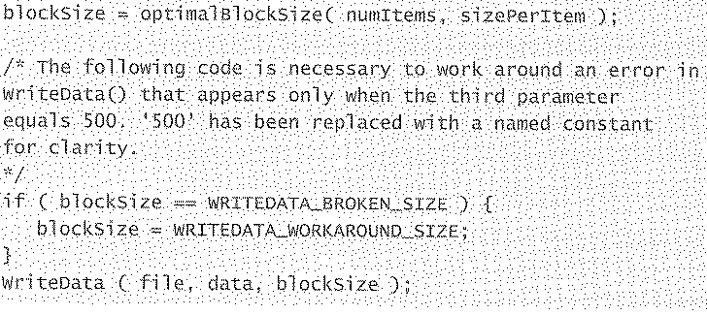
Documenting a Workaround for an Error
It would be better to fix the error, but for a temporary fix, this would do…

Slide 13
Don’t comment tricky code - Rewrite it!
// Very important note:
// The constructor for this class take a reference to a
// UiPublication. The UiPublication object MUST NOT
// BE DESTROYED before the DatabasePublication
// object. If it is, the DatabasePublication object will
// cause the program to die a horrible death.
While sometimes it is necessary to write clever code, it is often better to rewrite the code to avoid problems in maintenance
Q6
Notes:
Q6: While sometimes it is necessary to write clever code, what is a better strategy to avoid problems in maintenance?

Slide 14
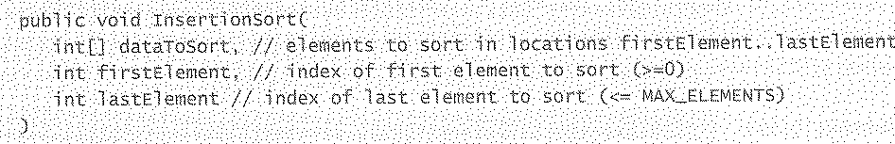
Document Input/Output where Declared

Slide 15
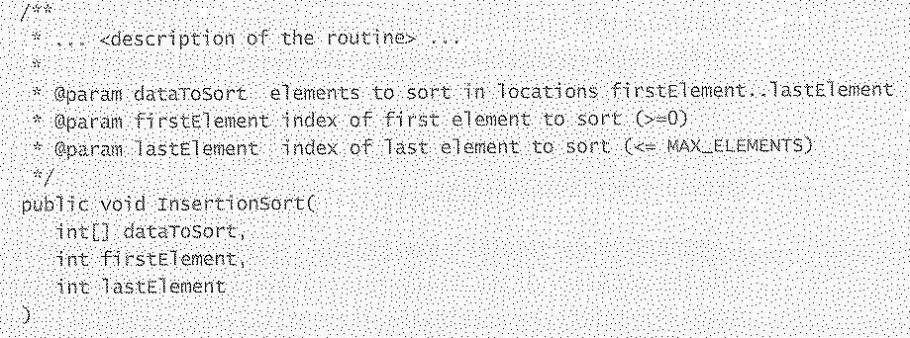
What about using something like JavaDoc?
Same as previous slide, but with JavaDoc
  JavaDoc parses the comments for specific elements to produce documentation…
Check out Doxygen: www.doxygen.org/
Q7
Notes:
Q7: What are a couple of examples of code-oriented documentation tools? [[Doxygen and JavaDoc]]

Slide 16
General Self-Documenting Guidelines
Ease of Maintenance – #1 Objective
Meaningful variable names
Comments only when needed
Extra variables used to clarify
Data types simple
Nominal path thru code is clear
Interfaces obvious
Refs to variables close together
Class name and interface says it all
  Purpose is clear
Q8
Notes:
Q8: True / False: Primary objective for Self-Documenting code is to make code easier to understand for maintenance.

Slide 17
Revisiting the Documentation Survey
Survey of software industry professionals
Highlights preferences for and aversions against software documentation tools
Participants agree that documentation tools should seek to better extract knowledge from software artifacts
2 Observations
  Some large-scale software projects had an abundance of documentation
  small to medium-scale software projects had little to no software documentation

Slide 18
What the 50 Questions Addressed?
Participant’s personal preference for different types of documentation, and their effectiveness
Ability of a document’s attributes, as opposed to its content, to promote (or hinder) effective communication
State of software documentation in the participant’s organization
Comparison of past projects to current ones
Effectiveness of documentation tools and technologies
Q9
Notes:
Q8: What key topics did the Documentation Survey paper address?

Slide 19
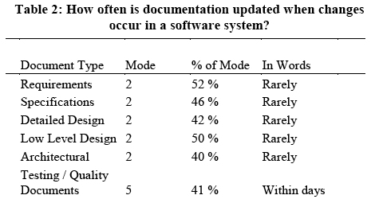
Are Documents Updated?

Slide 20
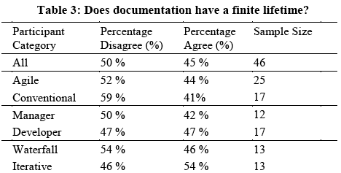
How long is Documentation Useful?

Slide 21
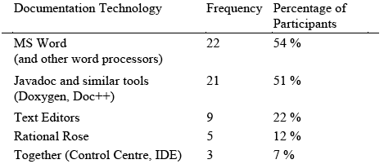
Documentation Technologies
Other tools included ArgoUML, Visio, FrameMaker, Author-IT, whiteboards and digital cameras, JUnit and XML editors

Slide 22
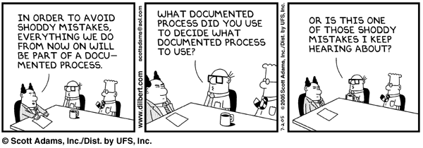
Maintenance Quality in Question

Slide 23


Documenting Maintenance

Slide 24
Additional Documentation Needed for Software Maintenance
Depends on Maintenance Process Used…
  Change Request Process
  Emergency
  Priority
  Release planning…
Software Maintenance Plan
Delta Vision Documents
Design Record
Q9
Notes:
Q9: What are some documents needed in maintenance beyond those typically produced in development?

Slide 25
Maintenance-Related Documents
Software Maintenance Plan
Maintenance Project Plan
  Maintenance project => a release…
Maintenance Oriented Guidelines/Manuals
Transition Plan
  From old way to new way…
Notes:
Software Maintenance Plan
How are you going to conduct maintenance of the software in your organization? Tasks? Releases? Roles, …
Maintenance Project Plan
Maintenance project => a release…
“This” release plan (and the next and the next…)
Software Manuals
Maintenance guidelines
Operations manuals/instructions
Installation instructions…
Transition Plan
From old way to new way…
We will talk about these in more detail in the rest of the course…

