Slide 1
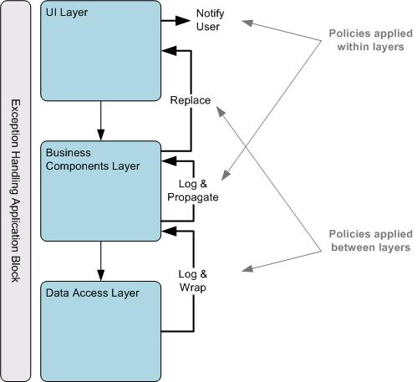
Software Construction and Evolution - CSSE 375 Exception Handling – Design
Below – Example of a basic set of policies for handling classes of errors. From http://www.computersplace.com/the-exception-handling-application-block-microsoft-enterprise-library-50/net
Steve Chenoweth
Office: Moench Room F220
Phone: (812) 877-8974 Email: chenowet@rose-hulman.edu
Notes:
This material is largely taken from Ch 6 of Robust Java: Exception Handling, Testing and Debugging, by Stephen Stelting. Prentice-Hall, 2005. ISBN 0-13-100852-8.

Slide 2
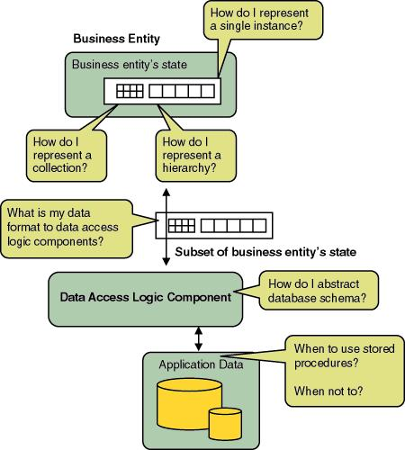
How do you make exception handling systematic?
We’ve been talking about programming techniques to handle exceptions.
But you have to step back to design, if you want to “add” better exception handling.
And, of course, this should have been done in the design phase!
Above – The design of exception handling should be a part of overall decision making about the system design. Here you see examples of key design decisions. From http://www.computersplace.com/the-exception-handling-application-block-microsoft-enterprise-library-50/net.
Q8
Notes:
So, choices are:
Handle exceptions as you encounter the need to do this.
Do a limited redesign when you need to add something more general, like logging.
Redesign the whole thing because you didn’t consider the “exception half” of the system!

Slide 3
Use DFMEA in designing this
DFMEA = Design Failure mode and Effect Analysis
Used by engineers in many fields
Steps:
Write down the functions your system does
Write down how each can fail
Write down risk (frequency) and severity of each
Identify causes of ones you care about!
Describe how each exception is detected
What’s in place to control this failure?
Use as a guide for how to address exceptions systematically
Q9
Notes:
See http://www.qualitytrainingportal.com/resources/fmea/fmea_10step_dfmea.htm for a systematic approach to DFMEA.

Slide 4
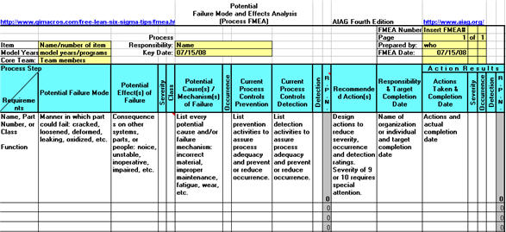
DFMEA Examples
A typical spreadsheet used for this:
Need to calculate “RPN” = “Risk Priority Number” = Severity x Occurrence x Detection. Each is on a 1-10 scale. “Detection” means ability of design controls to prevent or detect this kind of failure.
See “Sample DFMEA.xls” under Resources on the course website.
Q10
Notes:
Spreadsheet above is from http://www.qimacros.com/free-lean-six-sigma-tips/fmea.html.
Spreadsheet under Resources is from www.drivehq.com...
See also examples at:
http://www.fmeainfocentre.com/examples/xfmea_dfmea.pdf
http://www.qpatraining.com/free-resources/dfmea-steps.html

Slide 5
For software…
Every sequence of business actions (every use case) can be described in terms of likely failure scenarios.
These you can rate, as in DFMEA
In the associated software, there are “failure points” related to these possible business events
Two general approaches to each one:
How to prevent it from occurring
How to handle it if it occurs
Q11
Notes:
You have to decide which of those two to do!

Slide 6
Guidelines for exception design
Don’t try to handle everything
Use something like DFMEA to pick the big ones
Have an overall goal, like
“How reliable overall?” or
“What’s the cost of errors to the business?”
Broadcast errors only when more universal awareness is needed (like “throwing”)
Put all exceptions in terms that can be understood
Handle at the time exceptions occur (which is an issue if you only long them)
Design for “how the exception affects this object’s contract with the outside world”

