Slide 1
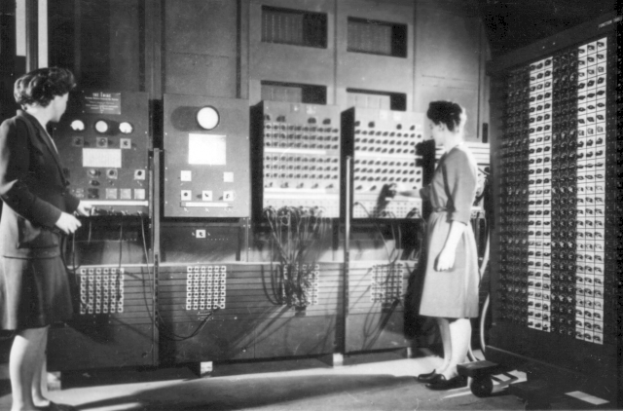
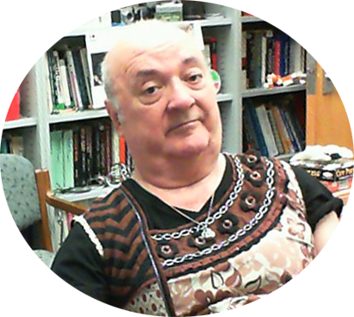
Software Construction and Evolution - CSSE 375 Exception Handling - Principles
Steve Chenoweth, RHIT
Above – Exception handling on the ENIAC. From http://en.wikipedia.org/wiki/File:Two_women_operating_ENIAC.gif.
Left – Our whole software field is about generating novelty. Once you discover everyone follows some rule, it’s almost immediately time to discover what happens if you break that. Here, clothes are supposed to be symmetrical, left vs right. So, how about if they are not?
Notes:
I’m using as a reference for this material, Robust Java: Exception Handling, Testing and Debugging, by Stephen Stelting. Prentice-Hall, 2005. ISBN 0-13-100852-8.

Slide 2
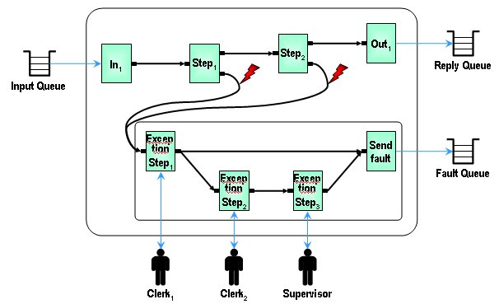
What is it?
A problem
The detection of that problem
A message showing we detected the problem
Ways to resolve, log, or otherwise act on the problem
Ways to make your system more robust
Ways to make it more like a product than a project
Above – Our software exception handling methods mimic sequences we can picture occurring, often taken from situations where humans would be performing those steps. From http://www.ibm.com/developerworks/websphere/library/techarticles/wasid/WPC_Concepts/WPC_Concepts.html.
Q1
Notes:
Heuristic for production systems – “50% of the code is error handling.”

Slide 3
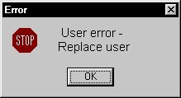
A perfect example - GUIs
Users do things that cause problems
For some, there’s an action of
Notifying the user
Asking them to fix the problem
Rechecking to see if they did
Users expect some level of help like this
Clients - ditto
IndividualHW1, due next class Thursday,
is all about controlling GUI’s!
Q2
Notes:
Image from http://officespam.chattablogs.com/archives/2006/09/computer-messages.html

Slide 4
Another example – input from other systems
In pipes-and-filters systems, many steps are essentially checking for errors
Q3
http://www.eaipatterns.com/PipesAndFilters.html

Slide 5
Languages have support for this
System.out.print("Enter your name: ");
// open up standard input
BufferedReader br = new BufferedReader(new InputStreamReader(System.in));
String userName = null;
// read the username from the command-line; need to use try/catch with the
// readLine() method
try {
userName = br.readLine();
} catch (IOException ioe) {
System.out.println("IO error trying to read your name!");
System.exit(1);
}
System.out.println("Thanks for the name, " + userName);
Notes:
We’ll be using Java examples

Slide 6
You need a design for each exception!
E.g. –
public void connect(String server, int port)
throws java.io.IOException
What error sequence is appropriate for the calling class to do?
Q4

Slide 7
Standard options are used!
Log the exception or relevant info
Ask the user or application for input
Use default values or alternate data
Forward control to some other part of the app
Convert the exception to another form
Ignore the problem
Retry the action
Take an alternate or recovery action
Prepare the system for shutdown
A preview of “Defensive programming” coming up!
Notes:
For logging, you can create a separate logging class to log errors, or use an API provided by the language, like the Java Logging API.

Slide 8
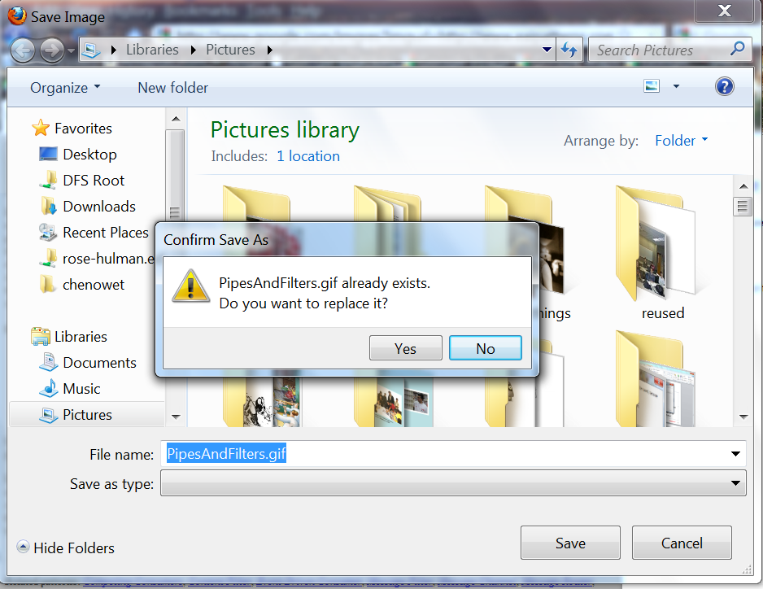
Asking the user for input
Assumes you have a “user” who can do this!
Typical sequence –
Detect the error
In the error routine –
Give the user choices or let them type a choice
Retry the action
Have a “way out” if they give up
Variation – give the user a chance to avoid a likely error!
Q5

Slide 9
Forwarding control
Pretty commonly done – like “throwing” exceptions in Java, to the calling class
Exceptions often are detected at a lower level, but only the higher-level app really knows what to do
Like in the connection example, on Slide 6
We’ll see the ins and outs of this, shortly…

Slide 10
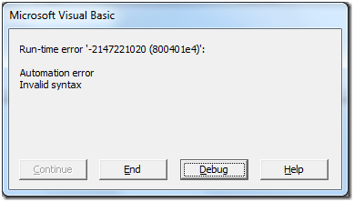
Exception handling rules
“Catch it if you can”
Handle specifically, but systematically
Log anything that makes sense to log
Convert to a “business context”
Q6
Notes:
Cryptic example from http://www.codeguru.com/csharp/.net/net_wcf/article.php/c18455__5/Using-the-WCF-Service-Moniker-to-Communicate-Between-Legacy-COM-Apps-and-New-NET-Framework-Apps.htm

Slide 11
And…
Systematically analyze possible errors
Analysis should include “errors that we could avoid in the first place”
Rate the risk of not dealing with these, vs the cost of handling them
Write down your analysis!
Don’t ignore them and let the run time blow up as a result, etc.
Don’t assume “they’ll never happen”
Q7

Slide 12
What’s the buggiest code?
It’s the error handling code!
Why?
Because it’s tested less than other code.
How to improve on that situation:
Write complete error-handling test cases.
Trace what’s tested in the code, using a coverage tool.
Target backup and recovery code for the most testing!
Q8

Slide 13
The article you read
What’s good about try / catch?
Keeps exceptions out of the main line of logic.
Makes what’s “supposed to happen” easier to read.
What’s good about “throwing” exceptions?
Sends them up to caller, if appropriate.
Caller may better know what to do!
May be able to consolidate actions there, providing consistency:
Like what to do if a file doesn’t open.
What to do if a user enters a field incorrectly.
How to handle missing DB data, in this case, using a common DB handler

Slide 14
But…
What’s bad about try/catch?
The error code goes off to a different place.
What if it needs to rejoin the main line of code, say, to repeat what caused the error?
What’s bad about “throwing” exceptions?
Programmers “throw” exceptions just because they don’t want to deal with them, and
The calling routine has no idea what the errors mean!
And they handle them in all kinds of incongruous ways.
Q9 – 11
Notes:
Questions 9 – 11 are from the reading!

Slide 15
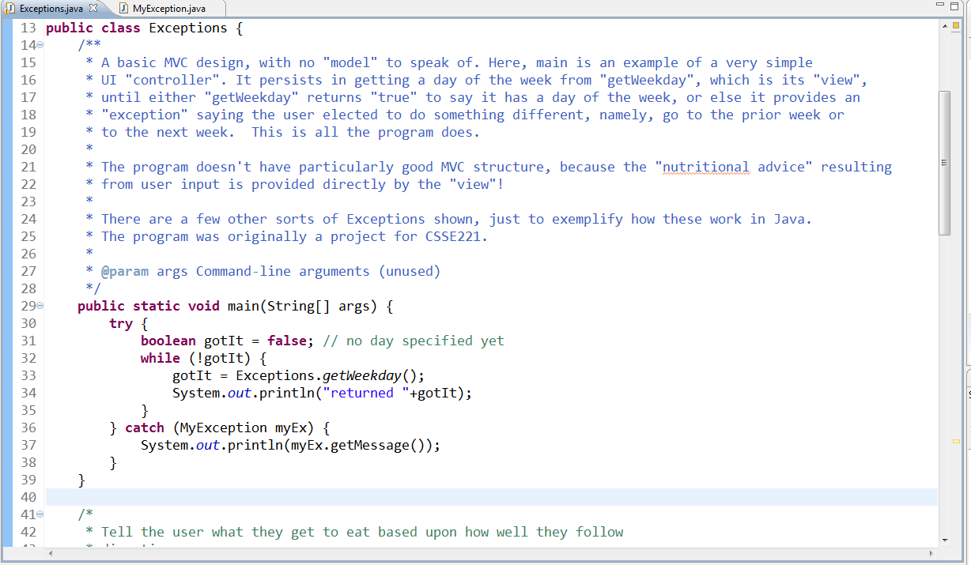
Program you looked at… Console UI
Keep trying till you get what you want!
User overrides the usual inputs.

Slide 16
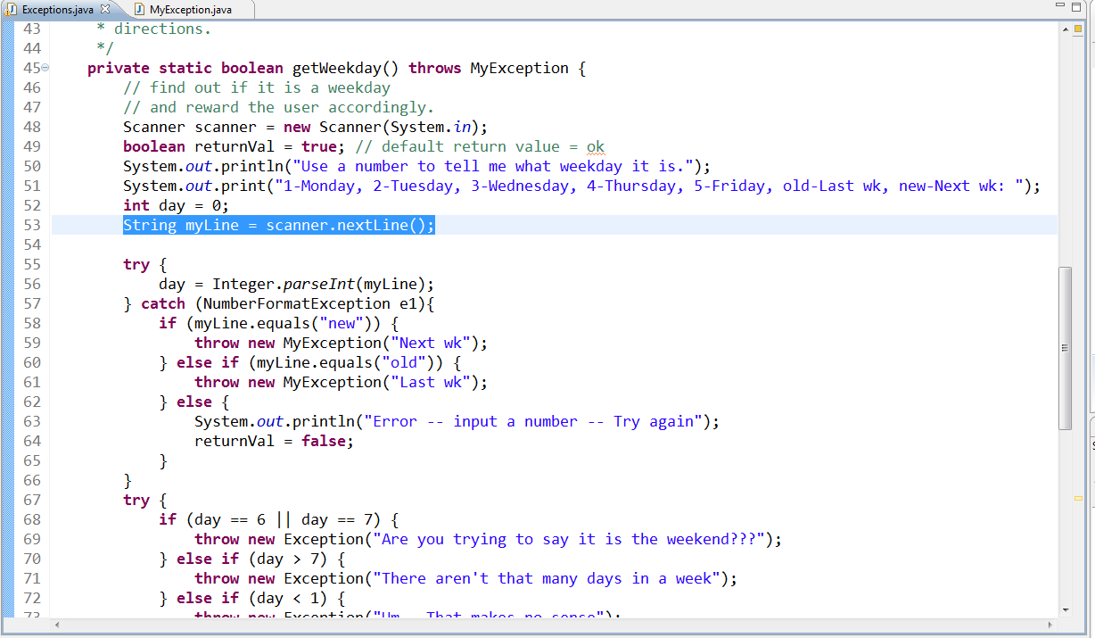
How the user overrides are created…
We created our own type of exception, which was “thrown” to main.
Note one line of input here, many lines of error checking!

Slide 17
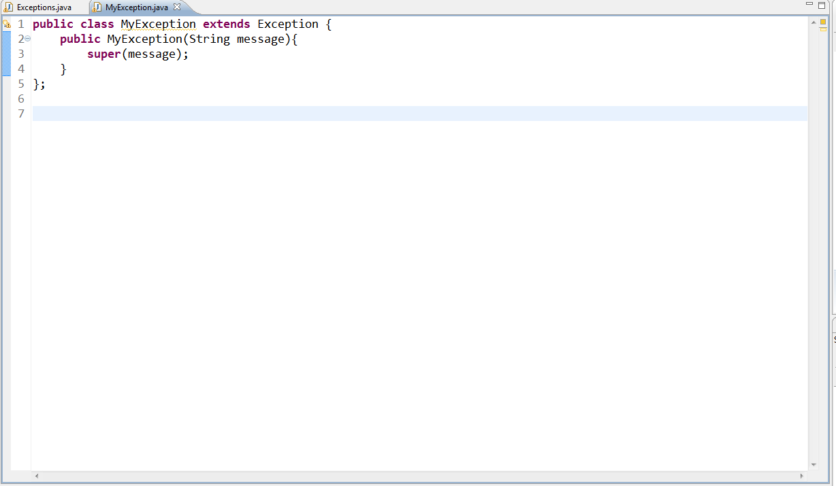
Here’s how we made the exception…
We could have “featured-up” this class!

