Slide 1
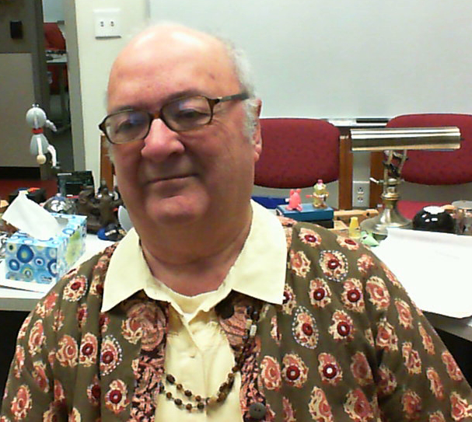
CSSE 375 – Software Construction & Evolution Problems with Changing Software - 1
Below – One response to the need for change – denial! Whether you agree with the cartoon George W Bush here, or with the majority view, it’s certainly true that change is uncomfortable, and we often seek ways to resist change even when it’s needed. From http://www.globalchangeblog.com/2009/11/why-dont-people-engage-climate-change-part-5-a-perfect-storm-of-climate-change-denial/.
Steve Chenoweth
RHIT
Left – The coat is Indian. Rosie, also probably Indian, appears interested in my own large ears, which usually specialize in listening to Rose students.
Notes:
The only way to make metrics interesting is to imagine you are the one making decisions about the product…
Remember that SW Maintenance is the large part of software expenditure and you need to optimize that!

Slide 2
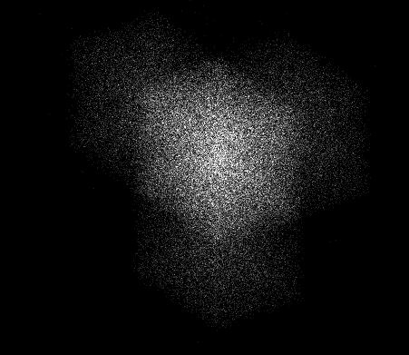
Almost all software does have to change…
Software Changes and Entropy Results
Ripple-Effects of Software Changes
Changes on Changes
Hydra-Effect…
What are some specific problems that occur?
What strategies work for each of them?
Above - Symbol for Creative Entropy, a company who build iPhone and iPod apps. From http://www.creativeentropy.com/
Q1

Slide 3
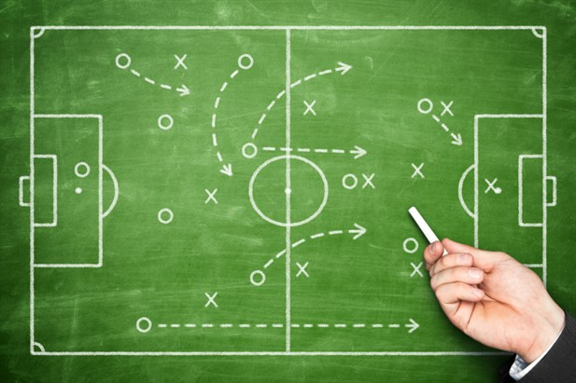
Feathers’ Change Tactics
Ch 6 – 23 – Lots of these tactics for different situations.
Today, we’ll talk about Ch 6 and parts of Ch 7, and 8 as examples.
Then, here’s where you score a goal!
Notes:
Image of football tactics from http://forum.ea.com/uk/posts/list/2659213.page.
Er, soccer.

Slide 4
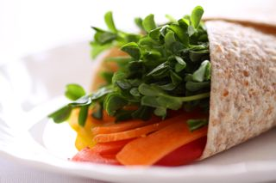
Ch 6 – Making fast changes
Ch 6
→ While also reducing the risk of introducing errors with these …
Sprout methods and classes
Wrap methods and classes
Right - Perfect implementation of this Chapter? – a wrap with sprouts.

Slide 5
Sprouting Methods - start
Ch 6
Given this code:
→ And a new “feature” goal -- to verify that none of the new entries are already in transactionBundle …
Q2
Notes:
A typical “small enhancement” that seems closely related to this method in this class.

Slide 6
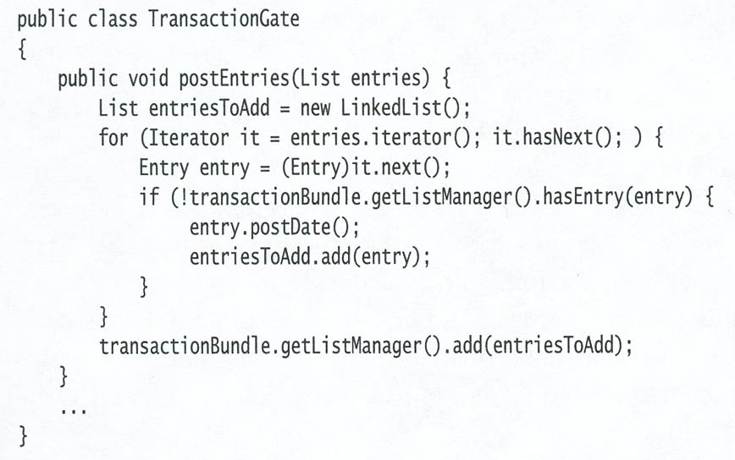
Sprouting methods – “what to avoid”
Ch 6
How would many people try to add this?
Q3
Notes:
The natural inclination is to use “temporal coupling” – because the new code and old code are run at the same time. Typically a bad idea, as you add more and more features to a system!

Slide 7
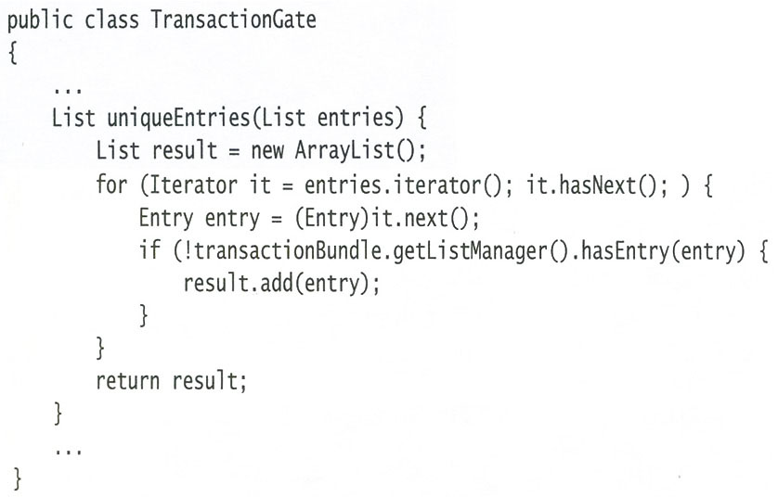
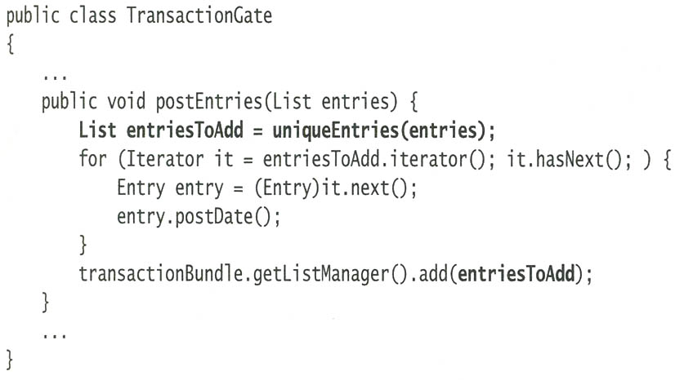
Sprouting methods – a better idea
Ch 6
Here we create a new method, just to handle the new “feature.”
Only an additional call line to it is needed in the existing method.
Notes:
See Ch 6 for the similar “sprouting classes” technique.

Slide 8
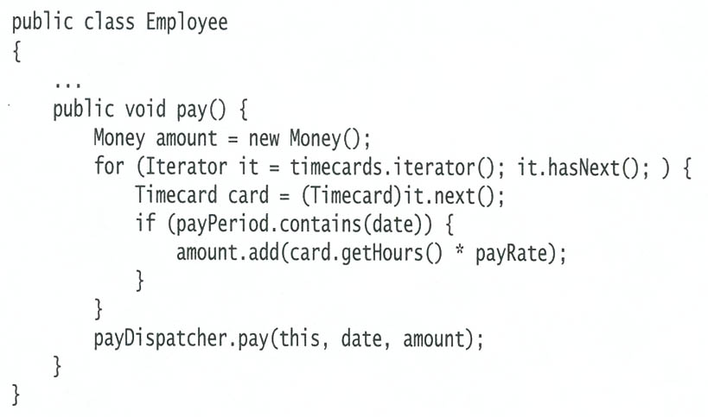
Wrapping methods - start
Ch 6
Existing method adds up daily timecards for an employee and then sends their payment information to a PayDispatcher.
Need to add a new “feature”: To update a file with the employee’s name so that it can be sent off to some reporting software.
Existing
code:
Q4

Slide 9
Wrapping methods - solution
Ch 6
Existing code is now “wrapped”:
Q5
Notes:
The book has a similar example of wrapping classes.

Slide 10
Ch 7 – Speeding-up changes
Ch 7
As systems evolve, it takes longer and longer to understand how to make the next change.
But, once you find where to make a change, it should not necessarily grow increasingly complex to decide how to make the change.
This Ch is about how to optimize this second part of making a change…
Q6
Notes:
Image from http://itsfoss.com/best-practices-to-speed-up-ubuntu/speed-up-computer-ubuntu-windows/

Slide 11
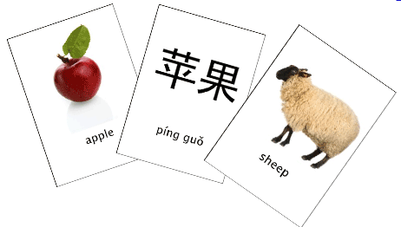
The role of lag time
Ch 7
It slows you down if there’s a delay in seeing if your fix works or not.
Feathers’ goal – See if you get feedback that your change worked in less than 10 seconds!*
Psychologically, under 2 seconds would be ideal!
Think learning vocabulary from flash cards…
*Recall that earlier Feathers said each unit test should run in under 1/10th of a second.
Right – Mandarin Chinese flash cards. From http://www.semanda.com/.
Notes:
The 2 second number is what I recall from experimental psych classes (reinforcement latency). Need to verify that.

Slide 12
How to organize code for builds
Ch 7
Goal – make a cluster of classes build more quickly…
How to minimize what has to be rebuilt every time you recompile…
Typical trick – Extract interfaces for the classes in your cluster that are used by classes outside the cluster:
Replace references to a class with references to its interface.
Section-off the cluster to a new package or library for testing.
Q7

Slide 13
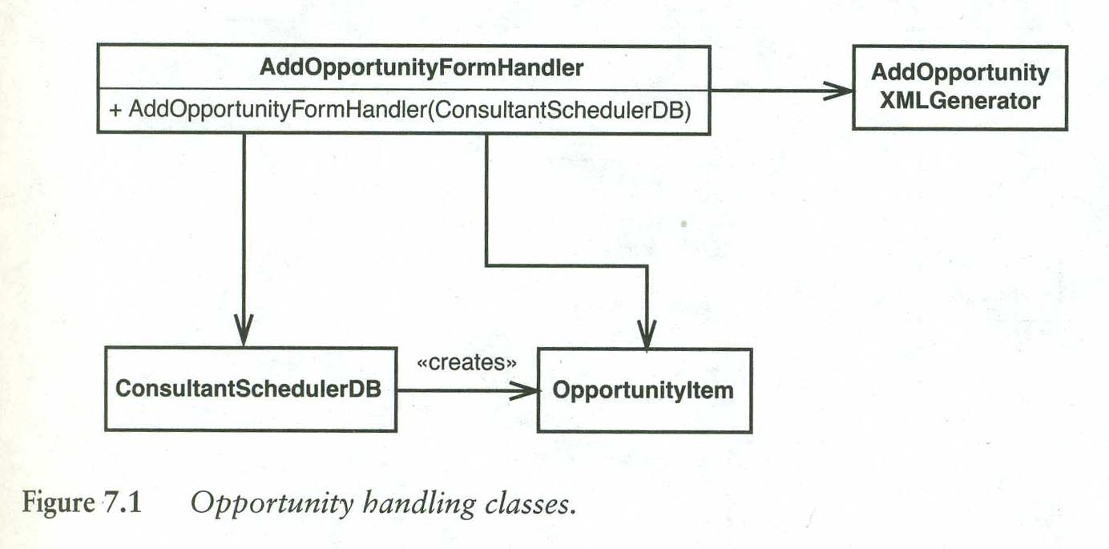
An example to speed-up
Ch 7
We need to make some changes to one of these classes, AddOpportunityFormHandler, and
We’d like to make the build go faster, too.

Slide 14
But…
Ch 7
All the classes that AddOpportunityFormHandler depends on are concrete!
And both ConsultantSchedulerDB and also AddOpportunityXMLGenerator could depend on other classes that aren’t in the diagram.
We first consider how to avoid ConsultantSchedulerDB, which is a parameter required for the AddOpportunityFormHandler’s constructor.
Q8

Slide 15
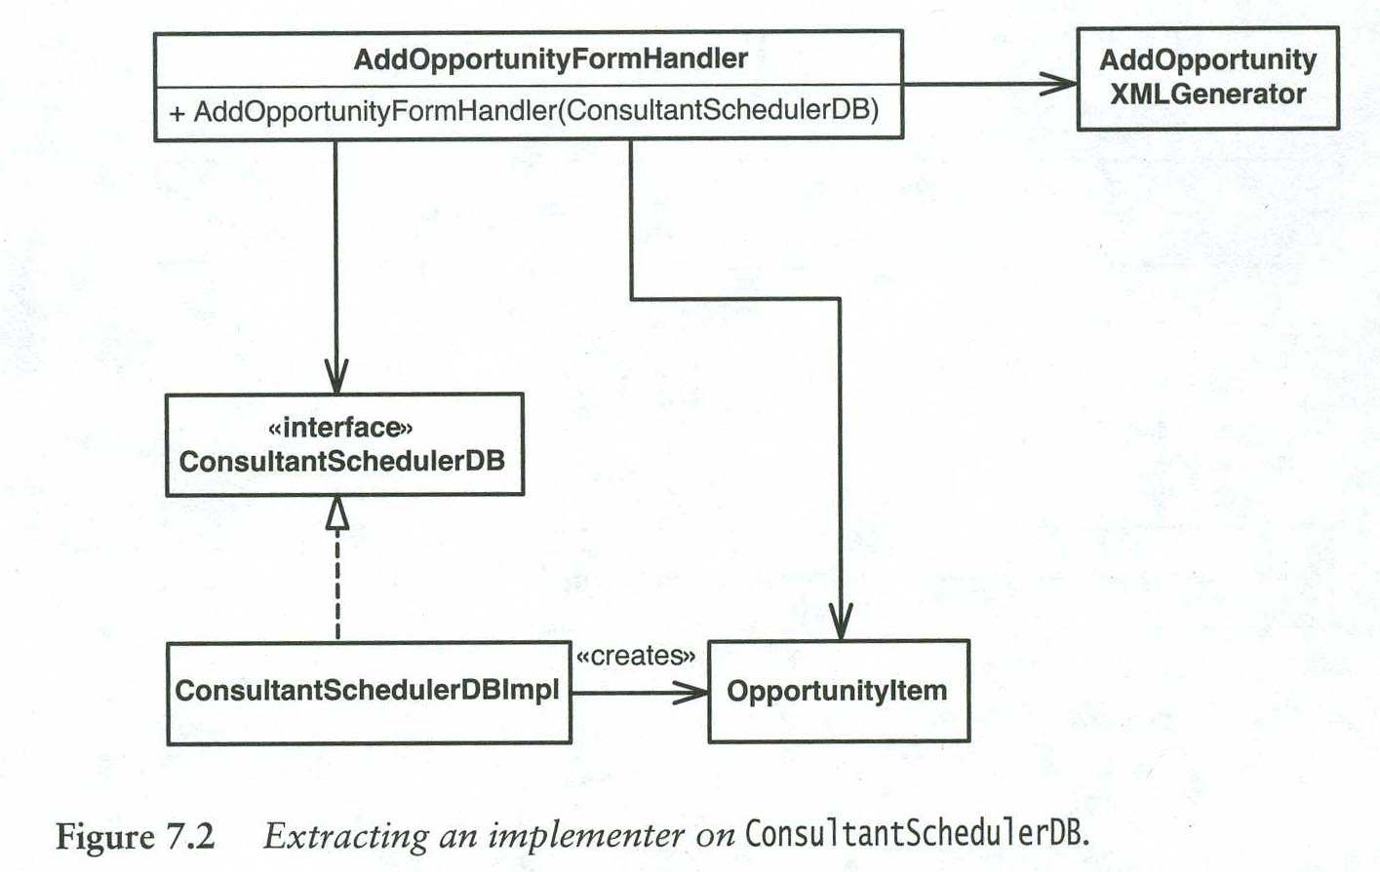
Replace the DB class with an interface
Ch 7
This also can make the build faster, because changes to that interface don’t require recompiling AddOpportunityFormHandler (we have a layer of indirection between these).

Slide 16
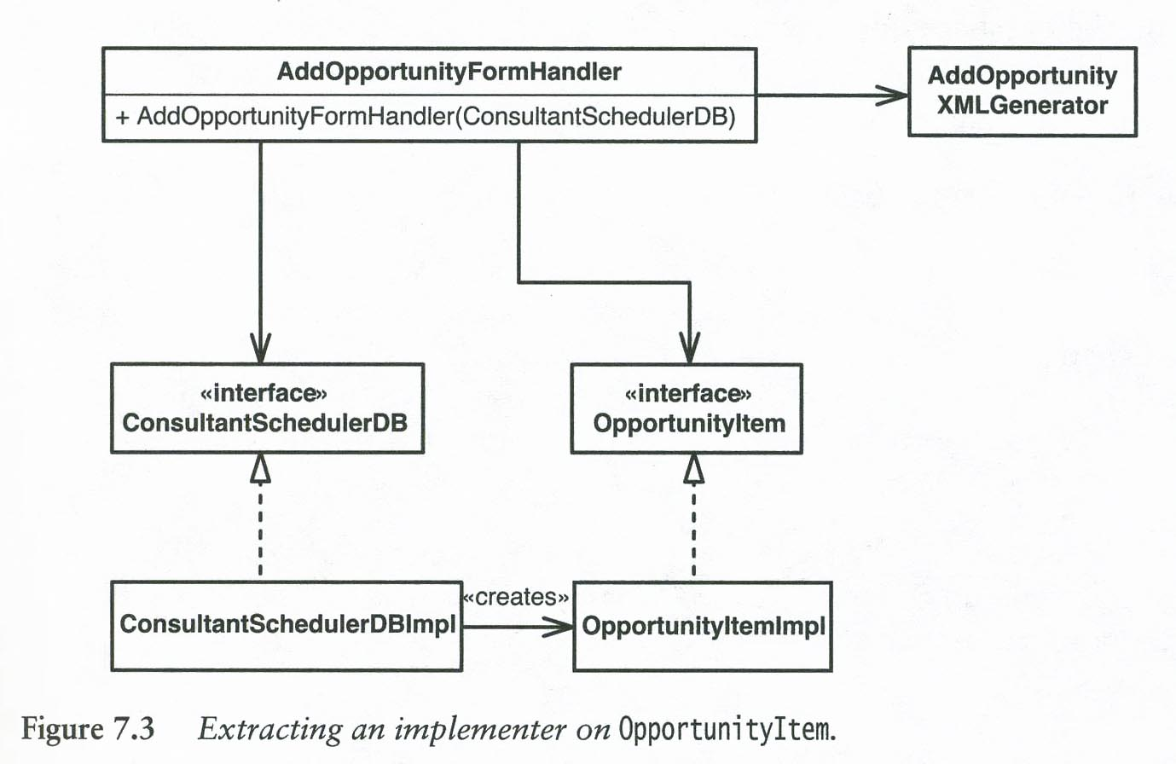
We can do this again…
Ch 7
With the OpportunityItem that’s created by the ConsultantSchedulerDB:
Q9
Notes:
This puts a “compilation firewall” in the code, between what we’re changing and the DB-related classes.
Adding to OpportunityItemImpl doesn’t require recompiling the rest of this cluster, in general.

Slide 17
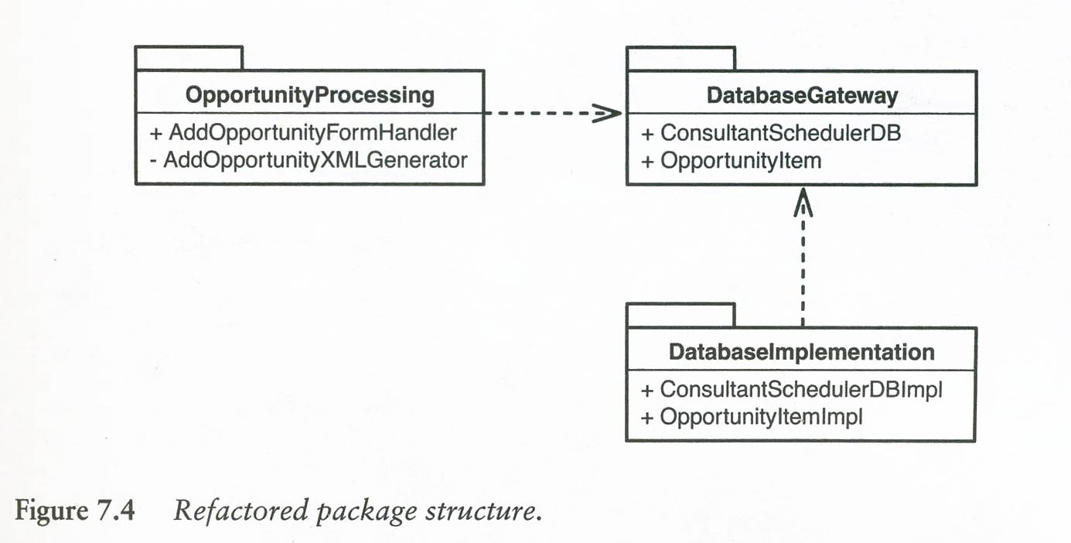
We could show this via packages
Ch 7
Break up the cluster to show recompilation gains:

Slide 18
Advantages
Ch 7
We have a package, OpportunityProcessing, that has no dependencies on the database implementation (just on the interfaces to it).
This is an application of the Dependency Inversion Principle:
When your code depends on an interface, dependency is usually very minor.
Your code doesn’t have to change unless the interface changes.
Notes:
See p. 84.

Slide 19
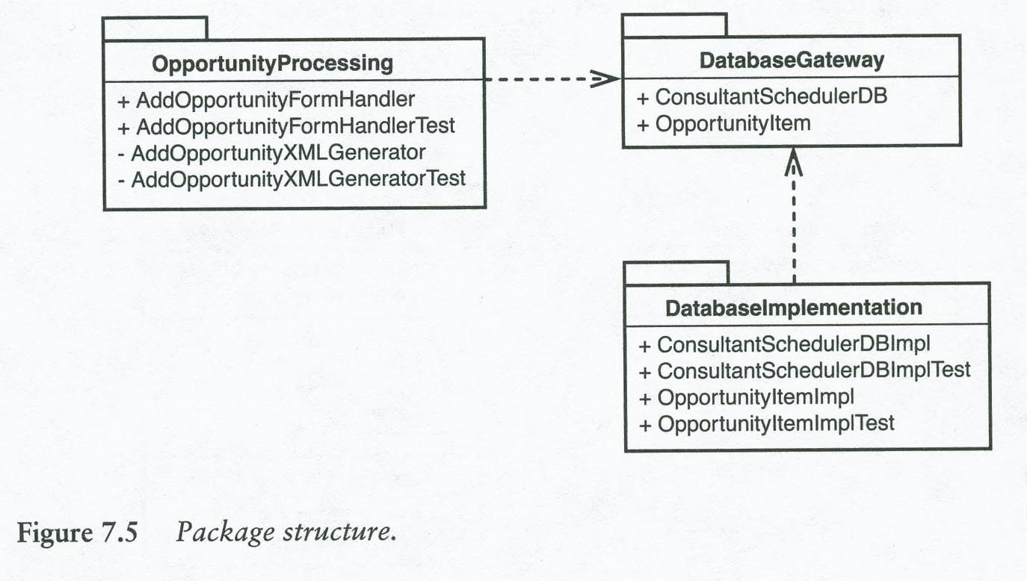
We also can reduce the reverse dependencies
Ch 7
So that we make the builds faster for code that depends on our class, AddOpportunityFormHandler, by creating interfaces also from them back to it:
Q10

Slide 20
Feathers’ conclusion
Ch 7
When you introduce more interfaces and packages into your design to break dependencies,
The amount of time it takes to rebuild the entire system goes up slightly. There are more files to compile. But,
The average time for a make, a build based on what needs to be recompiled, can go down dramatically.

Slide 21
Ch 8 – How to add a feature
Ch 8
Alternatives beyond sprouting and wrapping…
If you keep the old code, it doesn’t get better!
Need to get tests in place to speed development.
Feathers’ formula for TDD includes, as a last step –
Remove duplication:
The first try at new code often includes things borrowed from elsewhere.
Do we keep these, or combine them? Etc.
Notes:
TDD = Test-driven development.
It isn’t necessarily tied to OO. See p. 94.

Slide 22
Programming by difference
Ch 8
Say we’ve tested Java class MessageForwarder, which has method getFromAddress:
private InternetAddress getFromAddress(Message message)
throws MessageException{
Address [] from = message.getFrom ();
if (from != null && from.length > 0)
return new InternetAddress (from [0].toString ());
return new InternetAddress (getDefaultFrom());
This code strips-out the “from” of a received message so it can be used as the “from” in the forwarded message to list recipients.
Used in just one place in current code.
Notes:
pp. 94+
On p. 94, Feathers calls this MessageForwarder class MailForwarder – probably a typo.

Slide 23
New requirement…
Ch 8
Suppose we now need to support anonymous mailing lists.
We think we can use almost the same MessageForwarder class – so we subclass it, and use it for the new service:
MessageForwarder forwarder = new
AnonymousMessageForwarder();
With the only difference in the subclass being its getFromAddress(Message) class (vs. the last slide).
Q11

Slide 24
And the new method is…
Ch 8
Almost the same…
protected InternetAddress getFromAddress(Message message)
throws MessageException{
String anonymousAddress = “anon-” + listAddress;
return new InternetAddress (anonymousAddress);
The getFromAddress(Message) in the original MessageForwarder would also now be protected vs private.

Slide 25
This subclassing is a quick change
Ch 8
Gets code running fast
So long as the change isn’t part of a big tree of alternatives, in which case it may multiply the size of a family of classes!
For that situation, Feathers suggests parameters
Read from a file, or
From a separate class of their own, that’s just there to return parameter-dependent values
Q12

Slide 26
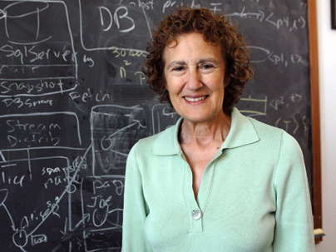
This kind of subclassing breaks the LSP
Ch 8
Each subclass overrides the original behavior of what’s now a parent class.
Alternatively, need a more general parent class, have the children differ where they need to.
Notes:
LSP = Liskov substitution principle
Image of Dr. Liskov from http://www.thenewagenda.net/2009/03/12/dr-barbara-liskov-awarded-nobel-prize-of-computing/.

