Slide 1
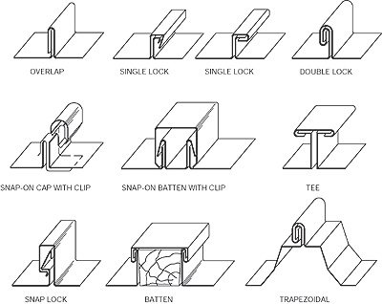
The “SEAM” Model
Feathers, Ch 4 - 5
Steve Chenoweth
Office Phone: (812) 877-8974
Cell: (937) 657-3885 Email: chenowet@rose-hulman.edu
Above – There are actually lots of kinds of “seams” – ask an ME!
Notes:
The book is about how to do maintenance efficiently and effectively. “Seams” are the key.
Image from http://www.nrca.net/roofing/Metal-roof-systems-for-steep-slope-applications-901.

Slide 2
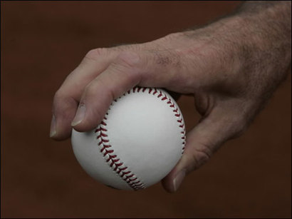
The Seam Model
A basic skill in software maintenance – figuring out effective ways to test it.
Unit and integration testing
There are several ways in which a method, say, tends to resist testing.
The Seam Model gives a systematic way around those problems.
Above – Seams in action – From Steven Ellis’s site on how to throw a fastball. http://www.stevenellis.com/steven_ellis_the_complete/2007/06/how_to_throw_a_.html.
Notes:
This is all in Ch 4 of Feathers.

Slide 3
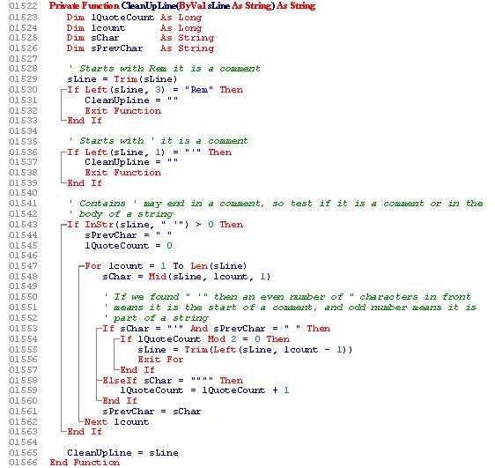
A huge sheet of text
When you start looking at code you aren’t already familiar with, this is what it is!
The goal is to find interesting places to study in depth
Analyze for possible problems
Try making changes
But if the code can’t be unit tested easily, how can you actually run it and see what it does?
Above – source code that played a role in a Minnesota court case over the legitimacy of breath test results. What does it do? http://www.mndwidefenseblog.com/2009/05/articles/source-code/court-of-appeals-rips-the-lid-off-dwi-intoxilyzer-source-code-issue/
Q1
Notes:
Making changes or fixing bugs in this “huge sheet of text” requires being able to test parts of it, to see what they do. But…

Slide 4
A “Seam” Example
Feathers shows a method in C++, which could be run in a unit test, except for the line –
PostReceiveError(SOCKETCALLBACK, SSL_FAILURE); which calls a tricky-to-include-in-testing external function.
What are the options here – without changing any of the lines in this method itself?
Q2
Notes:
This problem can occur, whether we use automated testing or not.

Slide 5
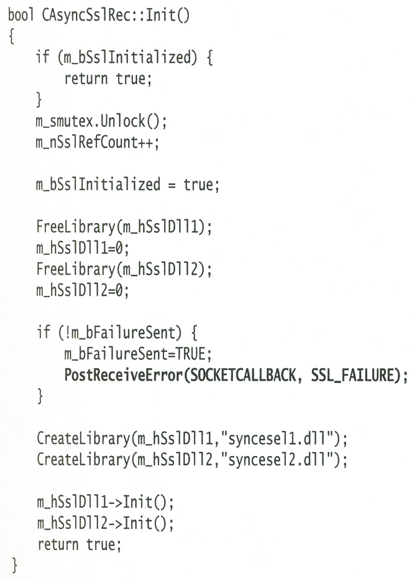
The rest of the method would be much easier to set up NUnit style unit tests for, except this one line!

Slide 6
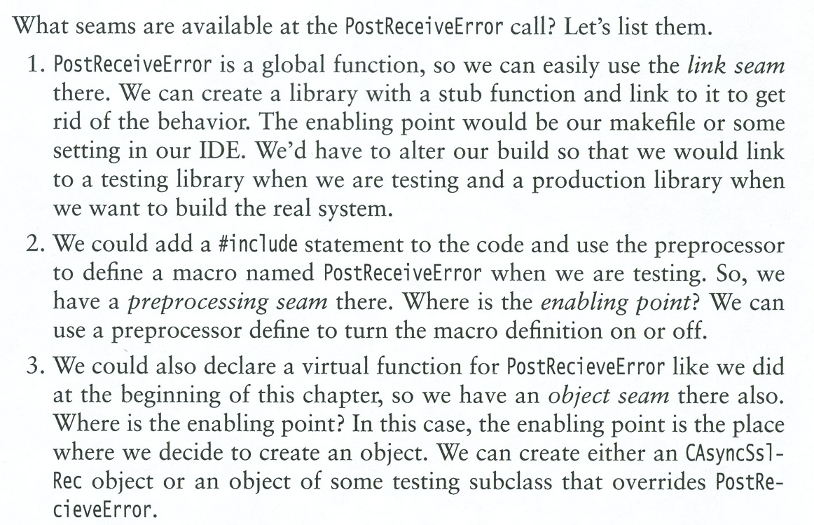
Q3

Slide 7
“Seam” Options, in summary
Postprocessing: We can change, for testing, what external code gets linked here.
Preprocessing: This happens to be C++ code, and so you could do some “#” macro that changes what happens in the call.
Object substitution: We can make objects for testing, like a subclass that overrides what gets called here.
Notes:
The first option isn’t so available in languages like Java.
But – the second one is – by controlling what libraries the compiler sees, and therefore invokes.

Slide 8
“Seam” Goal 1 – Unit Testing
Find a way to alter the behavior of some code, without changing the code itself.
For testing - Usually applied to code that causes trouble if run as intended, like for unit testing. Examples:
Communications calls
Database calls
GUI calls
This gives you “test” versions of your software, which are easier to run without messing with these external entities.
Q4
Notes:
You want the “test” versions to be easy to switch in and out of, and also to be clearly distinguishable from the “real” versions of your software – to avoid delivering “Easter eggs”!

Slide 9
“Seam” Goal 2 – Enhancements
Find a way to enhance the behavior of some code, without changing the code itself.
For adding features - Usually applied to code that you want to “do more” without altering this class or method.
This gives you easy ways to make enhancements, without adding bugs into the existing code.
Q5
Notes:
We’ll see examples in the next slides, from Ch 6, among other places.

Slide 10
These are key strategies!
If you can find ways to do these things systematically with your code, it means:
More timely testing
Easier ways to guess difficulty in changing and enhancing the code
Understanding what’s easy and hard, in terms of choices for how to change it

Slide 11
The SEAM model extends…
OCP - The “Open-closed principle” of OO:
Software entities (classes, modules, functions, etc.) should be Open for extension, but Closed for modification.
Question Feathers asks - Can we apply this principle to extending these entities for testing?
Put another way – If we have to alter the code substantially to do anything like a unit test, we’re on a slow boat to China!
Goal – “Change the code without changing the code!
Q6
Notes:
See 1996 article on this by Bob Martin at http://www.objectmentor.com/resources/publishedArticles.html.
Boat picture from http://www.bankruptcylitigationblog.com/archives/bankruptcy-in-the-news-out-of-the-fray-onto-the-slow-boat-to-china-putting-the-brakes-on-the-gm-bankruptcy-appeal.html.
Feathers discusses this principle on p. 287.

Slide 12
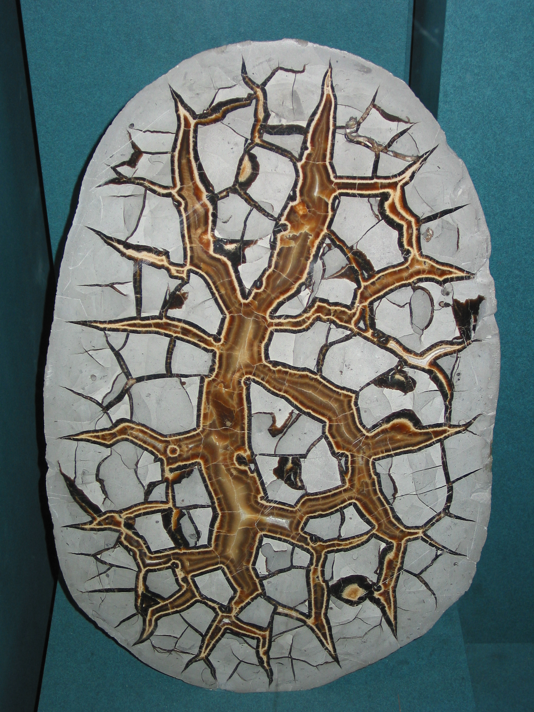
And the SEAM model uses…
DIP The “Dependency Inversion Principle” of OO:
Depend upon abstractions. Do not depend upon concretions.
We should couple at the abstract level, not at the concrete level.
E.g., try not to refer to concrete classes directly
In this case, is there a way that the test versions and the production versions of the code can be based on an abstract version of both?
We’ll discuss DIP some more in the next slide set.
Above – Yes, “concretion” is a word! Here’s one now.
Notes:
See for example, http://theknowledge.me.uk/mywiki/concepts/dependency-inversion-principle.html.
Feathers discusses this principle on p. 84.
Image from http://en.wikipedia.org/wiki/Concretion.

Slide 13
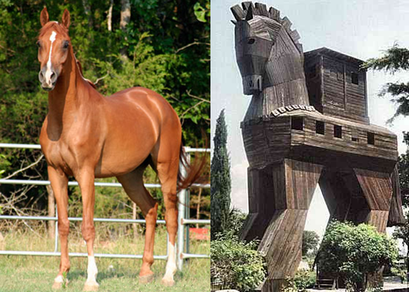
And has a lot to do with…
LSP – The “Liskov substitution principle”:
Let q(x) be a property provable about objects x of type T. Then q(y) should be provable for objects y of type S where S is a subtype of T.
I.e., subtypes don’t alter any of the desirable properties of their parents!
Notes:
This is from 574 – see Larman’s book for more info.
Image from http://aleris.wordpress.com/2009/06/14/understanding-liskov-substitution-principle/.
Feathers discusses this principle on p. 101.

Slide 14
Lots of tools work with “seams”
Automated refactoring tools
Mock objects
Unit test harnesses
Junit, etc.
General test harnesses
Framework for Integrated Tests (FIT), etc.
Notes:
These are described in Feathers’ Ch 5.

