Slide 1
Legacy Code
Right – Your basic Legacy, from Subaru, starting at $ 20,295, 24 city, 32 highway.
From Feathers, Ch 2
Steve Chenoweth, RHIT
Notes:
Image from http://www.berteramotors.com/2014-subaru-legacy-in-ct.htm.

Slide 2
We’re into Feathers now
Below – The new book we’ll be using for the next lectures. Above – Feathers.

Slide 3
We ended Fowler with “Big refactorings”
This is where we’ll start in Feathers
Fowler’s is a book to get started learning about good coding and maintenance practices.
Feathers’ book is a “practitioner’s standard” book.
More advanced, “real life”
Covers a lot of special cases
Q1

Slide 4
Two ways to change systems
Edit and proxy:
The industry standard
But not good!
You carefully plan the changes to make.
Make sure you understand the code to change.
Start making the changes.
When done, run the system to see if the change was enabled.
Poke around further to be sure nothing broke.
Seems like “working with care,” huh!
Q2

Slide 5
And…
Cover and modify:
A better “tool set” for making changes.
Work with a safety net.
Put a cloak over the code.
That’s tests.
Can make very sure if changes are good or bad.
Bad changes don’t leak out.
Q3

Slide 6
Need unit tests!
Find out fast if things worked.
Don’t wait long to see what worked.
What’s the ideal “feedback time” for humans?
Ideally, testing works like a slot machine!
Long loops to hear testing results – bad.
Q4
Notes:
Image from http://godplaysdice.wordpress.com/2010/06/07/the-secret-life-of-slot-machines/

Slide 7
We want…
Testing to detect changes, not
Testing to attempt to show correctness.
Definition of “regression testing.”
Have tests around the areas you’ll be changing:
A “software vice” around your changes.
Notes:
Image from http://www.baconsrebellion.com/2011/01/vice-tightens.html/.

Slide 8
Regression testing
Needs to be “white box,” too.
On everything, not just on GUI / whole app.
Can’t be uncertain about what caused a failure.
“What broke the build?”
We need to do this at the Unit Test level, for our refactoring.
Need to add tests with every change.
Q5

Slide 9
Remember unit tests from 376
A Unit Test is a piece of code (usually a method) that invokes another piece of code and checks the correctness and assumptions afterward. If the assumptions turn out to be wrong, the unit test has failed.

Slide 10
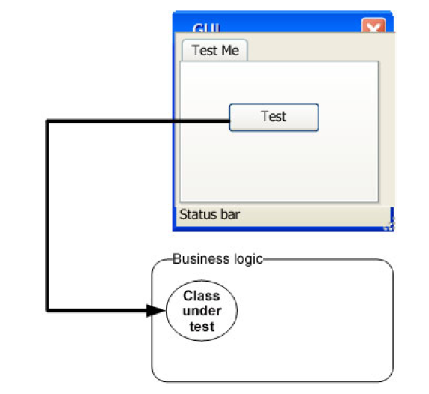
A Method of Testing
Notes:
Most people who try to unit test their code, either give up at some point or don’t actually perform unit tests. Instead they either rely on system and integration tests to be performed much later in the product life cycle or they resort to manually testing their code via custom test applications or by using the end product they are developing to invoke their code.
To write a good unit test, we need to understand the properties of a good unit test. To get there, we need to take a look at how people test their software in general. We all have written tests before. Hopefully, we all test our code before turning it in/releasing it to the general public. You might have used a console application that called the various methods of a class or component or perhaps some specially created code that check the functionality of the code, by manually running the tests. You may have also used the applications real UI to test your code.

Slide 11
Why not use the current technique?
This is, namely, operating the user interface to see if things still work.
Problems with it:
Traceability
Running prior tests
Legacy Code
Notes:
The way most developers test their functionality is through the final functionality of the user interface. Clicking some button triggers a series of events—various classes and components working together to produce the final result. If the test fails, all of these software components fail as a team, and it can be difficult to figure out what caused the failure of the overall operation.
Can I run and get results from the test I wrote two weeks or months or years ago?
If you can’t do that, how would you know whether you broke a feature that you created two weeks ago? Code changes regularly during the life of an application, and if you can’t (or won’t) run tests for all the previous working features after changing your code, you just might break it without knowing - “accidental bugging,” and it seems to occur a lot near the end of a software project, when developers are under pressure to fix existing bugs. Sometimes they introduce new bugs inadvertently as they solve the old ones. Wouldn’t it
be great to know that you broke something within three minutes of breaking it?
Can any member of my team run and get the results from tests I wrote two months ago?
This goes with the last point but takes it up a notch. You want to make sure that you don’t break someone else’s code when you change something. Many developers fear changing legacy code in older systems for fear of not knowing what other code depends on what they’re changing. In essence, they risk changing the system into an unknown state of stability.

Slide 12
Properties of a good unit test
It should be automated and repeatable.
It should be easy to implement.
Once it’s written, it should remain for future use.
Anyone should be able to run it.
It should run at the push of a button.
It should run quickly.
Q6
Notes:
A unit test should have the following properties:
It should be automated and repeatable.
It should be easy to implement.
Once it’s written, it should remain for future use.
Anyone should be able to run it.
It should run at the push of a button.
It should run quickly.
Many people confuse the act of testing their software with the concept of a unit test. To start off, ask yourself the following questions about the tests you’ve written up to now:
Can I run and get results from a unit test I wrote two weeks or months or years ago?
Can any member of my team run and get the results from unit tests I wrote two months ago?
Can I run all the unit tests I’ve written in no more than a few minutes?
Can I run all the unit tests I’ve written at the push of a button?
Can I write a basic unit test in no more than a few minutes?
If you’ve answered “no” to any of these questions, there’s a high probability that what you’re implementing isn’t a unit test. It’s definitely some kind of test, and it’s as important as a unit test, but it has drawbacks compared to tests that would let you answer “yes” to all of those questions.

Slide 13
Unit Test – A better definition
A unit test is an automated piece of code that invokes the method or class being tested and then checks some assumptions about the logical behavior of that method or class.
Notes:
Things to keep in mind
It must be easily written
It must be fully automated, trustworthy, readable and maintainable

Slide 14
Adv. Of Unit Testing Frameworks
Write Tests easily and in a structured manner.
Execute one or all of the unit tests.
Review Test Results.
Notes:
Up to now, the tests you’ve done were limited:
They were not structured - You had to reinvent the wheel every time you wanted to test a feature. One test might look like a console application, another uses a UI form, and another uses a web form. You don’t have that time to spend on testing, and the tests fail the “easy to implement” requirement.
They were not repeatable - Neither you nor your team members could run the tests you’d written in the past. That breaks the “repeatedly” requirement and prevents you from finding regression bugs. With a framework, you can more easily and automatically write tests that are repeatable.
Advantages:
1. Framework supplies the developer with a class library that holds
• base classes or interfaces to inherit.
• attributes to place in your code to note your tests to run.
• assert classes that have special assert methods you invoke to verify your code.
2. Framework provides a test runner (a console or GUI tool) that
• identifies tests in your code.
• runs tests automatically.
• indicates status while running.
• can be automated by command line.
3. The test-runners will usually provide information such as
• how many tests ran.
• how many tests didn’t run.
• how many tests failed.
• which tests failed.
• the reason tests failed.
• the ASSERT message you wrote.
• the code location that failed.
• possibly a full stack trace of any exceptions that caused the test to fail, and will let you go to the various method calls inside the call stack.

Slide 15
Example Frameworks
NUnit
cppUnit
JUnit
HUnit

Slide 16
Good unit tests…
Run fast.
“A unit test that takes 1/10th of a second to run is a slow unit test.”
Help us localize problems.

Slide 17
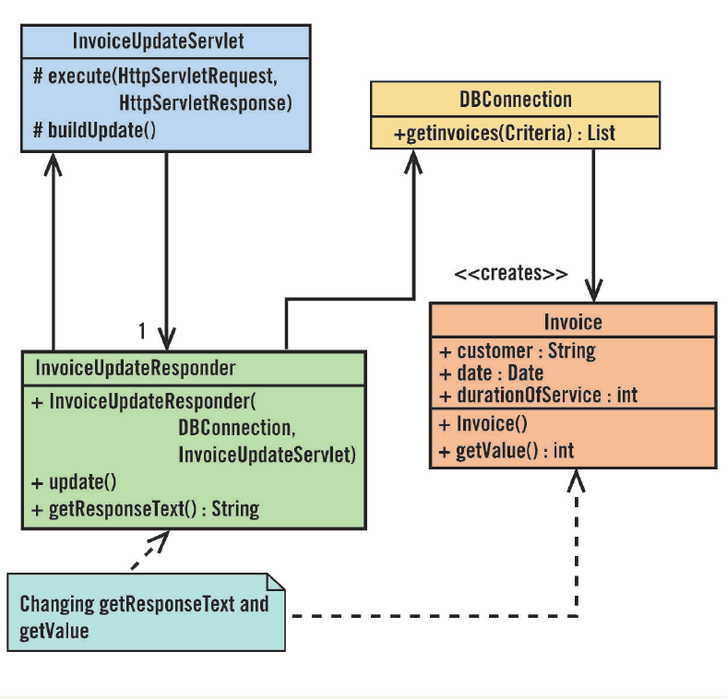
So, where to start, in making changes to legacy code?
Have tests around the changes you make.
Cover the code with tests before you change it.
Write tests for the classes these methods reside in.
Some of these could be tough!
Provide dummy info, etc.
Q7
Notes:
Image from www.drdobbs.com.

Slide 18
All the unit testing problems…
Are dependency problems!
Dependency is one of the most critical problems in software development.
In legacy code, we need to break dependency problems so that change is easier.
Dilemma – “To change the code, you need tests in place. To put those in place, you need to change the code.”
Q8

Slide 19
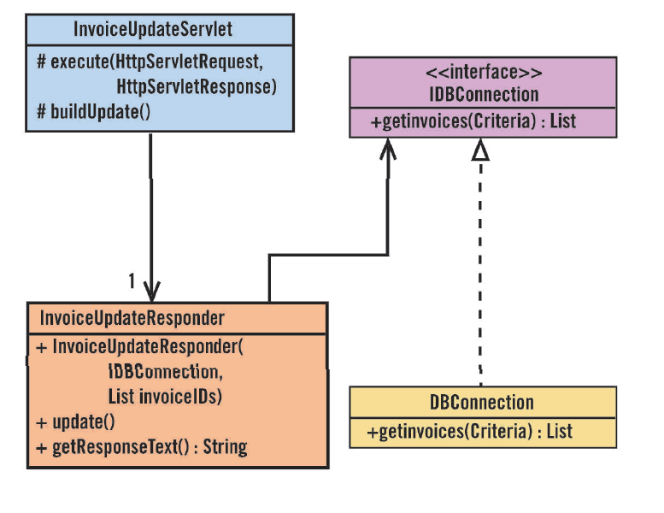
Breaking this one…
Here’s how we’d break the dependencies in this case:
Make up invoice ID’s.
Use an interface instead of the IDBConnection.

Slide 20
The legacy code change algorithm
Identify change points
Find test points
Break dependencies
Write tests
Make changes and refactor
Q9

