Slide 1
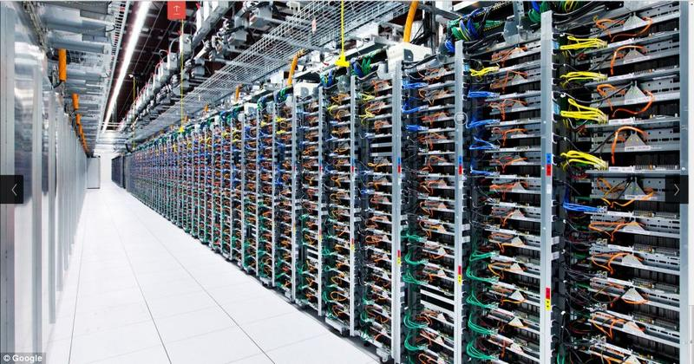
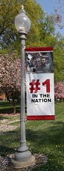

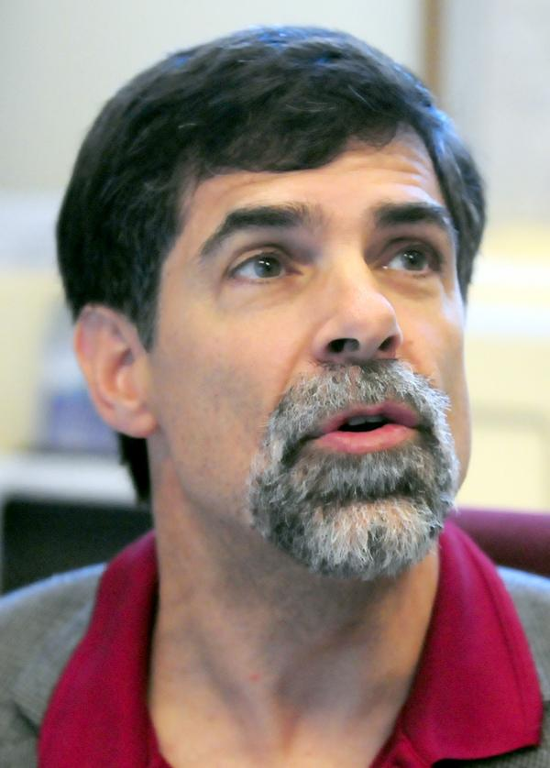

CSSE 375 Software Construction and Evolution:
Special Change Called Refactoring
Shawn Bohner & Steve Chenoweth
CSSE
Above - # 1 feeds # 1: What’s it take for Rose students to build stable software for Google?
Notes:
Image of Google server farm from http://www.stonescornermbe.com.au/2013/08/07/is-digital-really-more-green/.

Slide 2

Learning Outcomes: Refactoring
Apply appropriate refactoring
techniques to resolve design
problems in code
More perspective on
Software Change
Opening thoughts on
Refactoring
Example from Book…
Probably finish on your own

Slide 3
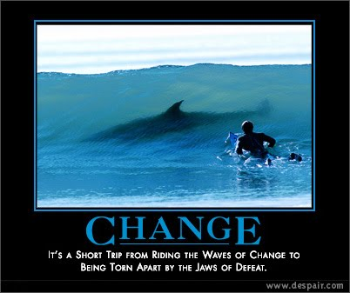
Origins of a Change
What motivation is there for change?
What are the causes
of a change?
What are some
categories of change?
Notes:
What motivation is there for change? Functionality, Non-functional, Bug-fix, Omission, Poor assumption
What are the causes of a change? Process change, legislature, competition, bug fixing, usability, mistakes, growth/performance issues, new technology
What classes are there of change? Functional, refactorings, HCI, rerouting, substitutions, performance, generalizing, data model

Slide 4
Change Types/Categories
Corrective Change – changes to fix errors in design, logic, coding, documentation
(does not change requirements specifications)
Adaptive Change – changes for use in a new environment – most common, your component vendors require moving to a new version
Perfective Change – changes to meet new or different customer needs/requirements – most common, additional features/capabilities
Preventive Change (special case of corrective) – change to fix errors before they occur (this term is not universally used)
  e.g., you know some customers will move to MacOS, fix your app so it will work there
Q1
Notes:
Q1: Which ones are more appropriate to use “maintenance”, and which “evolution?

Slide 5
Or,
New Requirements
Existing Requirements
Perfective
Corrective & Preventive
Existing Environment
New Environment
Adaptive

Slide 6
Cost Breakdown by Change Type
Should there be more spent on this?
Q2
Notes:
Q2: Corrective change is the fix and repairs to the software that do not change the requirements specification. What is the percent of the maintenance budget typically dedicated to corrective change?
What would this amount depend on?

Slide 7
What is Refactoring?
A disciplined technique for restructuring existing code, altering internal structure without changing external behavior
A series of small behavior preserving transformations, each doing little, but together can produce a significant restructuring
Each refactoring is small, so less likely to go wrong. The system is kept fully working after each refactoring, reducing the chance of a system getting broken
Q3
Notes:
Q3: What kind of software change is Refactoring?

Slide 8
Extremely Simple Example
Using any number other than zero in functional code is a road to disaster
Not clear why that value
Harder to change the value when rules change
Instead of writing
Feet := Miles * 5280;
Write…
const FEET_PER_MILE = 5280;
Feet := Miles * FEET_PER_MILE;
Notes:
Yeah but, it took more code… so, it’s more clear and now reusable.

Slide 9
Simple Video Rental Example (1 of 5)
public class Movie {
public static final int CHILDRENS = 2;
public static final int NEW_RELEASE = 1;
public static final int REGULAR = 0;
private String _title;
private int _priceCode;
public Movie(String title, int priceCode) {
_title = title;
_priceCode = priceCode;
}
public int getPriceCode() {
return _priceCode;
}
public void setPriceCode(int arg) {
_priceCode = arg;
}
public String getTitle() {
return _title;
}
}
Notes:
From the chapter you read… you did read it didn’t you?

Slide 10
Simple Video Rental Example (2 of 5)
public class Rental {
private Movie _movie;
private int _daysRented;
public Rental(Movie movie, int daysRented) {
_movie = movie;
_daysRented = daysRented;
}
public int getDaysRented() {
return _daysRented;
}
public Movie getMovie() {
return _movie;
}
}

Slide 11
Simple Video Rental Example (3 of 5)
public class Customer {
private String _name;
private Vector _rentals = new Vector();
public Customer(String name) {
_name = name;
}
public void addRental(Rental arg) {
_rentals.addElement(arg);
}
public String getName() {
return _name;
}
public String statement() {
double totalAmount = 0;
int frequentRenterPoints = 0;
Enumeration rentals = _rentals.elements();
String result = "Rental Record for " + getName() + "\n";
while (rentals.hasMoreElements()) {
double thisAmount = 0;
Rental each = (Rental) rentals.nextElement();

Slide 12
Simple Video Rental Example (4 of 5)
// More of public class Customer :
//determine amounts for each line
switch (each.getMovie().getPriceCode()) {
case Movie.REGULAR:
thisAmount += 2;
if (each.getDaysRented() > 2)
thisAmount += (each.getDaysRented() - 2) * 1.5;
break;
case Movie.NEW_RELEASE:
thisAmount += each.getDaysRented() * 3;
break;
case Movie.CHILDRENS:
thisAmount += 1.5;
if (each.getDaysRented() > 3)
thisAmount += (each.getDaysRented() - 3) * 1.5;
break;
}

Slide 13
Simple Video Rental Example (5 of 5)
// Even more of public class Customer :
// add frequent renter points
frequentRenterPoints++;
// add bonus for a two day new release rental
if ((each.getMovie().getPriceCode() == Movie.NEW_RELEASE) && each.getDaysRented() > 1)
frequentRenterPoints++;
// show figures for this rental
result += "\t" + each.getMovie().getTitle() + "\t" +
String.valueOf(thisAmount) + "\n”;
totalAmount += thisAmount;
}
// add footer lines
result += "Amount owed is " + String.valueOf(totalAmount) + "\n”;
result += "You earned " + String.valueOf(frequentRenterPoints) +
" frequent renter points”;
return result;
}
}

Slide 14
Some Observations
Not a very well-designed program
  Not even very object-oriented
Long statement routine in Customer is heavily loaded
  Several things could be done in other classes
Ugly Program, but it works…
  Computer doesn’t care what it looks like
  People who work on it do!
Poorly developed programs are hard to change and maintain
Q4
Notes:
Q4: Why are poorly developed programs costly to change and maintain?

Slide 15

Good Software Practice
When you find that you have to add a feature to a program, …
and the program’s code is not structured in a convenient way to add the feature, …
1st refactor the program to make it easier to add the feature, …
then add the feature.
Q5
Notes:
Q5: What is a good software practice when confronted with code that is hard to implement a change in?

Slide 16
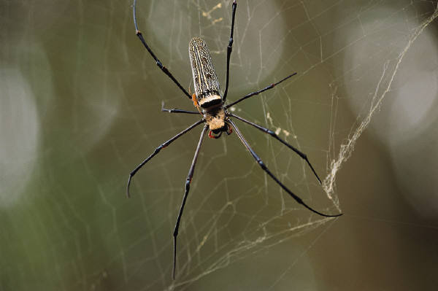
First Step, Before you Start Refactoring…
Most software bugs come from changing software…
Refactoring is changing software
Hence, before you start making changes, ensure you have a solid test suite
Q6
Notes:
Q6: What is the first step before you start refactoring (and after you have identified something in a program that needs to be refactored? (Kind of a repeat of a book question from Quiz 1!)

Slide 17
Redistributing Statement Method (1 of 3)
Statement method in Customer contains too much in line stuff
Use “Extract Method” to pull some of this out into its own methods
Problem: You have a code fragment that can be grouped together to be more relevant and or cohesive.
Solution: Turn the fragment into a method whose name explains the purpose of the method.
Q7
Notes:
Q7: What problem does the Extract Method address is software source code and what solution does the Extract Method suggest for the problem?

Slide 18
Redistributing Statement Method (2 of 3)
private double amountFor(rental each) {
double thisAmount = 0;
switch (each.getMovie().getPriceCode()) {
case Movie.REGULAR:
thisAmount += 2;
if (each.getDaysRented() > 2)
thisAmount += (each.getDaysRented() - 2) * 1.5;
break;
case Movie.NEW_RELEASE:
thisAmount += each.getDaysRented() * 3;
break;
case Movie.CHILDRENS:
thisAmount += 1.5;
if (each.getDaysRented() > 3)
thisAmount += (each.getDaysRented() - 3) * 1.5;
break;
}
return thisAmount;
}
thisAmount = amountFor(each);
Notes:
Create Method called “amountFor” and call it from Customer with
thisAmount = amountFor(each);

Slide 19
Redistributing Statement Method (3 of 3)
Using “Extract Method” refactoring technique to pull accountFor out into its own method starts to tidy up Statement
However, as is often the case when the extraction is complete, variable names may no longer make sense
So, for clarity fix the name of local variables to clarify the new method…

Slide 20
Clarify Names in New Method
private double amountFor(rental aRental) {
double result = 0;
switch (aRental.getMovie().getPriceCode()) {
case Movie.REGULAR:
result += 2;
if (aRental.getDaysRented() > 2)
return += (aRental.getDaysRented() - 2) * 1.5;
break;
case Movie.NEW_RELEASE:
result += aRental.getDaysRented() * 3;
break;
case Movie.CHILDRENS:
result += 1.5;
if (aRental.getDaysRented() > 3)
return += (aRental.getDaysRented() - 3) * 1.5;
break;
}
return result;
}
Notes:
Each → aRental
thisAmount → result

Slide 21
“Move Method” Technique
The amountFor method doesn’t use information from the Customer
  Use the Move Method technique
Problem: A method is, or will be, using or used by more features of another class than the class on which it is defined.
Solution: Create a new method with a similar body in the class it uses most. Either turn the old method into a simple delegation or remove it altogether.
Q8
Notes:
So, where is a better location for this “amountfor” method?
What naming will need to be changed to accommodate its new home?
Move to Rental
Q8: What problem does the Move Method address is software source code and what solution does the Move Method suggest for the problem?

Slide 22
Move amountFor Method to Rental Class
Class Rental …
double getCharge() {
double result = 0;
switch (getMovie().getPriceCode()) {
case Movie.REGULAR:
result += 2;
if (getDaysRented() > 2)
return += (getDaysRented() - 2) * 1.5;
break;
case Movie.NEW_RELEASE:
result += getDaysRented() * 3;
break;
case Movie.CHILDRENS:
result += 1.5;
if (getDaysRented() > 3)
result += (getDaysRented() - 3) * 1.5;
break;
}
return result;
}
Class Customer…
private double amountFor(rental aRental) {
return result;
}
Notes:
No longer need rental parameter aRental
Rename amountFor to getCharge()

Slide 23
Exercise: Think/Pair/Share
How would “Extract Method” be used on Frequent Renter Points?
How would “Move Method” be used on Frequent Renter Points?
Notes:
See Fowler’s Ch 1 for more hints!

