Slide 1
CSSE 374: More Object Design with Gang of Four Design Patterns
These slides derived from Shawn Bohner, Curt Clifton, and others involved in delivering 374.
Steve Chenoweth
Office: Moench Room F220
Phone: (812) 877-8974 Email: chenowet@rose-hulman.edu
Chandan Rupakheti
Office: Moench Room F203
Phone: (812) 877-8390 Email: rupakhet@rose-hulman.edu
Q1
Notes:
Q1: What Gang of Four Patterns have we examined so far in CSSE 374?
CLARIFICATION on one earlier topic:
Variation points: points of change in the existing system or requirements (e.g., multiple tax calculators)
Evolution points: points of change that may arise in the future but not currently present (e.g., hand-held POS devices)

Slide 2
Learning Outcomes: Patterns, Tradeoffs
Identify criteria for the design of a software system and select patterns, create frameworks, and partition software to satisfy the inherent trade-offs.
Using GoF Patterns in Iteration 3
Local caching
Failover to local services
Support for third-party POS devices
Handling payments
Exercise (if time)
Week 3 Feedback!
Q3

Slide 3
Gang of Four Design Patterns
Behavioral
Interpreter
Template Method
Chain of Responsibility
Command
Iterator
Mediator
Memento
Observer
State
Strategy
Visitor
Creational
Factory
Abstract Factory
Builder
Prototype
Singleton
Structural
Adapter
Bridge
Composite
Decorator
Façade
Flyweight
Proxy
Checkmark = Done
Q1
Notes:
Q1: What Gang of Four Patterns have we examined so far in CSSE 374? [command, observer, strategy, factory, abstract factory, singleton, adapter, composite, decorator, and façade]

Slide 4
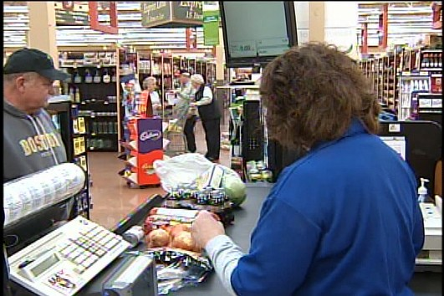
The basic problem – Nextgen POS relies on remote services
Need to get prices for items scanned
Need to update inventory from this scanning
Both these functions need to be fast
Both need to be very reliable
But the “master files” are on remote servers!
http://www2.wjbf.com/news/2011/feb/03/special-report-self-checkout-vs-clerk-checkout-im-113457/

Slide 5
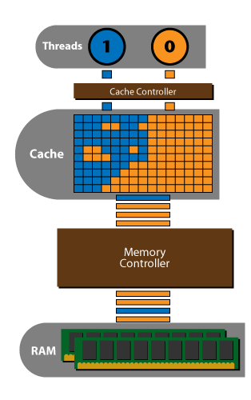
Failover & Performance with Local Caching
What is a cache? How does a cache usually work?
Why use a local cache for NextGen POS?
Performance
Improve recoverability
Q2
Notes:
Q2: What is a cache? [In general.]
Cache as used here - a collection of duplicate data stored elsewhere or computed earlier, where the original data is expensive to fetch (owing to longer access time) or to compute, compared to the cost of reading the cache

Slide 6
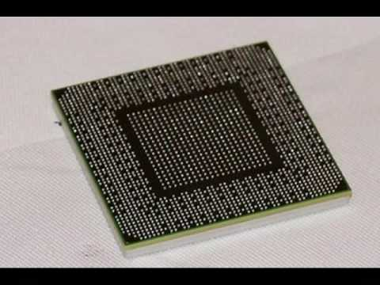
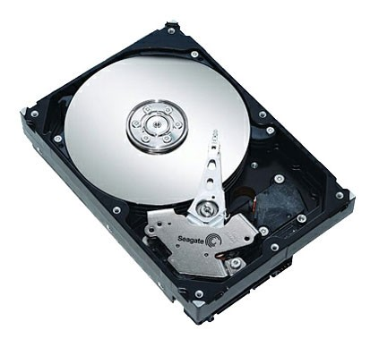
Search Strategy for Product Information
Look in memory (in map stored by ProductCatalog)
Look on local hard drive cache
Retrieve from remote persistence service
Q3
Notes:
Q3: What three places in the system could product information be stored for NextGen POS? [Ok, they’re shown above. But you should know why these are ech good ideas.]

Slide 7
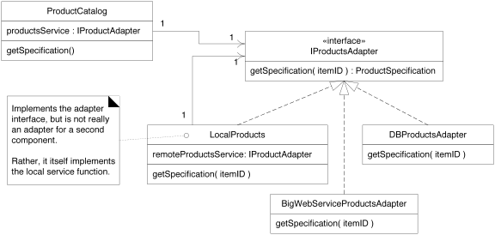
Applying the Adapter Pattern
“True” Adapters
Q4
Notes:
The responsibilities of various classes are what’s important here.
• Why are the ones pointed to called “True adapters”?
Q4: Why does NextGen POS use IProductsAdapter?

Slide 8
Using a Factory to Set Up for Local Caching
Eliminate local cache?
Change external data source?
Q5
Notes:
Consider the way the factory would be used here to create the other classes (and their services).
Q5: Why does NextGen POS use ServicesFactory to get an IProductsAdapter instance?
• What would have to change if we eliminated local cache? (just have Factory return externalService)
• What would have to change if we changed external services? (just instantiate a different adapter in message 1.1.1.)

Slide 9
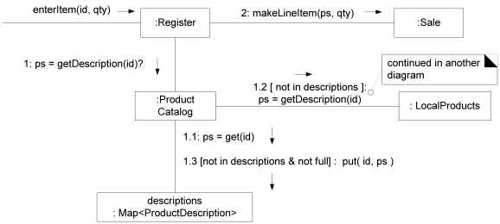
Product Lookup with In-memory Miss
Notes:
1.1: ps= get(id) is get from memory,
If not there, 1.2: ps= getDescriptions(id) is checking elsewhere and 1.3: put(id,ps) stores it in local memory.
Next page looks at :LocalProducts collaboration.

Slide 10
Product Lookup with Local Cache Miss
Notes:
1: ps= get(id) looked in local file
If not there, 2: ps= getDescriptions(id) is checking remoteService and 3: put(id,ps) stores it in Local cache
Note: if it isn’t there, we go to BigWebServiceAdapter…
• The lower figure discusses Object-Relational mapping
Note: Caching strategies to handle lazy and eager initialization…
Note: Stale cache and remote service operation to freshen cache.. What do we do with this?

Slide 11
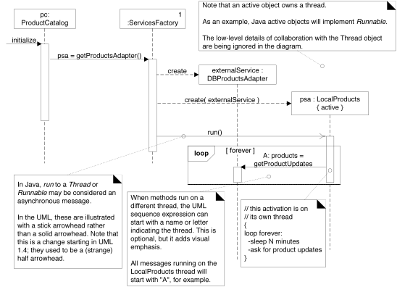
Using Threads to Freshen the Cache
Async msg
Notes:
Walk through figure. Note:
- active object
- async run() message
separate message in new thread to get updates
Loop forever { sleep N minutes; Ask for more updates}

Slide 12
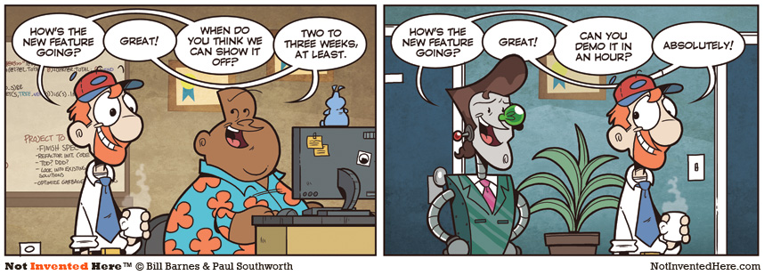
How’s the final iteration going?
Used by permission. http://notinventedhe.re/on/2009-12-28

Slide 13
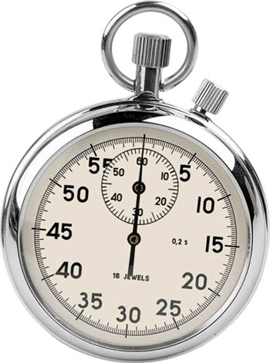
Handling Failure in NextGen POS:
What should happen if there is a local cache miss and the external product information service fails?
Think for 15 seconds…
Turn to a neighbor and discuss it for a minute
Notes:
Well, we don’t have the information on the product do we?
We’ll ask this one in class. Would you just not sell the product? manually enter price and UPC? Is it free?
We need to deal with this exception!

Slide 14
DCD: Exceptions Caught and Thrown
Notes:
UML class can have an additional section for Exceptions
UML allows the operation syntax to be any other language
Object Get(Key, Class) Throws DBUnavailableException, FatalException
Default UML Syntax
Put(Object, id) {exceptions=(DBUnavailableException, FatalException)}
Some UML tools allow one to specify (in a dialog box) the exceptions that an operation throws

Slide 15
Showing Exception in Sequence Diagrams
Name the Problem not the Thrower
Convert Exceptions pattern
Q6
Notes:
Discuss notation for throwing exceptions
• Convert: Throw an exception named appropriately for the level of abstraction; wrap the original exception
• Name: use a name that indicates why the exception was thrown, not who is throwing it (that’s in the stack trace anyway)
Q6: What does the Convert Exceptions pattern tell us to do?

Slide 16
How should NextGen POS handle this exception?
Common exception handling patterns
Use a central error logging object to record all exceptions for diagnosis by developers
Use a standard, application-independent, non-UI object to notify users
Can delegate to multiple different UI notifications
Protected Variation for changes in reporting
Q7
Notes:
Q7: What are two common exception handling patterns?
Fault: origin or cause of misbehavior
Error: Manifestation of the Fault in the system
Failure: denial of service caused by the fault.

Slide 17
Failover to Local Services with a Proxy
If at first you don’t succeed getting to remote, what the heck do you do?
Notes:
This is a major GoF pattern to consider, related to the discussion we just had.

Slide 18
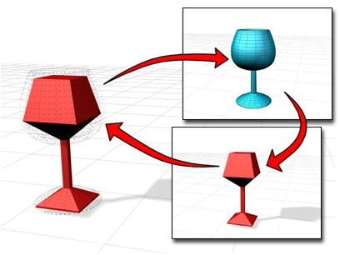
Proxy GoF Pattern
Problem: How do we control access to some subject object if we want to avoid giving direct access?
Solution: Add a level of indirection with a proxy object that implements the same methods as the subject and conditionally delegates to it.
Q8,9
Notes:
Q8: Briefly, what problem does the Proxy pattern solve?
Q9: Briefly, what solution does the Proxy pattern suggest?

Slide 19
Structure of the Proxy Pattern

Slide 20
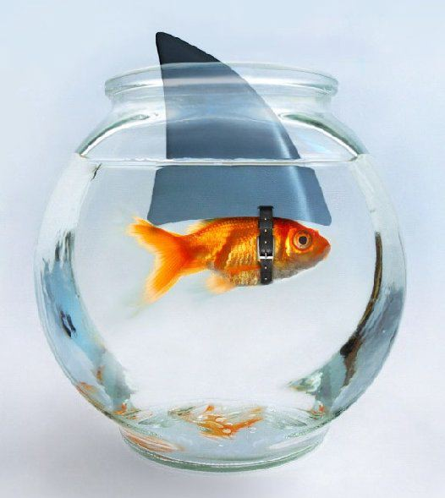
Proxy in NextGen POS
Posting sales to the accounting service
Send postSale(Sale) to a redirection proxy
Proxy attempts to post to external service
If it fails, then proxy stores result locally
Notes:
What do you do when the system fails to post to accounting service?

Slide 21
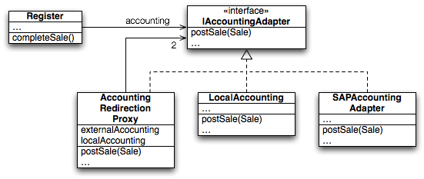
Proxy in NextGen POS — DCD
Notes:
• shrink images
Transition to next slide for object diagram

Slide 22
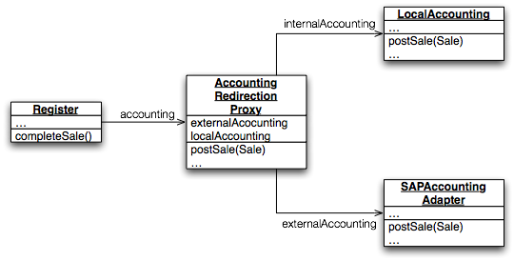
Proxy in NextGen POS: Object Diagram
Notes:
In class: Sketch a communication diagram showing how NextGen POS can use a Proxy to failover to local storage if the remote accounting service is down.

Slide 23
Exercise: Proxy for Failover
Break up into your teams
Consider how NextGen POS can use a Proxy to failover to local storage if the remote accounting service is down.
Sketch a communication diagram depicting the above situation.
Notes:
In class, we may consider this same idea for your project!

Slide 24
Week 3 Feedback!
Plus:
Class:
Quizzes before class
Having time to work on HW in class
Projects:
Teamwork!
Client communications
Having time in class to work on project
Having more time with team
Good to do an actual project

Slide 25
Week 3 Feedback!
Delta:
Class:
Quizzes before class
Due just before?
Need to go over slides
Need help on quiz questions
Quizzes are busy work
Make due at end of class
Stop lecturing on slides
Need code examples of patterns
HW:
Time consuming
Early morning deadlines!

Slide 26
Week 3 Feedback!
Delta:
Projects:
Clients not responding
Closer relationships with open-source clients
Clients overbearing – making design choices
Forcing class topics onto project work
What client wants vs what course asks for
Classmates need to be respectful to clients
Teammates need to work on project in class
Teammates need to attend meetings with clients
Scrum doesn’t fit all the documentation we do

