Slide 1
Design and Integration: Part 3
To prepare for today’s class, visit Cookie Clicker and plan with it for a few minutes:
http://orteil.dashnet.org/cookieclicker/
Notes:
Image of the game’s “eponymous cookie” from http://en.wikipedia.org/wiki/Cookie_Clicker

Slide 2
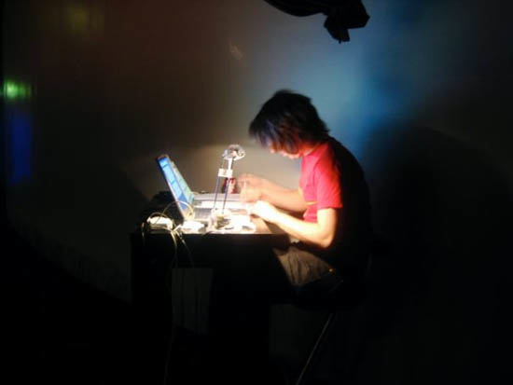
Why would you want to design?
…when you could start coding today!
Notes:
Image from http://cycling74.com/2012/09/11/working-with-hardware-dmx-part-2/

Slide 3
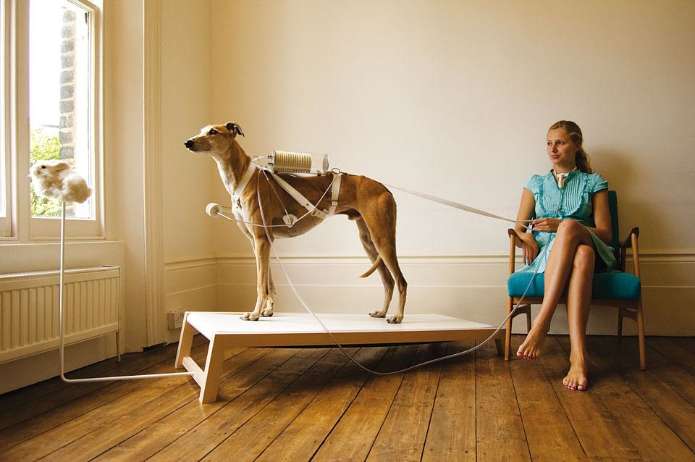
Design is dead?
Fowler’s contentions:
“In common usage, evolutionary design is a disaster.”
You can’t build a skyscraper like a doghouse.
You can’t hand-off work without a plan.
Once you’ve got this in Sprint 1, can you just evolve it?
Notes:
Image of a design prototype from http://www.domusweb.it/en/design/2011/08/31/states-of-design-04-critical-design.html

Slide 4
But why is upfront design bad?
Tension between designers and developers
Requirements change
Good design can accommodate that change! But it must correctly anticipate the KIND of change.
Maybe because you didn’t understand them at first – better requirements!
But also requirements change due to business changes – can’t easily plan.

Slide 5
How do you do design?
A series of at least 3 steps, maybe more.
What are those steps?
Do this on a Computer so you can easily add/modify steps.
Remember this is a “loose artifact” later!
You need to remember to keep it up to date.
Fowler’s “changing requirements.”

Slide 6
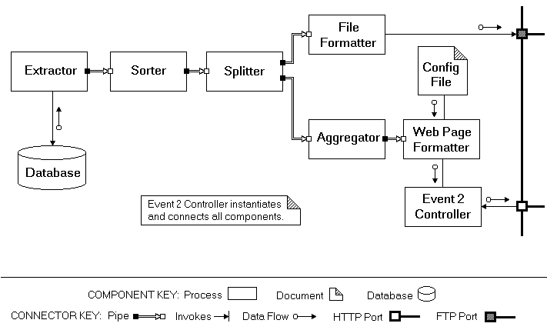
Always involves…
Iteration
Because you can’t get it right the first time.
Abstraction
At various levels.
The very abstract is very tricky.
What if the designers don’t code?
High-level architecture for an Event Processor
Notes:
Design from http://www4.desales.edu/~dlm1/it533/class03/pipe.html

Slide 7
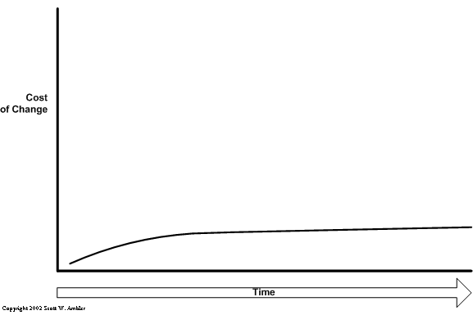
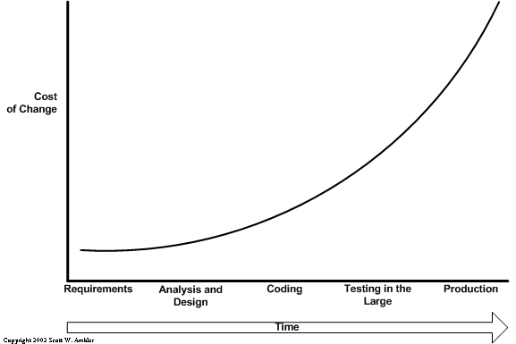
Fowler on XP
How do you avoid the “exponential curve” of costs as you change things to a delivered system?
But you have to do the “enabling practices”!
Kent Beck’s version!
Notes:
Images from http://www.agilemodeling.com/essays/costOfChange.htm
Play the slide show to see the first image, then the second.

Slide 8
Some of this is economics
If the customer is doing “pay as you go,” then they’ll balk at paying for a lot of design up front.
And you could get it wrong… and eat those costs.
A simple system:
Runs all the tests
Reveals all the intention
No duplication
Fewest number of classes or methods
Notes:
The definition of “simple system” is from Kent Beck.

Slide 9
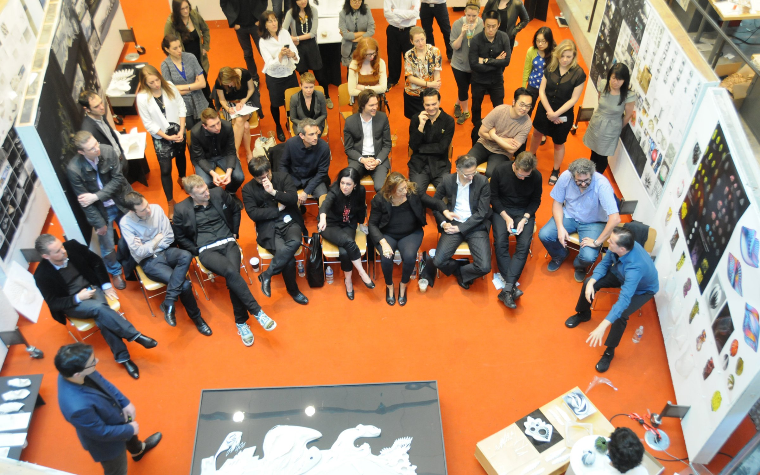
Some of it is social
Someone has to explain design to someone else.
Like all the stakeholders.
Notes:
Image from http://architecture.yale.edu

Slide 10
Frameworks
Common question!
A great enabler
Also dangerous
Takes time to get up to speed
Takes time
No value is delivered
What if you are wrong?
A huge gold plating operation
“Every class decorates some other class!”
Notes:
Decorator – See http://en.wikipedia.org/wiki/Decorator_pattern
Cookie decoration image from http://bakefresh.blogspot.com/2010/09/daring-decorated-sugar-cookies-with.html#.VEj6Br7selk

Slide 11
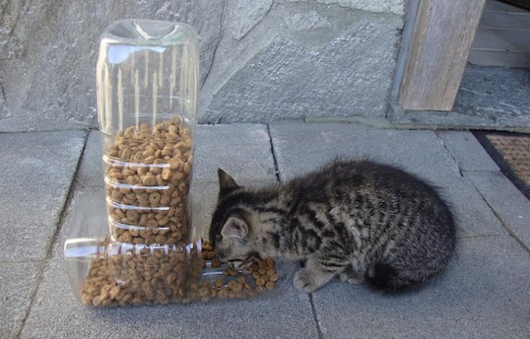
Reuse?
Good idea?
What would Highsmith think?
Adaptation over anticipation (p 217)
But – depends on “maleability of the medium.”
Architectural decisions are often expensive.
The overall goal is “low cost.”
Notes:
Reuse image from http://digitalsynopsis.com/design/20-creative-ways-to-reuse-old-stuff/

Slide 12
Recall from Tuesday – The standard design sequence
In all of engineering, it goes like this.
You at least need a good problem statement.
It should cover functional and non-functional requirements in generality.
You do the high-level design from that.
Top-down, with lots of alternatives.
Then pick from those, based on lots of criteria.
This is Phillips’ “Abstraction” (p 262)
Then you use the detailed requirements to fill-in the detailed design.
Bottom-up.
Do you need to express this, beyond coding?
Like?
Why?

Slide 13
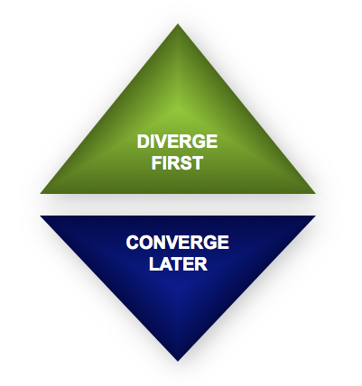
High-level design looks like good brainstorming
Try not to mix these two:
Coming up with new ideas.
Picking one, and focusing on how to do it well.
But,
For everything beyond coding, you have to maintain it forever!
So – Is it throwaway?
Start with 1 problem
Get lots of ideas!
End with 1 solution
Notes:
Image from http://www.creativerealities.com/innovationist-blog/bid/103494/Let-s-not-confuse-good-brainstorming-with-the-new-Groupthink

Slide 14
Design Cookie Clicker
Design at at different levels of abstraction
Client/server/db, languages in each, communication mechanism
Class design
Whatever else you think will help you get a good design

