Slide 1
Function Objects and Comparators
Nicholas Allen, Benjamin Stevens, CJ Miller

Slide 2
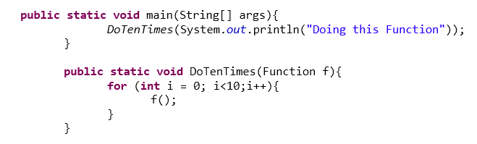
Why Do we Need Function Objects?
In many coding languages such as Python, JavaScript, and Perl, functions can be treated as objects and passed as a parameter to another function. However this is not possible in Java, thus the code to the right is incorrect.

Slide 3
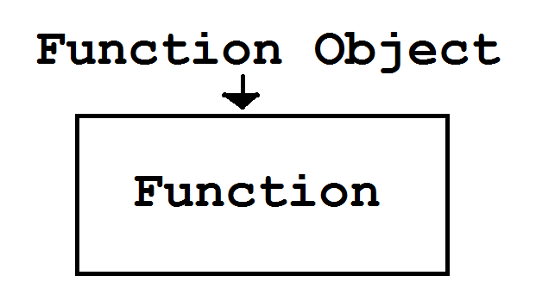
A New Approach
Instead what we need to do is wrap our function inside of a single method “Function Object”

Slide 4
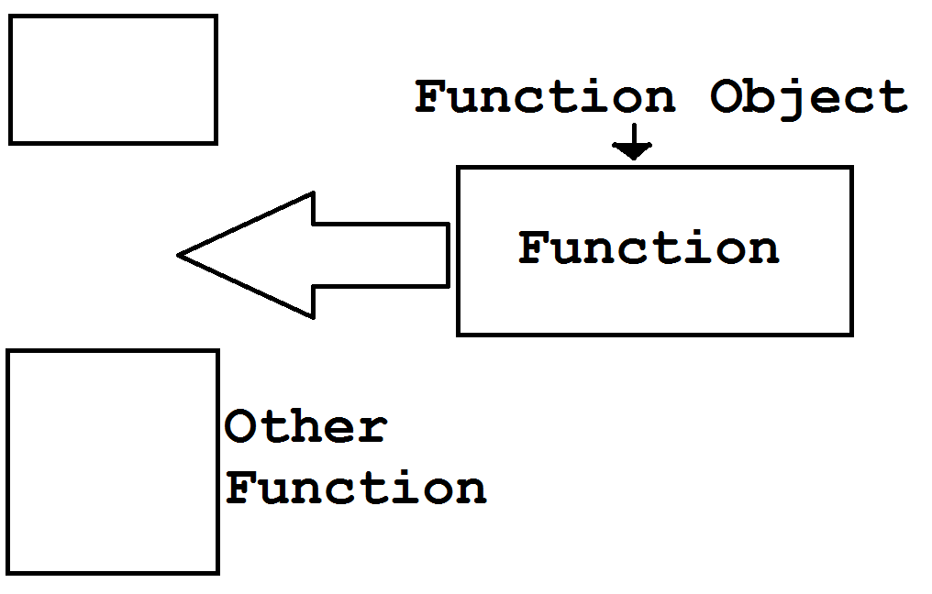
Result
We can now pass our newly created function object to another function, giving that function access to the method wrapped within the function object.

Slide 5
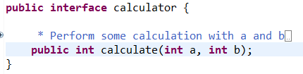
Example
Suppose we were to make a four function calculator using function objects
We would first create an interface with one method defined

Slide 6
In Class Demo
Now we need four volunteers to represent function objects for our four functions and one volunteer to be our class that is passed the function objects

Slide 7
Comparators
Unique type of function object is a comparator, which allows you to define rules to determine whether an element comes logically before or after another element.
These are primarily used in sorting algorithms for elements that can be sorted in a number of ways.

Slide 8
Coding Demo

