Slide 1
Merge Sort
Abigail Anderson
Ian Ludden
Melissa Thai
Tyler Whitehouse
CSSE221-02

Slide 2
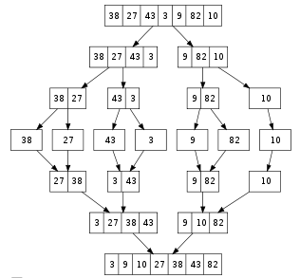
Main Idea
Divide
  If a given array A has 0 or 1 element, return; it is already sorted. Otherwise, split A into two sub-arrays A[x… m] and A[m+1…y]… m is halfway point
Conquer
  Recursively sort the two sub-arrays
Combine
  Combine the elements back into A[x…y] by defining a method that merges the two sub-arrays into a sorted sequence
  O(n log n) runtime!
Notes:
Divide - if a given array A has zero or one element, simply return; it is already sorted. Otherwise, split A into two sub-arrays A[x … m] and A[m+1 … y] (m is the halfway point of A[x … y]), each containing about half of the elements of A.
Conquer - conquer by recursively sorting the two sub-arrays A[x … m] and A[m+1 … y].
Combine - combine the elements back into A[x … y] by defining a method that merges the two sub-arrays A[x … m] and A[m+1 … y] into a sorted sequence.

Slide 3
Closer Look at the Combining Step
4 | 7 | 14
1 | 3 | 9 | 17
1
3
4
7
9
14
17
Notes:
Draw on board!

Slide 4
How Is This Used In Merge Sort?
9 | 2 | 6 | 5 | 3 | 10 | 1 | 7
Divide
9
2
6
5
3
10
1
7
2 | 9
5 | 6
3 | 10
1 | 7
2 | 5 | 6 | 9
1 | 3 | 7 | 10
1 | 2 | 3 | 5 | 6 | 7 | 9 | 10
Notes:
Suppose we have an unsorted array like this one. We can think of this array as 8 little sorted arrays, each with 1 element. We can merge each pair of arrays into a larger array using the combining step.

Slide 5
Pseudocode for Sort and Merge Methods
void sort(array you want to sort)
{
If array length <= 1, return. Else:
leftArray = left half of original array
rightArray = right half of original array
Sort(leftArray)
Sort(rightArray)
Merge(leftArray, rightArray, resultantArray)
}
void merge(leftArray, rightArray, resultantArray)
{
iLeft, iRight // indices of elements to consider
j // index of resultant array
While(neither iLeft not iRight is past the end)
  Move the smaller element into resultantArray
}

Slide 6
Sources
Big Java: Early Objects
http://www.princeton.edu/~achaney/tmve/wiki100k/docs/Merge_sort.html
http://www.personal.kent.edu/~rmuhamma/Algorithms/MyAlgorithms/Sorting/mergeSort.htm

