Slide 1

Tim Anderson, Daniel Lehman, Cort Pugh, Alia Robinson

Slide 2
Motivation
Animation is Cool
Can Allow for Illustrations of Certain Concepts
Without it Computers Would be a lot More Boring

Slide 3
Definition of animation
Pictures/frames are displayed in sequence
Frames are displayed several times per second

Slide 4
Animation Basics
The Animation Loop
  Update, Render, Sleep
Starting and Terminating an Animation
Pausing and Resuming
Double Buffering
Management of Inaccuracies in the Timer and Sleep Operations

Slide 5
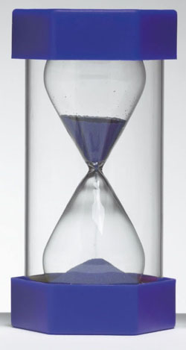
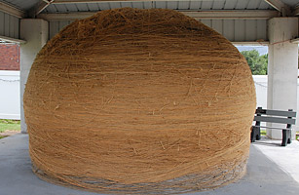
Implementations
Timers
Threads

Slide 6
Timers
javax.swing.Timer versus java.util.Timer
Timer calls actionPerformed at predetermined intervals to create animation

Slide 7
Threads
Animating Thread and GUI Event Processing Thread
  Possible Synchronization Issues
  Thread Safety
Thread.sleep() Allows for Updates and Views

Slide 8
Animation In General
Flash or Silverlight
Scripting Languages

Slide 9
Sources
Big Java
http://docs.oracle.com/javase/tutorial/uiswing/misc/timer.html
http://fivedots.coe.psu.ac.th/~ad/jg/ch1/index.html

