Slide 1
Java Animation
By Max Kelly and David Caggiano

Slide 2
Example of Animation

Slide 3
What is Animation?
It is the creation of moving images (animation) using computer technology.
http://www.webopedia.com/TERM/C/computer_animation.html

Slide 4
What Kinds of Animation
Computer-generated animation where the animation is designed solely on the computer system using threads, paint component, and a timer in a more fluid manner
Computer-assisted animation simple pop-up animations are done
Notes:
And/Or a timer (If you are using threads, do you need a timer? If you are using a timer, do you need threads? I think you need one or the other, not both.) Slide 6 is clearer on this.
Second bullet is not clear.

Slide 5
Other Sources of Animation
Using a picture or sound file you have on your computer

Slide 6
Implementing animation
You can use threads, paint, or a timer

Slide 7
Using a thread
Thread paintThread = new Thread(new Runnable(){
@Override
public void run(){
while(true) {
window.repaint();
try{
Thread.sleep(25);//determines the framerate for the animation
}
catch(InterruptedException e){
e.printStackTrace();
}
}
}
});
paintThread.start();//start the animation

Slide 8
Using a timer
import javax.swing.Timer;
...
Timer timer;
boolean b; // for starting and stoping animation
...
public Construct(){
timer = new Timer(100, new ActionListener() {
@Override
public void actionPerformed(ActionEvent ae) {
// other code // ...
repaint();
}
});
}
// whenever a button that calls the Construct is pressed //
if (b) {
timer.start();
}
else {
timer.stop();
}
b = !b;

Slide 9
Double Buffer
Instead of redrawing individually, will copy over the entire image using the drawImage() method

Slide 10
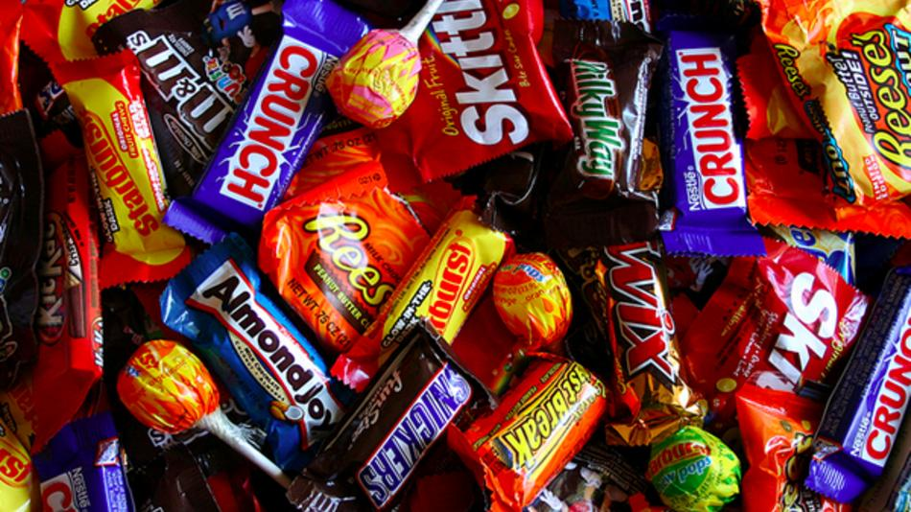
Double buffer activity
Free candy for volunteers

Slide 11
collisions
Happen between objects and borders of interface
To test this, call the intersects() method from the shapes interface

Slide 12
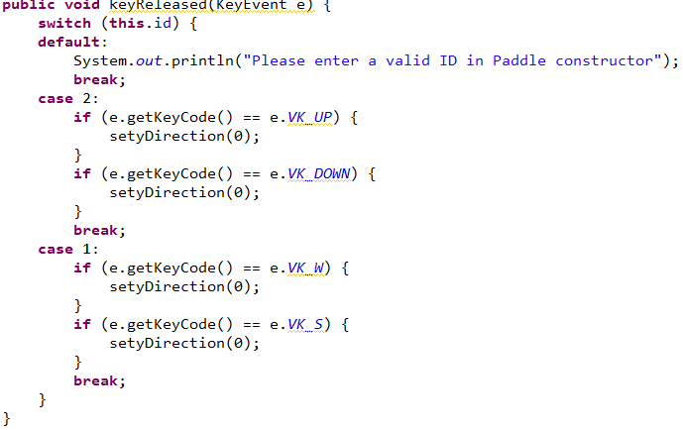
Multiple players
Use a switch statement that will switch the id of the objects

Slide 13
Pong demo

Slide 14
Applets
What is an applet?
  A program that is run on a browser and can be downloaded from the internet

Slide 15
applets
What is the advantage of using applets over applications?
  Can be used to create web pages or animation online

Slide 16
demo

