Slide 1
Selection and Insertion Sorts
Steven Haussmann, Garrett Barnes, Shayna Oriold

Slide 2
Challenges of Sorting
Execution time
Memory usage
Stability
Adaptivity
Online capability

Slide 3
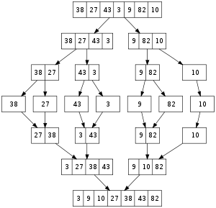
Common Sort Types
Bubble sort:
  Simple to design
  Easy to understand
  Inefficient- average time complexity of O(n²)
Mergesort:
  Efficient- time complexity of O(n log(n))
  Parallelizable
  Requires O(n) extra memory

Slide 4
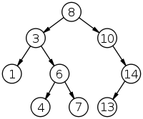
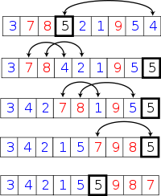
Binary Tree Sort:
  Worst case of O(n log(n))
  Requires the use of a tree structure
Quicksort:
  Similar to binary tree sorts; good efficiency
  Unstable- elements with the same key can be rearranged
  Relatively complex

Slide 5
Selection Sort
Time complexity of O(n²)
Simple to design
Outperforms some O(n²) algorithms such as bubble sort (but not all)
Makes very few writes- only O(n)

Slide 6
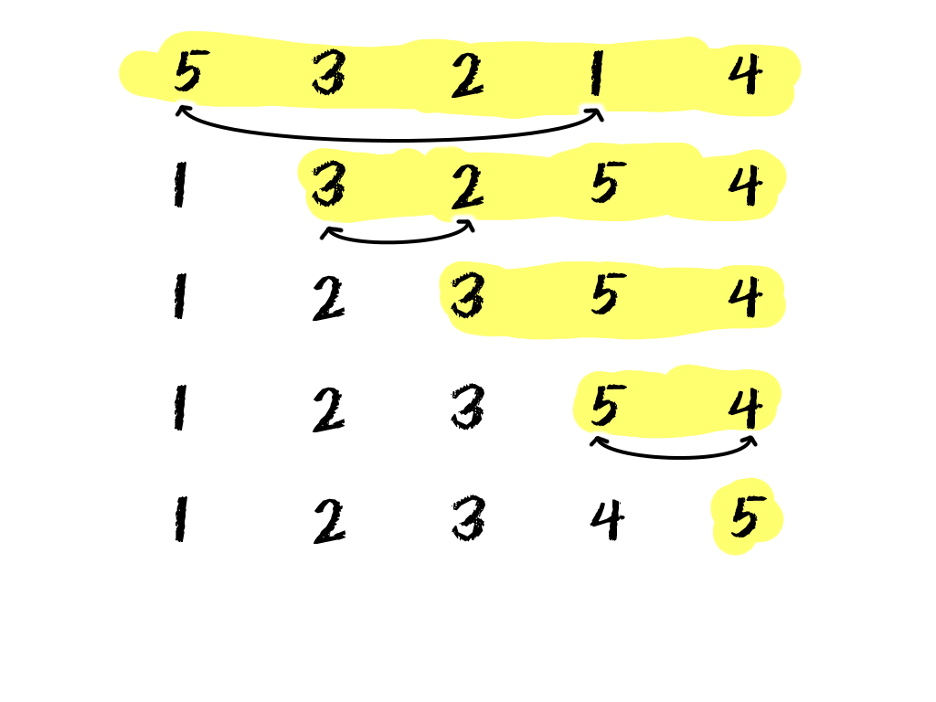

Slide 7
Procedure
Break list into sorted and unsorted segments
Find smallest/largest element of unsorted segment
Swap element with leading element of unsorted segment
Leading element is now part of the sorted segment

Slide 8
Insertion Sort
Time complexity of O(n²)
More efficient than most other quadratic-time sorts
Similar to the selection sort
Online
Stable
Very efficient for small sample sizes
Uses very little memory
Natural- people tend to sort using this method

Slide 9
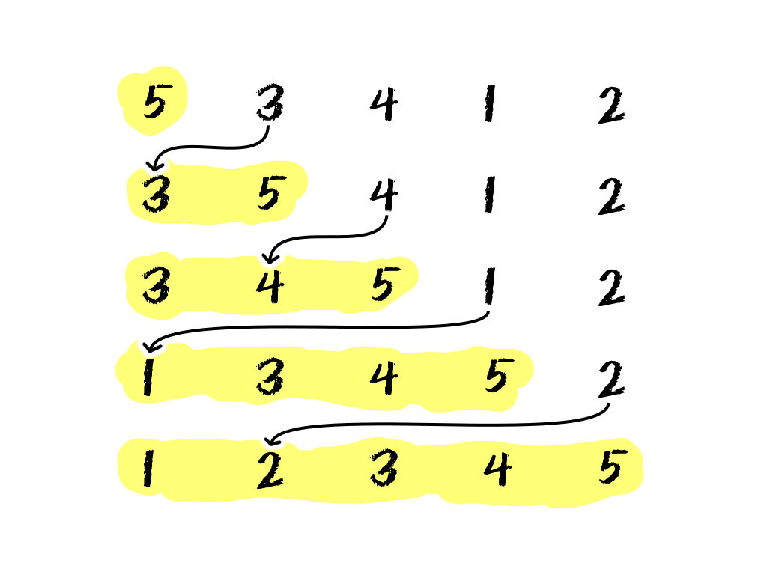

Slide 10
Procedure
Divide list into sorted and unsorted segments
Iterate through sorted segment with first unsorted element
Place element into correct spot; shift all array elements one slot to the right

Slide 11
Utilities
Excellent for real-time sorting
  Websites
  Slow input
Outperforms O(n log(n)) algorithms (e.g. quicksort) for very small datasets
Maintains stability
  Useful for sorting by two different criteria
    Name + GPA of student
    Model + color of car
Adaptive- handles mostly sorted lists well
  Ties into online capabilities

Slide 12
Comparisons:
Execution time
Writes to memory
Data comparisons

Slide 16
Comparison
Runtime:
  Insertion: O(n²)
  Selection: O(n²)
Writes:
  Insertion: O(n²)
  Selection: O(n)
Comparisons:
  Insertion: O(n²)
  Selection : O(n²)
Selection Sort:
  Slow-read: bad
  Slow-write: good
Insertion Sort:
  Slow-read: better
  Slow-write: bad
Judgement:
  Insertion wins out unless writing is expensive

