Slide 1
Insertion and Selection Sort
By: tom d’agostino, Katie lee, and Christian schulz
Csse 221: Fundamentals of Software Development Honors
Tuesday October 29, 2013

Slide 2
Overview:
Sorting algorithms rearrange the elements of a collection so that they are stored in a specific order.
Having a collection that is sorted is important for many tasks:
  Alphabetized lists of people
  Keeping things organized
  Some searching algorithms assume the list is already sorted
Both selection and insertion sort are used to sort linear lists in either ascending or descending order.

Slide 3
Selection Sort:
Finds the smallest element
Moves that element to the front of the list, switching it with the element currently in the front.
Finds the smallest element in the still unsorted part of the list
Moves that element to the front of the unsorted part of the list.
Example: 3, 6, 9, 2, 7
  2, 6, 9, 3, 7
  2, 3, 9, 6, 7
  2, 3, 6, 9, 7
  2, 3, 6, 7, 9
  Done!

Slide 4
Selection Sort:
Worst case scenario is a list sorted in opposite order
Big-Oh notation is O(n²)
Not so good for large data sets
Does not take up a lot of memory, uses constant memory

Slide 5
Activity:
We need about six volunteers from the class
Five line up in whatever order you choose
One person gets to be the sorter, and use selection sort to order the others from shortest to tallest
If you need help, ask your classmates

Slide 6
Insertion Sort:
Can be done by creating a new list, or within the original list
When creating a new list, the first element of the original list is removed, then added to the new list.
Next, the second original element is removed, and inserted into the new list depending on its relationship with the first element. It is inserted before the first element if it is less than the first element, and after it if it is greater.
This is done for each element, resulting in a new sorted list and an empty list
Example: 3, 6, 9, 2, 7
  NEW: ORIGINAL:
  3 6, 9, 2, 7
  3, 6 9, 2, 7
  3, 6, 9 2, 7
  2, 3, 6, 9 7
  2, 3, 6, 7, 9 EMPTY

Slide 7
Insertion Sort:
When sorting the original list, it starts at the beginning of the list and compares the first two elements, if the second is smaller than the first, it swaps them
Next it compares the 2nd and 3rd elements, swapping them if necessary
Next it re-compares the 1st and 2nd elements, swapping them if necessary
Continues until the list is completely sorted, comparing the 3rd and 4th, then 4th and 5th, and so on…
Essentially it compares each element to all of the ones before it in the list, swapping it with elements that it is smaller than.
If the element being sorted is ever greater than one it is being compared to, it is in it’s proper place, and the next unsorted element in the list begins to get sorted

Slide 8
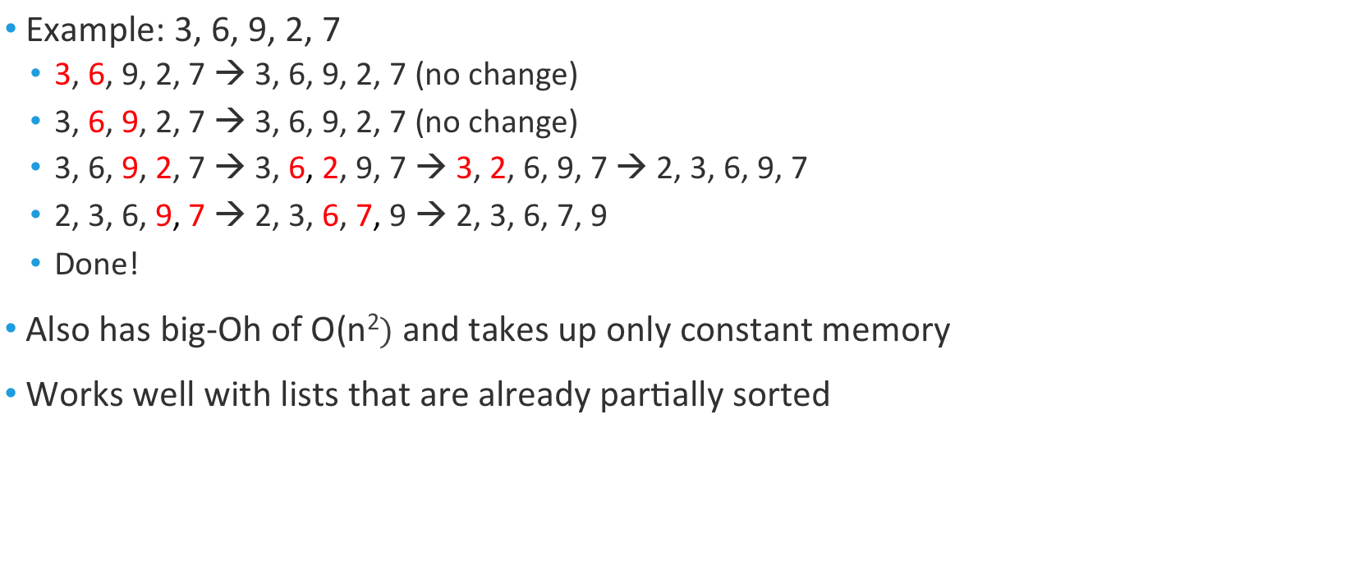
Insertion Sort:
Example: 3, 6, 9, 2, 7
  3, 6, 9, 2, 7 → 3, 6, 9, 2, 7 (no change)
  3, 6, 9, 2, 7 → 3, 6, 9, 2, 7 (no change)
  3, 6, 9, 2, 7 → 3, 6, 2, 9, 7 → 3, 2, 6, 9, 7 → 2, 3, 6, 9, 7
  2, 3, 6, 9, 7 → 2, 3, 6, 7, 9 → 2, 3, 6, 7, 9
  Done!
Also has big-Oh of O(n² and takes up only constant memory
Works well with lists that are already partially sorted

Slide 9
Activity:
We need about six (new) volunteers from the class
Five line up in whatever order you choose
One person gets to be the sorter, and use insertion sort to order the others from youngest to oldest
If you need help, ask your classmates

Slide 10
Coding Demo:
Check it out from the repository, InsertionAndSelection01

