Slide 1
Advanced GUI Programming
Austin Fahsl, Austin May, Shane Bruggeman

Slide 2
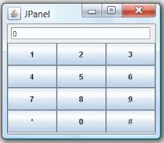
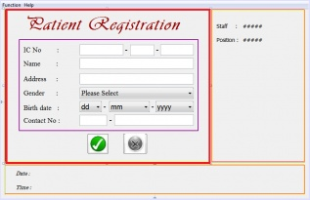
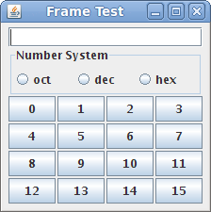
A Quick Review
Purpose:
  Guide the user
Implementation:
  Swing & AWT
Result:
  Modular coding
  Ease of access

Slide 3
AWT vs Swing
AWT
Swing
Abstract Windows Toolkit
Heavyweight
Native code counterparts handle functionality
All the features of AWT
Lightweight
Handles its own functionality

Slide 4

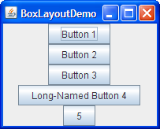
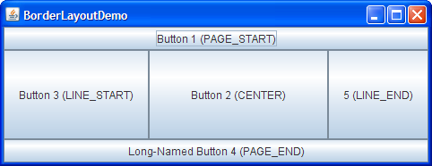
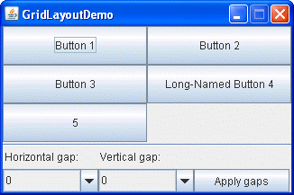
Layout Managers
Flow Layout
Box Layout
Border Layout
Grid Layout
FlowLayout, BorderLayout, GridLayout, GroupLayout

Slide 5
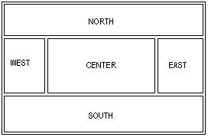
Layout Managers
Flow Layout
Border
new FlowLayout();
Places elements (in the order added) to the screen.
Starts a new line if the elements do not fit the current one
new BorderLayout();
Places elements into tpredetermined spaces on the tcomponent
NORTH, SOUTH, EAST,
WEST, CENTER

Slide 6
Layout Managers
Grid Layout
Box Layout
new GridLayout(int rows, int columns, panel)
Components take up all the space on the holder
new BoxLayout(panel, axis);
Axis can be horizontal or vertical
BoxLayout.LINE_AXIS
BoxLayout.PAGE_AXIS
BoxLayout.X_AXIS
BoxLayout.Y_AXIS

Slide 7
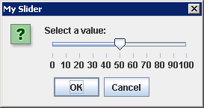
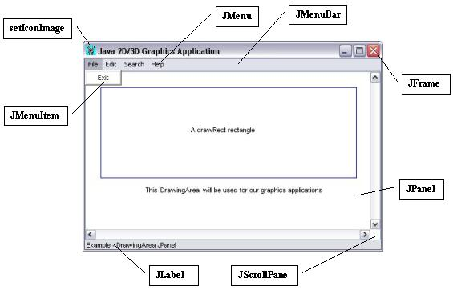
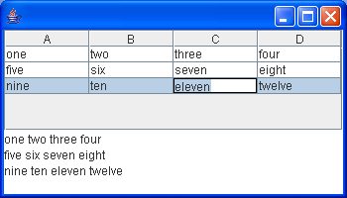
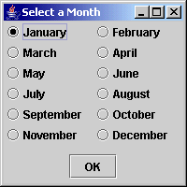
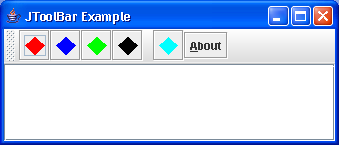
Exploring New JComponents
JSlider
JScrollPane & JMenu
JTable
JRadioButton
JToolbar
JTable, JRadioButton, JSlider, Jmenu, JScrollPane

Slide 8
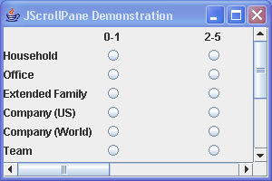
New JComponents
JTable
JSlider
JScrollPane
JTable
Make changes by “sliding” the bar
Use ChangeListener to detect sliding
Jslider slider = new JSlider();
Allows for windows larger than screen
Extends Panel and adds a scroll option
JScrollPane pane = new JScrollPane();
Easy data organization
Should be added to a JScrollPane
JTable table = new JTable(); and
scrollpane.getViewport().add(table);

Slide 9
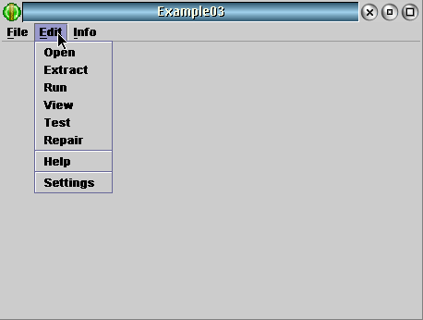
New JComponents
JMenu
JRadioButton
JToolBar
Jmenu → JMenuBar → Jmenu → JMenuItem
Useful for holding many options in categories
ButtonGroup → JRadioButton
Useful for chosing “one” option
JToolBar → Jcomponents . . . .
Provides easy access to menu options

Slide 10

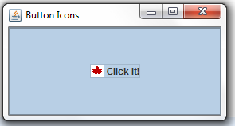
Images & Adding Images To JButtons
BufferedImage & Image Classes
Image image = ImageIO.read(new File(file))
BufferedImage image = ImageIO.read(new File(file))
button.setIcon(new ImageIcon(file));

Slide 11
http://math.hws.edu/eck/cs124/javanotes6/c13/index.html http://docs.oracle.com/javase/7/docs/api/ http://docs.oracle.com/javase/tutorial/uiswing/components/toolbar.html http://www.stackoverflow.com
Sources

