Slide 1
Advanced GUI Components in JAVA
Eric Stokes, Matt Behling

Slide 2
Advanced Layout Managers
GridbagLayout
CardLayout
SpringLayout

Slide 3
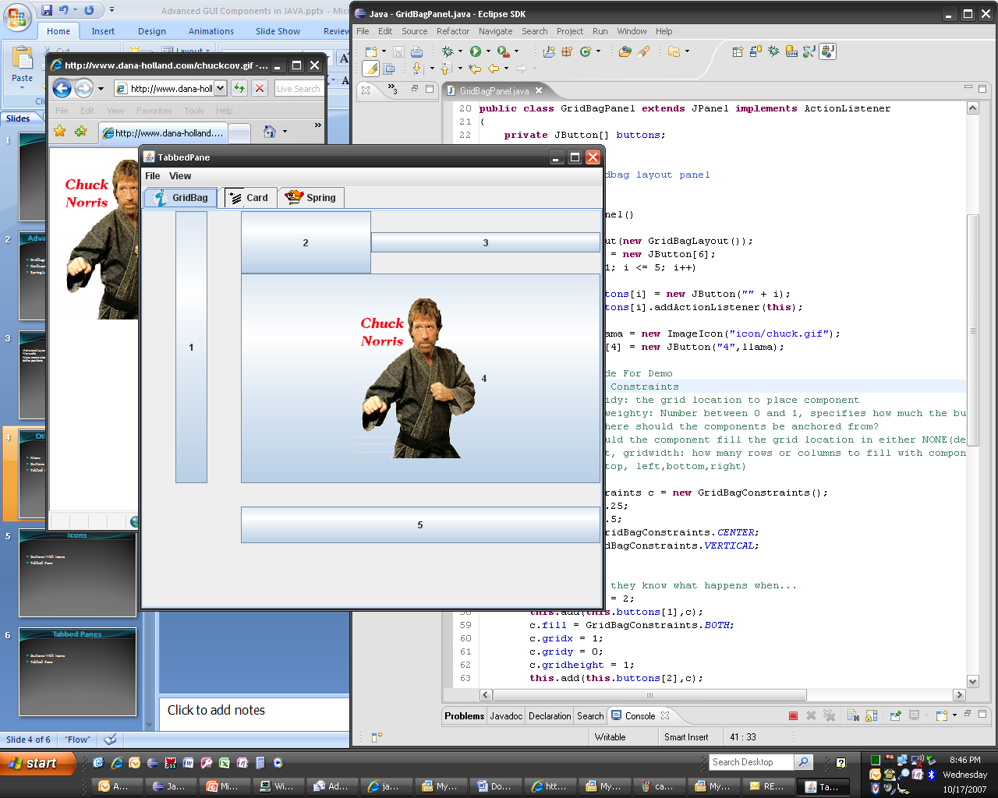
GridBagLayout
Advanced Layout
Versatile
Uses constraints to define positions

Slide 4
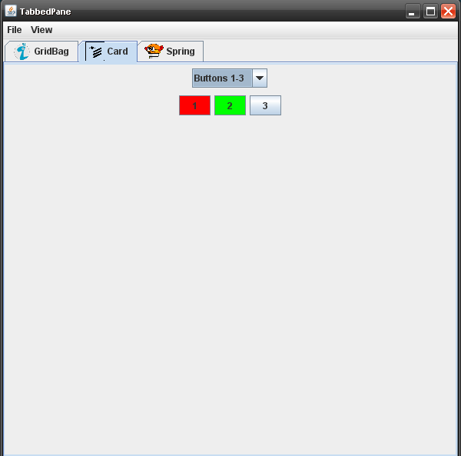
CardLayout
Similar to using tabbed panes
Gives the illusion of “hiding” and “showing components”
Keeps the state of components since it simply hides an entire JPanel
Can Use multiple switching components such as JMenu or JComboBox

Slide 5
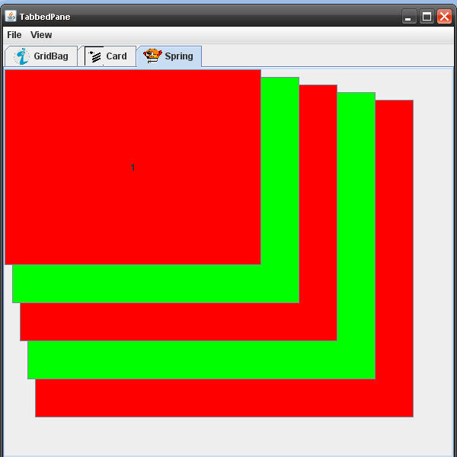
SpringLayout
Rudimentary layout
Not recommended for hand coding
Components are defined by their relationships to other components

Slide 6
Other GUI Components
Tabbed Panes
JMenu
Buttons With Icons

Slide 7
Tabbed Panes
Similar Behavior to CardLayout with a tab interface
Allows the use of Icons the same as JButtons

Slide 8
Jbuttons and Icons
Icons can be added to a button
The Icon is defaulted to the Left of text

Slide 9
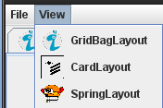
JMenu
Creates a menu similar to many applications
Useful for saving, loading, new, functions that would be accessed from many different parts of an application
Menus created from top down, Create MenuBar, then Menu, then MenuItem
Also Allows Icons

