Slide 1
Animation in Java

Slide 2
AnimationDemo
Checkout AnimationDemo from your repository. Run it. Examine its code as you go through the following slides.
AnimationDemo uses a Model-View-Controller (MVC) architecture
  Model: “represents the information (the data) of the application and the business rules used to manipulate the data.”
    In AnimationDemo, simply a number X that increases/decreases at each step of the simulation
  View: provides a visual display of the model
    In AnimationDemo, X is displayed as a point that moves right to indicate the passage of time and up/down to indicate X increasing/decreasing
  Controller: coordinates the Model and View
    In AnimationDemo, constructs and starts Threads for the Model and View

Slide 3
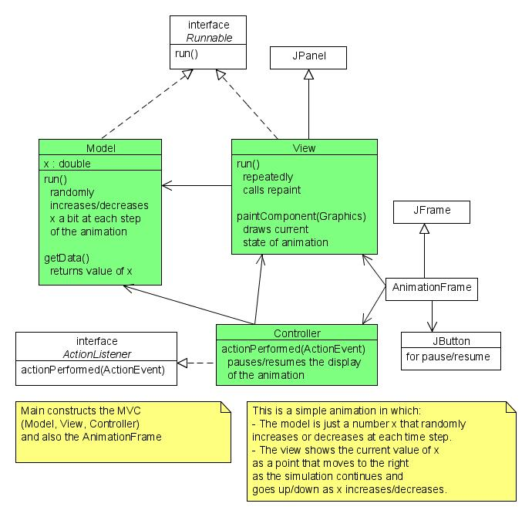
UML class diagram for AnimationDemo
Questions on structure of AnimationDemo?

Slide 4
Key Concepts for Animation in Java
Start a Thread that operates on the panel
  new Thread(panel).start();
  Find this statement in the Controller class
This means that the panel is Runnable, i.e., has a run method
  The run method runs once, when the Thread starts
  For animation, the run method should contain an infinite loop that repeatedly asks the panel to repaint itself
  Find the run method in the View class of AnimationDemo
    Note how the frame rate is controlled by Thread.sleep
Calls to repaint cause paintComponent to run
  paintComponent should draw the current state of the animation
  Find the paintComponent method in the View class of AnimationDemo
    Note where it gets its data from the Model
Questions about Animation in Java?
AnimationDemo chose to have separate animations (Threads) for the Model and the View,
to separate Model from View. Alternative: use a single Thread for both.

