Slide 1
CSSE 132
Data Representation II
Tuesday, April 8, 2025

Slide 2
Questions
How to represent non-integer numbers?
What is “precision” and “range”?
What does your computer do?

Slide 3
Recap: C data types
C declaration | ARMv8-A data type | Size (Bytes)
char | Byte | 1
short | Quarter Word | 2
int | Half Word | 4
long | Half Word | 4
long long | Word | 8
char * | Word | 8
float | Half Word | 4
double | Word | 8
(technically “at least 4”, but usually 4)
(assuming 64-bit machine)
(assuming 64-bit machine)

Slide 4
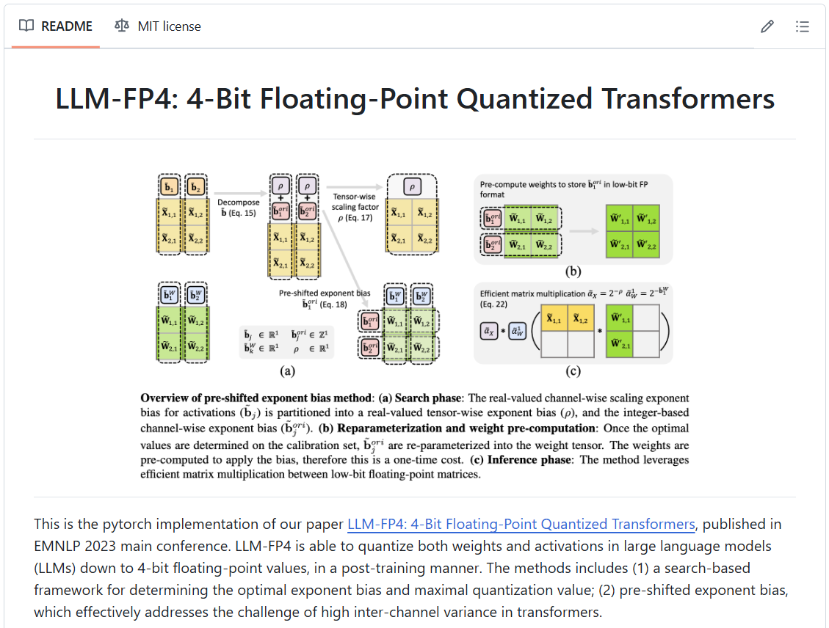
Floating point is having a moment
Current-gen LLMs require ~160GB of GPU memory.
This hardware can cost a lot!
Most people don’t have that much.
We’ve figured out how to “quantize” a model trained with fp32 and make it work with fp4!

Slide 5
Fractional binary numbers
Carnegie Mellon
What is 1011.101₂?

Slide 6
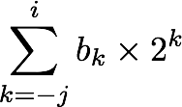
Fractional Binary Numbers
Carnegie Mellon
2^{i}
2^{i-1}
4
2
1
• • •
bi | bi-1 | ••• | b2 | b1 | b0 | b-1 | b-2 | b-3 | ••• | b-j
1/2
1/4
1/8
2^{-j}
• • •
Representation
  Bits to right of “binary point” represent fractional powers of 2
  Represents rational number:
Notes:
Latex source for equation: \sum_{k=-j}^i b_k \times 2^k

Slide 7
Convert decimal to binary float
Multiply by 2 by shifting left
Try 0.1: 0.0001100110011…
  0.1 x 2 = 0.2 – 0
  0.2 x 2 = 0.4 – 0
  0.4 x 2 = 0.8 – 0
  0.8 x 2 = 1.6 – 1
  0.6 x 2 = 1.2 – 1
  0.2 x 2 = 0.4 – 0
  0.4 x 2 = 0.8 – 0
  0.8 x 2 = 1.6 – 1
  0.6 x 2 = 1.2 – 1

Slide 8

Intuition for Floating Point Representation
How many digits could we use to represent 126,000,000,000?
What about $1.26∗{10}^{11} ?$
  12611?

Slide 9
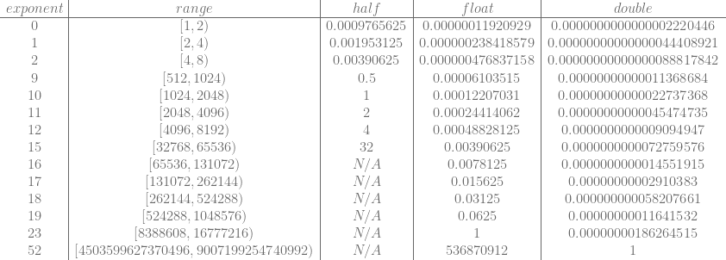
Range vs. Precision
Floats use a variable exponent whose value affects…
  Range: min to max values
  Precision: “tick” between adjacent values
Source: https://blog.demofox.org/2017/11/21/floating-point-precision/

Slide 10
IEEE 754
Half-precision 16-bit seeeeeffffffffff
  1 bit sign
  5 bit exponent (unsigned)
  10 bit fraction/significand (unsigned)
Formula: (−1)^{sign} × 2^{exp−15} × 1.significand
Simple Examples:
0 01111 0000000000 = (−1)⁰ × 2¹⁵⁻¹⁵ × 1.0000000000₂ = 1
1 00111 0000000000 = (−1)¹ × 2⁷⁻¹⁵ × 1.0000000000₂ = –1 × 2⁻⁸ = –2⁻⁸

Slide 11

IEEE 754 (cont.)
1 bit sign
8 bit exponent (unsigned)
23 bit (24 with leading 1) fraction/significand (unsigned)
Special cases:
  Zeros: sign = 1 or 0, exp = all 0, significand = all 0
  Infinity: sign = 1 or 0, exp = all 1, significand = all 0
  NaN: sign = 1 or 0, exp = all 1, significand = anything not all 0
float

Slide 12
What can go wrong?
Remember that both range and precision, while flexible, are limited.
In what ways can our abstract understanding of numbers be fooled by the reality of the datatype?

