Slide 1
CSSE 132
Strings and Structs
Monday, March 24, 2025

Slide 2
Questions
How are “strings” handled in C?
How to create an “object” in C? struct

Slide 3
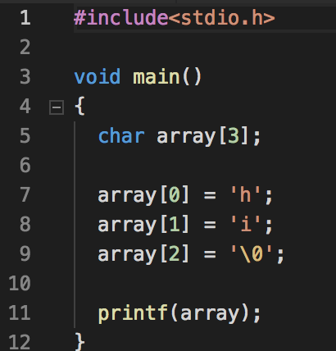
Strings
Arrays of characters (each 1 byte)
  Length is determined by the location of a null char ‘\0’
Address
Data
array + 0
array + 1
array + 2
'h'
'i'
'\0'

Slide 4
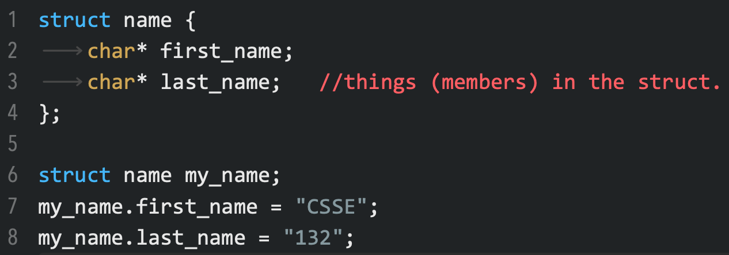
Struct
A compound type. C version of an “object”?
  Note: fields only, no “methods” per se.
Declaration
Use struct (Note type is struct name, not just struct or name.)

Slide 5
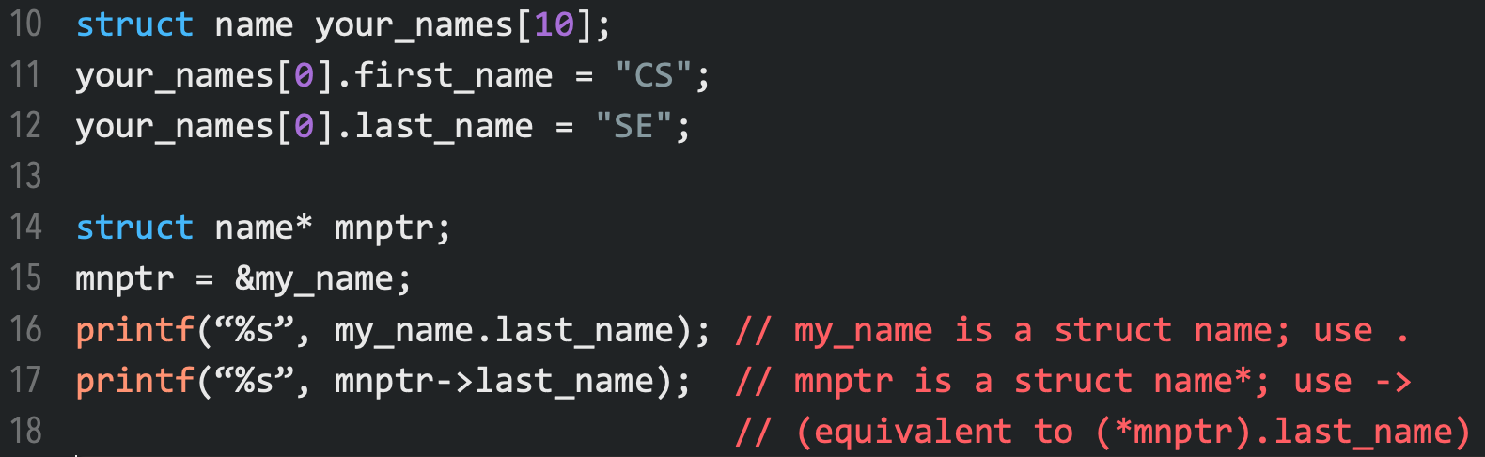
Struct usage
Struct can be used like other data types: can have an array of structs, or pointer to struct.
  struct array
  struct pointer (when to use use -> instead of . to get a member?)

Slide 6
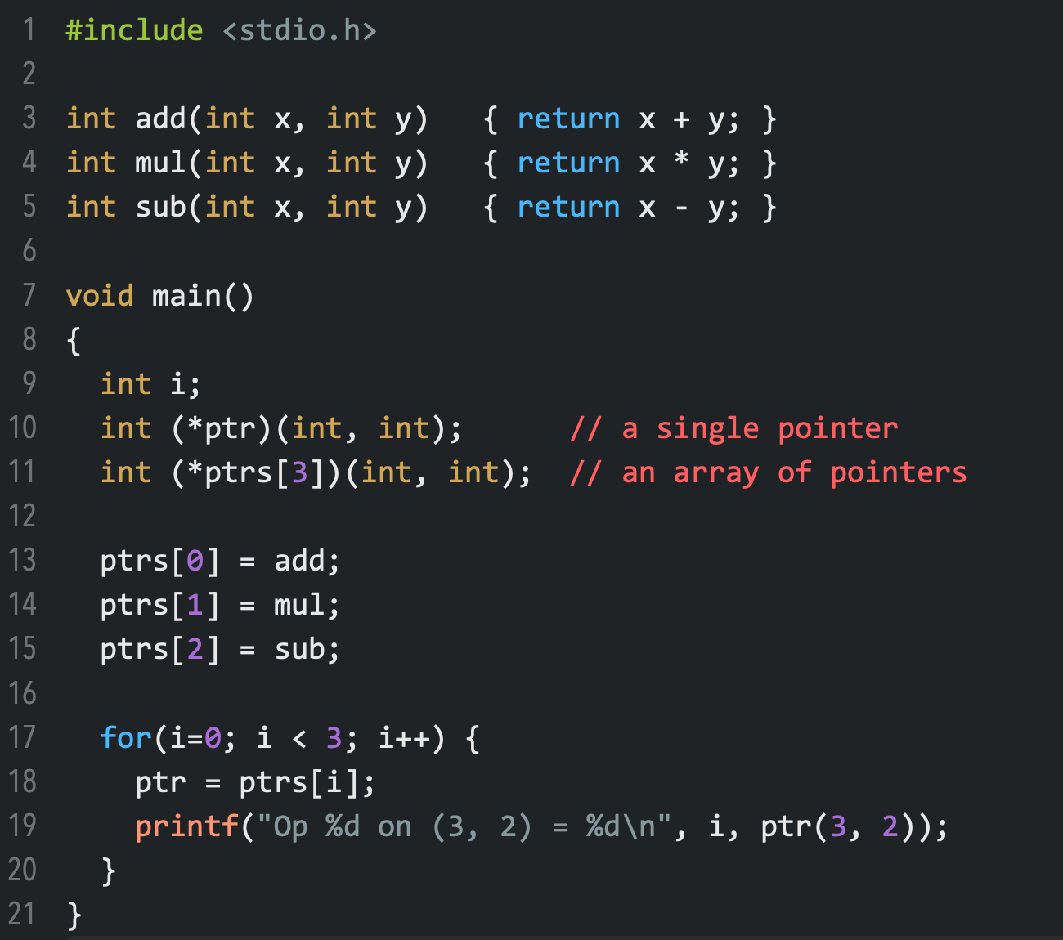
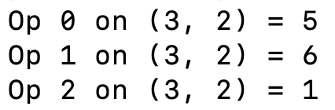
Function pointers
Declaration:
return_type (*name)(input_args)
C’s version of an “object”:
a struct, with “methods” given by function-pointer members!

Slide 7
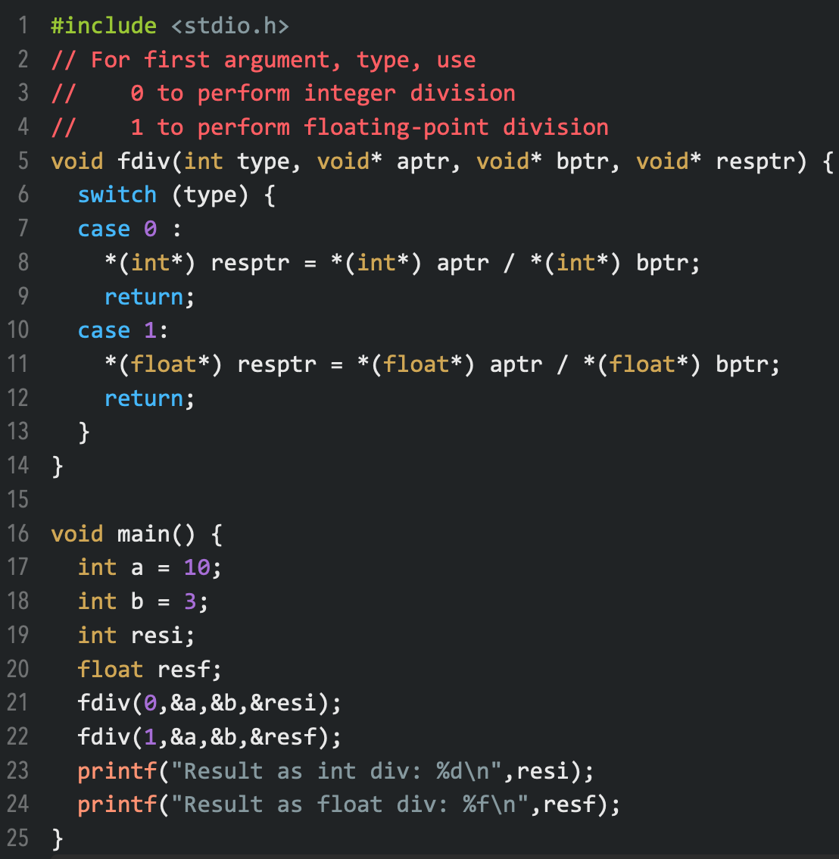

Void pointers
Useful for polymorphism on input arguments
  Example: printf arguments
For such a variable to be used, the pointer requires a cast to the appropriate type-pointer.

Slide 8
(Optional) Multi-dimensional arrays
Arrays of another arrays
  char array[3][4];
  array[i][j] == *(array + i*4 + j)
Examples:
  int main(int argc, char** argv)

Slide 9
Pointer of pointer
What is int ** ?
  int x;
  int* p;
  int** pp;
  x = 10;
  p = &x;
  pp = &pp;
Can we do the same to &, like &&x?
  NO.
0x0000 0008 | x | 10
0x0000 000c | p | 0x0000 0008
0x0000 0010 | pp | 0x0000 000c

