Slide 1
CSSE 132
Pointers and Arrays
Monday, March 23, 2026

Slide 2
Questions
What is a pointer?
How to carefully use pointers?
  pointer operation
  pointer arithmetic
How do data arrays work in C?
How to use pointers to access array elements?

Slide 3
Variables in memory
When you declare int x:
  Memory is allocated for x at a certain address
  Machine handles/remembers address of x
  (actually, handled at compile time)
0x0000 0008 | x

Slide 4
Pointer operation
Type int* xp means “xp is the address of an int”
  int* xp;
Getting the Address: &x means “address of data in x”
& is the address operator and asks “where is this thing?”
  int x = 3;
  xp = &x;
Dereference: retrieving/setting data at an address:
  *xp means “the data at memory address xp”
  int y = *xp;
  Can also be used to set that data
  *xp = 5;

Slide 5
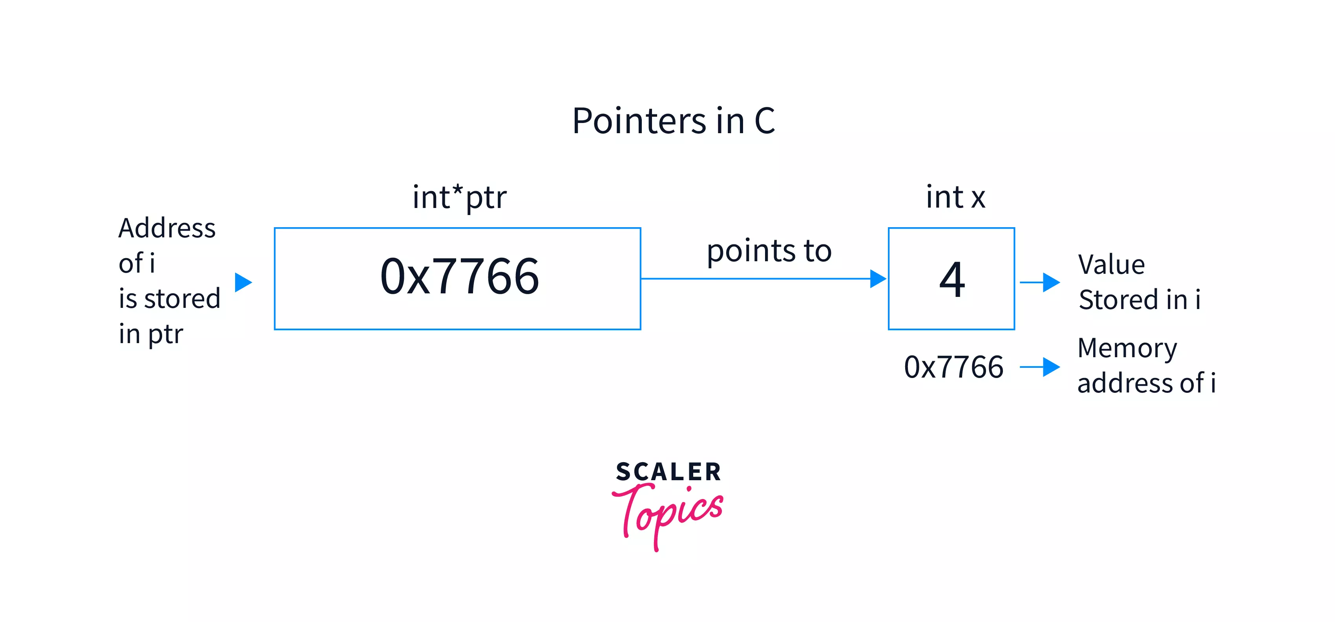
Pointer illustration
Pointer is the address (label) of a container (cabinet)
int x = 4;
int* ptr = &x;
// *ptr = 50
Source

Slide 6
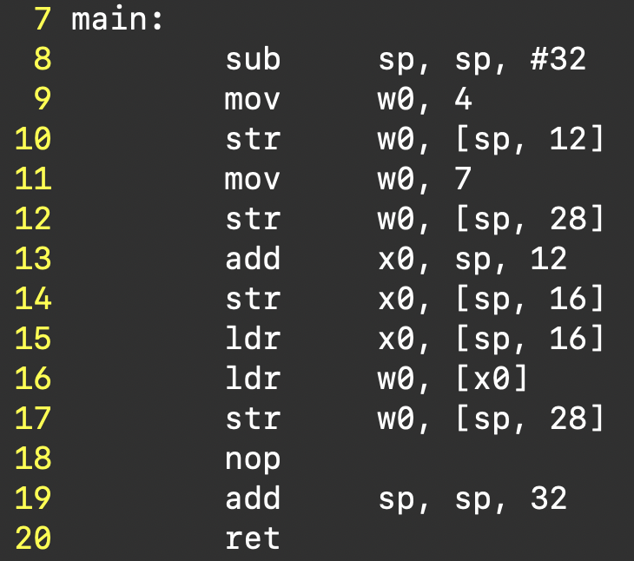
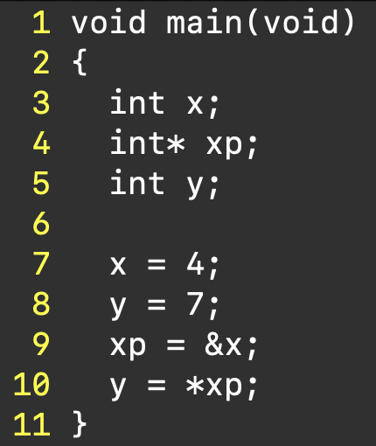
Example: pointers1.c
[ ] means to sum the things inside and dereference the resulting address (like *addr)

Slide 7
Pointer arithmetic
Assume a pointer p to type <type>, and p has value X (an address)
Then p + n (n is an integer) is a pointer, and has value (address)
X + n*size(type)
This means, if there are enough items of type <type> in memory starting at p, then
  p points to the 0th item of type <type>
  (p + n) points to the n^{th} item of type <type>

Slide 8
Pointer arithmetic (cont.)
0x0000 0008 | x
0x0000 000c | xp
0x0000 0010 | y
int x;
int* xp;
int y;
x = 4;
xp = &x;
y = 0;
xp = xp + 2 // it adds two of size(type) to xp
*xp = 7;
What is y? (assume using GCC)

Slide 9
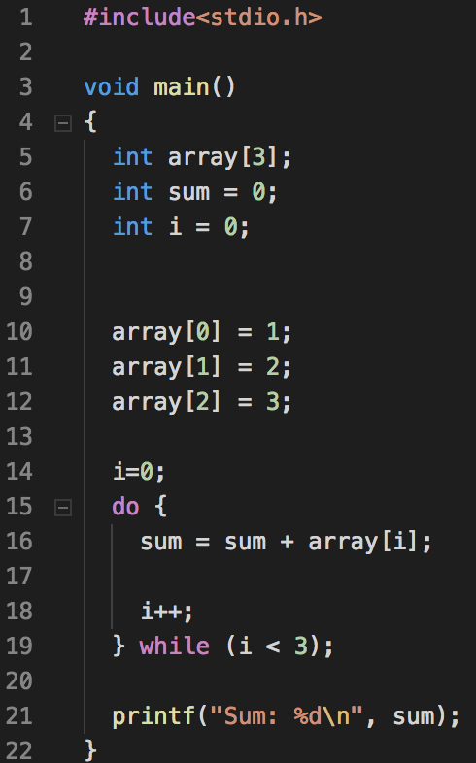
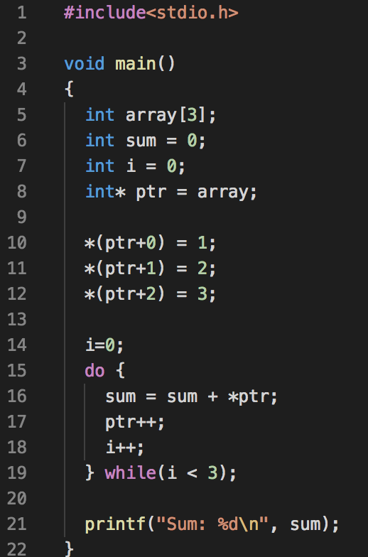
Arrays are Pointers
An array is a continuous chunk of memory
  array[1] is *(array + 1)

