Slide 1
CSSE 132
C Programming and Data Types
Monday, March 24, 2025

Slide 2
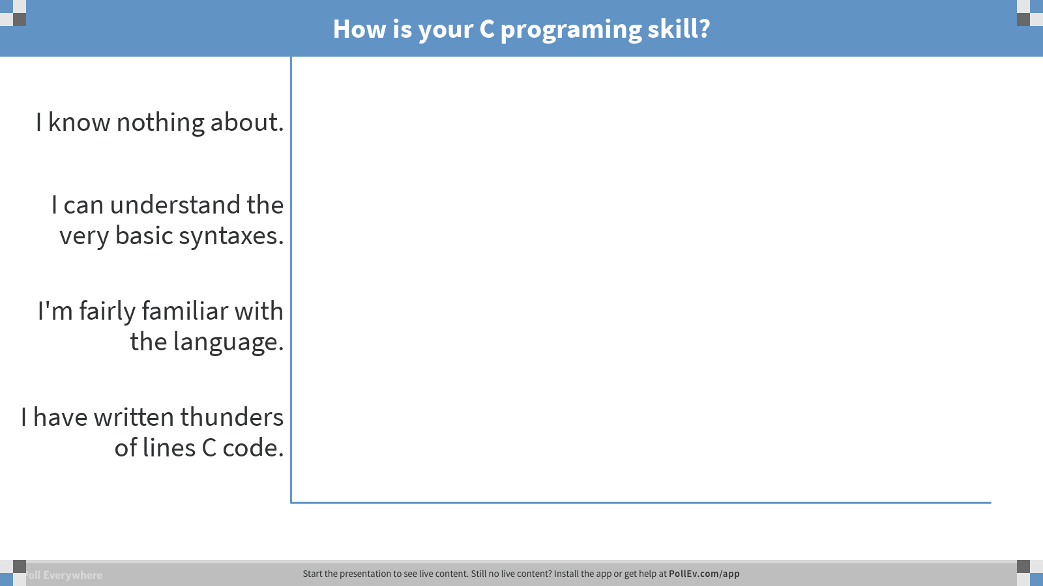
Notes:
How is your C programing skill?
https://www.polleverywhere.com/multiple_choice_polls/YS6q3mxlCM9BFo4

Slide 3
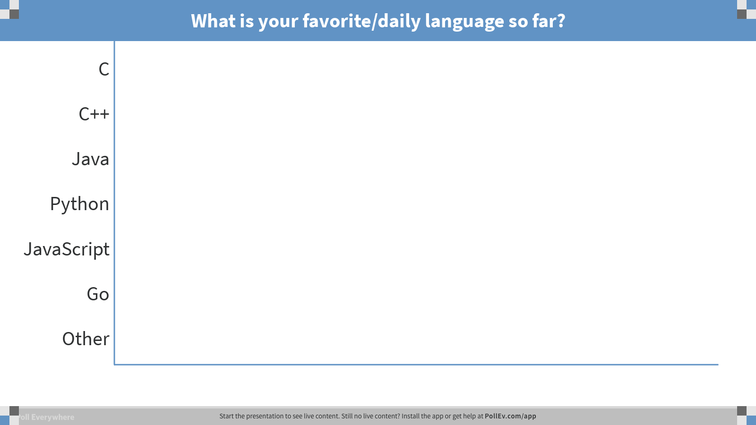
Notes:
What is your favorite/daily language so far?
https://www.polleverywhere.com/multiple_choice_polls/Ye5c73FBeOdF19c

Slide 4
C v.s. Java
Similarities:
  Syntax
  Functions
  if/for/while/else
Differences:
  C has no classes
  No exceptions
  No new
  No strings

Slide 5
Variables
Declare them: <type> <variable name>: int i;
Initialize them: use the assignment operator. i = 10;
Use semi-colon to end each line.

Slide 6
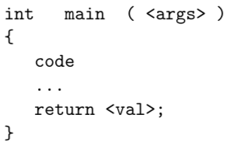
C code blocks and functions
Identify the parts: return type, arguments list, function name, body.

Slide 7
Operators
Arithmetic: +, -, *, / ,%
Relational and Logical: <, >, <=, >=, ==, !=, &&, ||
Bitwise: & ,| , <<, >>
Assignment: =

Slide 8
Data types
C declaration | ARMv8-A data type | Size (Bytes)
char | Byte | 1
short | Quarter Word | 2
int | Half Word | 4
long | Half Word | 4
long long | Word | 8
char * | Word | 8
float | Half Word | 4
double | Word | 8
(technically “at least 4”, but usually 4)
(assuming 64-bit machine)
(assuming 64-bit machine)

Slide 9
Import a library
#include <name_of_lib>

Slide 10
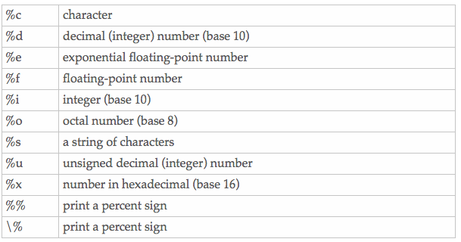
printf (a function in stdio.h)
Like System.out.println, but flexible.
Format strings: conversion specifiers sprinkled into string

Slide 11
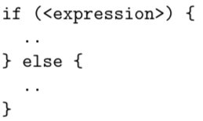
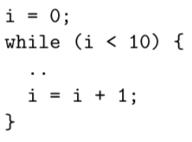
Control and loops

