Slide 1
CSSE 132
Introduction to Computer Systems
Course Overview
Friday, February 27, 2026

Slide 2
Outline
Get to know each other
Get to know the course

Slide 3
CSSE132 Themes
How does a computer represent different types of data?
How does my high-level code (e.g., C) relate to machine code (code that the computer hardware is capable of performing)?
How does a computer manage data in memory?
How does communication happen
  between programs?
  between users and programs?
  between computers or networked devices?
In general, the interface between software and hardware

Slide 4
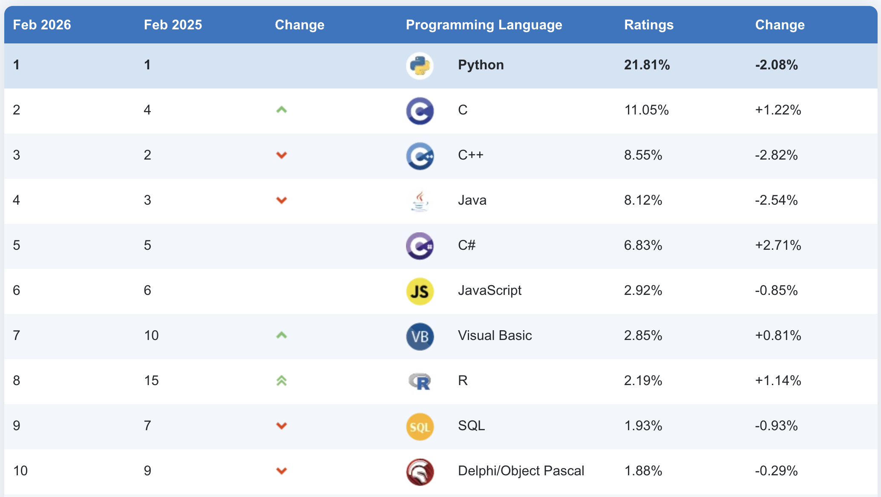
Why take this class?
You will know C.
And work in Linux!
“Introduction to hacking”
Source: TIOBE index

Slide 5
Why take this class? (cont.)
You will be prepared for
  [Along with ECE 233] CSSE 232 (computer architecture) and ECE 332 (comp. arch. II)
  CSSE 332 (operating systems)
  CSSE 432 (computer networks) [elective]
You will become a better programmer.
  Abstractions vs. Reality
  What can go wrong?
Car analogy.
  You already know how to drive it (and will keep getting better)
  But what's under the hood?

Slide 6
Course components
Full Syllabus
Course website: https://www.rose-hulman.edu/class/csse/csse132
Homework (8)
  On time (Thu 11:59pm)
Class participation
  Quizzes not collected, for learning
Labs (8)
Exams (2 mid + final)
Grading
Class participation | 5%
Homework | 16%
Labs | 16%
Exams | 63% = 18% + 18% + 27%
You must earn a passing average on the exams to pass the course.

Slide 7
Resources
Website
  Syllabus, schedule, slides, examples, resources, etc.
Moodle
  Link to instructor schedule, Teams offline Q&A
  Grades
Gradescope
  Written homework submission
ARM64 VMs (wait for Lab 1)
  Linux “hardware” for our work in C and ARM assembly
Gitter (wait for Lab 1)
  Student repositories for code management

Slide 8
What’s next?
Bookmark webpage: https://www.rose-hulman.edu/class/csse/csse132
Prelab 1: due by Lab time Wednesday
Homework 1: due Thu 11:59pm (can start after Day 2 class)

