Slide 1
CSSE 132
Introduction to Networking
Thursday, May 8, 2025

Slide 2
Modern networking is a tower of abstractions.
Each layer of abstraction
exists to solve particular
problems.
Let’s talk through these problems today.

Slide 3
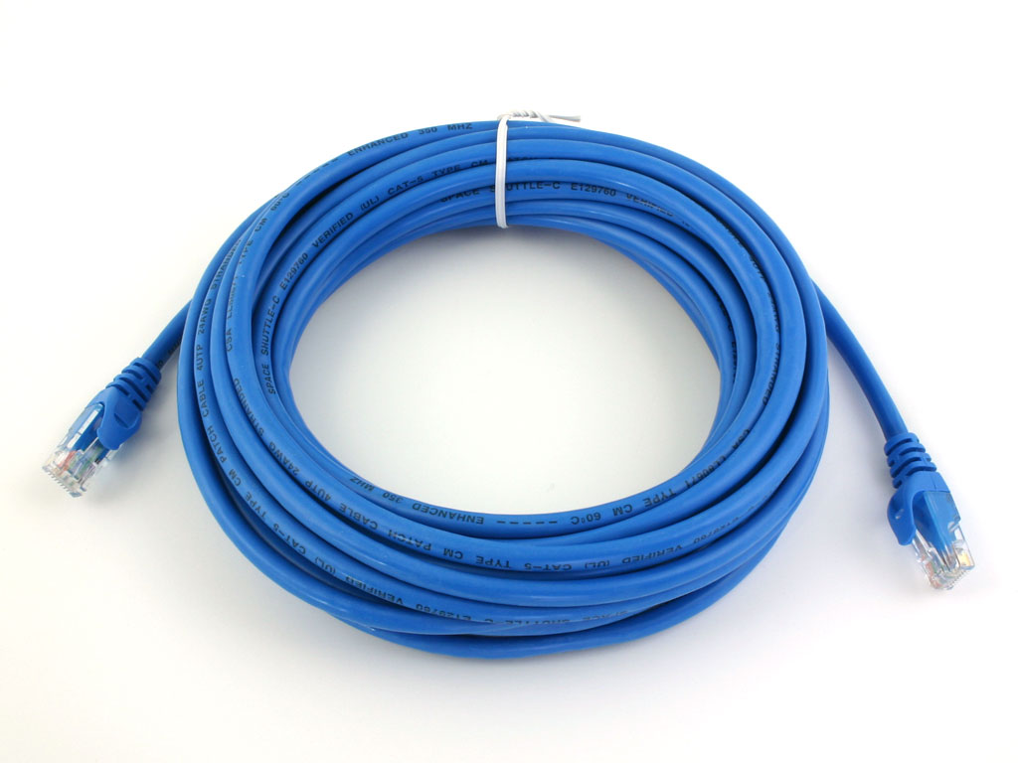
Problem: how can two computers communicate?
Physical connection between two machines
(electrical or optical)
Could also do Wifi

Slide 4
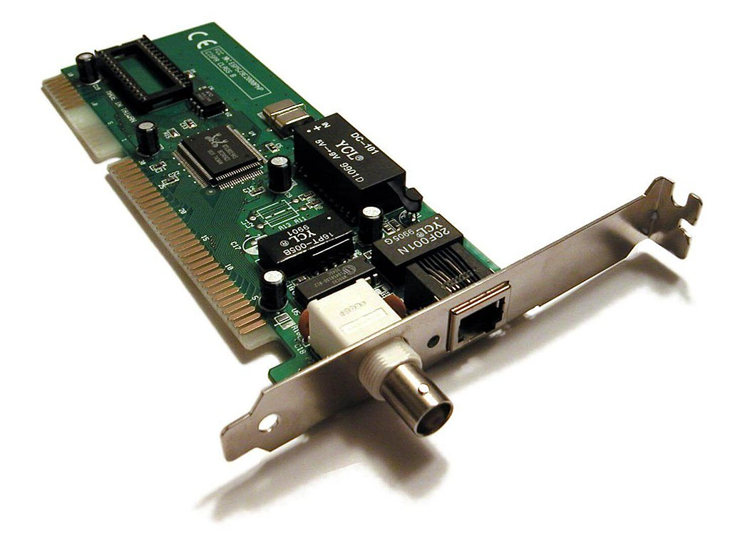
Problem: how can two computers communicate?
NIC – Network Interface Controller
Place to attach some sort of cable
Electrical connection to your computer

Slide 5

Problem: how can two computers communicate?
Direct connection. Simple, but limited.

Slide 6
Problem: how can lots of computers communicate?
Direct connections?

Slide 7
Problem: how can lots of computers communicate?
Direct connections?
Uh oh.

Slide 8
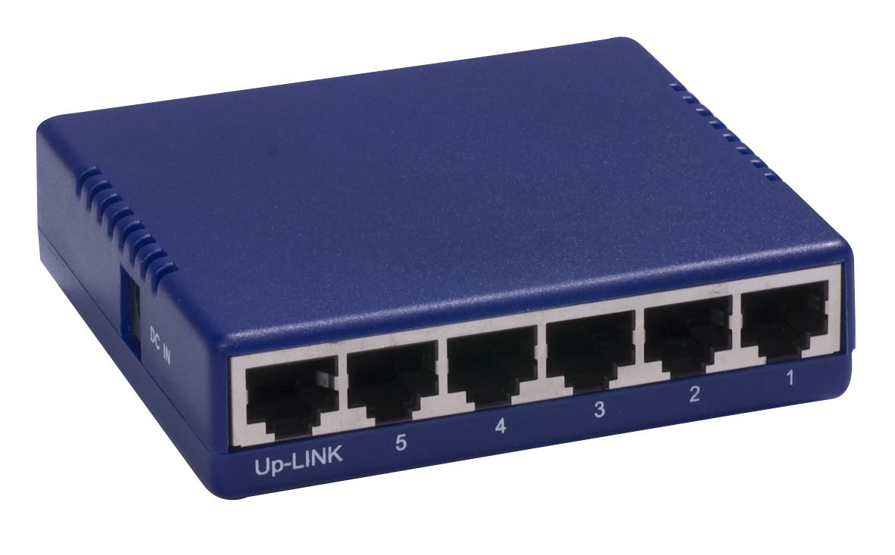
Problem: how can lots of computers communicate?
Network hub

Slide 9
Problem: how can lots of computers communicate?
Network hub
  Like a shared wire
  Signal on one port is echoed out all other points

Slide 10
Problem: how do we talk to one device, instead of all of them?
MAC address: 00:15:5d:e1:0f:40
MAC address
  Media Access Controller
  6 bytes
  Stamped at the factory
  Should be unique^{[1]}
^{[1] This is kind of a lie.}

Slide 11
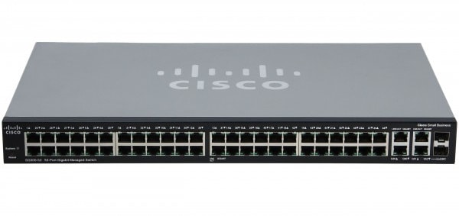
Problem: how do we talk to one device, instead of all of them?
Network switch
  Looks like a hub
  Remembers which MAC is on which wire
  Only send the signal out on one wire
switch table
if7: 00:15:5d:e1:0f:40
if12: 08:2e:4d:03:1d:ac
…

Slide 12
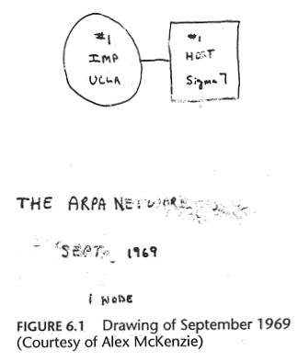
Problem: the Internet got very big.
A switch can’t reasonably learn every MAC for every device

Slide 13
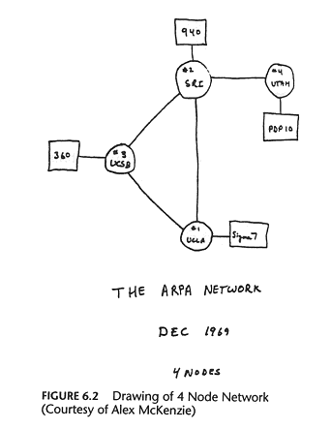
Problem: the Internet got very big.
A switch can’t reasonably learn every MAC for every device

Slide 14
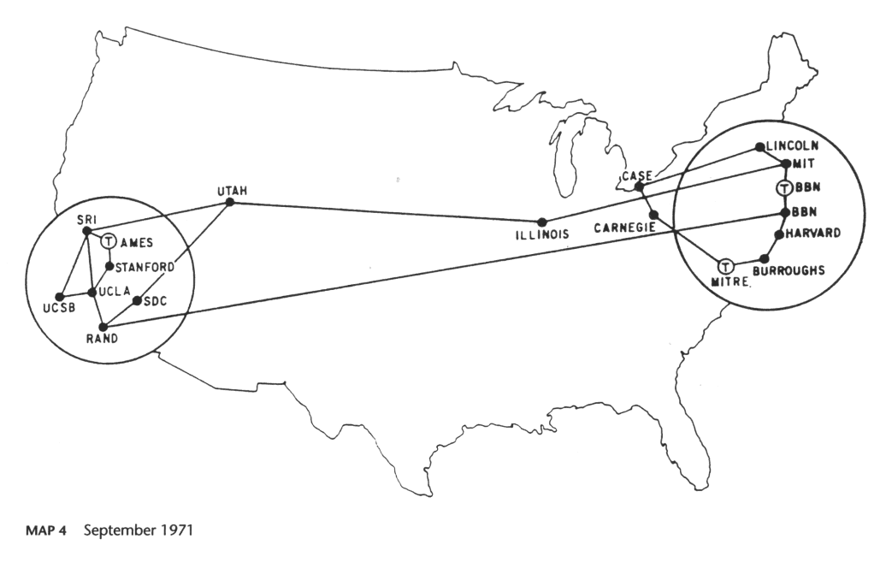
Problem: the Internet got very big.
A switch can’t reasonably learn every MAC for every device

Slide 15
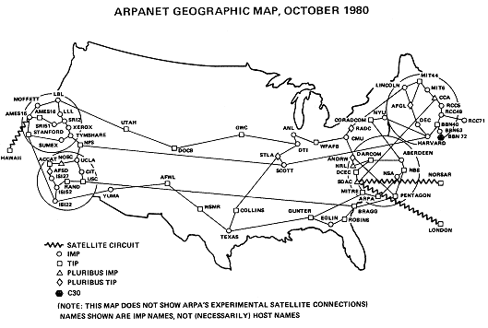
Problem: the Internet got very big.
A switch can’t reasonably learn every MAC for every device

Slide 16
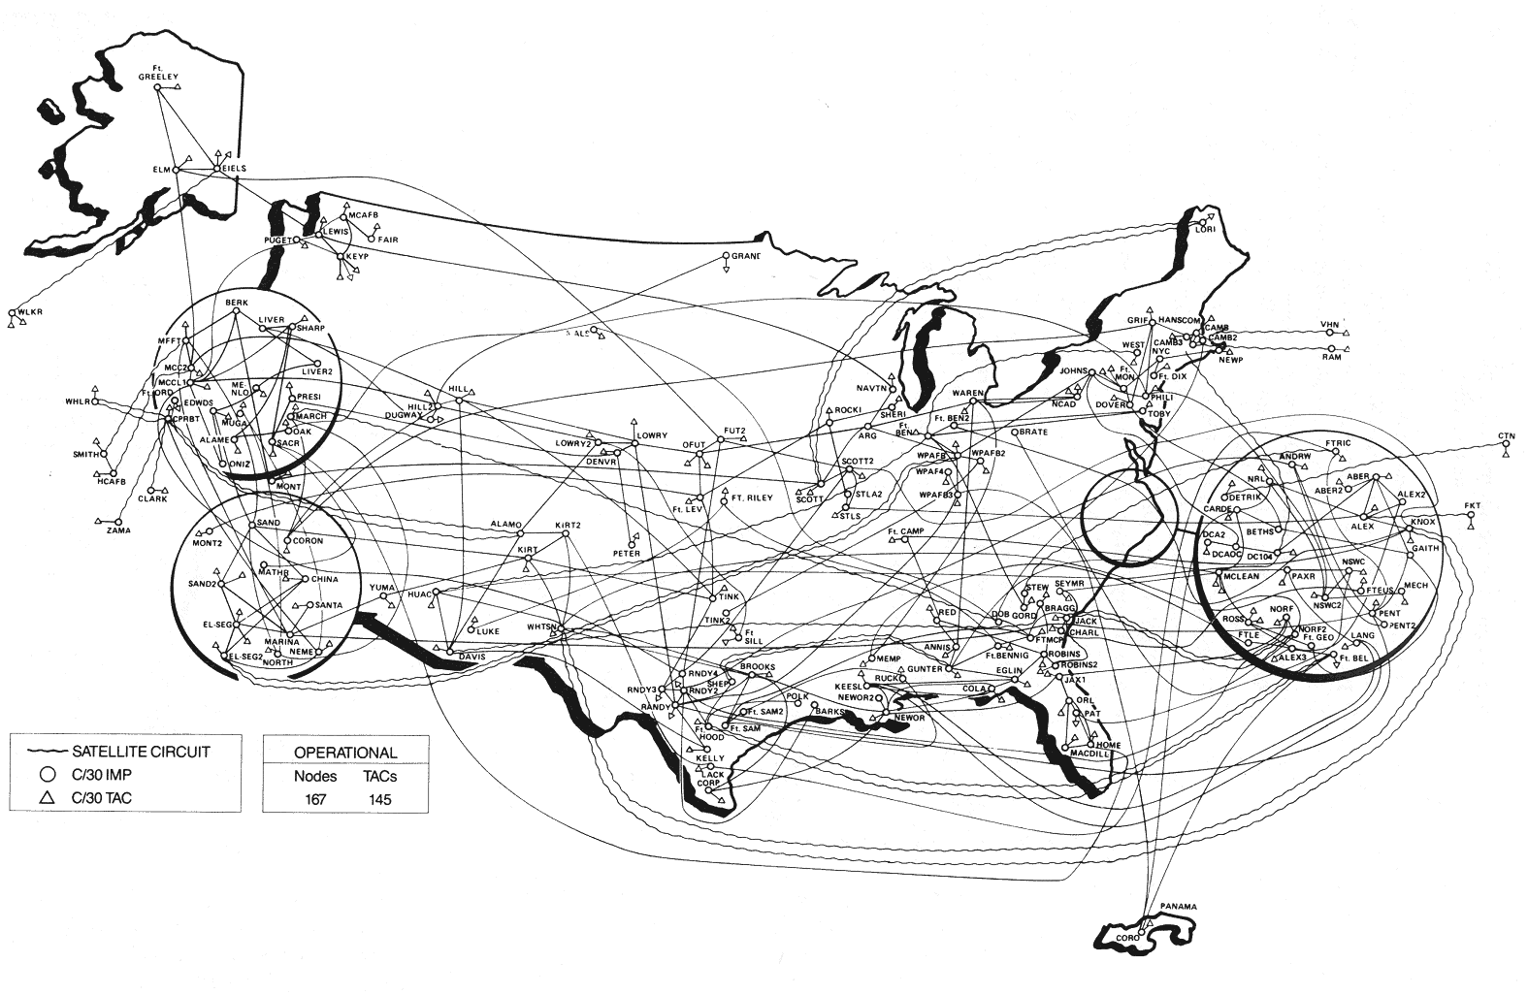
Problem: the Internet got very big.
A switch can’t reasonably learn every MAC for every device
MILNET, 1984 (split from ARPANET)

Slide 17
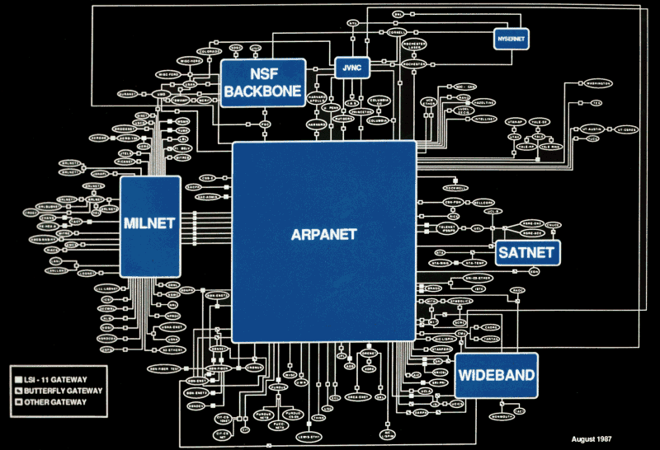
Problem: the Internet got very big.
A switch can’t reasonably learn every MAC for every device
State of the Internet in 1987

Slide 18
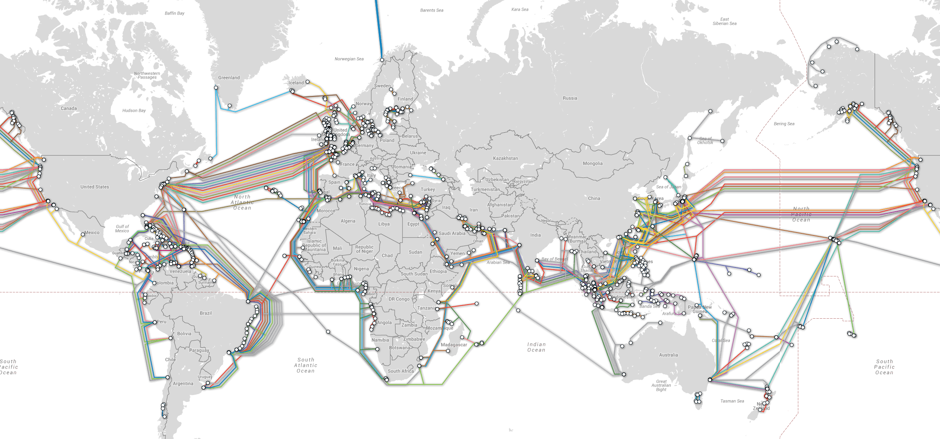
Problem: the Internet got very big.
A switch can’t reasonably learn every MAC for every device
Modern map of the Internet’s underwater fiber optic cables. [https://www.submarinecablemap.com/]

Slide 19
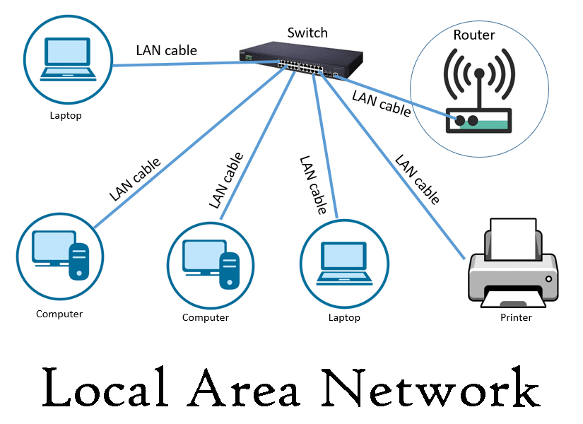
Problem: the Internet got very big.
The Internet
Solution: Wide Area Networks
  Nodes are special networking computers (routers)
  Routers direct packets through the WAN
Solution: Local Area Networks
  Consists mostly of user devices and switches
  Have a designated “gateway” router to communicate outside the LAN.

Slide 20
Problem: the Internet got very big.
Solution: a hierarchical addressing scheme
  Internet Protocol (IP)
  4 bytes
  E.g., all 137.112.___.___ addresses are for Rose-Hulman.
(So many more details: subnets, public / private addresses, network address translation, routing protocols, IPv6 addresses…)

Slide 21
Checkin: layers of abstraction
What problem does each layer solve?
  PHY: How to use physics to carry signal
  Data Link: How to share a signal-carrying medium
  Network: How to deliver data to the correct recipient via the best route
Layers we haven’t talked about yet:
  Transport: How to ensure that your data reaches its destination
  Session: How to deliver data to the right process on your computer
  Remaining layers: take Networks!

Slide 22
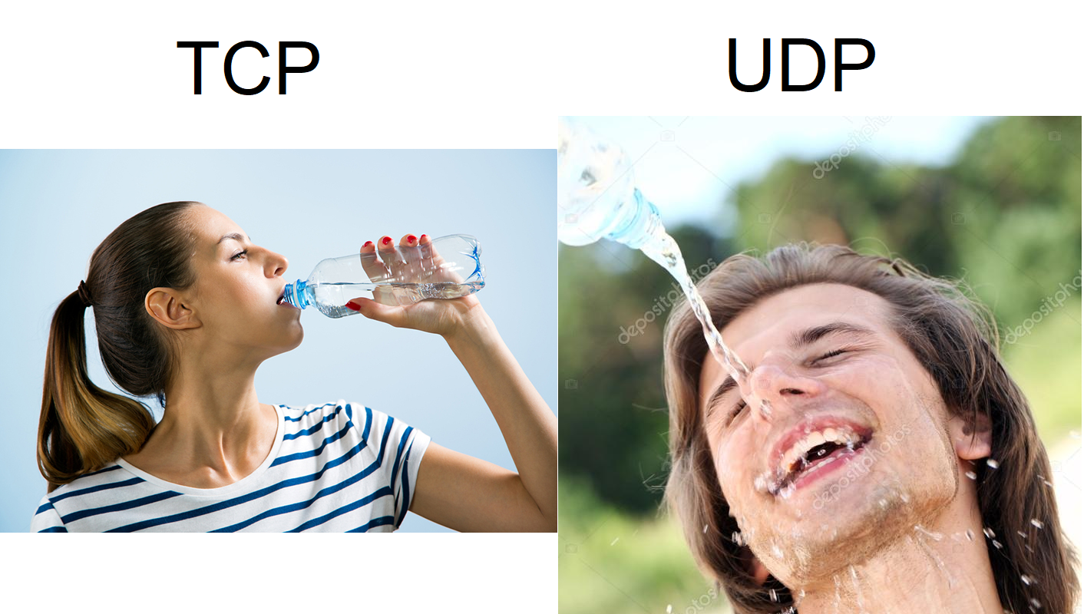
Problem: How to confirm if your data made it to the destination?
TCP: reliable
  Transmission Control Protocol
  Handshakes
  Checksums
  Acknowledgements
  Think: downloading emails, webpages, files
UDP: unreliable
  User Datagram Protocol
  All about speed
  Ignore mistakes
  Think: real-time games, streaming

Slide 23
Problem: How do programs share network access within one computer?
Send and receive data in packets
Attach an ID number to each packet
  Called “port”
  We need each program to use a different port
  OS will deliver a packet to the process with the matching port

Slide 24
Inside a message - Packet

Slide 25
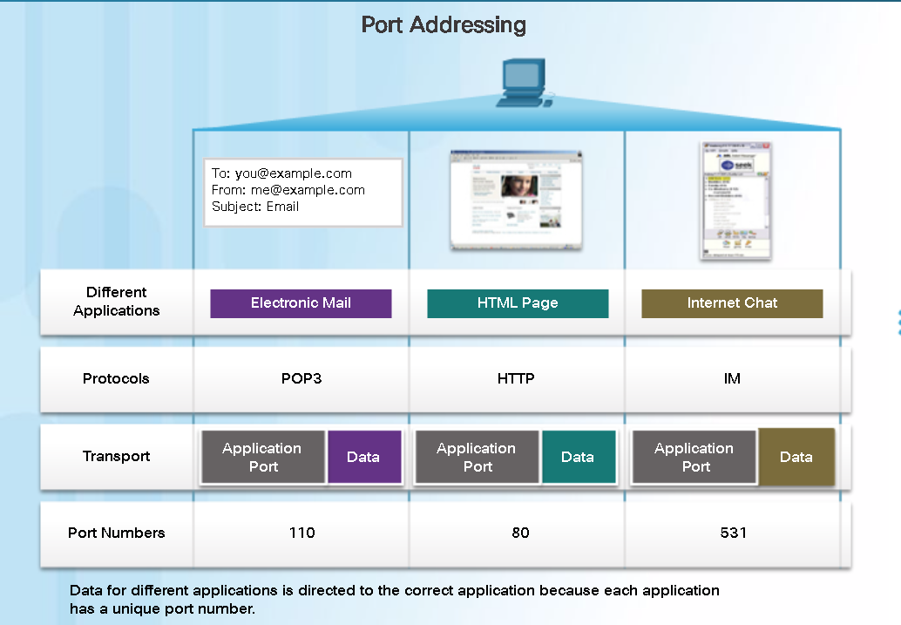
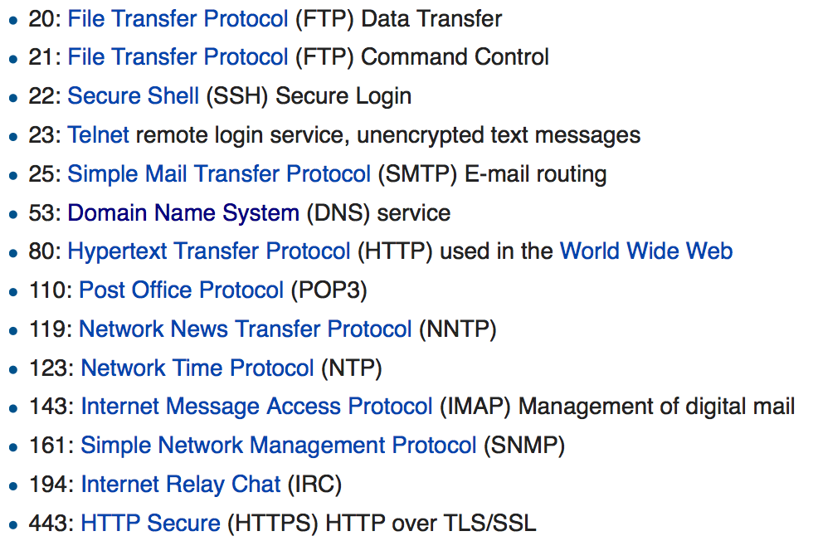
Port

Slide 26
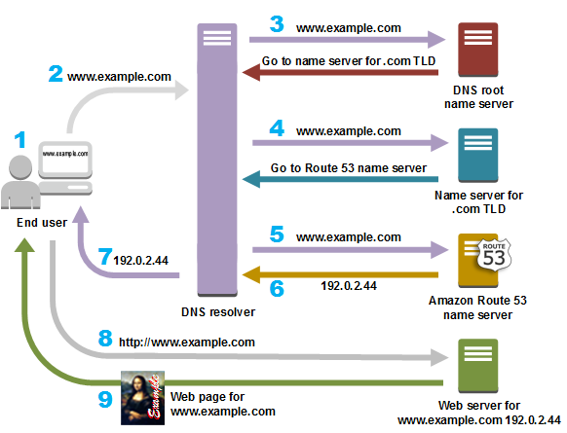
Better Naming: DNS
DNS: Domain Name System
  Humans don’t like to type IP addresses
Common choices:
  Google: 8.8.8.8
  Cloudflare: 1.1.1.1
  OpenDNS: 208.67.222.222

Slide 27
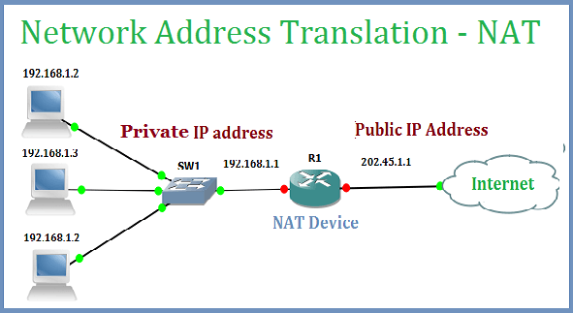
Backup slide:
IP: Naming/Addressing
IPv4: 32bit
  89702E83 = 137.112.46.131
Rose-Hulman IP: 137.112.0.0/16 = 2¹⁶
Is 2³² sufficient? If not, how?
  NAT (Network Address Translation)
  IPv6: 128 bit → 2¹²⁸

