Slide 1
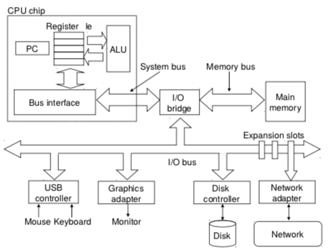
CSSE 132
Memory Addressing
Thursday, March 12, 2026

Slide 2
Questions
How to manage data in memory?
Notes:
Do a quick recap on the top-down view.

Slide 3
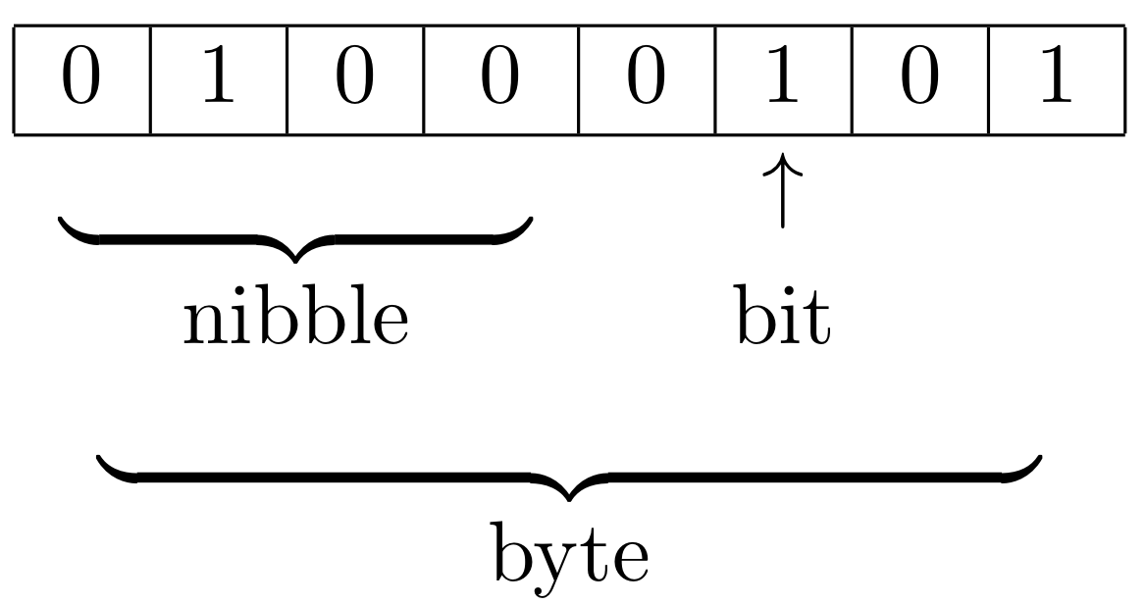
Reminder: Units of data
Bit (b): One bit
Byte (B): 8 bits
Nybble: 4 bits
Word: many bytes. Commonly 4 or 8 bytes, depends on hardware.
Demo: typesizes.c

Slide 4
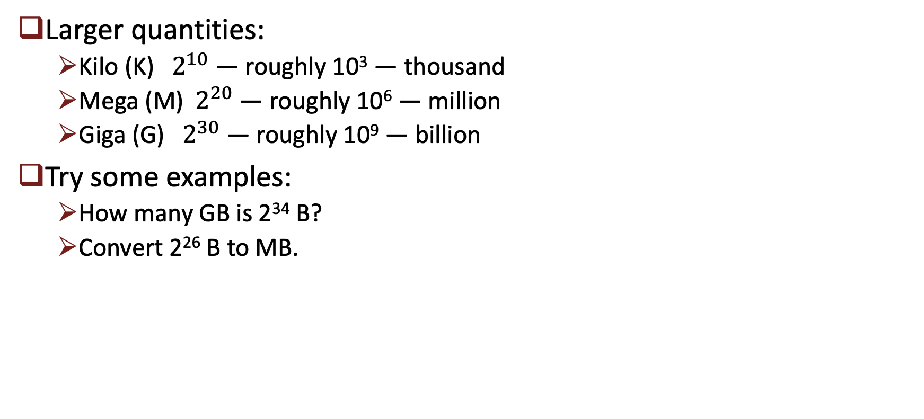
Units of data (cont.)
Larger quantities:
  Kilo (K)${ 2}^{10}$ — roughly 10³ — thousand
  Mega (M)${ 2}^{20}$ — roughly 10⁶ — million
  Giga (G) ${ 2}^{30}$ — roughly 10⁹ — billion
Try some examples:
  How many GB is 2³⁴ B?
  Convert 2²⁶ B to MB.

Slide 5
Where is memory?

Slide 6


Locating data
To a process, main memory looks like one big array of bytes.
Each byte has an “address”.
We name the bytes by counting.

Slide 7
Locating data (cont.)
How big can memory be?
  How big is your computer’s address space? (Hint: your ARM64 VM has a 64-bit system)

Slide 8
Locating data (cont.)
For larger objects (more than a byte), we need to specify the order of storing bytes in memory.
  Little-Endian: Low-order byte (Least Significant Byte) is stored at a lower address.
  Big-Endian: High-order byte (Most Significant Byte) is stored at a lower address.

Slide 9
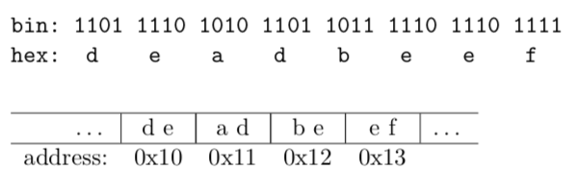

Locating data (cont.)
Example:
Big Endian
Good for comparison
Little Endian
Good for arithmetic operation

