Slide 1
CSSE 132
Introduction to Assembly
Thursday, April 3, 2025

Slide 2
Outlines
How does programing language become executable code?
Introduce Assembly – ARM
Assembly Practice

Slide 3
C vs. Java vs. Python
What happens at development time vs. runtime?
We focus on C.

Slide 4
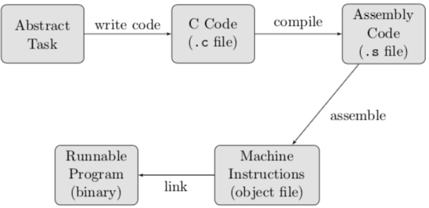
Program path
Task → C Code → Assembly → object code →executable code

Slide 5
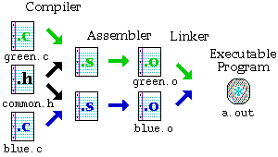
Creating an executable
Source: http://www.eng.hawaii.edu/Tutor/Make/1-2.html
Notes:
Compiler stage: All C language code in the .c file is converted into a lower-level language called Assembly language; making .s files.
(can use -S option)
Assembler stage: The assembly language code made by the previous stage is then converted into object code which are fragments of code that the computer understands directly. An object code file ends with .o.
(Can use –c option) The object code is generated using the instruction set architecture of the underlying machine.
Linker stage: The final stage in compiling a program involves linking the object code to code libraries which contain certain "built-in" functions, such as printf. This stage produces an executable program, which is named a.out by default. (Can use –o option to rename executable)
5

Slide 6
Compiling
In example.c:
int foo() {
int x = 13;
int y = 14;
return x + y;
}
In example.s:
foo:
sub sp, sp, #16
mov w0, 13
str w0, [sp, 12]
mov w0, 14
str w0, [sp, 8]
ldr w1, [sp, 12]
ldr w0, [sp, 8]
add w0, w1, w0
add sp, sp, 16
ret
gcc –S example.c
Tells gcc to compile C code example.c into assembly code example.s

Slide 7
Assembling
In example.s:
foo:
sub sp, sp, #16
mov w0, 13
str w0, [sp, 12]
mov w0, 14
str w0, [sp, 8]
ldr w1, [sp, 12]
ldr w0, [sp, 8]
add w0, w1, w0
add sp, sp, 16
ret
In example.o:
0000000000000000 <foo>:
0: d10043ff sub sp, sp, #0x10
4: 528001a0 mov w0, #0xd // #13
8: b9000fe0 str w0, [sp, #12]
c: 528001c0 mov w0, #0xe // #14
10: b9000be0 str w0, [sp, #8]
14: b9400fe1 ldr w1, [sp, #12]
18: b9400be0 ldr w0, [sp, #8]
1c: 0b000020 add w0, w1, w0
20: 910043ff add sp, sp, #0x10
24: d65f03c0 ret
(binary written as hex)
gcc –c example.s
Tells gcc to assemble assembly code example.s into object code example.o

Slide 8
Linking
If your program needs other code (like a print library or something), it has to be “linked”.
To accomplish this, you can use ld: something like
  ld example.o /usr/lib/aarch64-linux-gnu/libc.so
But there are nuances, so probably better to just use gcc from the source
  From C: compile-assemble-link with
  gcc example.c –o example
  From Assembly: assemble-link with
  gcc example.s –o example

Slide 9
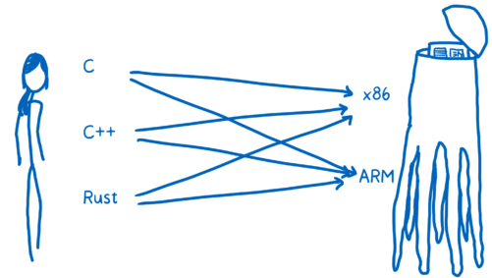
What is Assembly language?
https://hacks.mozilla.org/2017/02/a-crash-course-in-assembly/

Slide 10
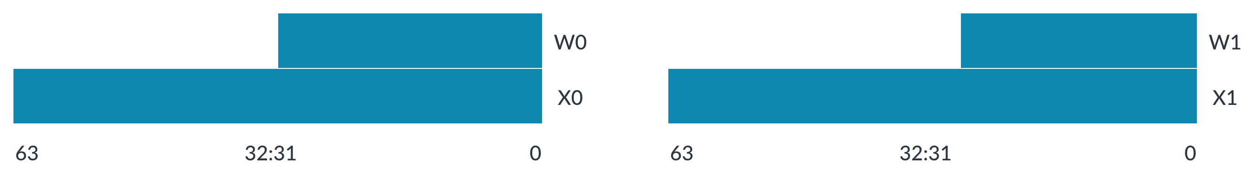
Reminder: Registers
In Armv8-A (aarch64, arm64) there are 31 general-purpose 64-bit registers, numbered 0, … 30.
Each register can be used as a 64-bit X register (X0..X30), or as a 32-bit W register (W0..W30). [Case-insensitive: x0 same as X0]
Recommended to use registers 0–15 in your code
When a W register is written, the top 32 bits of the 64-bit register are zeroed.
ADD w0, w1, w2 @ 32-bit addition on registers 0 and 1
ADD x0, x1, x2 @ 64-bit addition on the same registers!

Slide 11
ARM64 Register Examples
MOV w0, 3 @ w0 = 3
MOV w1, -1 @ w1 = -1
@ [Note: 0x00000000ffffffff]
ADD w2, w0, w1 @ w2 = w0 + w1
ADD w2, w1, 3 @ w2 = w1 + 3

Slide 12
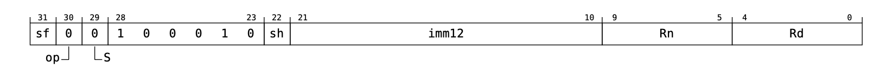
Anatomy of an Assembly Instruction
Assembly (.s)
Object (.o)
add w2, w1, 3
768: 11000c22 add w2, w1, #0x3
Hex: 1 1 0 0 0 c 2 2
Bin: 0 0 0 1 0 0 0 1 0 0 0 0 0 0 0 0 0 0 0 0 1 1 0 0 0 0 1 0 0 0 1 0
op code
for ADD
From Arm Architecture Reference Manual for A-profile architecture

Slide 13
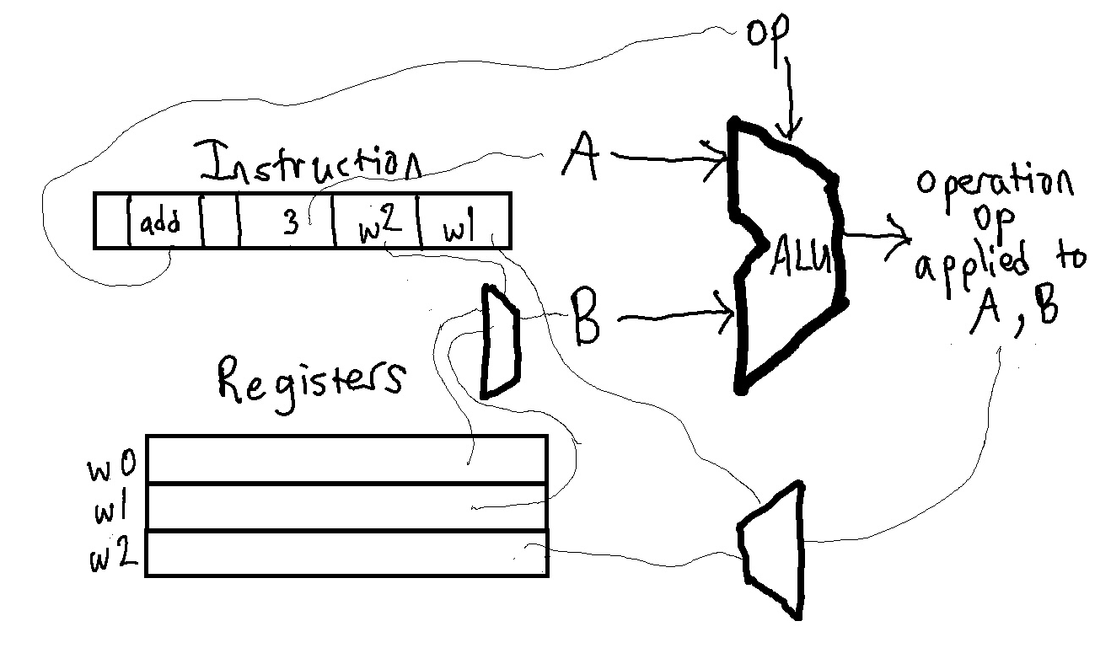


Behind the Scenes: Circuits Compute
op code
for ADD

Slide 14
Bigger data storage?
Store
  str w1, <address>
Load
  ldr w1, <address>
Example:
  Suppose x1 contains an address.
  ldr w0, [x1]
  add w0, w0, #1
  str w0, [x1]
ldr
str

Slide 15
Instruction storage?
Instruction memory
PC: program counter register
  Each instruction run causes CPU to load [pc], execute it, then increment it.
764: b9000be0 str w0, [sp, #8]
768: 11000c22 add w2, w1, #0x3
76c: b9400fe1 ldr w1, [sp, #12]
pc
Note: you might think of as having the value 0x768 (the line number)…
while not quite correct*, it gets at the idea of the instruction’s address.
*The address actually references the CODE part of memory.

Slide 16
Branching
b <target>
Conditional Executions:
  Add a suffix to the instruction (e.g., NE, GT, GE, LE, LT, EQ)
  depends on previously set flags (usually previous instruction)
    Comparison Flags: N (negative) Z (zero) C (carry) V (overflow)

