Slide 1
CSSE 132 Linux I/O
Monday, May 4, 2020

Slide 2
Questions
How do Linux systems interact with external devices?
Files
How is I/O handled in Linux?
Unbuffered I/O
Buffered I/O
Interactive C program: read from keyboard — fgets

Slide 3
Linux I/O
All I/O devices, such as networks, disks, and terminals, are modeled as files.
All input and output is performed by reading and writing the appropriate files.
Data in and out use the same API:
User IO
Printing
Network Communication
External devices
Demo: We can check the data on ram by reading the file /dev/mem

Slide 4
File types
Regular file (-)
Directory files (d)
Special files
Block file (b)
Character device file (c)
Named pipe file or just a pipe file (p)
Symbolic link file (l)
Socket file (s)
Try: ls -l /dev/

Slide 5
Unbuffered vs. Buffered I/O: Syntax
Unbuffered | Buffered
open | fopen
read | fread
write | fwrite
close | fclose
lseek | fseek ftell
Unbuffered I/O (less useful—we won’t study in detail)
write, read, open, close, lseek
Buffered I/O (we’ll use this!)
fwrite, fread, fopen, fclose, fseek, ftell

Slide 6
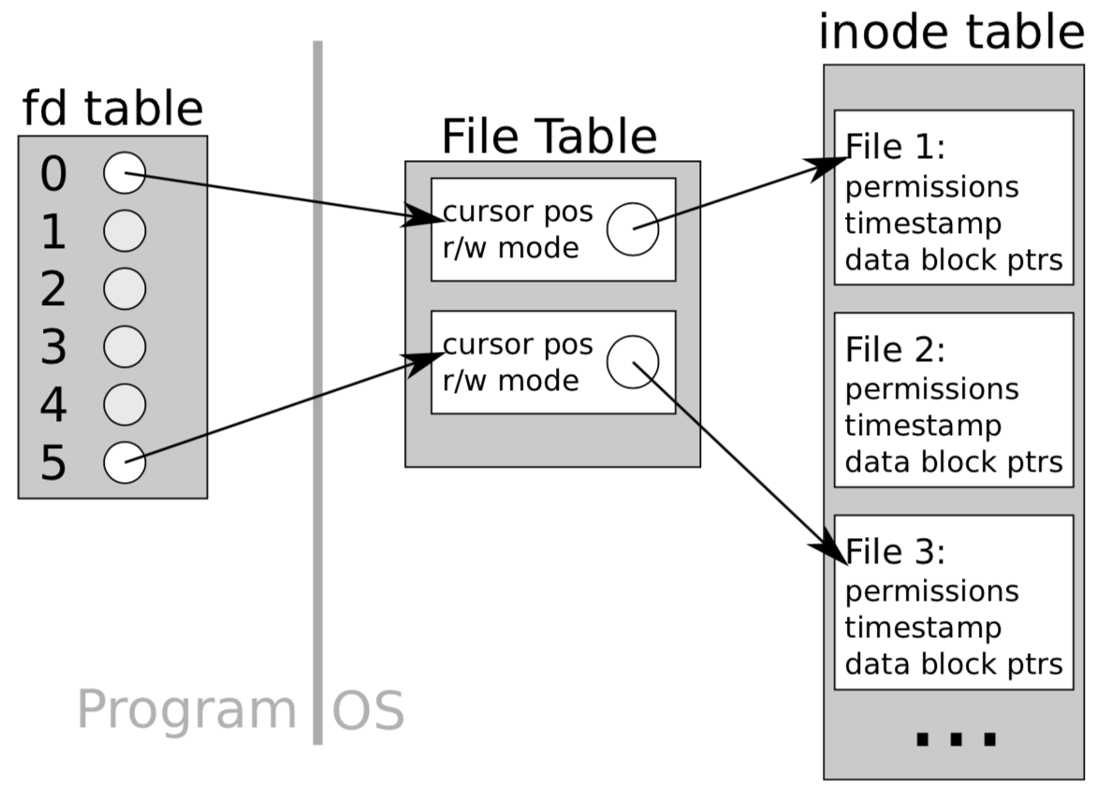
Unbuffered I/O
Open a file, get a file descriptor (a non-negative number) from OS.
Some are reserved for special purposes:
file descriptor 0 is a process' stdin
file descriptor 1 is a process' stdout
file descriptor 2 is a process' stderr
Target to a certain place (cursor) in the file (OS tracks the cursor)
Read/write one character a time directly from OS, and move the cursor

Slide 7
Using Unbuffered I/O (POSIX)
Open/Close
int open(const char *pathname, int flags);
Returns fd number or -1 if error
flags: O_RDONLY, O_WRONLY, O_RDWR. Optional: O_CREAT, O_TRUNC, … (“or” them together with |)
int close(int fd);
Returns zero or -1 if error
Write/Read
size_t write(int fd, const void *buf, size_t count);
Write count bytes from buf to the file given by fd
Returns number of bytes written
size_t read(int fd, void *buf, size_t count);
Read up to count bytes from file given by fd into the buffer buf
Returns the number of bytes read (will stop at end of file)
Moving the cursor
off_t lseek(int fd, off_t offset, int whence);
whence is reference point: can be SEEK_CUR, SEEK_SET (beginning), SEEK_END (end)
Return the offset from the beginning

Slide 8
Buffered I/O
Open a file, get a file stream (FILE *, a pointer to a struct)
FILE includes file descriptor, a pre-fetch buffer, cursor position, etc.
Read/write to the buffer first, and commit to OS in a batched manner.
Image source: https://wisemonkeys.info/blogs/IO-Buffering

Slide 9
File Representations: Buffered vs. Unbuffered
Unbuffered →
Buffered →
Unbuffered →
Buffered →
Diagram from https://www.usna.edu/Users/cs/wcbrown/courses/IC221/classes/L09/Class.html

Slide 10
Using Buffered I/O
Write and Read:
size_t fwrite(const void *ptr, size_t size, size_t nmemb, FILE *stream);
Write nmemb number of objects, each of size bytes
size_t fread(void *ptr, size_t size, size_t nmemb, FILE *stream);
Open/Close:
FILE *fopen(const char *pathname, const char *mode);
Modes:
"r" read
"w" write
"w+" write, create if doesn’t exist.
int fclose(FILE *stream);
Move/locate the cursor:
int fseek(FILE *stream, long offset, int whence);
long ftell(FILE *stream);

Slide 11
fgets
A special-case fread designed for strings!
char * fgets(char* s, int size, FILE* stream);
Read ≤ (size – 1) bytes from stream to s, and append a null terminator at the end.
Reading stops after EOF or a newline ('\n')
Especially useful for reading in user input from stdin.
Example:
fgets(buffer, 5, stdin);
read ≤ 4 bytes from keyboard input to buffer and append '\0' at the end

