Slide 1
CSSE 132 Introduction to Networking
Thursday, October 24, 2024

Slide 3
Two computers scenario
Physical media
PHY-layer concern: how to form information from signal
Modulation: $A∙cos(2πf_{c}t+ φ)$
Coding: 000 is 0, 111 is 1

Slide 4
Four computers scenario
Naming/Address: how to talk with a certain computer
MAC address
How to send message to another computer
Hub: repeater, PHY layer (Layer 1), no software
Switch: software-driven, MAC layer(layer 2), package filter
Who should talk when: Medium Access Control (MAC)
CSMA/CD: Carrier Sense Multiple Access Collision Detection
CSMA/CA: Carrier Sense Multiple Access Collision Avoidance

Slide 5
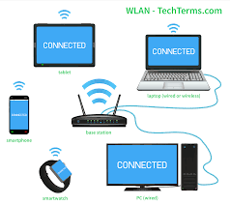
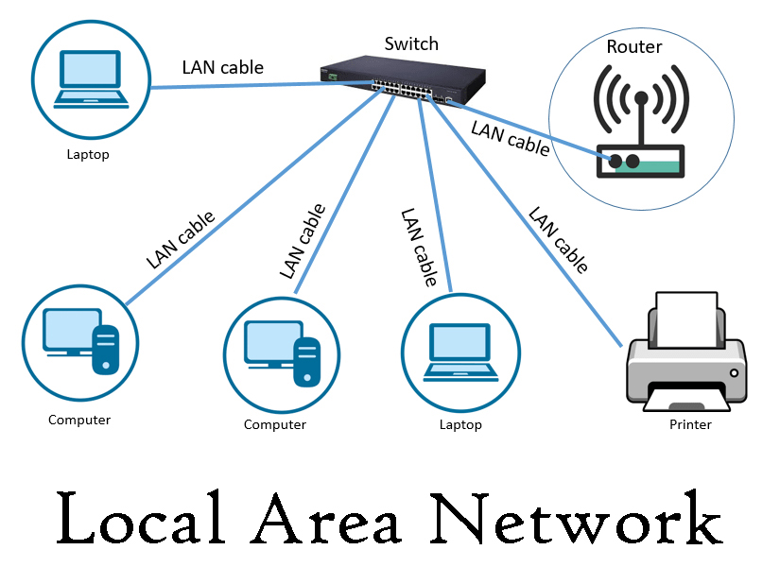
LAN (Local Area Network)

Slide 6
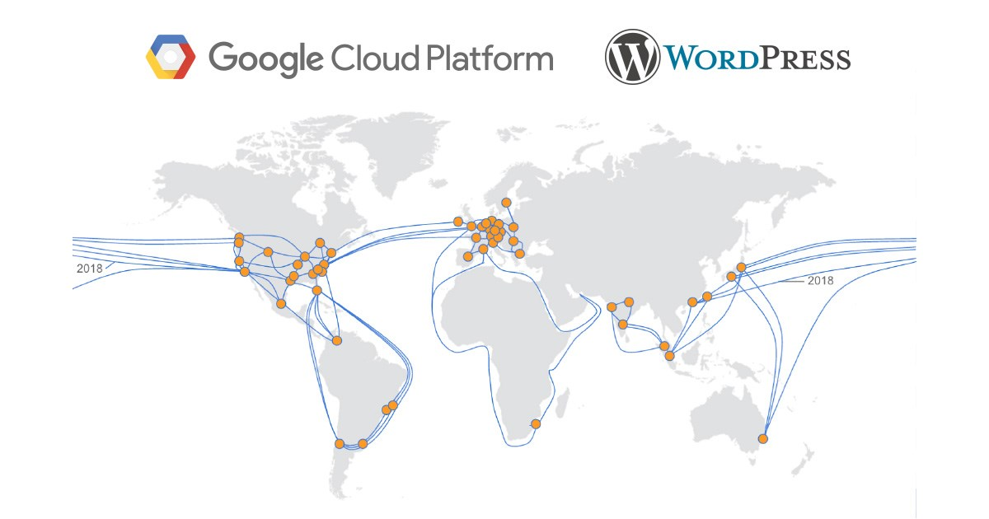
Connecting two LANs
Bridge: Connecting two same type of networks (e.g., Ethernet to Ethernet)
Router: Connecting different types of networks (e.g., WiFi to Ethernet)
Problems:
CDN (content delivery network)
Routing: how to deliver message through ”best” route

Slide 7
Many many LANs

Slide 8
Layers of Network
Different scopes and roles in the network
PHY: How to carry info thru signal
MAC: How to coordinate the access of the channel
Network: How to delivery message via best route
Transport: How to delivery infomation with certain rate

Slide 9
Inside a message - Packet

Slide 10
IP: Naming/Addressing
IPv4: 32bit
89702E83 = 137.112.46.131
Rose-Hulman IP: 137.112.0.0/16 = 2¹⁶
Is 2³² sufficient? If not, how?
NAT (Network Address Translation)
IPv6: 128 bit → 2¹²⁸

Slide 11
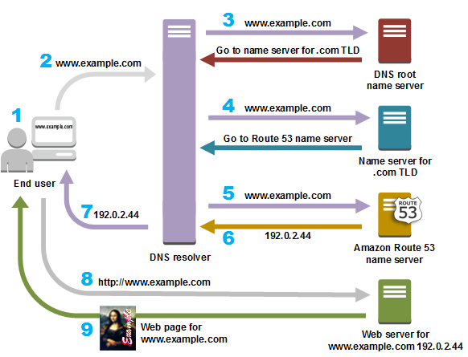
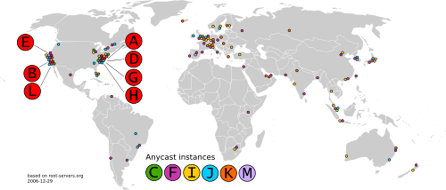
Better Naming: DNS
DNS: Domain Name System

Slide 12
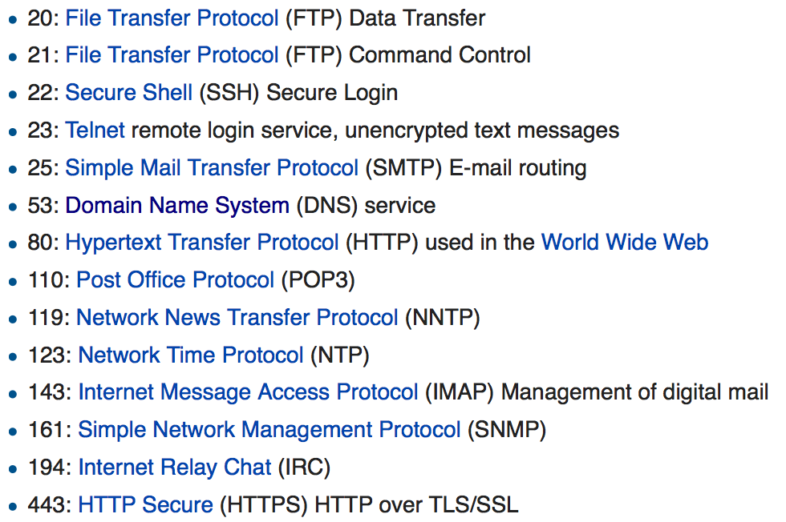
Port
A service identifier

