Slide 1
CSSE 132
Memory Hierarchy
Monday, December 6, 2021

Slide 2
Questions
How do different types of memory work?
  Static RAM
  Dynamic RAM
  Solid State Drive
  Disk
How to judiciously leverage memory - caching?
Notes:
Do a quick recap on the top-down view.

Slide 3
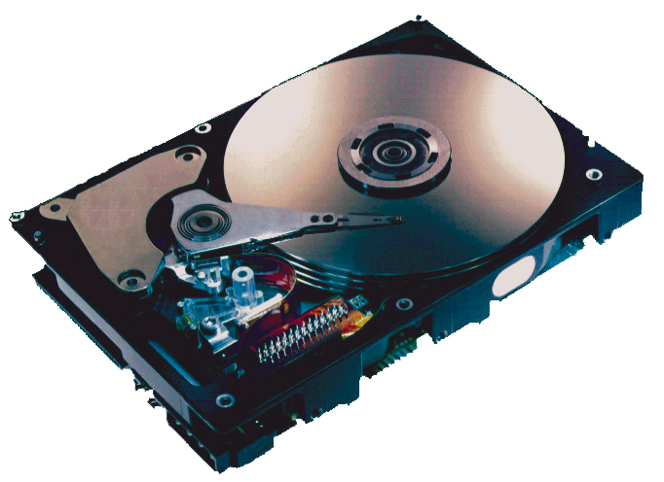
Where is memory?

Slide 4
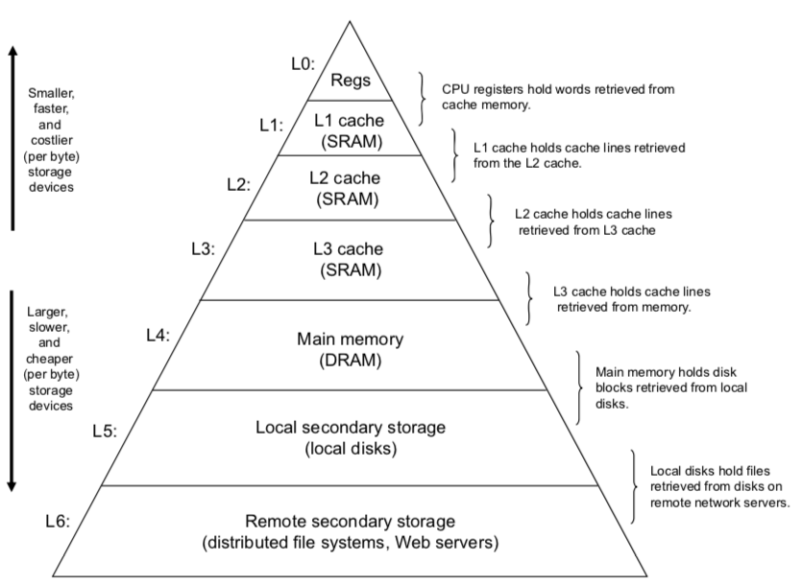
Memory Hierarchy

Slide 5
Performance specs
 | Data Rate | Density | Cost
SRAM | insane | 6 transistors/bit | $5,000/GB
DRAM | ~100GB/s | 1 transistor/bit | $20-75/GB
SSD | 500-2,000MB/s | - | $0.5/GB
Hard Disk | 200MB/s | - | $0.02/GB
Internet | 100MB/s | -

Slide 6
Static RAM
Super fast but expensive.
Implemented with latches and flip-flops.
Always active
Mostly volatile*
Used for:
  Register file
  DRAM cache

Slide 7
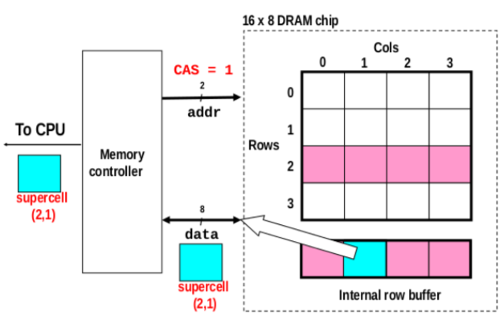
Dynamic RAM (DRAM)
Need to be refreshed (also volatile)
Read/Write:
  Row-Access Strobe (RAS)
  Column-Access Strobe (CAS)

Slide 8
Solid State Drive (SSD)
I/O bus
Requests to read and
write logical disk blocks
Solid State Disk (SSD)
Flash
translation layer
Flash memory
Block 0
Block B-1
…
…
…
Page 0
Page 1
Page P-1
Page 0
Page 1
Page P-1
Pages: 512KB to 4KB, Blocks: 32 to 128 pages
Data read/written in units of pages.
Page can be written only after its block has been erased
A block wears out after about 100,000 repeated writes.

Slide 9
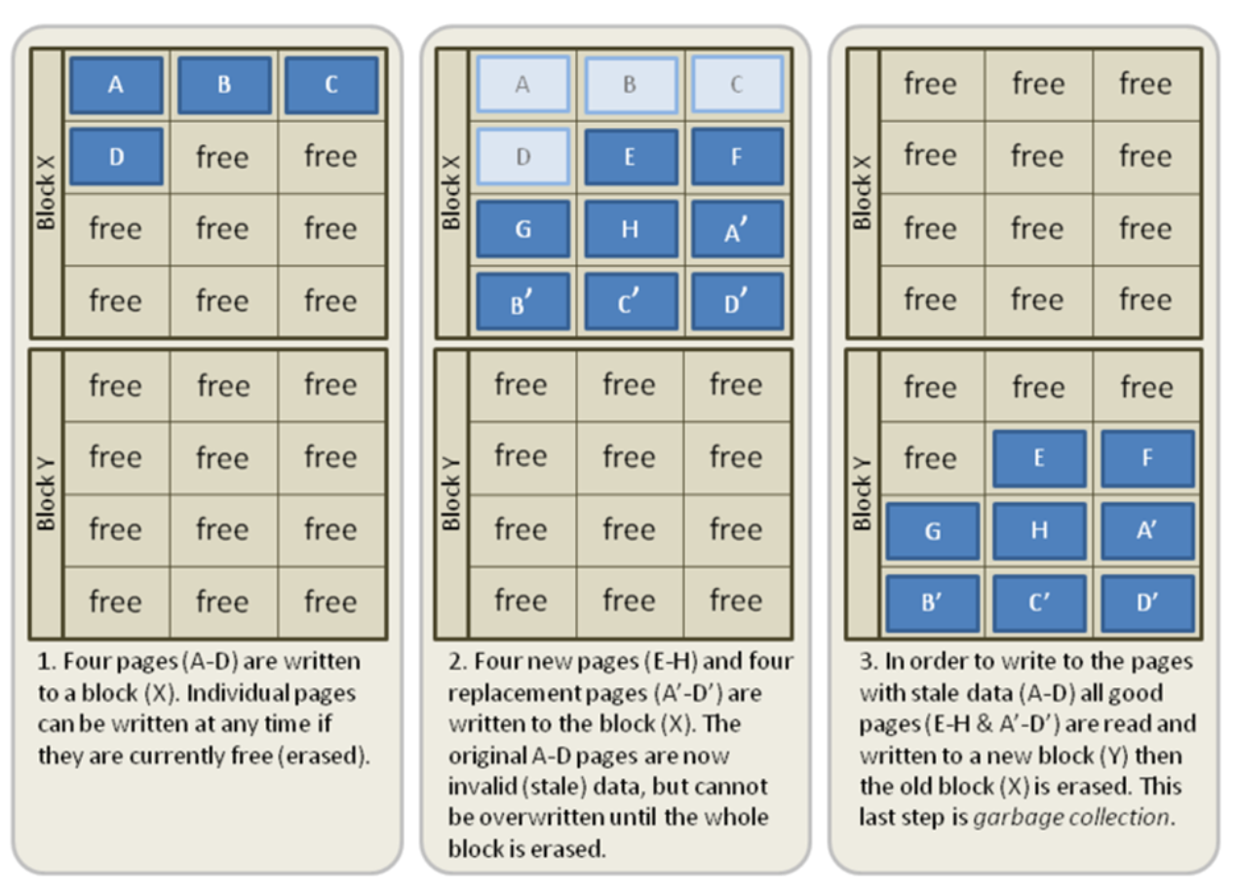
Garbage collection of SSD

Slide 10
Hard Disk
Spindle
Arm
Platters
Actuator
Image courtesy of Seagate Technology

Slide 11

Hard Disk Running

Slide 12
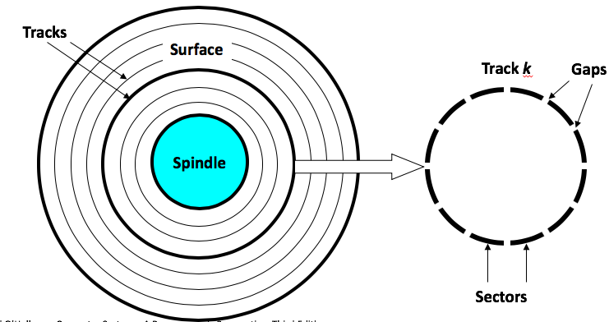
Disk Geometry
Disks consist of platters, each with two surfaces.
Each surface consists of concentric rings called tracks.
Each track consists of sectors separated by gaps.

Slide 13
Disk Access
Head in position above a track
Notes:
Goal:
Show the inefficeincy of current disk requests.
Conveyed Ideas:
Rotational latency is wasted time that can be used to service tasks
Background Information:
None.
Slide Background:
None.
Kill text and arrows

Slide 14
Disk Access
Rotation is counter-clockwise
Notes:
Goal:
Show the inefficeincy of current disk requests.
Conveyed Ideas:
Rotational latency is wasted time that can be used to service tasks
Background Information:
None.
Slide Background:
None.
Kill text and arrows

Slide 15
Disk Access – Read
About to read blue sector
Notes:
Goal:
Show the inefficeincy of current disk requests.
Conveyed Ideas:
Rotational latency is wasted time that can be used to service tasks
Background Information:
None.
Slide Background:
None.
Kill text and arrows

Slide 16
Disk Access – Read
After BLUE read
After reading blue sector
Notes:
Goal:
Show the inefficeincy of current disk requests.
Conveyed Ideas:
Rotational latency is wasted time that can be used to service tasks
Background Information:
None.
Slide Background:
None.
Kill text and arrows

Slide 17
Disk Access – Read
After BLUE read
Red request scheduled next
Notes:
Goal:
Show the inefficeincy of current disk requests.
Conveyed Ideas:
Rotational latency is wasted time that can be used to service tasks
Background Information:
None.
Slide Background:
None.
Kill text and arrows

Slide 18
Disk Access – Seek
After BLUE read
Seek for RED
Seek to red’s track
Notes:
Goal:
Show the inefficeincy of current disk requests.
Conveyed Ideas:
Rotational latency is wasted time that can be used to service tasks
Background Information:
None.
Slide Background:
None.
Kill text and arrows

Slide 19
Disk Access – Rotational Latency
After BLUE read
Seek for RED
Rotational latency
Wait for red sector to rotate around
Notes:
Goal:
Show the inefficeincy of current disk requests.
Conveyed Ideas:
Rotational latency is wasted time that can be used to service tasks
Background Information:
None.
Slide Background:
None.
Kill text and arrows

Slide 20
Disk Access – Read
After BLUE read
Seek for RED
Rotational latency
After RED read
Complete read of red
Notes:
Goal:
Show the inefficeincy of current disk requests.
Conveyed Ideas:
Rotational latency is wasted time that can be used to service tasks
Background Information:
None.
Slide Background:
None.
Kill text and arrows

Slide 21
Disk Access – Service Time Components
After BLUE read
Seek for RED
Rotational latency
After RED read
Data transfer
Seek
Rotational
latency
Data transfer
Notes:
Goal:
Show the inefficeincy of current disk requests.
Conveyed Ideas:
Rotational latency is wasted time that can be used to service tasks
Background Information:
None.
Slide Background:
None.
Kill text and arrows

Slide 22
Disk Access Time
Average time to access some target sector approximated by:
  T_{access} = T_{avg seek} + T_{avg rotation} + T_{avg transfer}
Seek time (T_{avg seek})
  Time to position heads over cylinder containing target sector.
  Typical T_{avg seek} is 3—9 ms
Rotational latency (T_{avg rotation})
  Time waiting for first bit of target sector to pass under r/w head.
  T_{avg rotation} = 1/2 x 1/RPMs x 60 sec/1 min
  Typical T_{avg rotation} = 7,200 RPMs
Transfer time (T_{avg transfer})
  Time to read the bits in the target sector.
  T_{avg transfer} = 1/RPM x 1/(avg # sectors/track) x 60 secs/1 min.

Slide 23
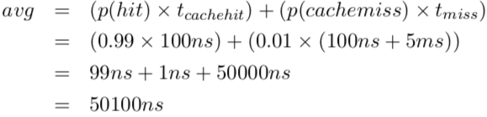
Caching
Use a fast memory to mirror a piece of slow memory.
  Cache access time: 100ns
  Memory access time: 5ms
  Cache miss rate: 1% (say a terrible cache)

