Slide 1
CSSE 132 Advanced Pointers
Wednesday, December 15, 2021

Slide 2
Questions
How to create an “object” in C?
What about polymorphism?
E.g., input can be one of several types?

Slide 3
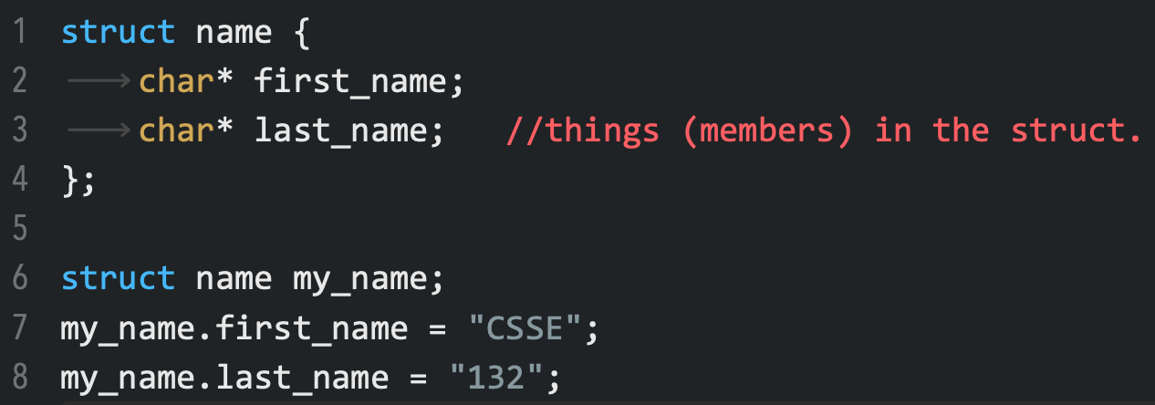
Struct
A compound type. C version of an “object”?
Note: fields only, no “methods” per se.
Declaration
Use struct (Note type is struct name, not just struct or name.)

Slide 4
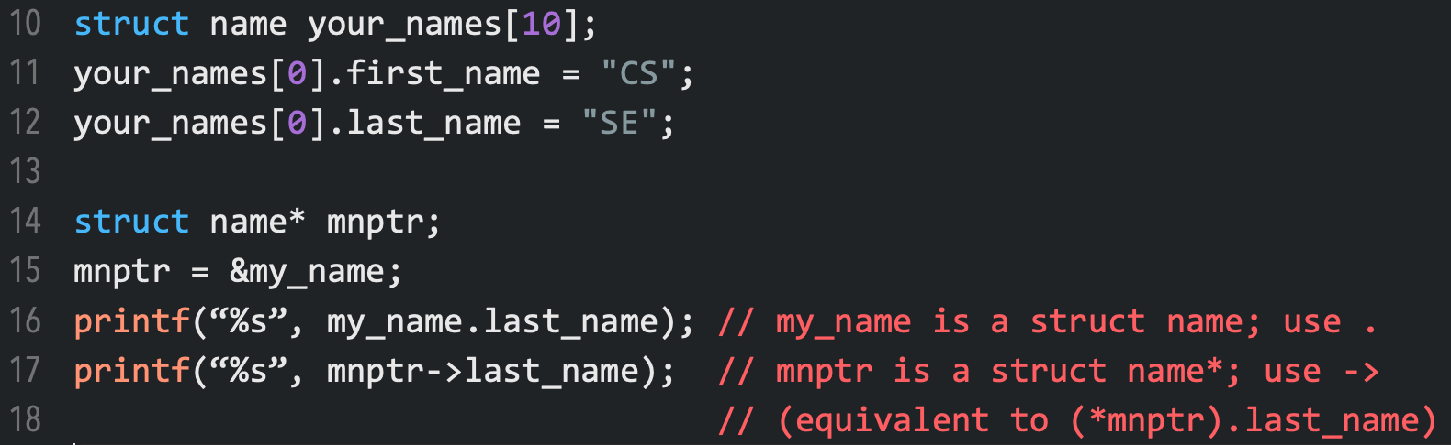
Struct usage
Struct can be used like other data types: can have an array of structs, or pointer to struct.
struct array
struct pointer (when to use use -> instead of . to get a member?)

Slide 5
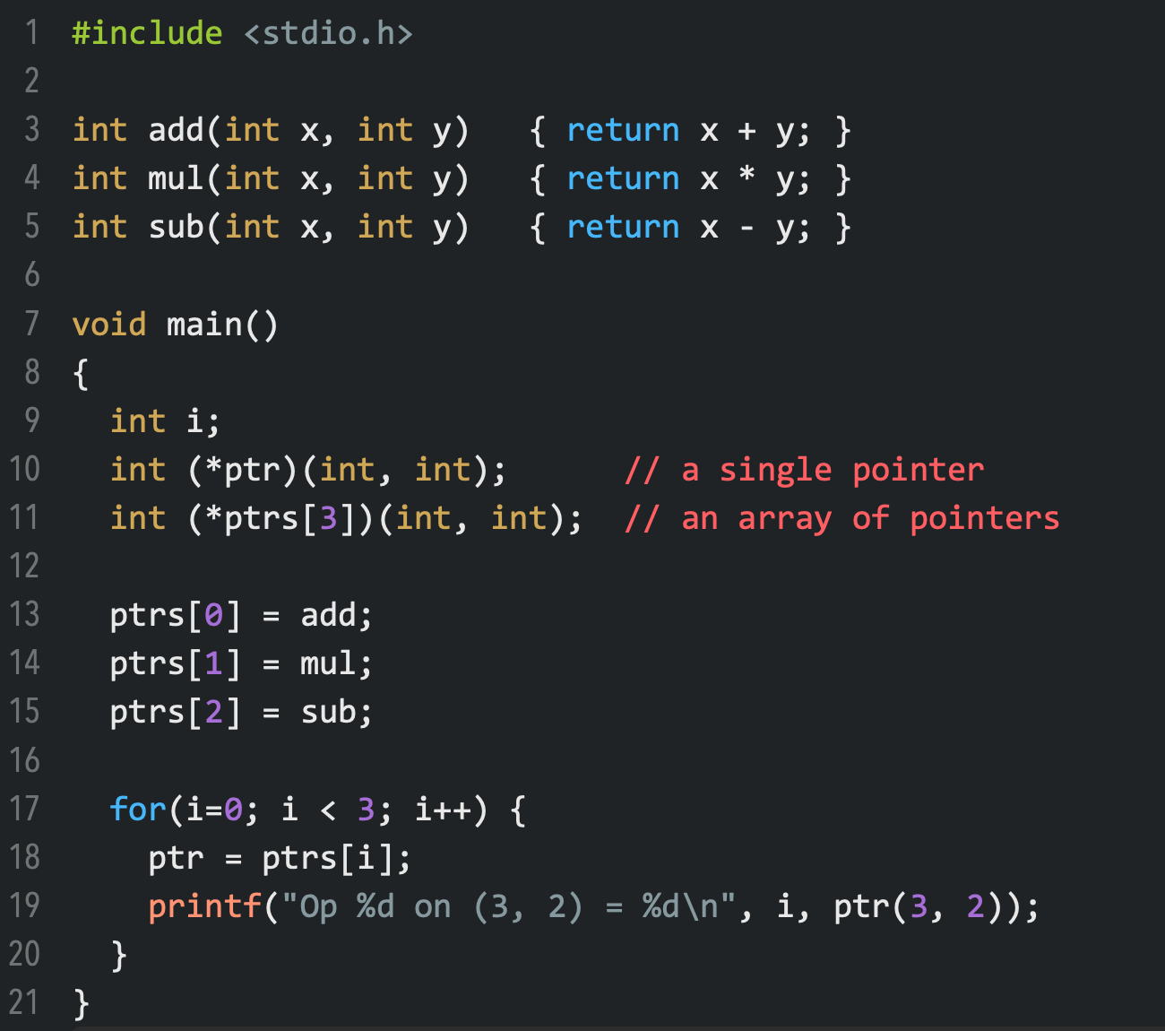
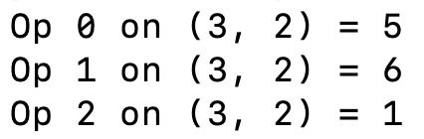
Function pointers
Declaration:
return_type (*name)(input_args)
C’s version of an “object”:
a struct, with “methods” given by function-pointer members!

Slide 6
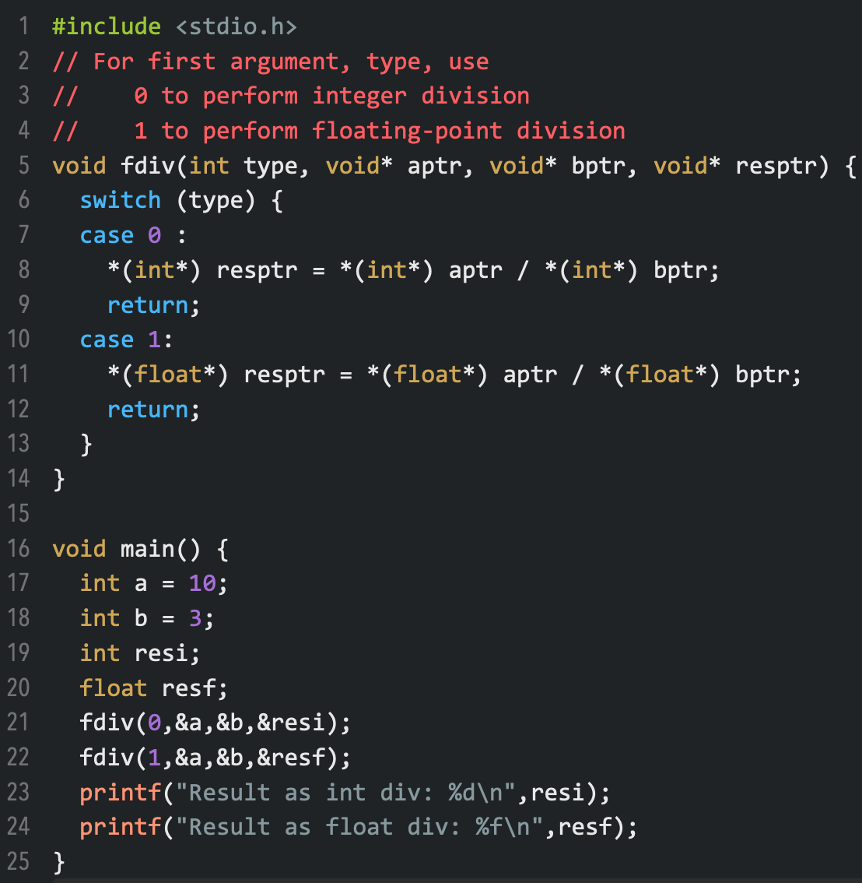

Void pointers
Useful for polymorphism on input arguments
Example: printf arguments
For such a variable to be used, the pointer requires a cast to the appropriate type-pointer.

Slide 7
(Optional) Multi-dimensional arrays
Arrays of another arrays
char array[3][4];
array[i][j] == *(array + i*4 + j)
Examples:
int main(int argc, char** argv)

Slide 8
Pointer of pointer
What is int ** ?
int x;
int* p;
int** pp;
x = 10;
p = &x;
pp = &pp;
Can we do the same to &, like &&x?
NO.
0x0000 0008 | x | 10
0x0000 000c | p | 0x0000 0008
0x0000 0010 | pp | 0x0000 000c

