Slide 1
CSSE 132 Further Topics in Memory
Wednesday, January 19, 2022

Slide 2
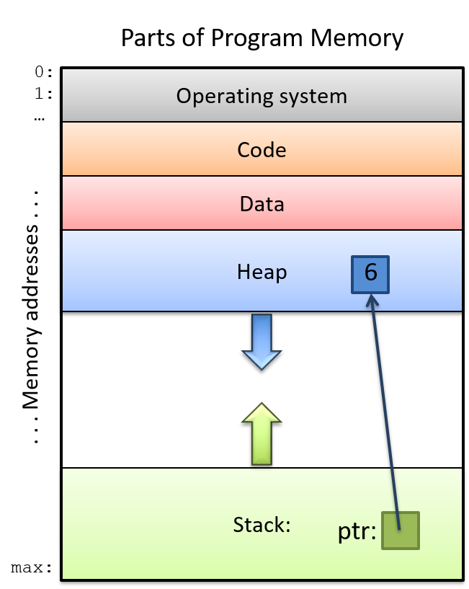
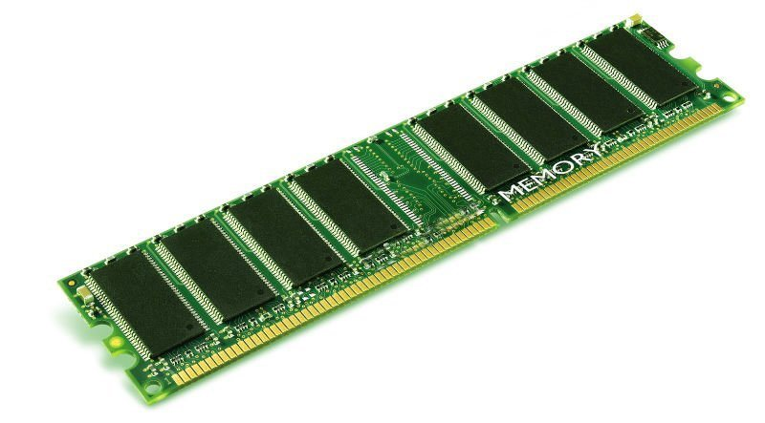
A Program’s View of Memory, vs. Reality
Is the processor working directly with main memory (DRAM)?
Source

Slide 3
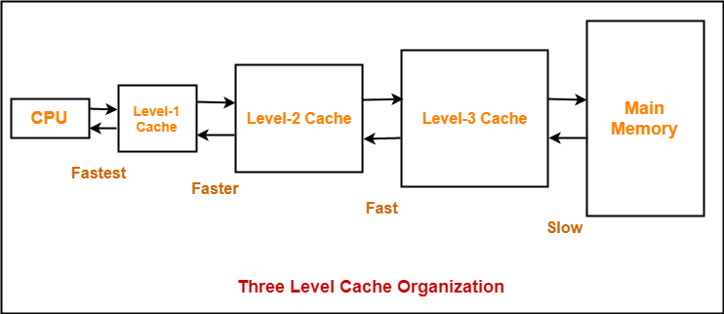
Cache
Source

Slide 4
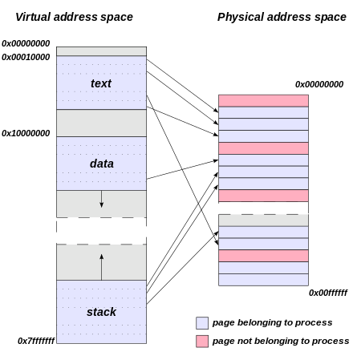
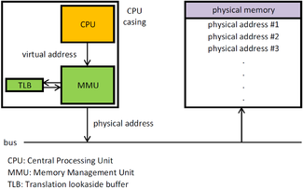
Virtual Memory
See also:
Memory Management Unit (MMU) handles virtual-physical translation
Translation Lookaside Buffer (TLB) “address-translation cache”
Source

Slide 5
malloc() and free()
With this approach to dynamic memory allocation, what can go wrong?
Can we implement safety measures in this model?
What other models are possible? What are the tradeoffs?

Slide 6
Example alternatives to malloc() and free()
Garbage collection – e.g. in Java
When no references to an object remain, that object’s memory is garbage-collected
Smart pointers – e.g. in C++
An abstract data type that simulates pointers while providing extended features, e.g. automatic deallocation when the last pointer to it is destroyed

