Slide 1
CSSE 132
Pthreads
Tuesday, February 8, 2022

Slide 2
Agenda
Intro: Concurrent programing
Parallel computing with pthreads.
  (+) Performance improvement
  (–) Concurrency issues – mutual exclusion

Slide 3
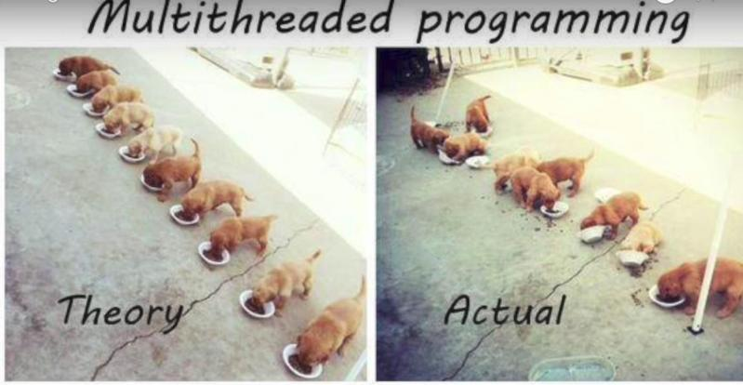
Concurrent Programming
Run multiple “things” (processes, threads) simultaneously
Share resources!!

Slide 4
Intro to pthreads
May be provided either as user-level or kernel-level
A POSIX standard (IEEE 1003.1c) API for thread creation and synchronization
API specifies behavior of the thread library, implementation is up to development of the library
Common in UNIX operating systems (Solaris, Linux, Mac OS X; in the kernel)

Slide 5
PThreads: Compiling
To compile a program that uses POSIX Threads, we need to include the pthread header in our source code:
#include <pthread.h>
And pass the -pthread flag to the compiler:
$ gcc -o program program.c -pthread
Adapted from Peter Bui@ND

Slide 6
PThreads: Creating
When our program starts, we have one main thread. To create another one, we can use the pthread_create function:
void *function(void *arg) { // Thread function
int tid = *((int*) arg);
printf("thread %d\n", tid);
return NULL;
}
pthread_t thread; // Thread structure
int i = 7;
pthread_create(&thread, NULL, function, &i); // Create thread
What if function needs more input arguments?
Adapted from Peter Bui@ND

Slide 7

PThreads: Waiting
To wait for a thread to complete, we can use the pthread_join function:
int* result;
pthread_join(thread, (void **)&result);
A thread can return a value either by doing return or pthread_exit:
pthread_exit(NULL);
Adapted from Peter Bui@ND

Slide 8
Let's use pthreads
Look at the threadSpeedTest code, play just a bit with adjusting the size
Then modify it so it makes more threads according to the THREAD_COUNT variable.

Slide 9
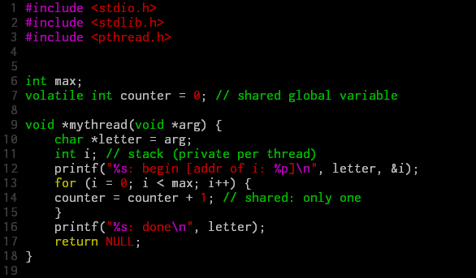
Problems with concurrent programming
* volatile means the variable may change.

Slide 10
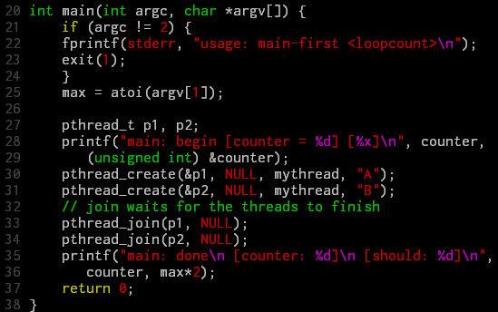
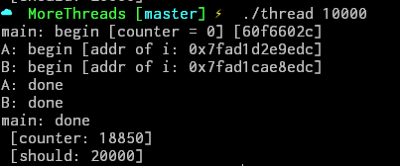


Problems with concurrent programming (cont.)

Slide 11
Problem investigation
ldr r3, [r3]
add r3, r3, #1
str r3, [r2]
counter = counter + 1 →
If ..
Thread 1
Thread 2
ldr r3, [r3]
add r3, r3, #1
str r3, [r2]
ldr r3, [r3]
add r3, r3, #1
str r3, [r2]

Slide 12
How to solve this issue?
Brainstorm

Slide 13
Solution: Mutual exclusion
We'll talk about a working solution in the next class

