Slide 1
CSSE 132
Linux I/O
Monday, May 4, 2020

Slide 2
Questions
How do Linux systems interact with external devices?
  Files
How is I/O handled in Linux?
  Unbuffered I/O (today)
  Buffered I/O (next time)

Slide 3
Linux I/O
All I/O devices, such as networks, disks, and terminals, are modeled as files.
All input and output is performed by reading and writing the appropriate files.
Data in and out use the same API:
  User IO
  Printing
  Network Communication
  External devices
Demo: We can check the data on ram by reading the file /dev/mem

Slide 4
File types
Regular file (-)
Directory files (d)
Special files
  Block file (b)
  Character device file (c)
  Named pipe file or just a pipe file (p)
  Symbolic link file (l)
  Socket file (s)
Try: ls -l /dev/

Slide 5
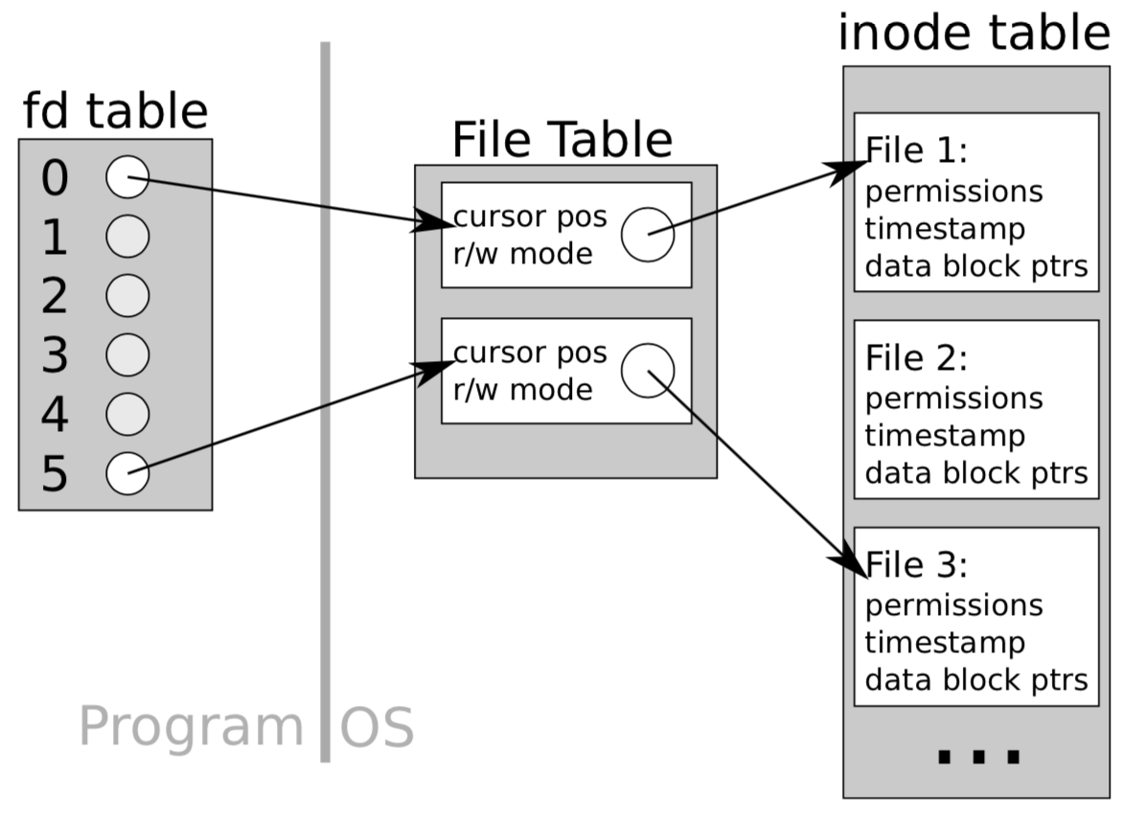
Unbuffered I/O
Open a file, get a file descriptor (a non-negative number) from OS.
  Some are reserved for special purposes:
    file descriptor 0 is a process' stdin
    file descriptor 1 is a process' stdout
    file descriptor 2 is a process' stderr
Target to a certain place (cursor) in the file (OS tracks the cursor)
Read/write one character a time directly from OS, and move the cursor

Slide 6
Using Unbuffered I/O (POSIX)
Open/Close
  int open(const char *pathname, int flags);
    Returns fd number or -1 if error
    flags: O_RDONLY, O_WRONLY, O_RDWR. Optional: O_CREAT, O_TRUNC, … (“or” them together with |)
  int close(int fd);
    Returns zero or -1 if error
Write/Read
  size_t write(int fd, const void *buf, size_t count);
    Write count bytes from buf to the file given by fd
    Returns number of bytes written
  size_t read(int fd, void *buf, size_t count);
    Read up to count bytes from file given by fd into the buffer buf
    Returns the number of bytes read (will stop at end of file)
Moving the cursor
  off_t lseek(int fd, off_t offset, int whence);
    whence is reference point: can be SEEK_CUR, SEEK_SET (beginning), SEEK_END (end)
    Return the offset from the beginning

Slide 7
Unbuffered IO Practice
Go to the link below for practice:
https://repl.it/@song3/UnbufferedIO

Slide 8
Using buffered I/O: streams
Write/Read
  size_t fwrite(const void *ptr, size_t size, size_t nmemb, FILE *stream);
  size_t fread(void *ptr, size_t size, size_t nmemb, FILE *stream);
  char *fgets(char *s, int size, FILE *stream);
Open/Close
  FILE *fopen(const char *path, const char *mode);
  int fclose(FILE *fp); (returns 0, or EOF if error)
fseek / ftell

