Slide 1
CSSE 132
The Heap
Wednesday, January 19, 2022

Slide 2
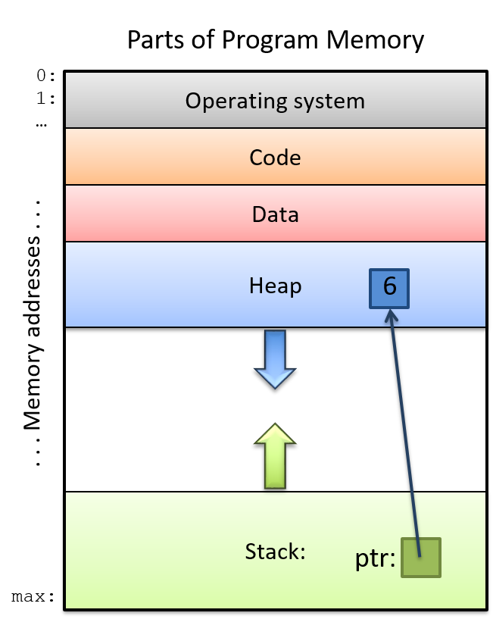
Recap: Stack
A “private space” for each function
Static
We lost the space when function returns
Source

Slide 3
Motivation example: array with variable size
#include <stdio.h>
int main(){
char my_string[5];
scanf("%s",my_string);
printf("%s",my_string); //Does this work?
}
*scanf() in this case takes a user input and then assign the string to my_string;

Slide 4
Motivation example: Where is my string
0 #include <stdio.h>
1
2 char* create_string()
3 {
4 char my_string[3];
5 my_string[0] = 'H';
6 my_string[1] = 'i';
7 my_string[2] = '\0';
8 return my_string;
9 }
10 int main()
11 {
12 printf("%s",create_string()); //Does this work?
13
14 return 0;
15 }
16

Slide 5
Heap: Dynamic Allocation
The Allocator:
  gives you the starting (lowest) address for a contiguous block of requested size
  keeps track of starting address and length for each block
  avoids giving out in-use parts of the heap
  returns 0 if it can’t find space

Slide 6
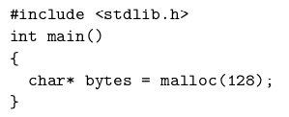
malloc
This is the function you can ask for “space”

Slide 7
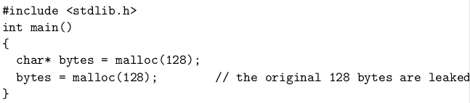
malloc (cont.)
You are in charge of what is assigned to you.

Slide 8
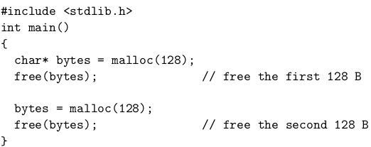
free

Slide 9
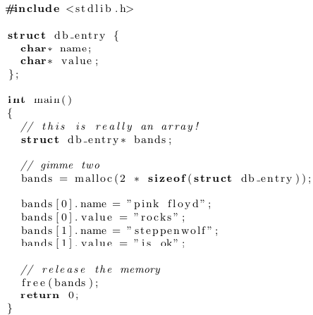
sizeof
Allocating a larger group of bytes requires math. sizeof to the rescue!

Slide 10
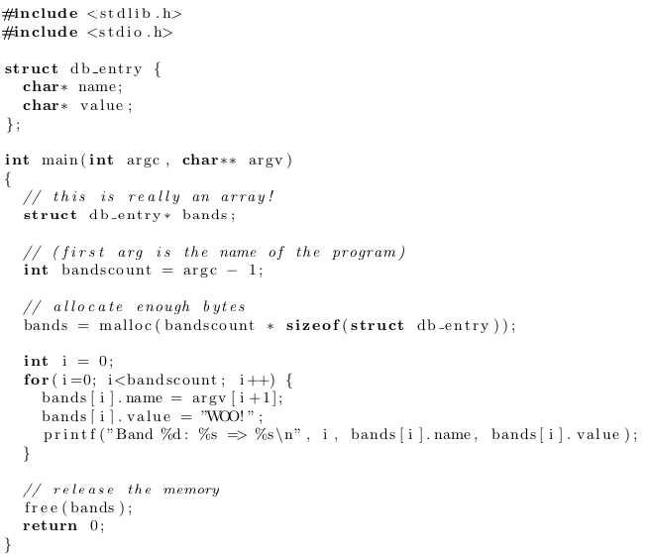
Examples
Using argc and argv (optional)

Slide 11
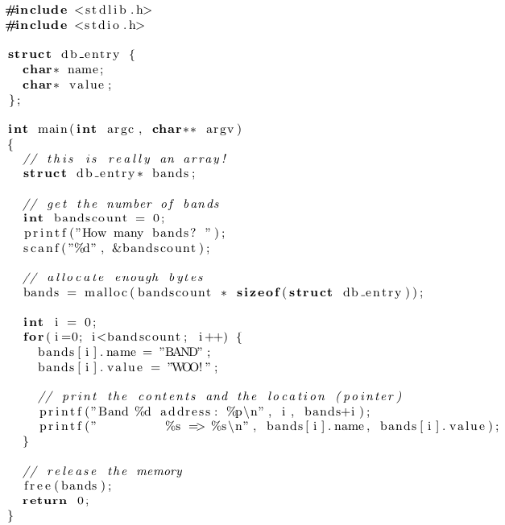
Examples （cont.)
Using scanf

