Slide 1
CSSE 132
The Stack
Monday, April 20, 2020

Slide 2
Outline
Motivation
Stack overview
Practice

Slide 3
0 int do_nothing()
1 {
2 int a = 3;
3 int b = 4;
4 return 0;
5 }
6 int add(int a,int b)
7 {
8 int result;
9 result = a + b;
10 do_nothing();
11 return result;
12
13 }
14 int main()
15 {
16 int res = 0;
17 int a = 1;
18 int b = 2;
19 res = add(a, b);
20 return res;
21 }
Questions:
Three functions have same variables named a,b. Why they can have different values in different functions and not interfere with each other?
Trace the order in which instructions are executed.
How does the program know to go back to line 20 when the add function completes?

Slide 4
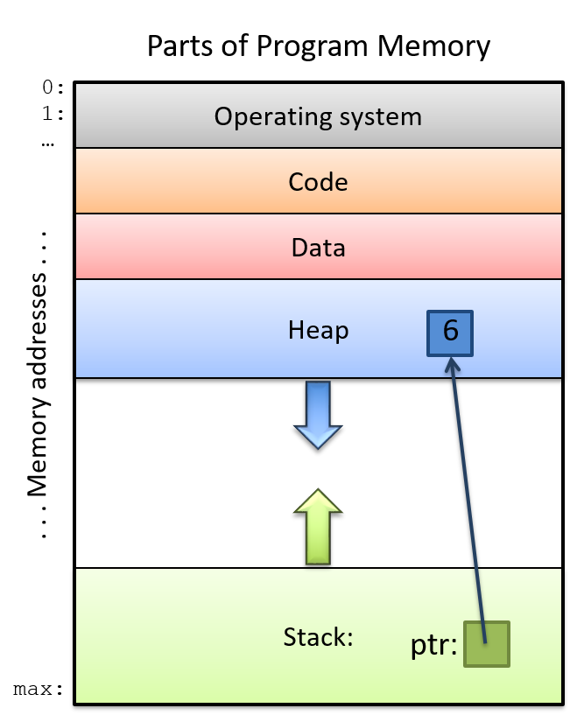
Why Stack?
Handle local variables/automatic variables.
Handle function calls.
Source

Slide 5
Local variable: Begin with some boring text
When a function is called, a ”private space” (a.k.a. stack frame) is created.
A stack frame is specified by a stack pointer (sp) (and/or frame pointer).
When another function is called, the previous “private space” gets set aside for later, and a new ”private space” is created for the new function.
After a function is finished, its stack frame gets released, and back to where it was called.

Slide 6
How to handle local variables: Example
i = 3
x = 3
….
i = 2
x = 2
….
i =1
x = 1
int count_down(int i){
int x = i;
if(x == 1)
return 1;
else
return count_down(x - 1);
}
int main(){
count_down(3);
}

Slide 7
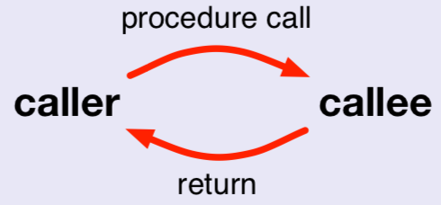
How to handle a function call
Caller vs. callee
  caller the code that calls the procedure
  callee the code that implements the procedure

Slide 8
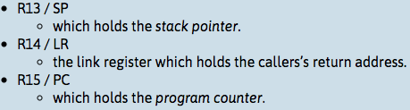
What the caller does
Set up input argument in registers (r0, r1, r2, r3)
bl addr: Branch link to procedure
  return address goes in lr, a.k.a. r14
On return, read return val from r0.

Slide 9
What the callee does
Back up registers to be modified: lr (maybe also other regs r4-r11)
Run function body
Fill up r0 for return
Restore registers
Go back to where it was called by checking lr or the place lr was stored.

Slide 10
Example: add(), C code
int main()
{
int res = 0;
int a = 1;
int b = 2;
res = add(a, b);
return res;
}
int add(int a, int b)
{
int result;
result = a + b;
do_nothing();
return result;
}
int do_nothing()
{
int a = 3;
int b = 4;
return 0;
}

Slide 11
Example: add(), ARM assembly code
.MAIN:
sub sp, sp, #20
str lr, [sp, #16]
mov r3, #0
str r3, [sp, #12]
mov r3, #1
str r3, [sp, #8]
mov r3, #2
str r3, [sp, #4]
ldr r1, [sp, #4]
ldr r0, [sp, #8]
bl .ADD
str r0, [sp, #12]
ldr r0, [sp, #12]
add sp, sp, #20
.ADD:
sub sp, sp, #20
str lr, [sp, #16]
str r0, [sp, #8]
str r1, [sp, #4]
add r2, r0, r1
str r2, [sp, #12]
bl .DO_NOTHING
ldr r0, [sp, #12]
add sp, sp, #20
ldr pc, [sp, #-4]
.DO_NOTHING:
sub sp, sp, #8
mov r3, #3
str r3, [sp, #4]
mov r3, #4
str r3, [sp]
mov r0, #0
add sp, sp, #8
bx lr

Slide 12
Function call: Caller prologue
.MAIN:
sub sp, sp, #20
str lr, [sp, #16]
mov r3, #0
str r3, [sp, #12]
mov r3, #1
str r3, [sp, #8]
mov r3, #2
str r3, [sp, #4]
ldr r1, [sp, #4]
ldr r0, [sp, #8]
bl .ADD
str r0, [sp, #12]
ldr r0, [sp, #12]
add sp, sp, #20
.ADD:
sub sp, sp, #20
str lr, [sp, #16]
str r0, [sp, #8]
str r1, [sp, #4]
add r2, r0, r1
str r2, [sp, #12]
bl .DO_NOTHING
ldr r0, [sp, #12]
add sp, sp, #20
ldr pc, [sp, #-4]
set b as the 2nd arg to the function add
set a as the 1st arg to the function add
Branch to function add. Also, load return address into lr.

Slide 13
Function call: Callee prologue
.MAIN:
sub sp, sp, #20
str lr, [sp, #16]
mov r3, #0
str r3, [sp, #12]
mov r3, #1
str r3, [sp, #8]
mov r3, #2
str r3, [sp, #4]
ldr r1, [sp, #4]
ldr r0, [sp, #8]
bl .ADD
str r0, [sp, #12]
ldr r0, [sp, #12]
add sp, sp, #20
.ADD:
sub sp, sp, #20
str lr, [sp, #16]
str r0, [sp, #8]
str r1, [sp, #4]
add r2, r0, r1
str r2, [sp, #12]
bl .DO_NOTHING
ldr r0, [sp, #12]
add sp, sp, #20
ldr pc, [sp, #-4]
reserve stack space for add
save LR onto the stack so we can overwrite it*
store input arg a
store input arg b
*Note: not always necessary. Leaf vs. non-leaf function
https://azeria-labs.com/functions-and-the-stack-part-7/

Slide 14
Function call: Callee epilogue
.MAIN:
sub sp, sp, #20
str lr, [sp, #16]
mov r3, #0
str r3, [sp, #12]
mov r3, #1
str r3, [sp, #8]
mov r3, #2
str r3, [sp, #4]
ldr r1, [sp, #4]
ldr r0, [sp, #8]
bl .ADD
str r0, [sp, #12]
ldr r0, [sp, #12]
add sp, sp, #20
.ADD:
sub sp, sp, #20
str lr, [sp, #16]
str r0, [sp, #8]
str r1, [sp, #4]
add r2, r0, r1
str r2, [sp, #12]
bl .DO_NOTHING
ldr r0, [sp, #12]
add sp, sp, #20
ldr pc, [sp, #-4]
release stack space for add
load next instruction’s address from the saved prior value of LR.

Slide 15
Function call: Caller epilogue
.MAIN:
sub sp, sp, #20
str lr, [sp, #16]
mov r3, #0
str r3, [sp, #12]
mov r3, #1
str r3, [sp, #8]
mov r3, #2
str r3, [sp, #4]
ldr r1, [sp, #4]
ldr r0, [sp, #8]
bl .ADD
str r0, [sp, #12]
ldr r0, [sp, #12]
add sp, sp, #20
.ADD:
sub sp, sp, #20
str lr, [sp, #16]
str r0, [sp, #8]
str r1, [sp, #4]
add r2, r0, r1
str r2, [sp, #12]
bl .DO_NOTHING
ldr r0, [sp, #12]
add sp, sp, #20
ldr pc, [sp, #-4]
store the returned result from add

Slide 16
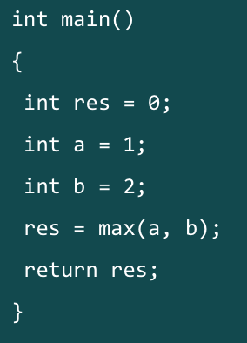
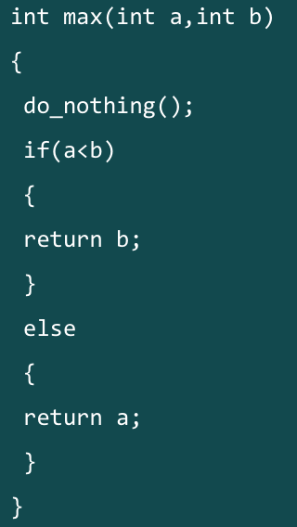
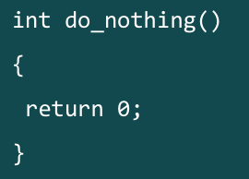
Example: max()

Slide 17
Function call: Prologue
sub sp, sp, #16 /* End of the prologue. Allocating space on the stack for the function called.*/
str lr, [sp, #14] /* Start of the prologue. Saving Frame Pointer and LR onto the stack */

Slide 18
Function call: Prologue (cont.)
mov r0, #1 /* setting up local variables (a=1). This also serves as setting up the first parameter for the function max */
mov r1, #2 /* setting up local variables (b=2). This also serves as setting up the second parameter for the function max */
bl max /* Calling/branching to function max */

Slide 19
Function call: Epilogue
add sp, sp, #16 /* Start of the epilogue. Readjusting the Stack Pointer The Stack Frame of a function is finally destroyed at this step. */
ldr pc, [sp, #-4]/* End of the epilogue. Jumping to previously saved LR via direct load into PC. */
*leaf v.s. non-leaf function https://azeria-labs.com/functions-and-the-stack-part-7/

