Slide 1
CSSE 132
C Programming and Data Types
Monday, September 30, 2019

Slide 2
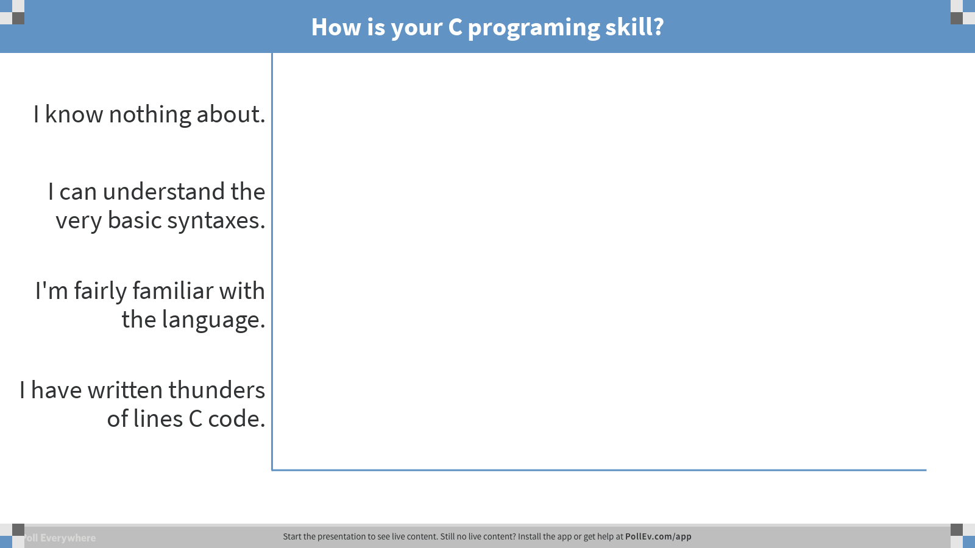
Notes:
How is your C programing skill?
https://www.polleverywhere.com/multiple_choice_polls/YS6q3mxlCM9BFo4

Slide 3
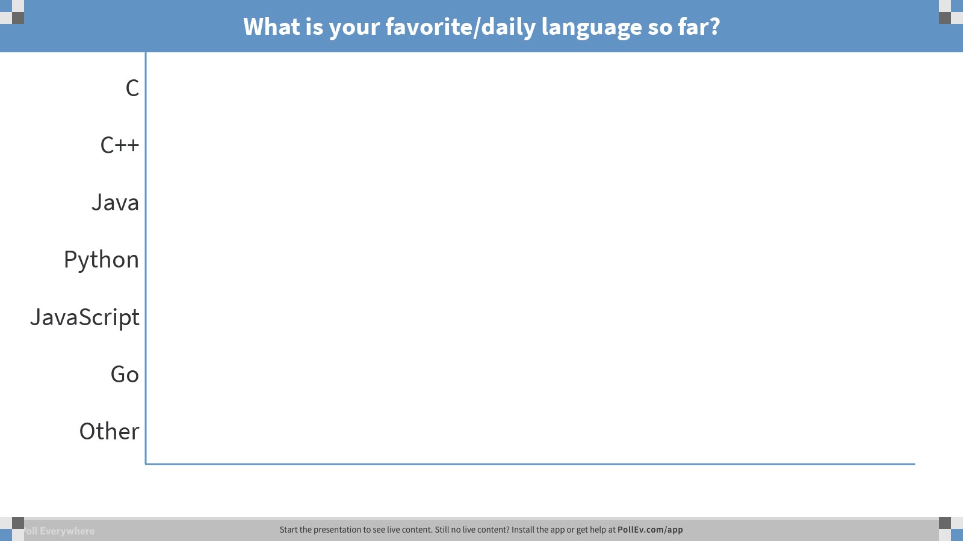
Notes:
What is your favorite/daily language so far?
https://www.polleverywhere.com/multiple_choice_polls/Ye5c73FBeOdF19c

Slide 4
C v.s. Java
Similarities:
  Syntax
  Functions
  if/for/while/else
Differences:
  C has no classes
  No exceptions
  No new
  No strings

Slide 5
Variables
Declare them: <type> <variable name>: int i;
Initialize them: use the assignment operator. i = 10;
Use semi-colon to end each line.

Slide 6
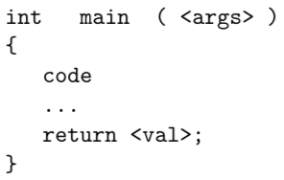
C code blocks and functions
Identify the parts: return type, arguments list, function name, body.

Slide 7
Operators
Arithmetic: +, -, *, / ,%
Relational and Logical: <, >, <=, >=, ==, !=, &&, ||
Bitwise: & ,| , <<, >>
Assignment: =

Slide 8
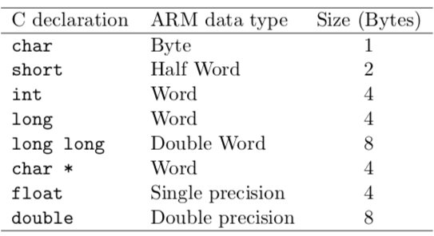
Data types

Slide 9
Import a library
#include <name_of_lib>

Slide 10
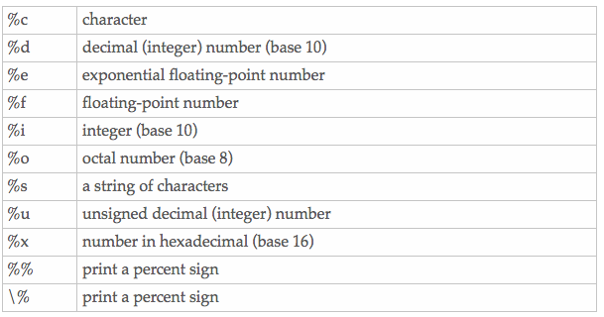
printf (a function in stdio.h)
Like System.out.println, but flexible.
Format strings: conversion specifiers sprinkled into string

Slide 11
String
In C, a string is just an array of char that is terminated by '\0'.
the length of a string is not stored in C.
  I.e., in order to calculate the length of a string, you must scan that array until a '\0' is found.

Slide 12
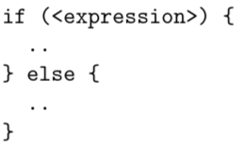
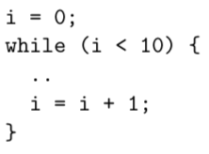
Control and loops

Slide 13
Demo

