Slide 1
CSSE 132
Introduction to Assembly
Monday, December 6, 2021

Slide 2
Outlines
How does programing language become executable code?
Introduce Assembly – ARM
Assembly Practice

Slide 3
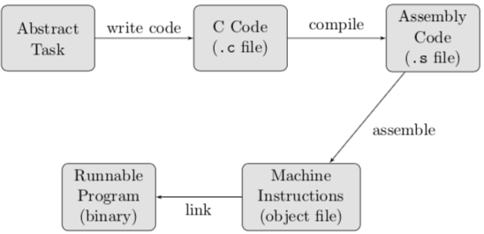
Program path
Task → C Code → Assembly → object code →executable code

Slide 4
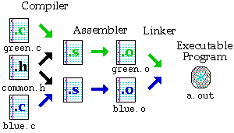
Creating an executable
Source: http://www.eng.hawaii.edu/Tutor/Make/1-2.html
Notes:
Compiler stage: All C language code in the .c file is converted into a lower-level language called Assembly language; making .s files.
(can use -S option)
Assembler stage: The assembly language code made by the previous stage is then converted into object code which are fragments of code that the computer understands directly. An object code file ends with .o.
(Can use –c option) The object code is generated using the instruction set architecture of the underlying machine.
Linker stage: The final stage in compiling a program involves linking the object code to code libraries which contain certain "built-in" functions, such as printf. This stage produces an executable program, which is named a.out by default. (Can use –o option to rename executable)
4

Slide 5
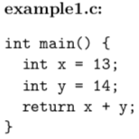
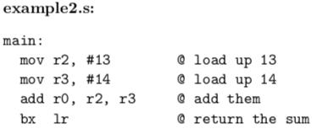
Compiling
gcc –S example1.c
(optimized for understanding)

Slide 6
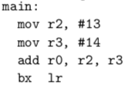
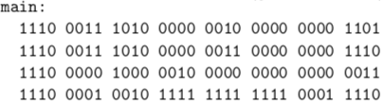
Assembling
gcc –c test.s

Slide 7
Linking
If your program needs other code (like a print library or something), it has to be “linked”.
To accomplish this, you can use ld: (ld -o program library.o test.o -lprint)

Slide 8
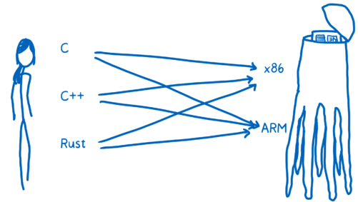
What is Assembly language?
https://hacks.mozilla.org/2017/02/a-crash-course-in-assembly/

Slide 9
Registers
There are 30 general-purpose 32-bit registers, with the exception of ARMv6-M and ARMv7-M based processors. The first 16 registers are accessible in user-level mode.
We normally just use R0 – R6

Slide 10
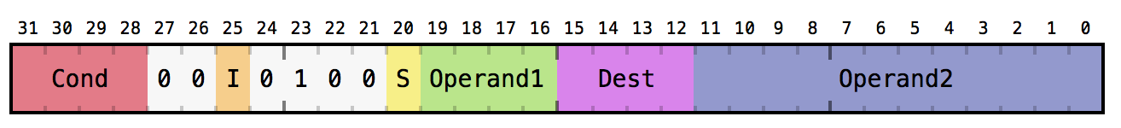
Addition using Assembly
Add r1, #3, #4

Slide 11
Bigger data storage?
Store str (4 bytes)
  str r1, <address>
Load ldr (4 bytes)
  ldr r1, <address>
Example:
  ldr r0, [X]
  add r0, r0, #1
  str r0, [X]

Slide 12
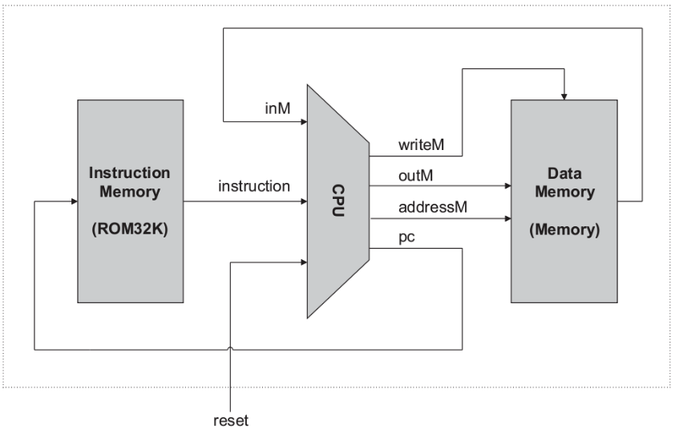
Instruction storage?
Instruction memory
PC: program counter register
  Each instruction run causes CPU to load [pc], execute it, then increment it.

Slide 13
Branching
b <target>
Conditional Executions:
  Add a suffix to the instruction (e.g., NE, GT, GE, LE, LT, EQ)
  depends on previously set flags (usually previous instruction)
    Comparison Flags: N (negative) Z (zero) C (carry) V (overflow)

Slide 14
Function call
Calling and returning!
  How does caller function jump to callee function?!
  How does callee function jump back to the right place in caller
Passing parameters!
  How does caller function pass parameters to callee function?!
Storing local variables!
  Where does callee function store its local variables?!

Slide 15
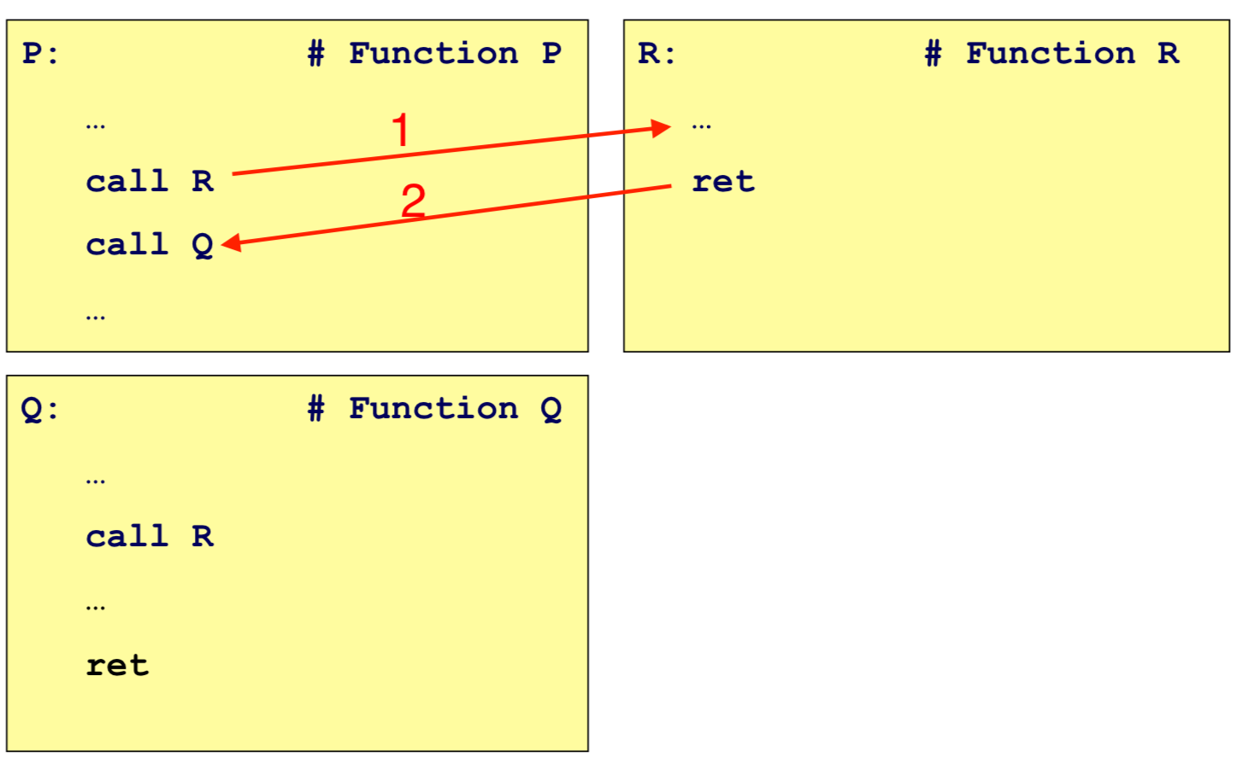
Stack as solution

Slide 16
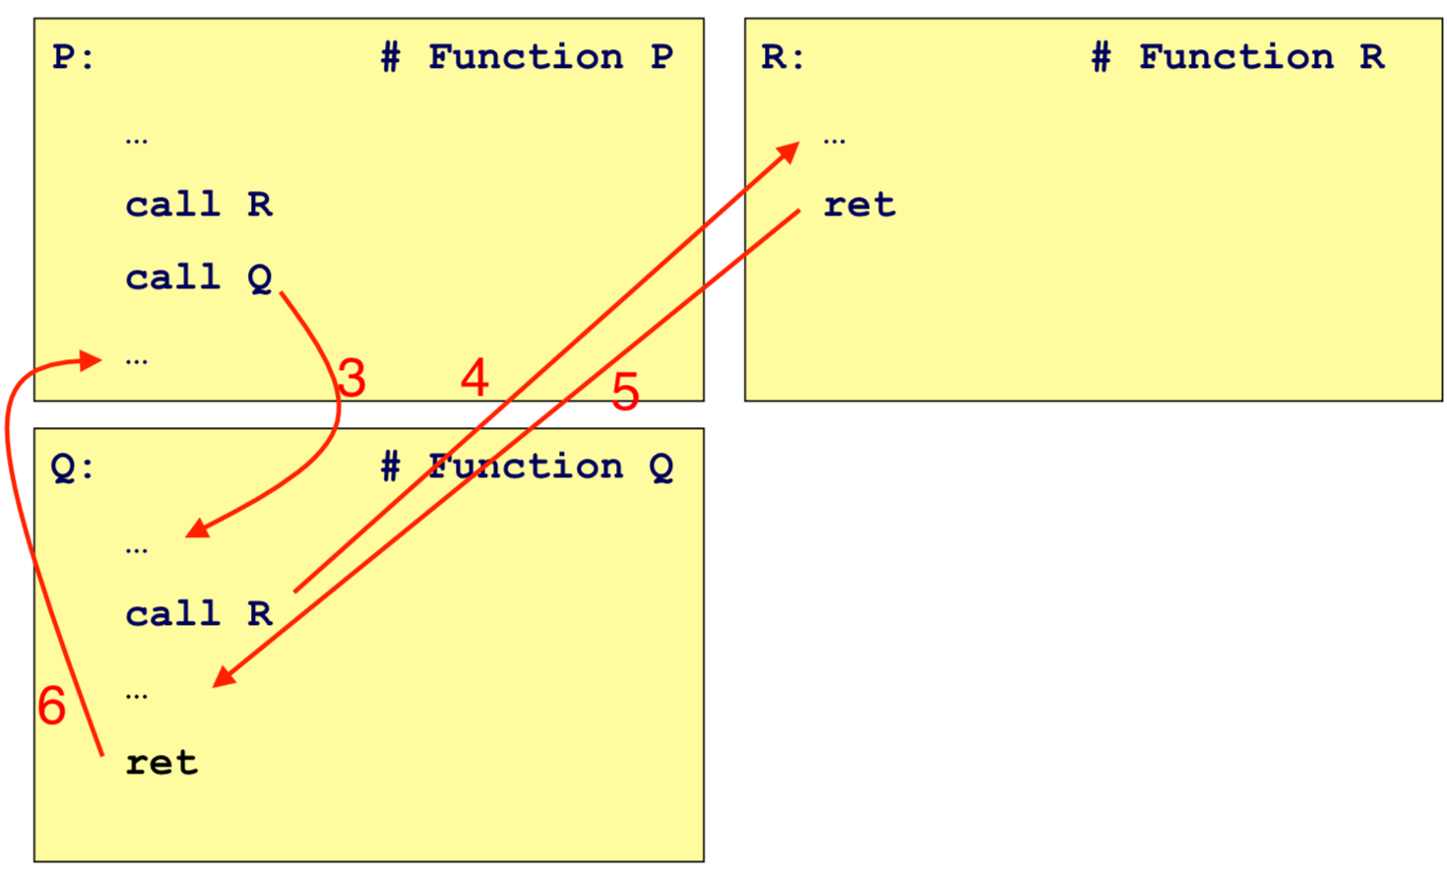
Stack as solution (cont.)

