Slide 1
CSSE 132
Data Representation
Tuesday, November 30, 2021

Slide 2
Preview of ECE 233: Circuits compute!
At its heart (CPU), a computer performs operations on data
  E.g. add r1, r3, r2
  adds values in registers r3 and r2 and stores the result in r1.
On computers, circuits handle
  Storage of data (memory)
  Operations on that data (computation)
You’ll learn more in ECE 233. Introduction to Digital Systems
Important for CSSE 132: How are “numbers” represented on a computer?

Slide 3
Questions
How to convert between binary, decimal, and hexadecimal?
How do computers represent information?
  Bits, bytes, words, etc.
How do computers handle signed numbers?
Notes:
Do a quick recap on the top-down view.

Slide 4
A recap on numbering systems
Decimal is a 10 digit number system (base 10)
  0,1,2,3,4,5,6,7,8,9
Binary is a 2 digit number system (base 2)
  0,1
Hexadecimal is a 16 digit number system (base 16)
  0,1,2,3,4,5,6,7,8,9,A,B,C,D,E,F
For now, we consider unsigned numbers (i.e., non-negative)
Notes:
Do a brief counting example. From 0 -> exhausted the least digit -> reset to 0 -> add one to the higher significant digit

Slide 5

Binary
Use decimal as an example:
  ${15}_{10}=1 × {10}^{1}+5 × {10}^{0}$
So ${110}_{2}=1 × 2^{2}+1 × 2^{1}$ $+0 × 2^{0}$
  ${=6}_{10}$
Notes:
Write the 3-digit binary table on board.

Slide 6
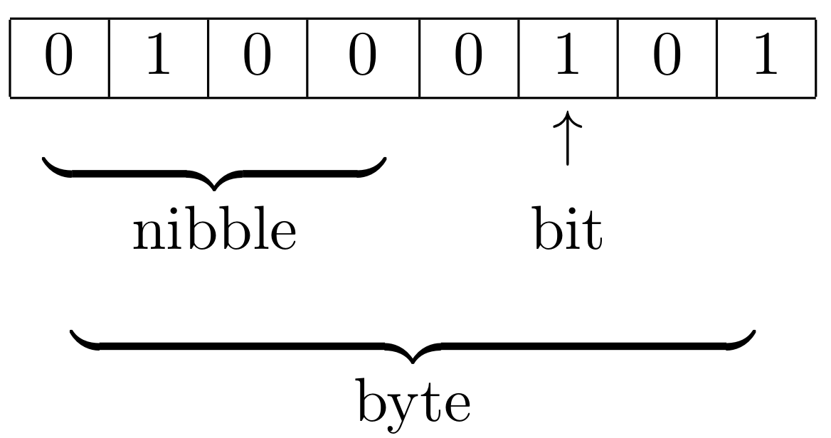
Units of data
Bit (b): One bit
Bytes (B): 8 bits
Nybble: 4 bits
Word: many bytes. Commonly 4 bytes, depends on hardware.
Demo: typesizes.c

Slide 7
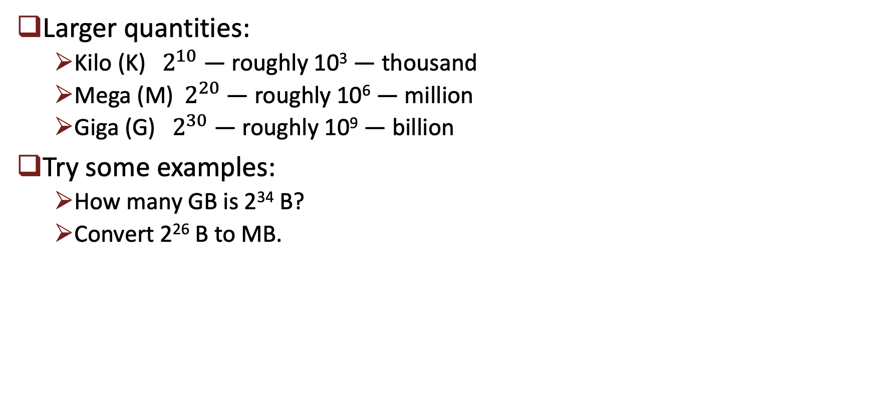
Units of data (cont.)
Larger quantities:
  Kilo (K)${ 2}^{10}$ — roughly 10³ — thousand
  Mega (M)${ 2}^{20}$ — roughly 10⁶ — million
  Giga (G) ${ 2}^{30}$ — roughly 10⁹ — billion
Try some examples:
  How many GB is 2³⁴ B?
  Convert 2²⁶ B to MB.

Slide 8
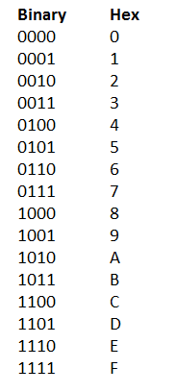
Hexadecimal
Writing zeros and ones is annoying.
Let’s do 4 bits (a nybble) a time.
An example:
How about hex to binary? Say 0xA7F8
0xCAFE

Slide 9
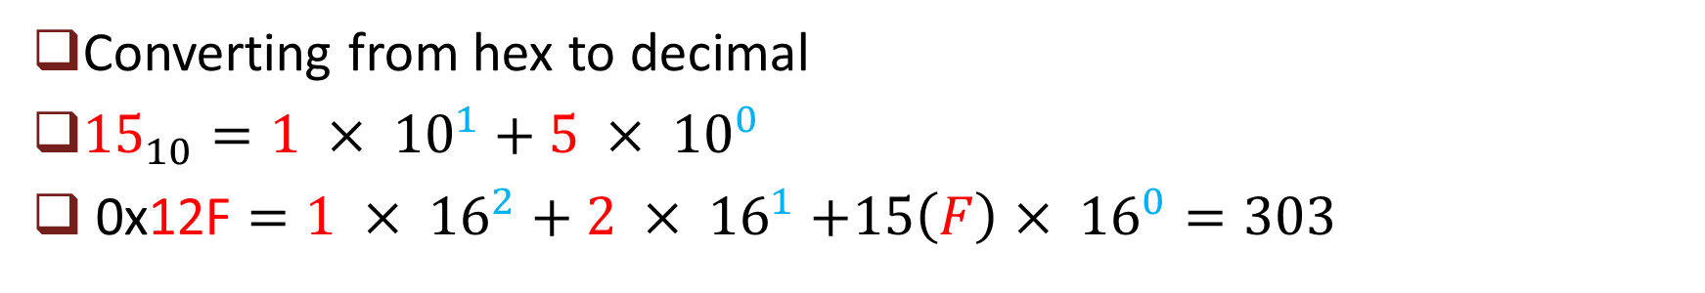
Hexadecimal (cont.)
Converting from hex to decimal
${15}_{10}=1 × {10}^{1}+5 × {10}^{0}$
0x12F $=1 × {16}^{2}+2 × {16}^{1}$ $+15\left(F\right)× {16}^{0}=303$

Slide 10
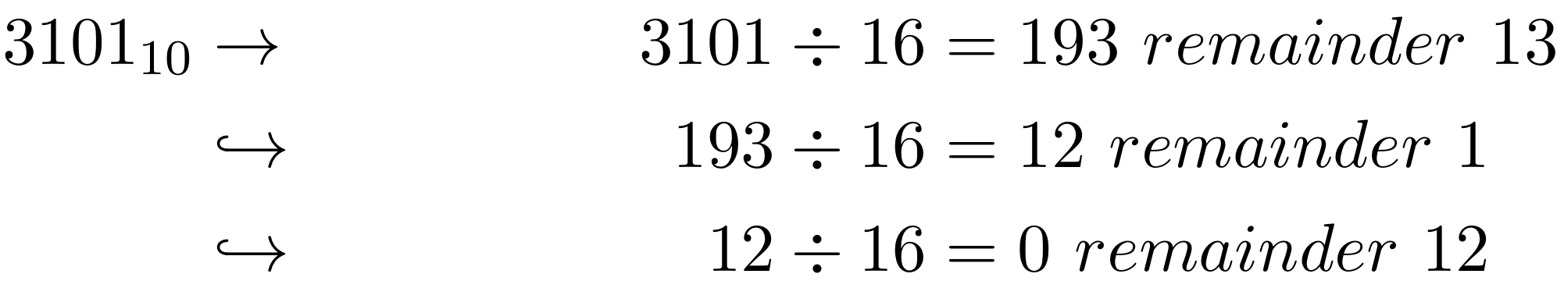
Hexadecimal (cont.)
Converting from decimal to hex:
  Divide by base, recursively.
  Take remainder as the digit, starting from the least significant digit.
  Example: convert 3101 of decimal to hex
  Another example: 500
D
1
C
0xC1D

Slide 11
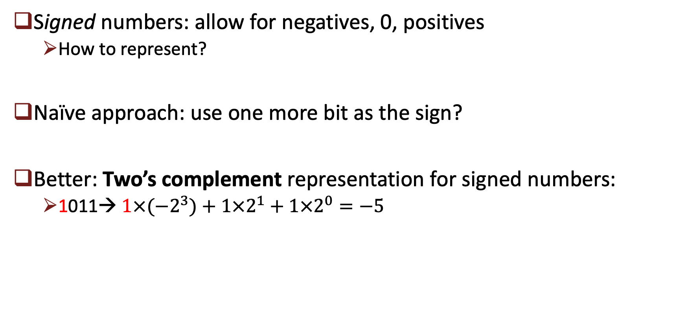
Negative numbers
Signed numbers: allow for negatives, 0, positives
  How to represent?
Naïve approach: use one more bit as the sign?
Better: Two’s complement representation for signed numbers:
  1011→ ${1×(−2}^{3})+1×2^{1}+1×2^{0}=−5$
Notes:
It is wasteful to use MSB as sign only

Slide 12
Negative numbers (cont.)
Shortcut to find –x from x (≠ min value): Flip all bits and add 1.
  5 (0101) → –5
    0101 flip bits → 1010
    Add one 1010 + 1 = 1011 → (–5)
Can be used to identify the value of a negative number
Demo: signchange.c

Slide 13
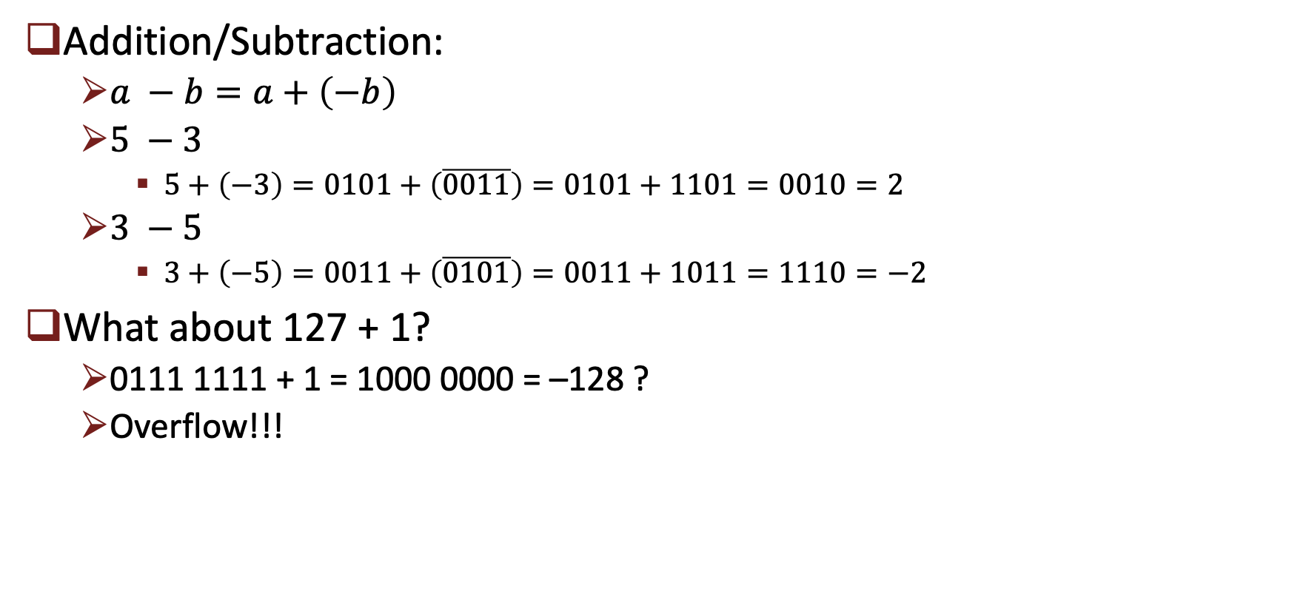
Negative numbers (cont.)
Addition/Subtraction:
  $a −b=a+\left(−b\right)$
  $5 −3$
    $5+\left(−3\right)=0101+\left(\overline{0011}\right)=0101+1101=0010=2$
  $3 −5$
    $3+\left(−5\right)=0011+\left(\overline{0101}\right)=0011+1011=1110=−2$
What about 127 + 1?
  0111 1111 + 1 = 1000 0000 = –128 ?
  Overflow!!!
Demo: overflow.c

Slide 14
Datatype Interpretations
Can a number be interpreted differently as signed vs. unsigned? Or even something else?
  Demo: interpret1.c
Is overflow dependent on interpretation?
  Demo: interpret2.c
What happens when we “cast” an int (4 bytes) as a short (2 bytes)?
  Demo: truncation.c

