Slide 1
CSSE 132
Data Representation II
Thursday, October 17, 2019

Slide 2
Questions
How to represent fractional numbers?
What is the precision or range?
What your computer really does?

Slide 3
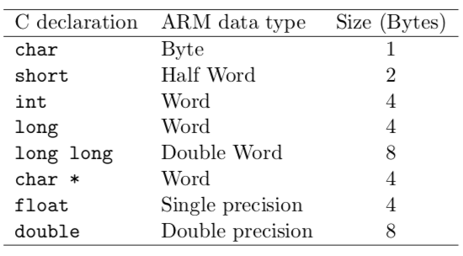
Recap: C data type

Slide 4
Fractional binary numbers
Carnegie Mellon
What is 1011.101₂?

Slide 5
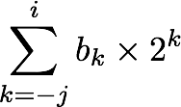
Fractional Binary Numbers
Carnegie Mellon
2^{i}
2^{i-1}
4
2
1
• • •
bi | bi-1 | ••• | b2 | b1 | b0 | b-1 | b-2 | b-3 | ••• | b-j
1/2
1/4
1/8
2^{-j}
• • •
Representation
  Bits to right of “binary point” represent fractional powers of 2
  Represents rational number:
Notes:
Latex source for equation: \sum_{k=-j}^i b_k \times 2^k

Slide 6
Convert decimal to binary float
Multiply by 2 by shifting left
Try 0.1: 0.0001100110011…
  0.1 x 2 = 0.2 – 0
  0.2 x 2 = 0.4 – 0
  0.4 x 2 = 0.8 – 0
  0.8 x 2 = 1.6 – 1
  0.6 x 2 = 1.2 – 1
  0.2 x 2 = 0.4 – 0
  0.4 x 2 = 0.8 – 0
  0.8 x 2 = 1.6 – 1
  0.6 x 2 = 1.2 – 1

Slide 7
Range verse Precision
Range: Max – Min
Precision: Minimal tick

Slide 8

Intuition
How many bits to represent 126,000,000,000?
What about $1.26∗{10}^{11} ?$
  12611?

Slide 9
IEEE 754
Half-precision 16-bit seeeeeffffffffff
  1 bit sign
  5 bit exponent (unsigned)
  10 bit fraction/significand (unsigned)
Formula: −1^{sign} × 2^{exp−15} × 1.significand
Simple Examples:
0 01111 0000000000 = −1⁰ × 2 ¹⁵⁻¹⁵ × 1.0000000000₂ = 1
1 00111 0000000000 = −1¹ × 2 ⁷⁻¹⁵ × 1.0000000000₂ = 1 × 2⁻⁸ × 1 = 2⁻⁸

Slide 10
IEEE 754 (cont.)
1 bit sign
8 bit exponent (unsigned)
24 bit fraction/significand (unsigned)
Special cases:
  Zeros: sign = 1 or 0, exp = all 0, significand = all 0
  Infinity: sign = 1 or 0, exp = all 1, significand = all 0
  NaN: sign = 1 or 0, exp = all 1, significand = anything not all 0

