Slide 1
CSSE 132
Pointer and Arrays
Friday, April 9, 2021

Slide 2
Questions
What is a pointer?
How to carefully use pointers?
  pointer operation
  pointer arithmetic
How do data arrays work in C?
How to use pointers to access array elements?

Slide 3
Variables in memory
When you declare int x:
  Memory is allocated for x at a certain address
  Machine handles/remembers address of x
  (actually, handled at compile time)
0x0000 0008 | x

Slide 4
Pointer operation
Type int* xp means “xp is the address of an int”
  int* xp;
Getting the Address: &x means “address of data in x”
& is the address operator and asks “where is this thing?”
  int x = 3;
  xp = &x;
Dereference: retrieving/setting data at an address:
  *xp means “the data at memory address xp”
  int y = *xp;
  Can also be used to set that data
  *xp = 5;

Slide 5
Pointer illustration
Pointer is the address (key) to a container (cabinet)
int* ptr;
int var = 50;
ptr = &var;
//*ptr == 50

Slide 6
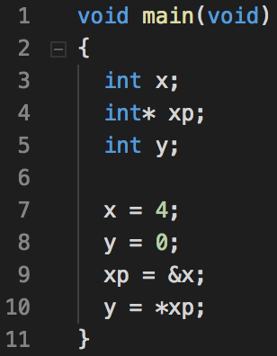
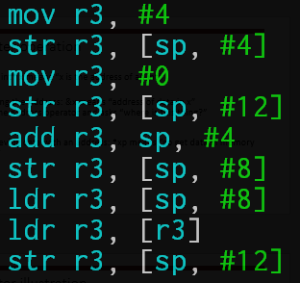
Example: pointers1.c
[ ] means to sum the things inside and dereference the resulting address (like *addr)

Slide 7
Pointer arithmetic
Assume a pointer p to type <type>, and p has value X (an address)
Then p + n (n is an integer) is a pointer, and has value (address)
X + n*size(type)
This means, if there are enough items of type <type> in memory starting at p, then
  p points to the 0th item of type <type>
  (p + n) points to the n^{th} item of type <type>

Slide 8
Pointer arithmetic (cont.)
0x0000 0008 | x
0x0000 000c | xp
0x0000 0010 | y
int x;
int* xp;
int y;
x = 4;
xp = &x;
y = 0;
xp = xp + 2 // it adds two of size(type) to xp
*xp = 7;
What is y? (assume using GCC)

Slide 9
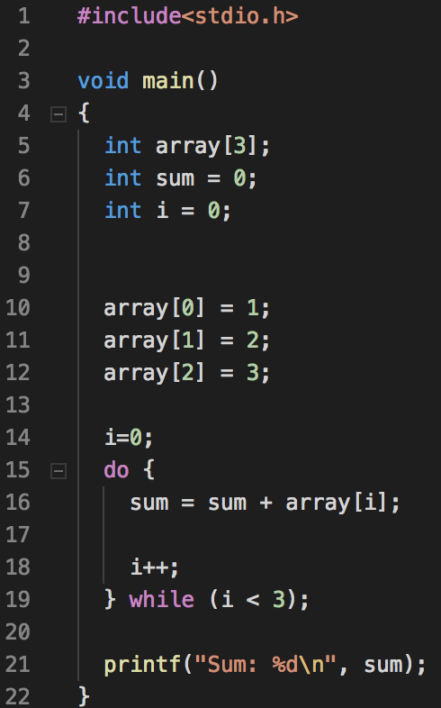
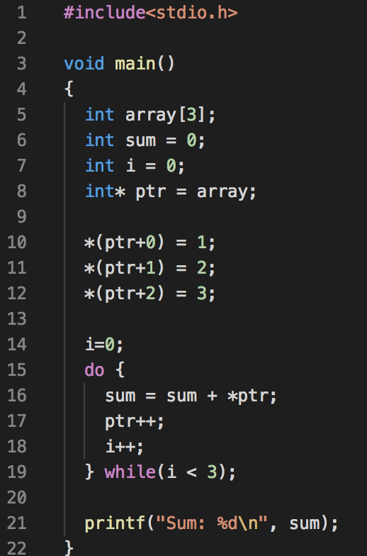
Arrays are Pointers
An array is a continuous chunk of memory
  array[1] is *(array + 1)

Slide 10
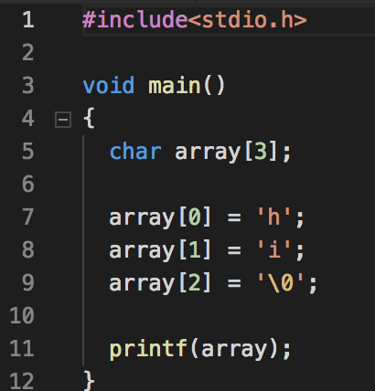
Strings
Arrays of characters (each 1 byte)
  Length is determined by the location of a null char ‘\0’

Slide 11
Struct
Declaration
  struct name
  {
  char first_name[10];
  char last_name[10]; //things (members) in the struct.
  };
Use struct
  struct name my_name;
  my_name.first_name = “CSSE”;
  my_name.last_name = “132”;

Slide 12
Multi-dimensional arrays
Arrays of another arrays
  char array[3][4];
  array[i][j] == *(array + i*4 + j)
Examples:
  int main(int argc, char** argv)

Slide 13
Pointer of pointer
What is int ** ?
  int x;
  int* p;
  int** pp;
  x = 10;
  p = &x;
  pp = &pp;
Can we do the same to &, like &&x?
  NO.
0x0000 0008 | x | 10
0x0000 000c | p | 0x0000 0008
0x0000 0010 | pp | 0x0000 000c

Slide 14
Struct usage
Struct can be used like other data types: can have an array of structs, or pointer to struct.
  struct array
    struct name your_names[10];
    your_names[0].first_name = “CS”;
    your_name[0].last_name = “SE”;
  struct pointer (when to use use -> instead of . to get a member?)
    struct name my_name;
    … // set attributes of my_name
    struct name* mnptr;
    mnptr = &my_name;
    printf(“%s”, my_name.last_name); // my_name is a struct name; use .
    printf(“%s”, mnptr->last_name); // mnptr is a struct name*; use ->

Slide 15
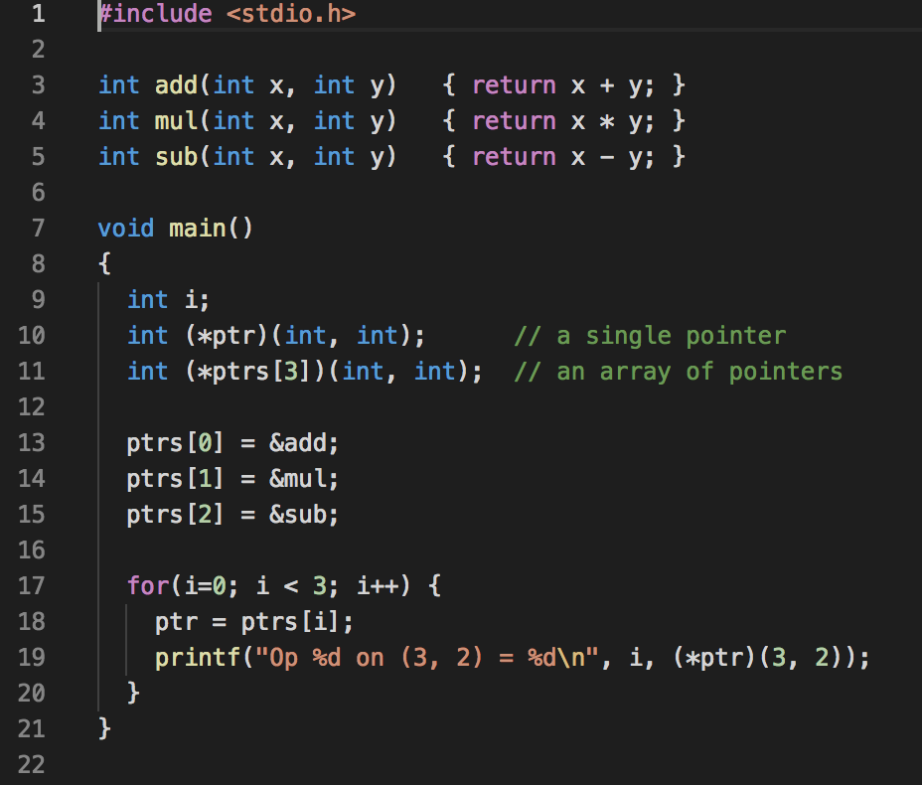
Function pointers (Optional)
Declaration return_type (*name)(input_arguments)

