Slide 1
CSSE 132
Build ALU with Verilog
Thursday, March 7, 2019

Slide 2
Questions
How to add more features to the ALU?
  Overflow detector (cont.)
  Zero detector
How to program the gates -- Verilog?
Notes:
Do a quick recap on the top-down view.

Slide 3
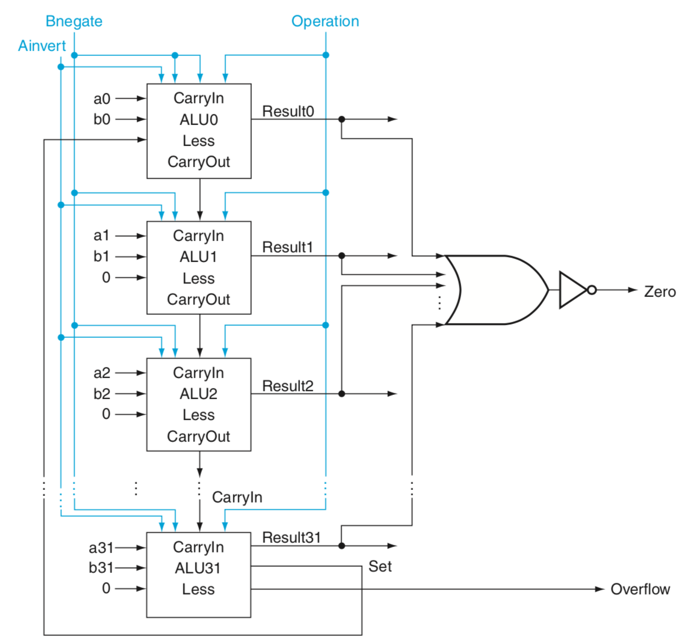
ALU (adding Zero Detector)
Why zero detector?
  Set less than → a – b < 0
  Set on equal → a – b = 0
All results return 0

Slide 4
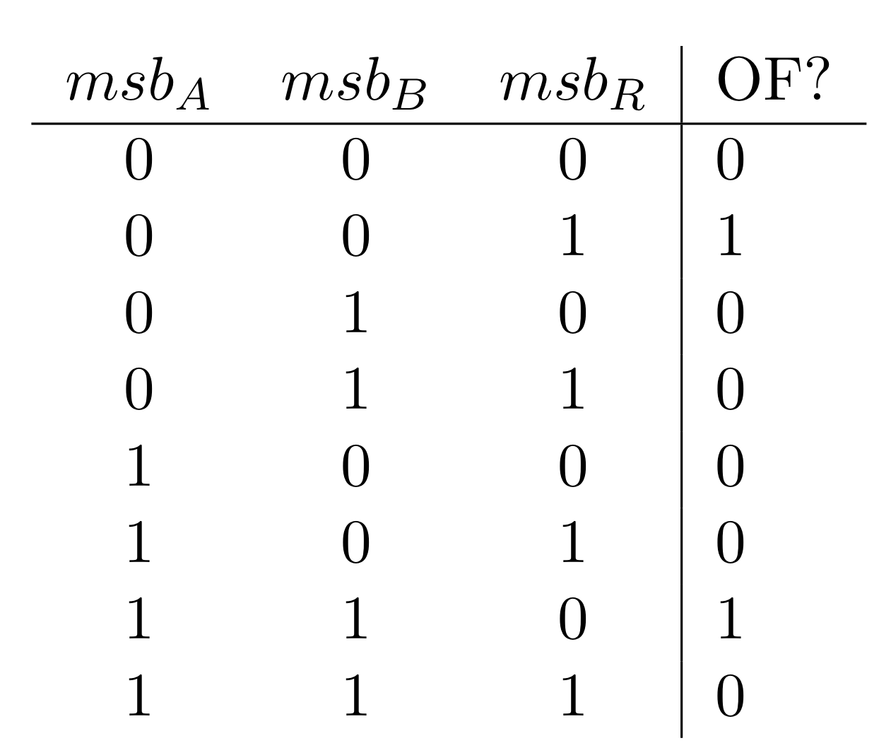
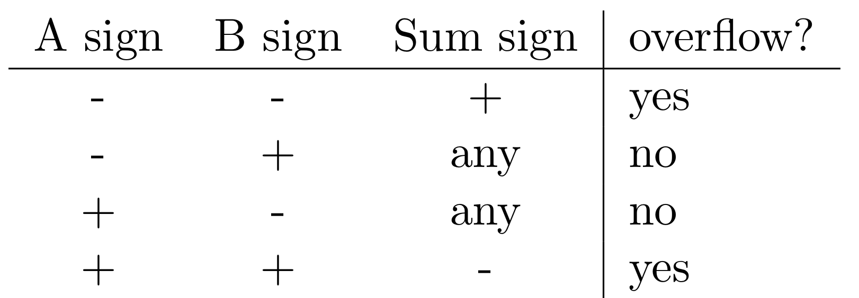
ALU (adding Overflow Detector)
For addition

Slide 5
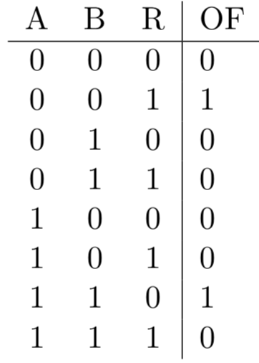

ALU (Overflow Detector cont.)
For addition

Slide 6
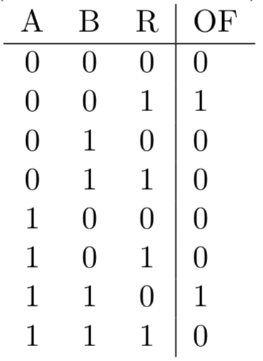
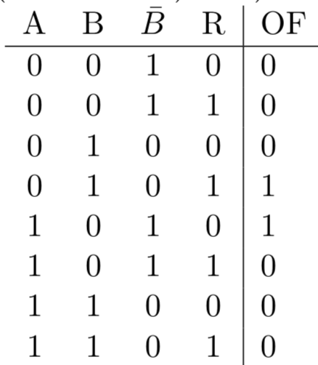

ALU (Overflow Detection cont.)
For Subtraction
  $A −B=A+(−B)$
  Binv = 1

Slide 7
Introduce to Verilog
Hardware Description Language
Basically, it describes how to design circuits out of gates.
All things in Verilog happen in parallel.

Slide 8
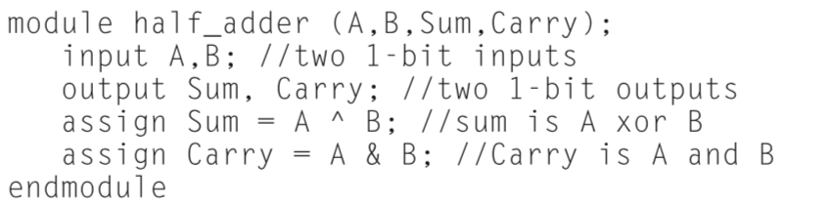
Verilog: Basic Syntax
No braces, instead begin and end
Components are enclosed in module tags.
Each module name is followed by a list of inputs and outputs
Notes:
Show a demo vlog_and.v

Slide 9
Verilog: Variables
Types
  wire : Just wires, used for combinational logic.
  reg : similar to registers: used for sequential (and sometimes combinational).
Assignment
  – Blocking assignment (=): execution pauses until this is done.
  – Non-Blocking assignment (<=): happens in parallel to everything else.
Busses: arrays of wires.
  – Declare: wire [15:0] blah;
  – Assign: foo = 16’b0010101111110101;
  – Reference: foo = blah[15:8];

Slide 10
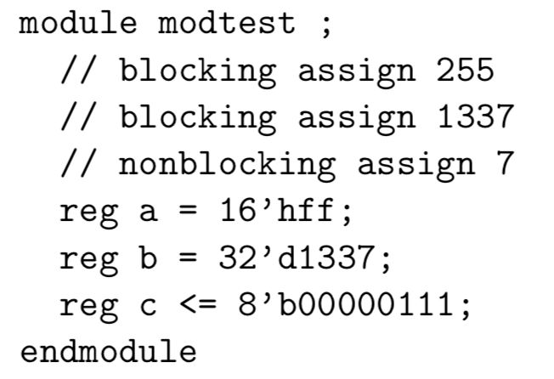
Verilog: Variables (cont.)
Values and Radix: s’bxx for size s, base b and value xx.

Slide 11
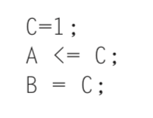
Verilog: Time
Everything is in parallel unless you specify.
  Blocking assignments are serialized
  non-blocking are parallel (updated after block completes)
  a single module can have multiple things happening at once!
  indicate delay with the # operator. #5; //waits 5ns
Example: assuming all values are initially zero, what are the values of A and B after executing this Verilog code?

Slide 12
Verilog: Execution Blocks
begin and end.
A block of things can run once, run repeatedly, or get re-run when something changes.
  Once: initial begin
  Repeated: always begin
  Triggered (on either): always @(var)

Slide 13
Verilog: Abstract concepts
These are extras for the simulator and are useful for writing test fixtures.
  $write : like printf
  $display : like printf with newline
  $finish : halts the simulation

Slide 14
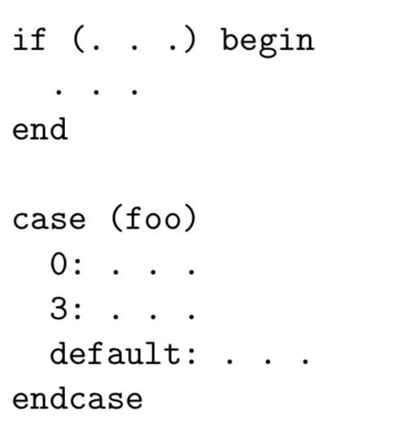
Verilog: Selection
Similar to C
Notes:
Examples in examples/alu4b.v.

Slide 15
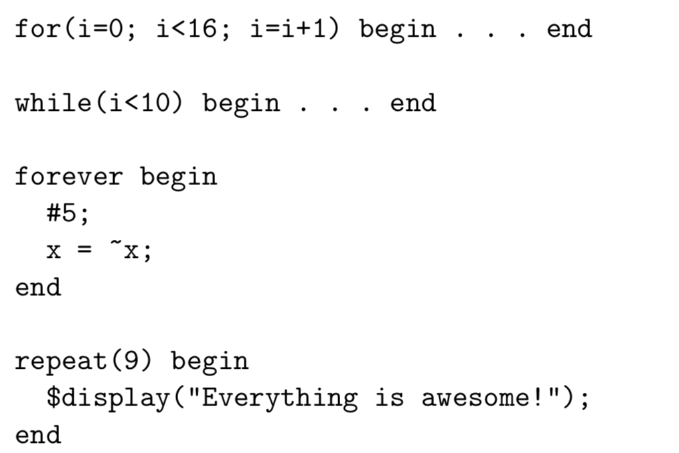
Verilog: Looping
Similar to C

