Slide 1
CSSE 132
Combinational Logic and Adders
Friday, September 6, 2019
Adapted from CMU 15-213/18-213/15-513

Slide 2
Review with exercise
What is the result of 0101 – 1010 if values are signed? Does it overflow?
-5 != 11, so it is overflow​

Slide 3
Outline
Let’s build Adder with logic gates ☺
  First, write down Truth Table to spell out desired output
  Second, get Logic Equation out of Truth Table
  Last, draw Circuit from Logic Equation.
Start with 1-bit adder and expand to multi-bit.
Notes:
Do a quick recap on the top-down view.

Slide 4
3 Steps to design any circuit
First, write down Truth Table to spell out desired output
Second, get Logic Equation out of Truth Table
Last, draw Circuit from Logic Equation.
Let me walk you through this by designing a voting circuit
  Given three boolen inputs (A, B and C), we want to design a circuit to output (V) as the majority of A, B, C.

Slide 5
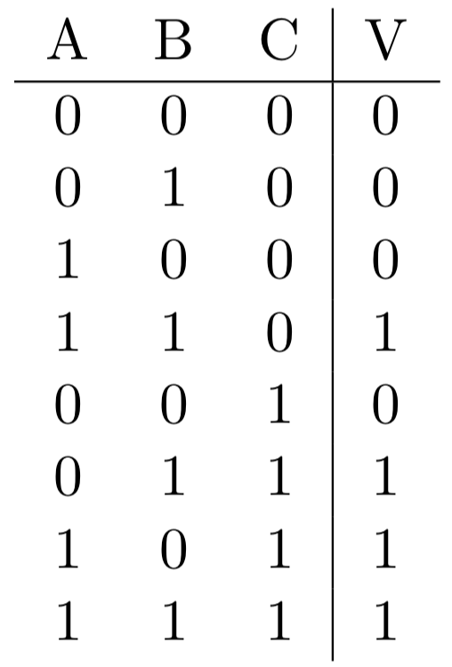
Write down Truth Table for A B C and V
Truth table defines the required computation

Slide 6
get Logic Equation out of Truth Table
How we can write an equation to satisfy truth table
  Sum-of-Product (SOP) can help
Step 1: find the “ones”
Step 2: write down as SOP

Slide 7
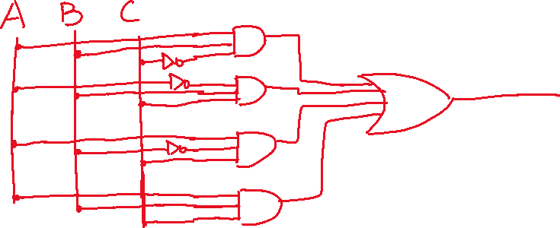
draw Circuit from Logic Equation
Given a logic equation, how can we design a circuit to implement the logic computation

Slide 8
Motivation
1
1
1
Carry Out
0
0
1
A
Result
+
+
+
B
+
0
1
1
1
0
0
Carry In

Slide 9
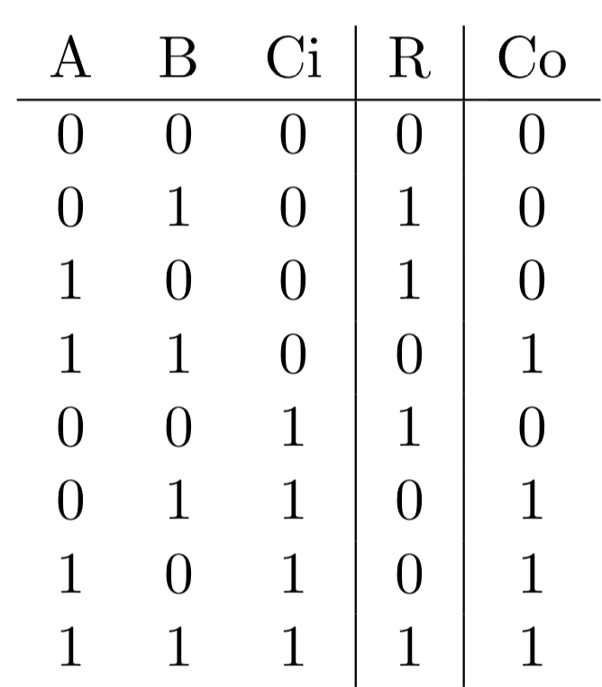
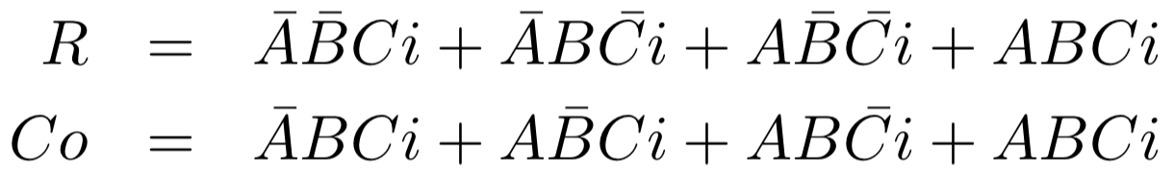
Adder: carry in

Slide 10
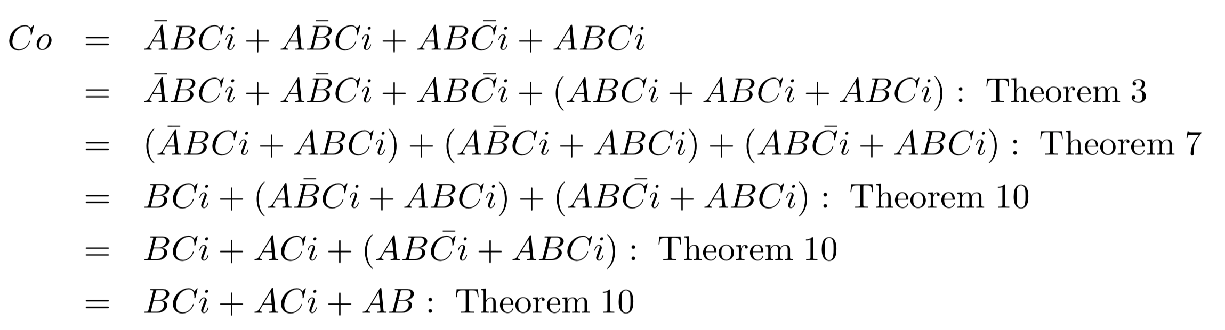
Adder: optimize equation

Slide 11
Extend to multiple-bit adder
→

Slide 12
Def. combinational logic
Logic blocks:
  Combinational (no memory): The output only depends on current input;
  Sequential (with memory): The output depends on both inputs and stored value in the memory;

