Slide 1
CSSE 132 Linux I/O
Monday, May 4, 2020

Slide 2
Questions
How do computers interact with external devices?
How is I/O handled in Linux?
Unbuffered I/O
Buffered I/O

Slide 3
Linux I/O
All I/O devices, such as networks, disks, and terminals, are modeled as files.
All input and output is performed by reading and writing the appropriate files.
Data in and out use same set of API:
User IO
Printing
Network Communication
External devices
Demo: We can check the data on ram by reading the file /dev/mem

Slide 4
File types
Regular file(-)
Directory files(d)
Special files
Block file(b)
Character device file(c)
Named pipe file or just a pipe file(p)
Symbolic link file(l)
Socket file(s)
Check ls -l /dev/

Slide 5
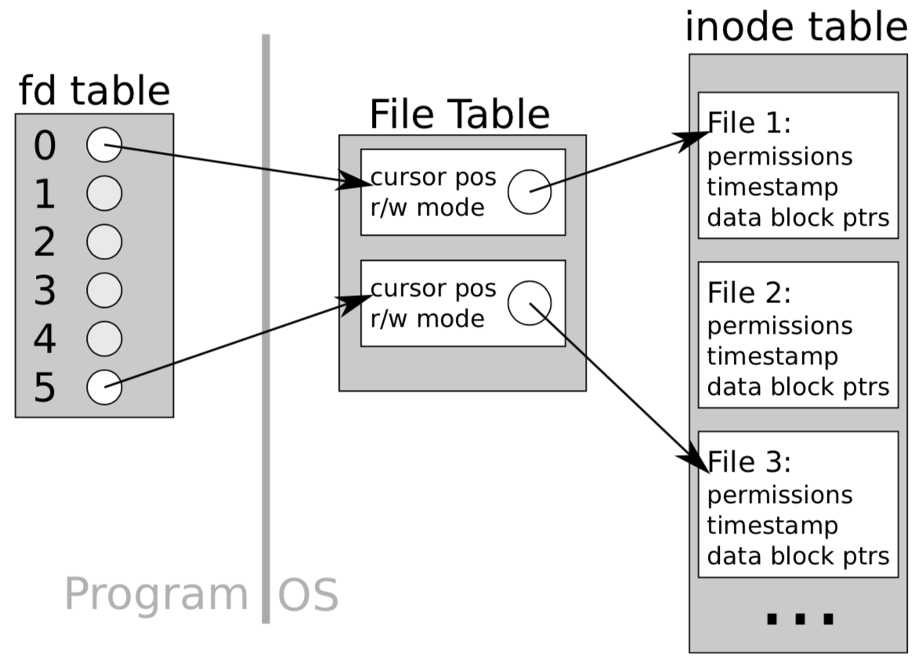
File Descriptors
An indicator (integer number) to access a “file”

Slide 6
Unbuffered I/O
Open a file, get a file descriptor (a non-negative number) from OS.
Some are reserved for special purposes:
file descriptor 0 is a process' stdin file descriptor 1 is a process' stdout file descriptor 2 is a process' stderr
Target to a certain place (cursor) in the file (OS tracks the cursor)
Read/write one character a time directly from OS, and move the cursor

Slide 7
Buffered I/O
Open a file, get a file stream (FILE *, a pointer to a struct)
FILE includes file descriptor, a pre-fetch buffer, cursor position, and etc.
Read/write to the buffer first, and commit to OS in a batched manner.
Pros and Cons of buffered I/O v.s. unbuffered I/O

Slide 8
Using unbuffered I/O (POSIX)
Write/Read
size_t write(int fd, const void *buf, size_t count);
size_t read(int fd, void *buf, size_t count);
Open/Close
int open(const char *pathname, int flags);
open returns fd number or -1 if error
flags: O_RDONLY, O_WRONLY, O_RDWR
optional flags: O_CREAT, O_TRUNC, etc. Or them together.
int close(int fd);
returns zero or -1 if error
Moving the cursor
off_t lseek(int fd, off_t offset, int whence); //return the offset
from the beginning
SEEK_CUR, SEEK_SET, SEEK_END

Slide 9
Unbuffered IO Practice
Go to the link below for practice:
https://repl.it/@song3/UnbufferedIO

Slide 10
Using buffered I/O: streams
Write/Read
size_t fwrite(const void *ptr, size_t size, size_t nmemb, FILE *stream);
size_t fread(void *ptr, size_t size, size_t nmemb, FILE *stream);
char *fgets(char *s, int size, FILE *stream);
Open/Close
FILE *fopen(const char *path, const char *mode);
int fclose(FILE *fp); (returns 0, or EOF if error)
fseek / ftell

