Slide 1
CSSE 132
Introduction to Networking
Thursday, May 2, 2019

Slide 3

Two computers scenario
Physical media
PHY-layer concern: how to form information from signal
  Modulation: $A∙cos(2πf_{c}t+ φ)$
  Coding: 000 is 0, 111 is 1

Slide 4
Four computers scenario
Naming/Address: who talks to whom
A Forwarder/Repeater: HUB
Who should talk at when: Medium Access Control (MAC)

Slide 5
One hundred computer
The repeater can be overwhelmed
Selectively Repeater: SWITCH
  It kind of remembers who normally talks with whom (a table)
Now we have a LAN (Local Area Network)

Slide 6
Connecting two LANs
Bridge: Connecting two same type of networks (e.g., Ethernet to Ethernet)
Router: Connecting different types of networks (e.g., WiFi to Ethernet)
Concerns:
  Routing: how to deliver message through
  ”best” route.

Slide 7
Many many LANs

Slide 8
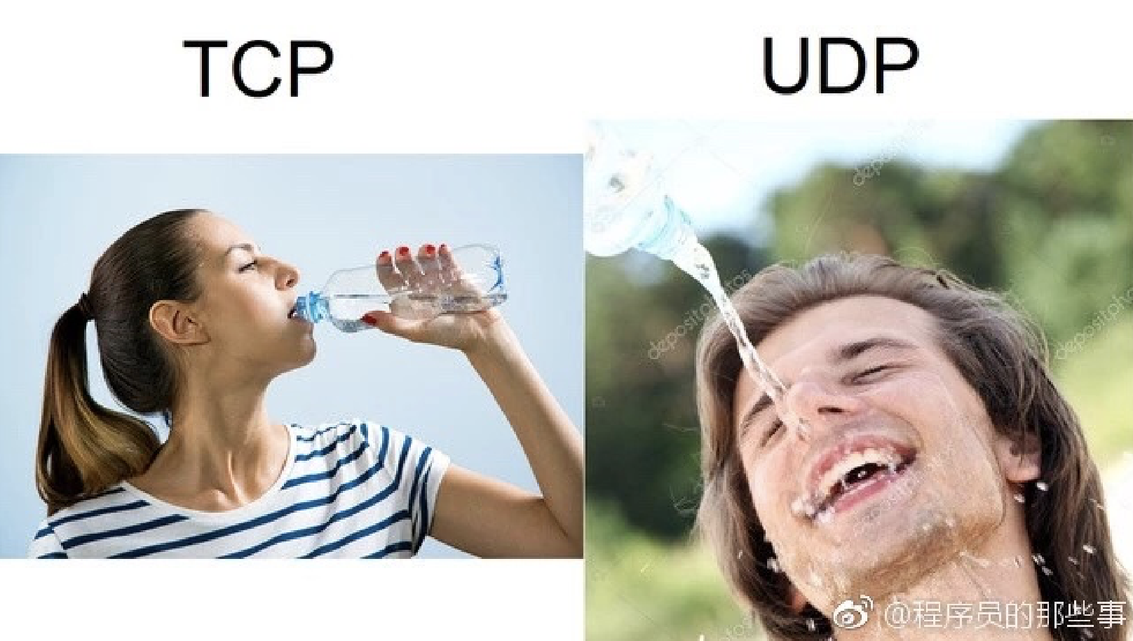
Layers of Network
Different scopes and roles in the network
  PHY: How to carry info thru signal
  MAC: How to coordinate the access of the channel
  Route: How to delivery message via best route
  Transport: How to delivery infomation with certain rate

Slide 9
Inside a message - Packet

Slide 10
IP: Naming/Addressing
IPv4: 32bit
  89702E83 = 137.112.46.131
Rose-Hulman IP: 137.112.0.0/16 = 2¹⁶
Is 2³² sufficient? If not, how?
  NAT (Network Address Translation)
  IPv6: 128 bit → 2¹²⁸

Slide 11
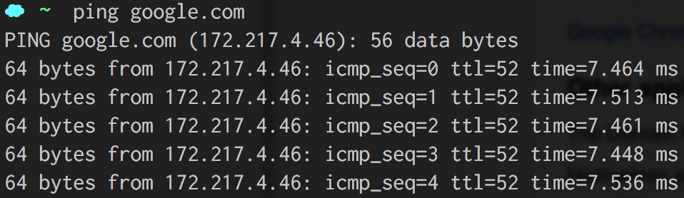
Better Naming: DNS
DNS: Domain Name System
Problems? DNS hack

Slide 12
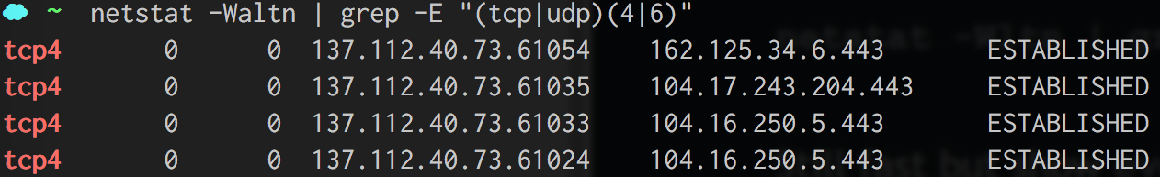
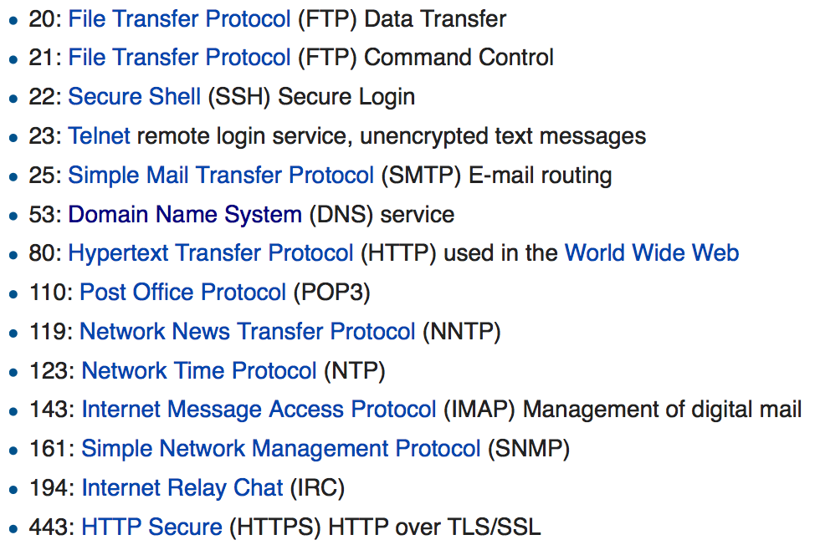
Port
A service identifier

