Slide 1
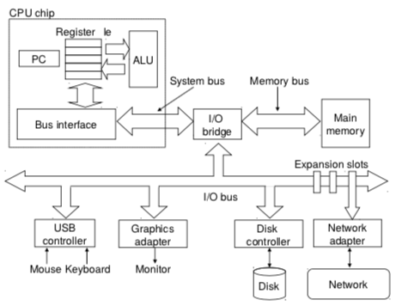
CSSE 132
Memory Addressing
Sunday, September 22, 2019

Slide 2
Questions
How to make a writable memory?
Notes:
Do a quick recap on the top-down view.

Slide 3
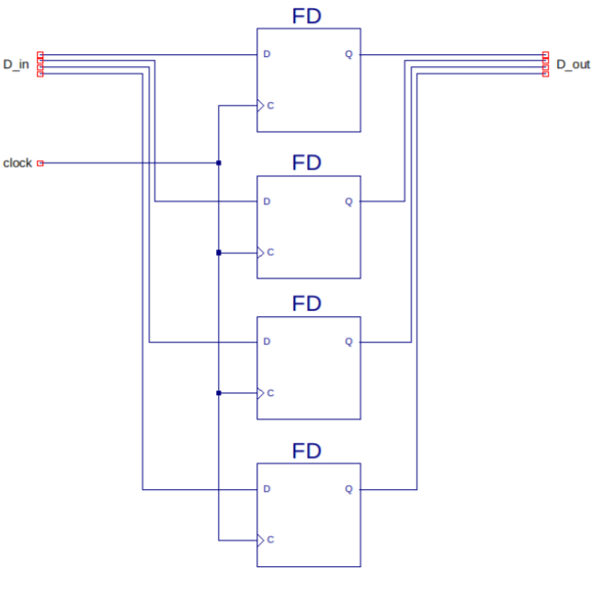
Memory addressing
How to decide which bit (i.e., FD) to read?

Slide 4
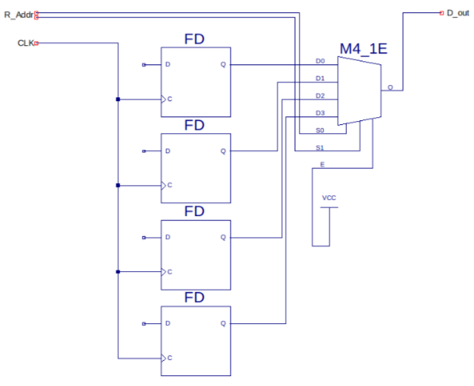
Memory addressing (cont.)
How to make it writable?

Slide 5
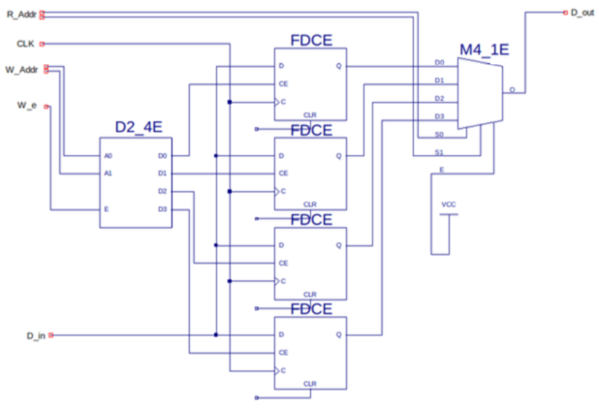
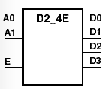
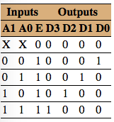
Memory addressing (cont.) - Optional

Slide 6
Where is memory?

Slide 7


Locating data
Each byte has an “address”.
We name the bytes by counting.

Slide 8
Locating data (cont.)
How big can memory be?
  How big is your computer’s address space? (Hint: you have a 32-bit system)

Slide 9
Locating data (cont.)
For larger objects (more than a byte), we need to specify the order of storing bytes in memory.
  Little-Endian: Low-order byte (Least Significant Byte) is stored at a lower address.
  Big-Endian: High-order byte (Most Significant Byte) is stored at a lower address.

Slide 10
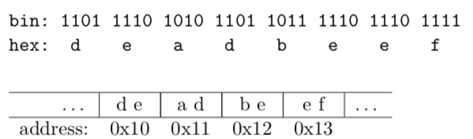

Locating data (cont.)
Example:
Big Endian
Good for comparison
Little Endian
Good for arithmetic operation

